Slide 1
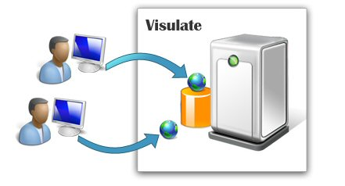
Visulate
Real Estate Investment Workshop

Slide 2

Visulate Team
Sue Goldthorp
Licensed Real Estate Professional .
Property Manager.
Investor & Landlord.
Experience Summary:
5 years real estate investment.
Joint Owner of 16 Investment Properties.
Peter Goldthorp
Oracle Software Architect .
Experience Summary:
20 years Software Development .
18 Years Database Design.
15 years Product Development at Oracle.
6 years Offshore Development.
5 years Release Management.

Slide 3
Agenda
Five ways to make money in Real Estate
Investment Property Lifecycle
Property Valuation Methods
CMA, Cap Rate, Cash on Cash, GRM, ARV, Price per Unit.
Repairs and Carrying Costs
Estimating Cashflow
Investment Analysis Workshop

Slide 4
Five Ways People Make Money in Real Estate
Capital Appreciation
Buy for $50k, sell for $60k, make $10k.
Use of Leverage Finance
Buy for $50k with $10k down, sell for $60k make 100%
Income
Buy for $50k rent for $600 per month.
Deferred Taxation
Asset depreciation, mortgage interest, 1031 exchange
Services and Fees
Investment overhead

Slide 5
Investment Property Lifecycle
Identify Candidate Properties
Secure Funding
Close
Repair Property
Lease and Operate
Analyze Properties
Negotiate and Agree Purchase
Sell Property

Slide 6
Investment Lifecycle - Products
Loopnet
MLS
CoStar
Identify Candidate Properties
Secure Funding
Close
Repair Property
Lease and Operate
Analyze Properties
Negotiate and Agree Purchase
Sell Property
Yardi
Intuit MRI

Slide 7
Investment Lifecycle – Visulate
Identify Candidate Properties
Secure Funding
Close
Repair Property
Lease and Operate
Analyze Properties
Negotiate and Agree Purchase
Sell Property
Buyer
Advertise
Owner
Manager
Owner Manager
Bookkeeping

Slide 8
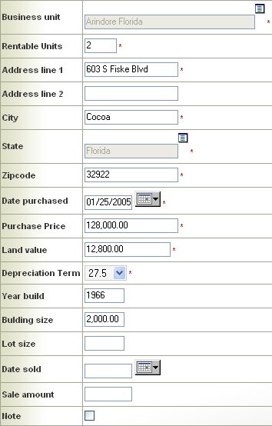
Property Management Features
Record property & finance details.
Manage repairs and maintenance.
Record expenses.
Track recurring payments.
View income and expense reports.
Record Schedule E tax information.

Slide 9
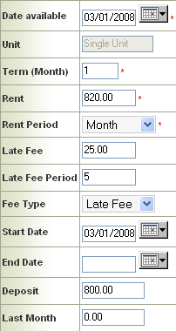
Tenancy Agreements
Record tenant details.
Create tenancy agreements.
Assign tenants to agreements.
Generate payment schedule.
Collect rent and late fees.
Print monthly statements.
Manage agreement actions.
Phone calls, letters and evictions.

Slide 10
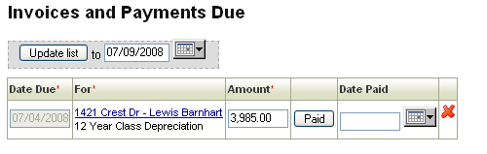

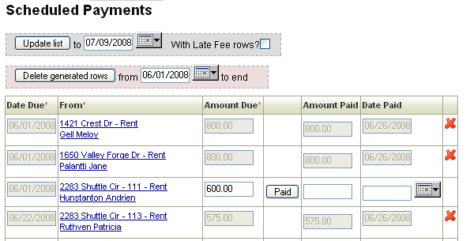

Accounts Payable and Receivable
Generated Automatically from Expenses and Tenancy Agreements.
Classified by Tax Category.
Single Click to Pay.
Generated Late Fees.
Running Totals.

Slide 11
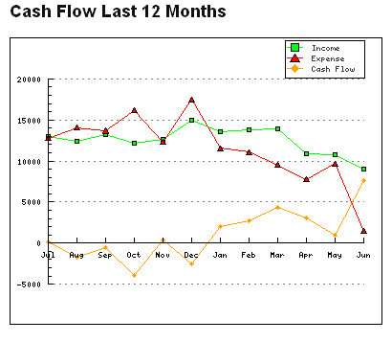
Investment Analysis
Cash Flow & Performance Summaries.
Cap Rate and Cash on Cash Calculations.
Performance Projections and Estimates.
Breakdowns by Property and Business Unit.

Slide 12
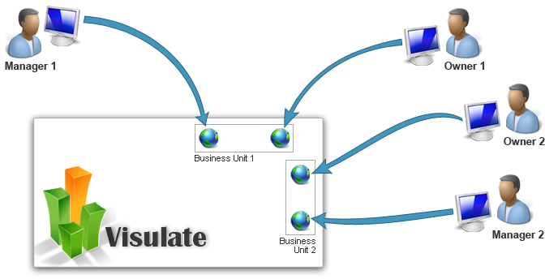
Business Partners and Business Units
Multi-user multi-role software.
Each property is assigned to a business unit.
Users granted role based access to business units.
Business owner controls role grants

Slide 13
Current Status
Visulate codeline is stable.
Working on accounting enhancements.
Looking to capitalize on our investment.

Slide 14
Investment Lifecycle – Opportunities
Owner
Broker Manager
Owner Manager
Accountant
Attorney
Buyer
Broker
Broker
Lender
Partner
Accountant
Attorney
Identify Candidate Properties
Secure Funding
Close
Repair Property
Operate
Analyze Properties
Negotiate and Agree Purchase
Sell Property

Slide 15
Phase 1 – Accounting & Advertising
Advertise
Owner
Broker Manager
Owner Manager
Bookkeeping
Buyer Role
Identify Candidate Properties
Negotiate and Agree Purchase
Close
Repair Property
Operate
Analyze Properties
Secure Funding
Sell Property

Slide 16
Phase 1 - Implementation
Populate commercial property data from public records.
Mail-shot owners to offer property management and listing services.
Contact brokers to offer free listing service.
Act as buyers agent.

Slide 17
Phase 2 – Real Estate Brokers
Advertise
Owner
Broker Manager
Owner Manager
Bookkeeping
Buyer Role
Broker
Identify Candidate Properties
Negotiate and Agree Purchase
Close
Repair Property
Operate
Analyze Properties
Secure Funding
Sell Property

Slide 18
Phase 2 - Implementation
Contact brokers to offer website design reviews.
Implement “skins” on Visulate framework.
Custom domain and layout templates.
Introduce broker process support.

