Slide 1
EDUBRIDGE Mini Project
By,
Pranit Gourkhede
Topic : Digital Clock
Trainer: Ruby Mehra Bindra
Java Full Stack Developer Batch 2021-7127

Slide 2
INTRODUCTION..
The main aim of this project is to learn and implement the back end Technology and logics that we have learned during our course . To create a digital clock, we will use J Frame, J Label, and Timer class from the Swing framework. The J Frame class is used to construct a top-level window for a Java application. The J Label class is used to display a string and the Timer class is used to fire events at specified intervals.

Slide 3
Technology used to build digital clock
Java jdk-11.0.14
Spring-tool-suite-3.9.6
Java Swing (GUI)

Slide 4
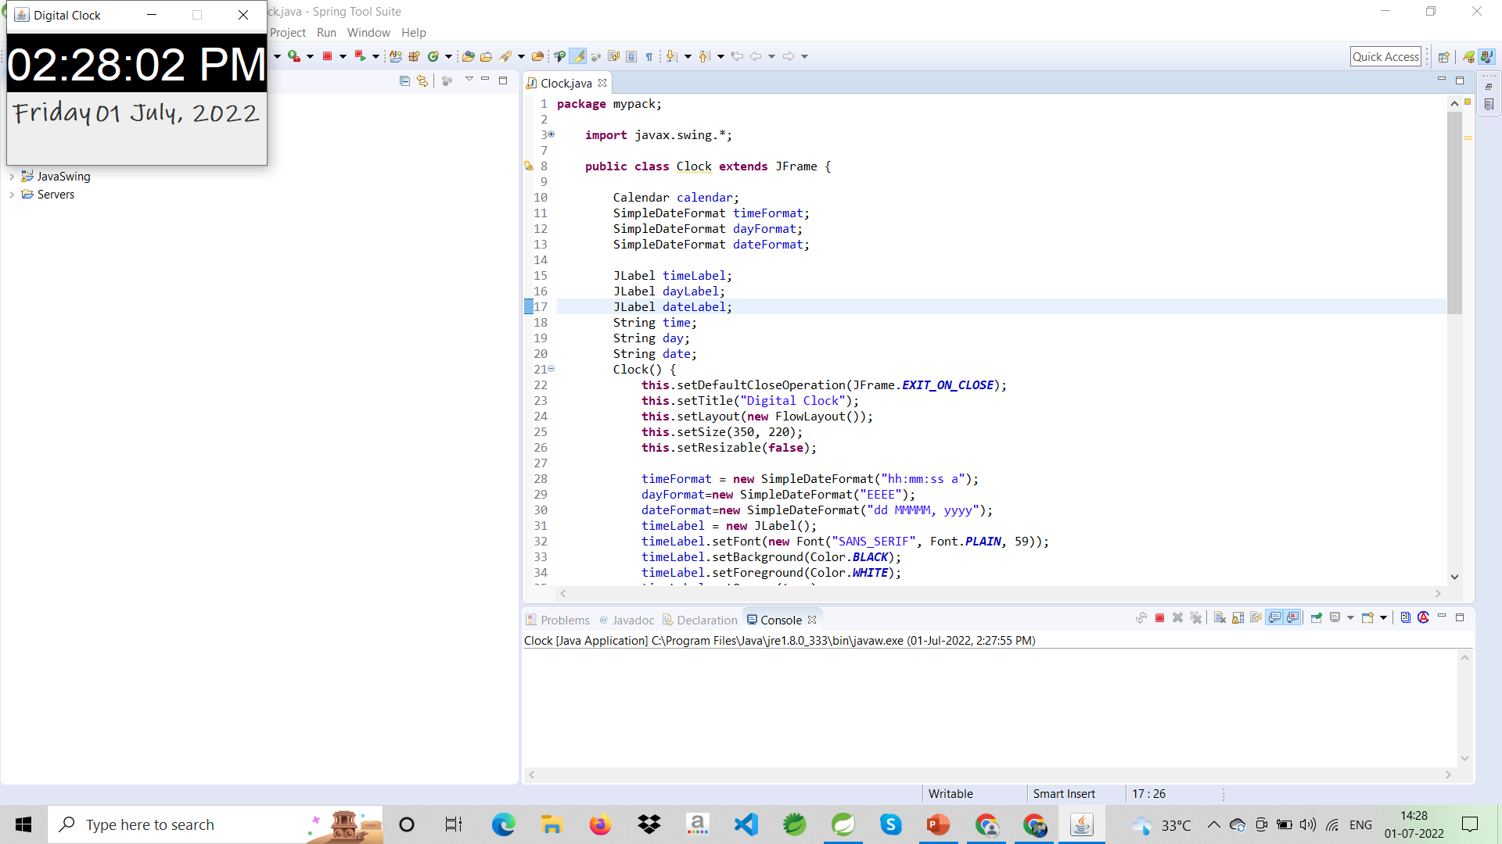
Home Page Output:

Slide 5
My Files:
GitHub:-https://github.com/pgolu

Slide 6


