Slide 1
XXXX XXXX Personal Project
Pablo Gomez Hidalgo

Slide 2
00.
Introduction

Slide 3
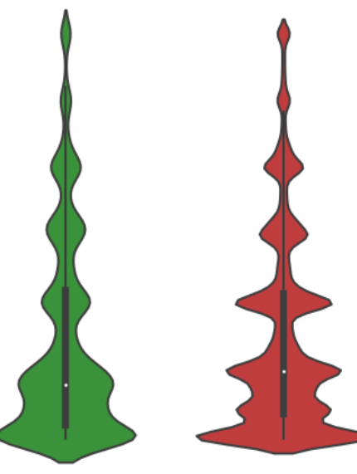
What was the analysis?
It has 4 different Points
Analysis of the tables
Primary Key search and union of tables
Analysis of the union
Future Lines
The longest point was the analysis of Public Records and the merge.

Slide 4
01.
Analysis of Tables
Part 1: Loan Performance

Slide 5
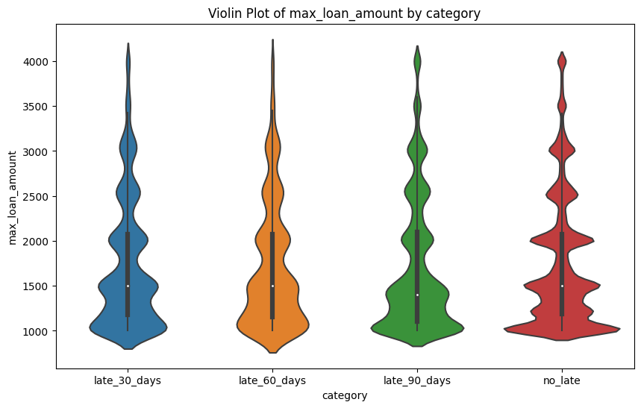
Notes:
There are 4 categories
I checked they are correctly saved
Analytics Matchkey is a primary key of the table

Slide 6
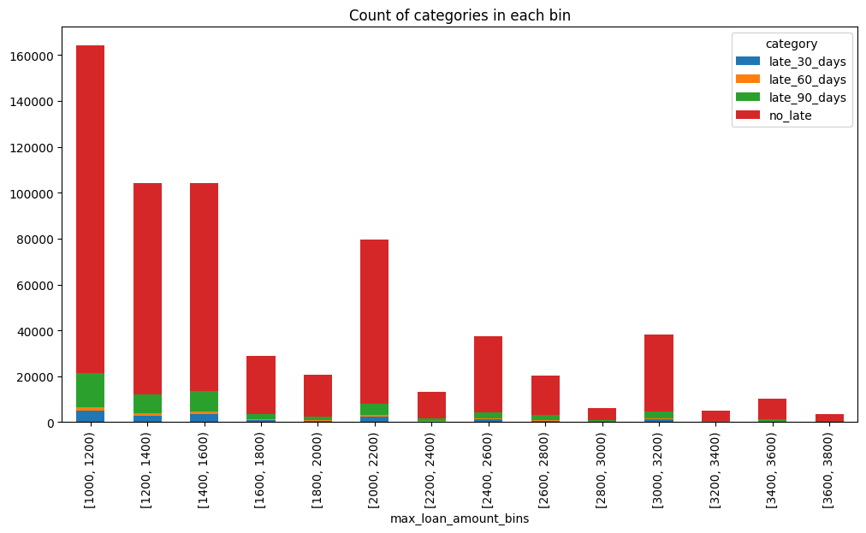
Notes:
Vast majority is paid on time
In smaller amount there are more late payment

Slide 7
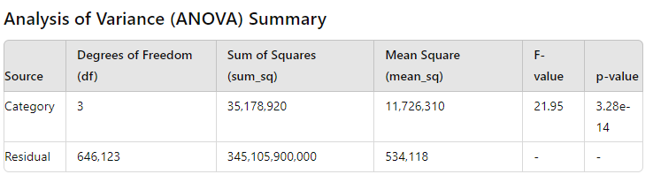
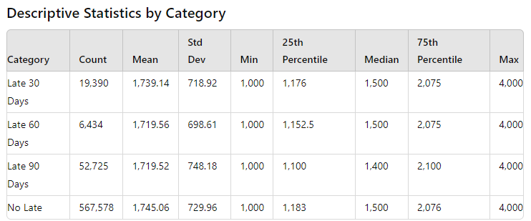
Notes:
There is statistically difference between means
Pretty close each other

Slide 8
01.
Analisys of Tables
Part 2: Public Records

Slide 9
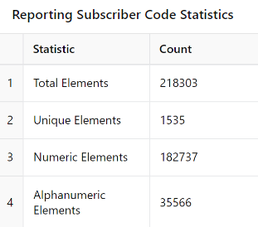
Delete Columns:
Planiff Name, Attorney Name , Docket Number
Reporting Subscriber Code
Notes:
Delete due to empty
Delete because the description doesn much and i dont find the way to interpreate it

Slide 10
Transform to dummies:
Industry Code Kind of Business: no mach, but it still encapsulates information.
Public Record Type Code, Public Record Source Type Code: Correlation and Interpretation
Equal Credit Opportunity Act Code, Legislative Prohibited Code. Binary and informative
Notes:
Industry Code doesn’t much the explanation in the dictionary, it is only binary but maybe there are information there
Public Record Type Code, Public Record Source Type Code: Have a lot of information and correlated
Equal Credit Opportunity Act Code, Legislative Prohibited Code : Both binary and with a lot of information

Slide 11
Dates:
Effective Date Verified: the process takes effect
Filed Date: Beginning of the process
Both follow the order: Data correct
Notes:
They used to check if register are correct
File Date: This date is always the starting point of the bankruptcy process
Effective Date (Date Verified): This date generally occurs later in the process. It refers to when the provisions of a confirmed bankruptcy plan become operative.

Slide 12
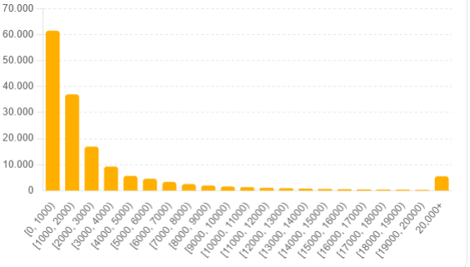
Amount:
Empty Data: 0.2827
Incorrect Data: 9.999.999
Try to Interpolate
Notes:
Amount has empty data
Has incorrect data: 9.999.999 (probably incorrect) Also other values maybe too big.
Trying to interpolate to get all empty values

Slide 13
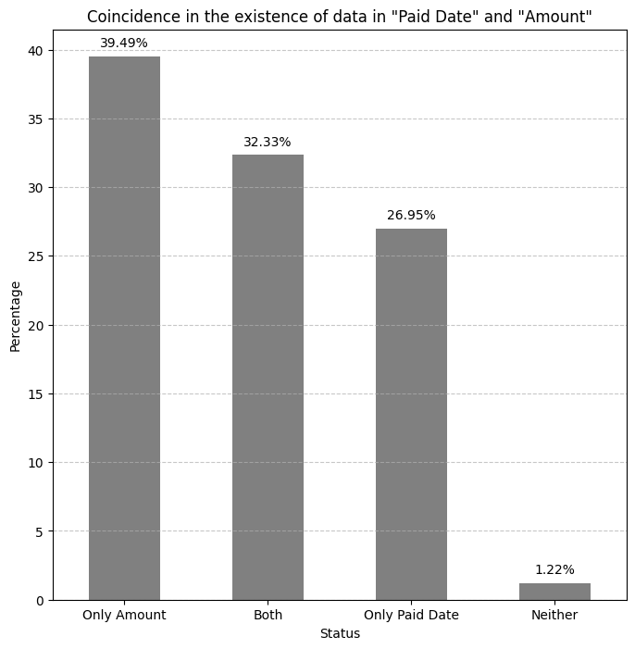
Paid Date
Empty in 40.71%
Dummy transformation
Notes:
Low correlation with the empty amount

Slide 14
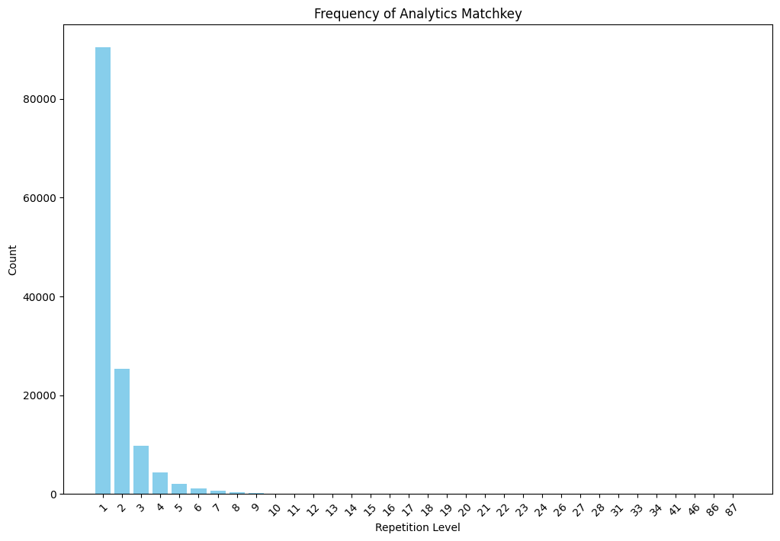
Analytics Matchkey
Important Meaning
Strongly repeated
Number of bankruptcies
Create new column: Number of bankrupticies
Notes:
Important for the Primary key

Slide 15
02.
Primary key
Public Records & Loan performance

Slide 16
Why is it important?
It helps to understand the meaning of the table itself.
Helps understand the meaning of each row.
Helps to merge both tables

Slide 17
Loan Performance:
It has a primary key
Delay in repaying
Matchkey represents a person repaying
Public Records:
It does not have primary key
Payment in a bankruptcy case
Every machkey is a person who filled a bankruptcy
Notes:
Primary key as a person, as a case, as a documnet or payment.
Every Macht

Slide 18
03.
Merge
Public Records & Loan performance

Slide 19
Merge in Two Steps
First Criteria: Last Filed Date
Second Criteria: Randomized
Notes:
First criterio. Believe that the last bankrutpcy case can contain more revelevant information for the case.
Due to is not enough to merge, between the same bankruptcy case. I select random
More study to get more information

Slide 20
04.
Combined Analysis
Public Records & Loan performance

Slide 21
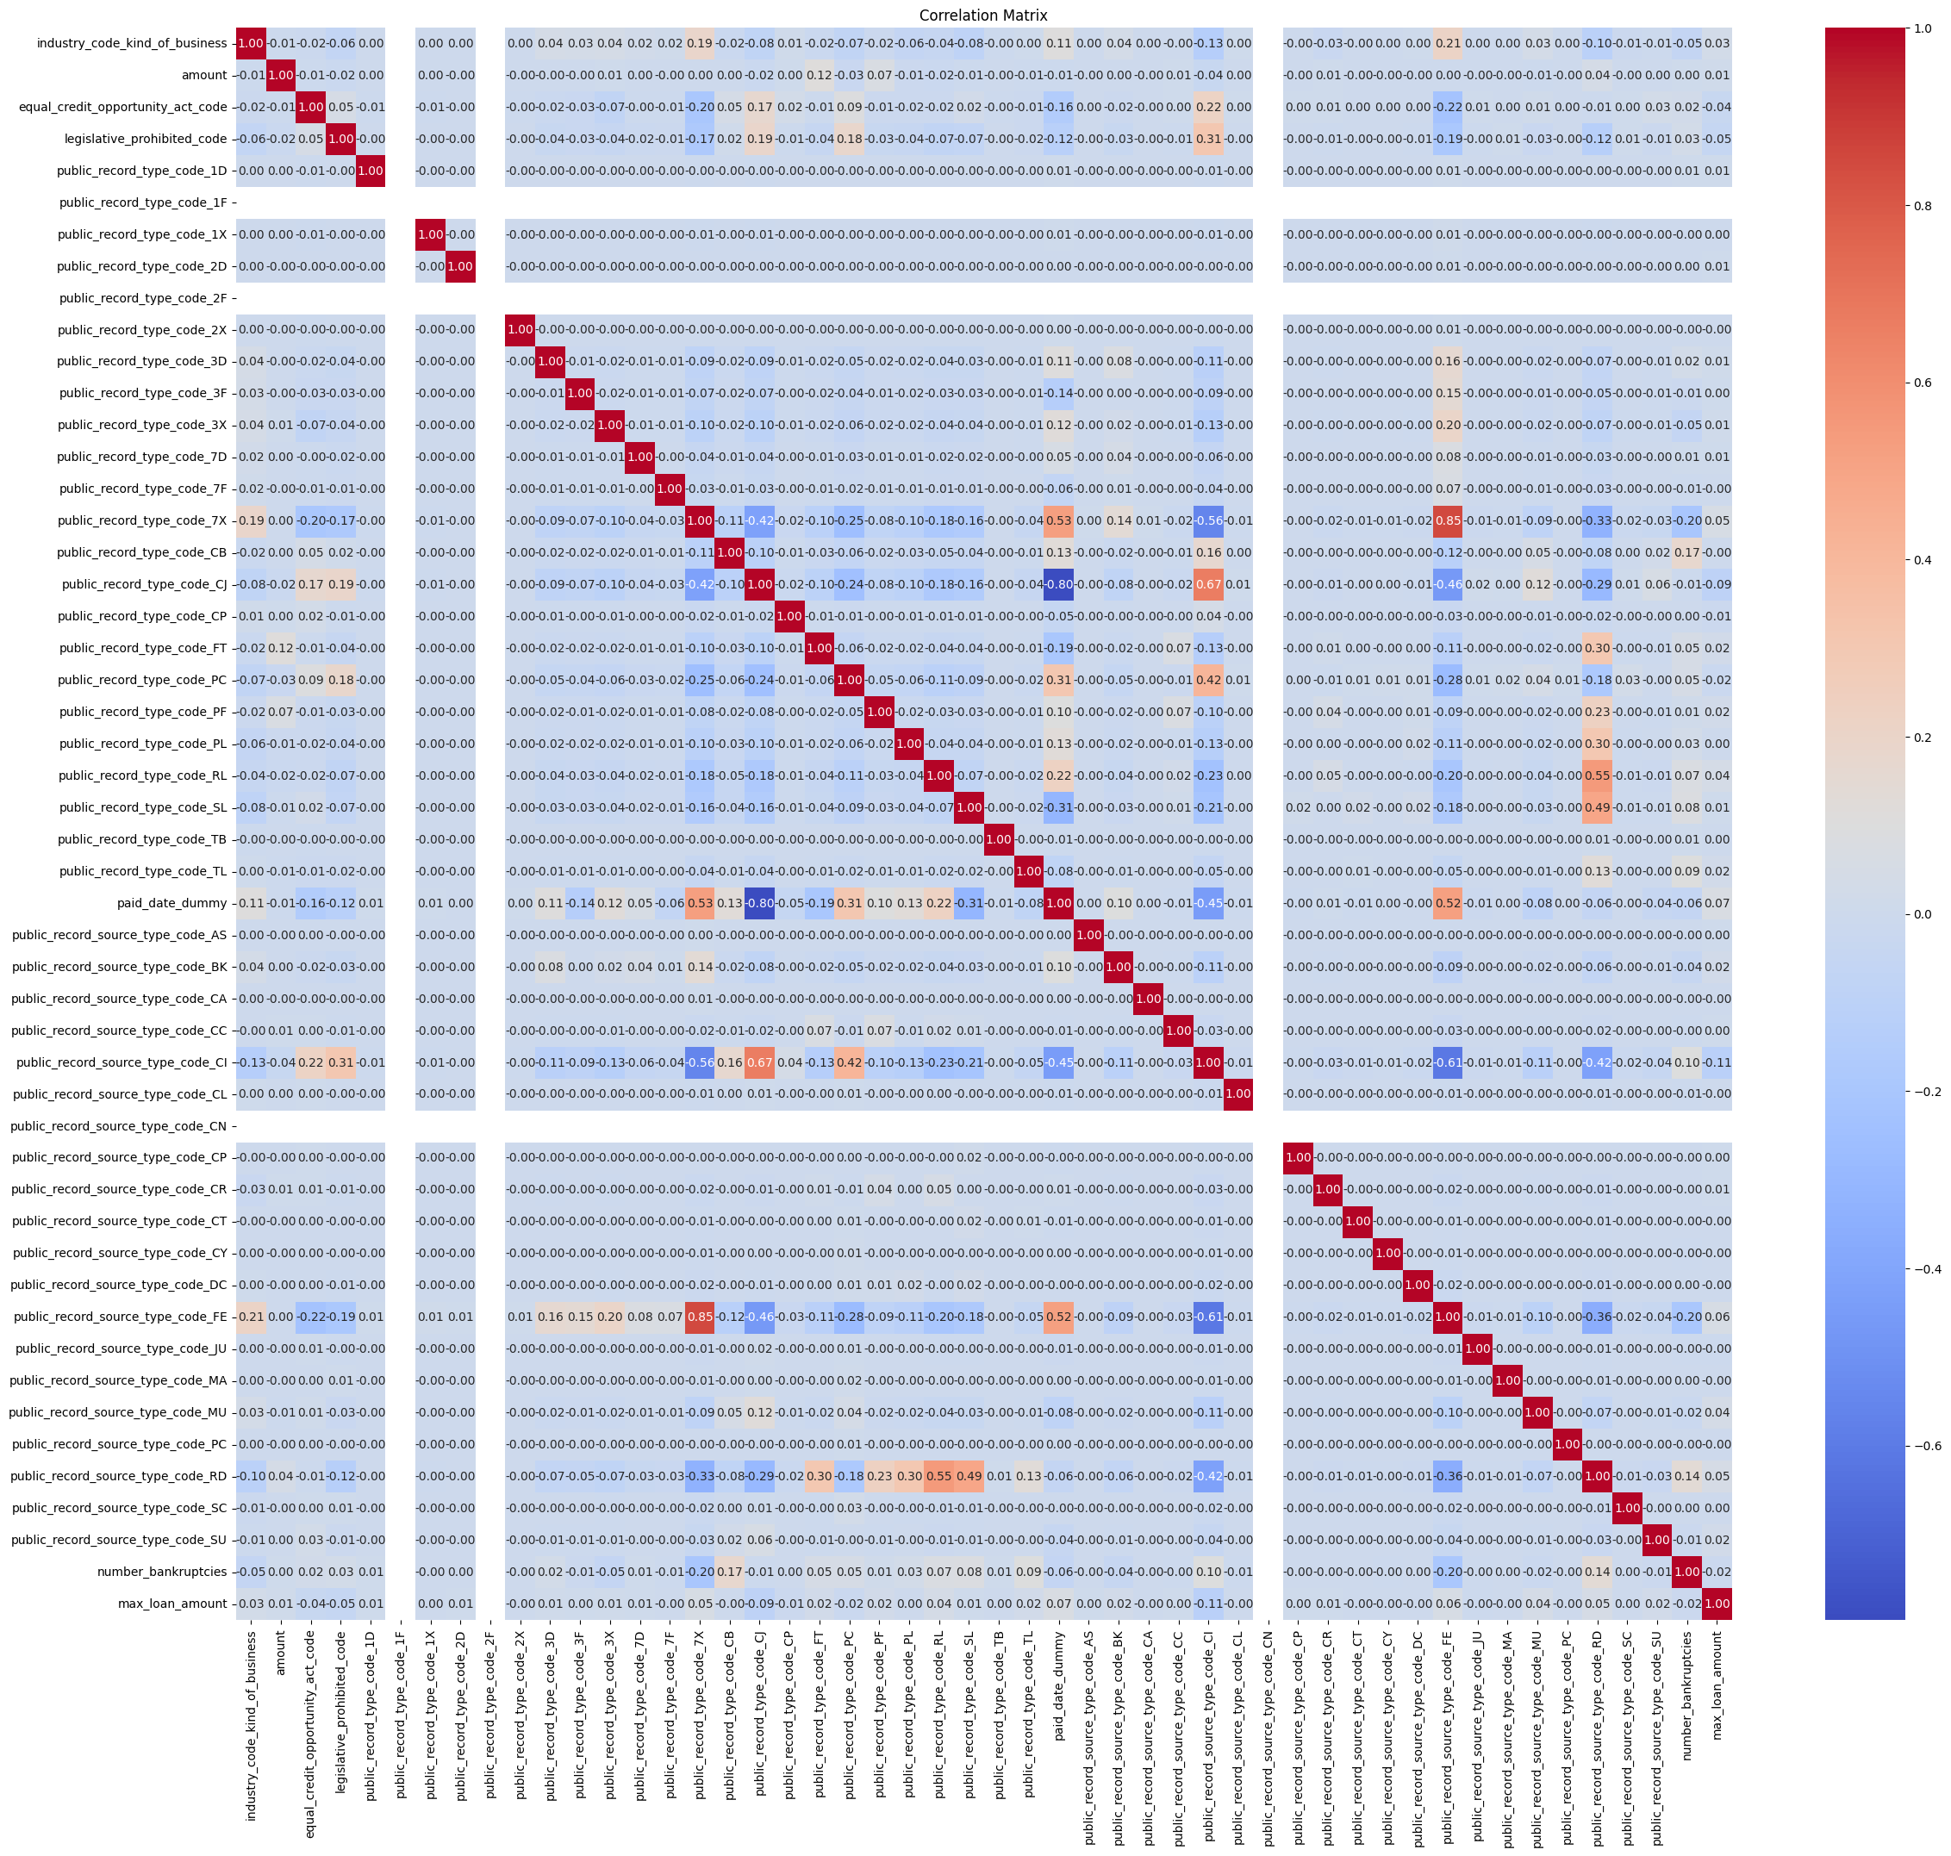
Normalization, Correlation and Collinearity
Normalization of numeric variables: Try to get same effect form all varibales
Correlation between variables: Ideas of how some variables affect each others
Variance Inflation Factor: Detect collinearity problems for linear models
Notes:
There is a high collenniality, this is surely due to the use of dummy variables, since these can be explained by each other.

Slide 22
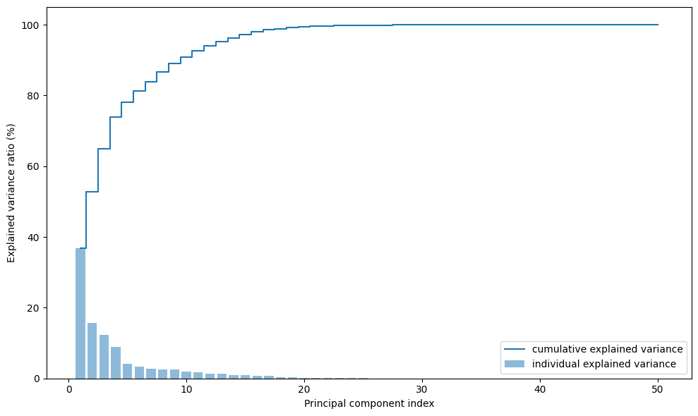
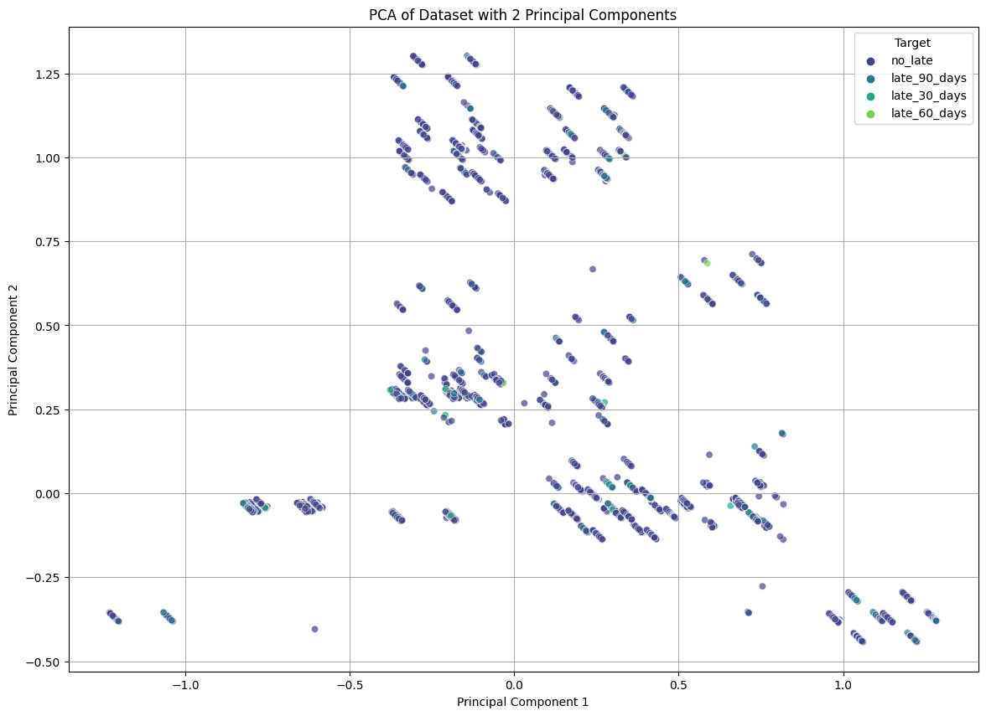
Principal Component Analysis
Notes:
With eight principal components most of the variance can be explained.
When making a plot to search for outliers, it is found that it is not easy to separate the points into different categories at a glance.

Slide 23
04.
Future Work

Slide 24
Possible lines to continue Working:
Trying to catch more information of the delete columns
Deeply study the meaning of rows with same Matchkey
Trying to catch more information from the dates
Anaysis of outliers and levereged points
Diferent dimesnionality reducction
Training linear and no linear model for future classification

Slide 25
END

