Slide 1
Control region on the X, not eliminated= X1
Primer Forward_O2256: CGTGATAGTGGAATCTCCTGTCAT
Primer Reverse_O2257:CGGATACTCACATGTGGATTGCT
Eliminated region of nested GRS on the X= GRS2
Primer Forward_O2351:gggttgtaggggtgagttca
Primer Reverse_O2352:aactttcgtggggaggctaa
Eliminated region of subtelomeric GRS on the X= GRS4
Primer Forward_02254:GGCGTTTTCGAGATAATCCTTGC
Primer Reverse_O2255:TCAGCCTAAGCCAAATTGGTGT
Eliminated region of intermediate coverage on the X= 15151g
Primer Forward_02252:GATTCCAGAGGCAGGGTGAC
Primer Reverse_O2253:GCGAGGTTGTCAGCTCTTTTTATG

Slide 2

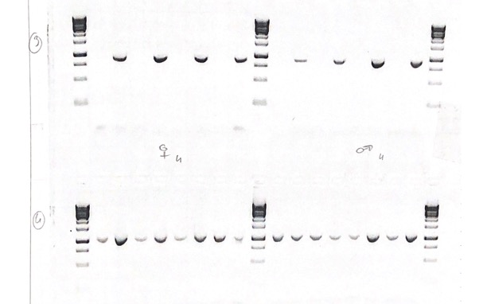
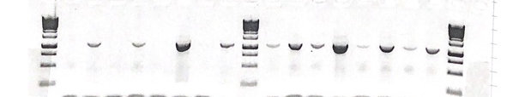
Experiment #1 on our PS1017 strain (full of males) on 4 dissected males and 4 dissected females
♂♀︎︎
Head
Head
Head
Head
Head
Head
Body
Body
Head
Head
Body
Body
Body
Body
Body
Body
1
2
3
4
1
2
3
4
GRS4
♂♀︎︎
Head
Head
Head
Head
Head
Head
Body
Body
Head
Head
Body
Body
Body
Body
Body
Body
X1
1
2
3
4
1
2
3
4
♂♀︎︎
Head
Head
Head
Head
Head
Head
CONCLUSION
-> in all samples, the control region is retained , the eliminated region GRS4 is not detected in the head
-> intermediate region is eliminated only in the soma of the 4 females !
Body
Body
Head
Head
Body
Body
Body
Body
Body
Body
1
2
3
4
1
2
3
4
15115g

Slide 3
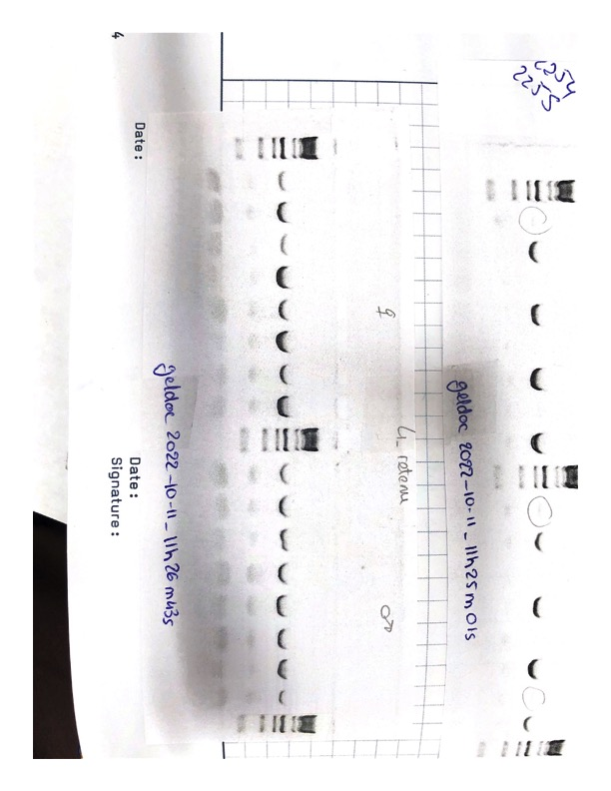
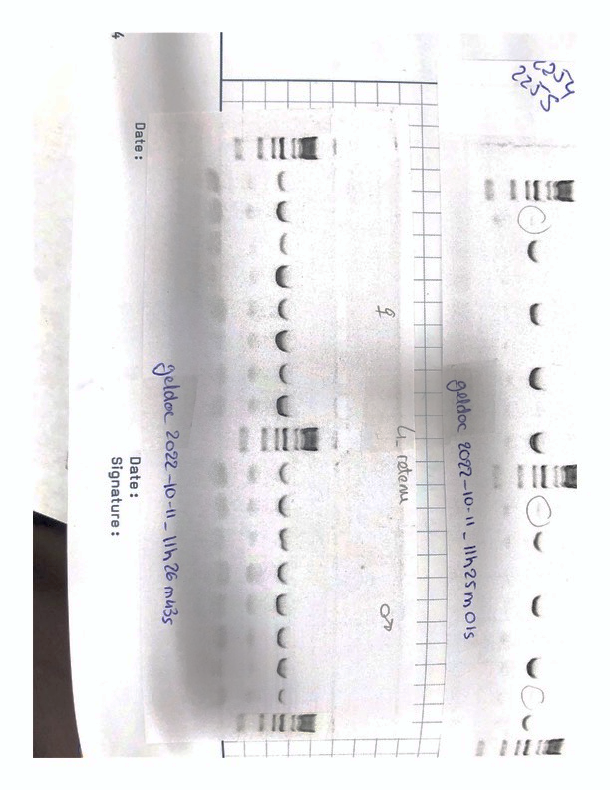
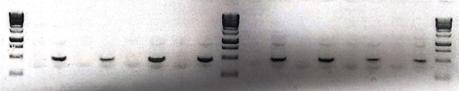
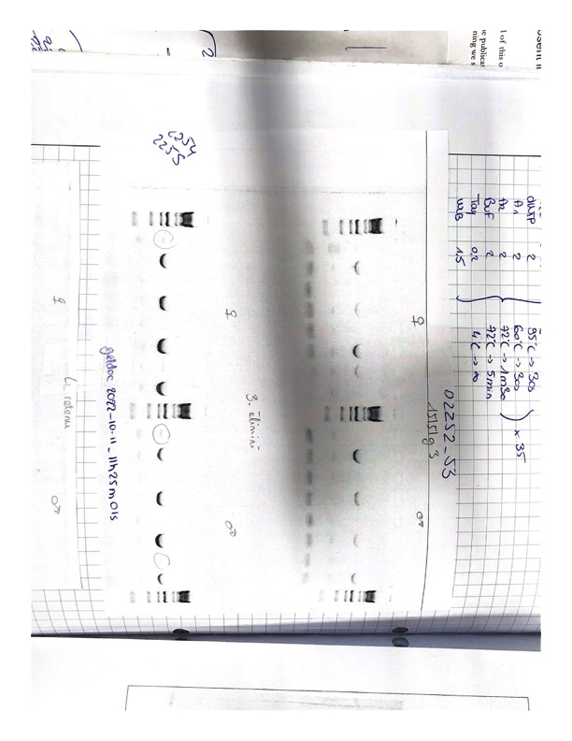
Experiment #2 on our PS1017 strain (full of males): on 4 other dissected females and 4 other dissected males
♂♀︎︎
Head
Head
Head
Head
Head
Head
Body
Body
Head
Head
Body
Body
Body
Body
Body
Body
X1
1
2
3
4
1
2
3
4
♂♀︎︎
CONCLUSION
-> in all samples, the control region X1 is retained ,
-> GRS4 does not really work anymore, since tiny bands are now detected in some heads ! WHY ??
-> GRS2 seems better as a control for the eliminated region
-> the intermediate region shows inconsistent results: no more detection in the male heads, detection in the head of 1 female (and not in its body BTW) in this ex. in other gels, it sounds like it is random, but not sex-specific
Head
Head
Body
Head
Head
Head
Head
Body
Body
Body
Body
Body
Head
Body
Head
Body
1
2
3
4
1
2
3
4
GRS4
♂♀︎︎
Head
Head
Body
Head
Head
Head
Head
Body
Body
Body
Body
Body
Head
Body
Head
Body
GRS2
1
2
3
4
1
2
3
4
♂♀︎︎
Head
Head
Head
Head
Head
Head
Body
Body
Head
Head
Body
Body
Body
Body
Body
Body
1
2
3
4
1
2
3
4
15115g

Slide 4
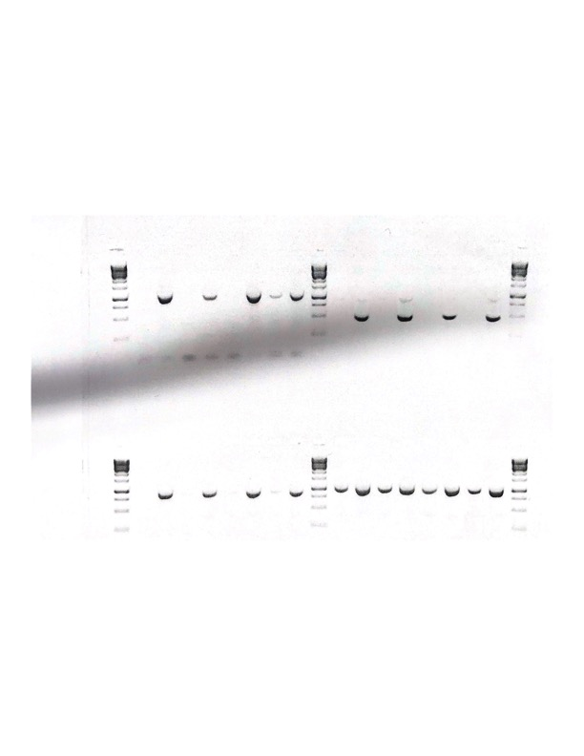
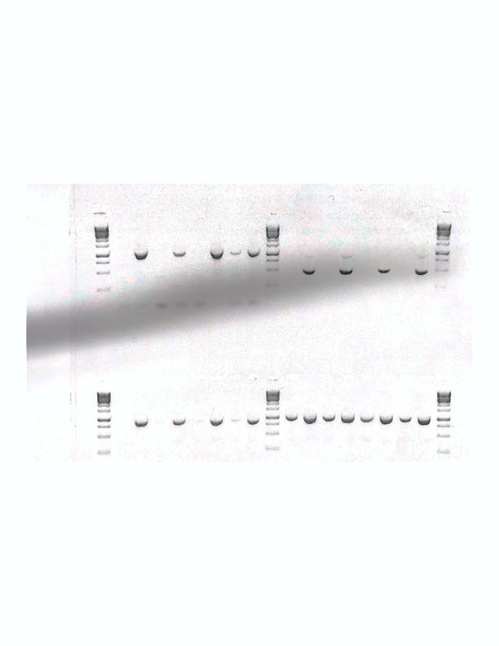
Experiment #3 on your PS1017 strain (no males): on 4 other dissected females
♂♀︎︎
Head
Head
Head
Head
Head
Head
Body
Body
Head
Head
Body
Body
Body
Body
Body
Body
X1
1
2
3
4
1
2
3
4
♂♀︎︎
CONCLUSION
-> in all samples, the control region X1 is retained ,
-> GRS4 does not really work anymore, since tiny bands are now detected in the head ! But again not in all individuals
-> GRS2 seems better as a control for the eliminated region
-> the intermediate region shows inconsistent results: found in 1 female out of 4
Head
Head
Body
Head
Head
Head
Head
Body
Body
Body
Body
Body
Head
Body
Head
Body
1
2
3
4
1
2
3
4
GRS4
♂♀︎︎
Head
Head
Body
Head
Head
Head
Head
Body
Body
Body
Body
Body
Head
Body
Head
Body
GRS2
1
2
3
4
1
2
3
4
♂♀︎︎
Head
Head
Head
Head
Head
Head
Body
Body
Head
Head
Body
Body
Body
Body
Body
Body
1
2
3
4
1
2
3
4
15115g

Slide 5
More PCR on the intermediate region, summary on October13 2022 PCR performed on our strains (male and female)
Using several couples of primers on 15115g, in total we found that it is eliminated in 11/21 females and 17/28 males
Using another locus on the intermediate region (we call PCR3.2): eliminated in 3/12 females and 4/12 males
Using another locus on the intermediate region (call PCR3.3): eliminated in 4/13 females and 4/11 males

Slide 6
CONCLUSION
The GRS4 region does not seem to be systematically eliminated
The intermediate region seems to be eliminated in 50% of animals, but this is unrelated to sex.
->we could test whether this is heritable (because there is heterogeneity in the popuulation), or depends on environment (depends how was the plate at time of elimination for a given embryo !?)

