Slide 1


BATZ
AUTOMOTIVE SYSTEMS
Meeting your challenges
COST CARRIERS APPLICATION
APPLICANT
Request for cost carriers opening/modification
Request for invoicing
August 2022

Slide 2
BATZ
AUTOMOTIVE SYSTEMS
Meeting your challenges
Request for
cost carriers opening/modification
August 2022

Slide 3
INDEX
OBJETIVE, SCOPE AND ACCESS
CREATE A NEW PROJECT IN THE APPLICATION I,II
EDIT REQUEST
TABLE STRUCTURE - I, II
TO CREATE NEW STEPS
1. STEP TYPE A1: TIMECARDS I,II
2. STEP TYPE A2: TECHNICAL OFFER-BUDGED I, II
3. STEP TYPE B : MANUAL I, II, III, IV
PROJECT SHORT NAME
SENDING TO VALIDATION (STEPS)
SELECT STEPS
STEPS VALIDATION SENDING PAGE I,II, III.
FLOW
POSSIBLE MESSAGES/ WARNINGS WHEN YOU SEND TO VALIDATE
YOU SHOULD INFORM ABOUT PROJECT AFFECTED (FOR ECO’S)
THE PROJECT DOES NOT CONTAIN ABREVIATION
BUDGET APPROVED DIFFERS FROM EXPENSES SUM
SENDING TO VALIDATION (GENERAL INFO)
UPDATING OF THE GENERAL INFO I, II
FLOW
STATES OF THE STEP
REAL DATA
MODIFICATION OF REJECTED STEP
MODIFICATION OF APPROVED STEP
INMEDIATE SYNCRONIZATION OF PTKSIS INFO

Slide 4
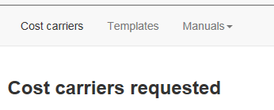
OBJETIVE, SCOPE AND ACCESS
OBJETIVE: Improve the cost carrier request process for new projects or modifications. Improve the economic monitoring of the project, reduce the time to obtain indicators.
SCOPE: All cost carriers regarding to Industrialization, Advance, Predevelopment and ECO (change) projects will be requested through this application.
ACCESS: Intranet icon
Shows all projects of the logged in user (project owner/co-owner in PTKSIS)

Slide 5
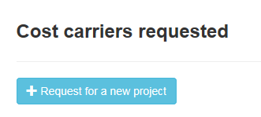
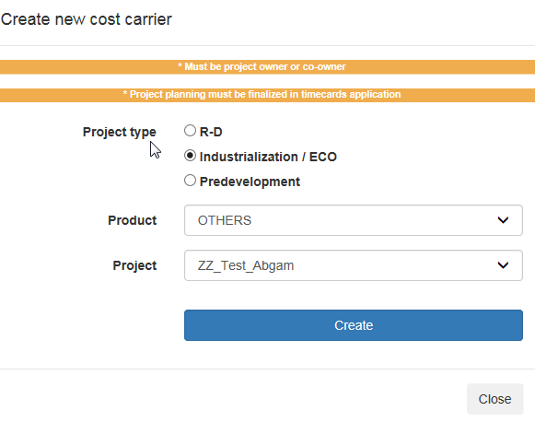

CREATE A NEW PROJECT IN THE APPLICATION - I
Requirements for all projects:
To be Owner or Co-Owner of the project in PTKSIS
Project planning must be finalized in timecards application.
For industrialization type projects it is necessary also:
Awarding offer version must be registered in Technical offer-Budget application
1
Select project type
2
Select product + project
3

Slide 6
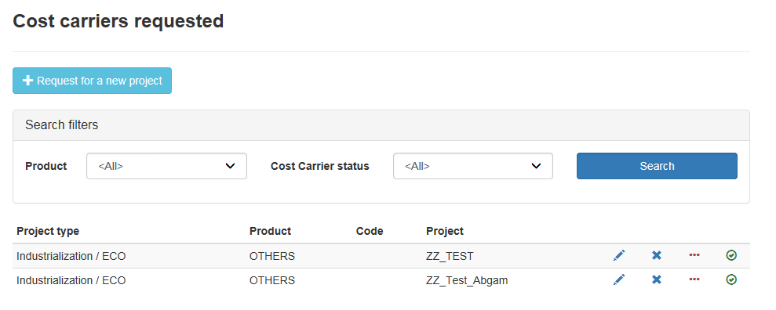






CREATE A NEW PROJECT IN THE APPLICATION - II
The project has been created
4
Edit Request. To create the project steps required in the project.
Detete request: It can only be deleted if it does not have approved steps.
To add a different plant to the productive one.
Actual Status and History: Validation history.
Totals: All approved project expenses.

Slide 7
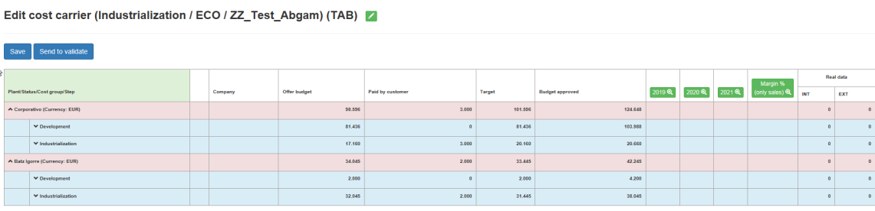
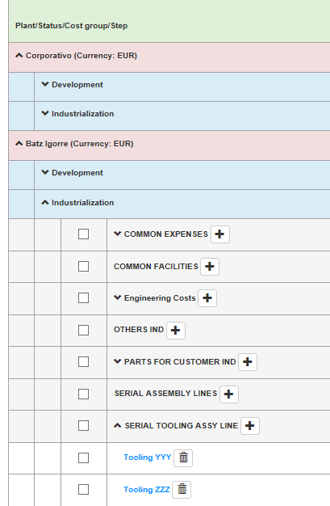
EDIT REQUEST - TABLE STRUCTURE - I
Y AXIS STRUCTURE
Plant: Plant that has the expense or the income
1.1 State: State in which the expense/income is made
1.1.1 Cost group: Group of steps
1.1.1.1 Step: Cost carrier that will open in XPert
**Cost Groups are created in the Project Template (exclusive access to application administrators).

Slide 8
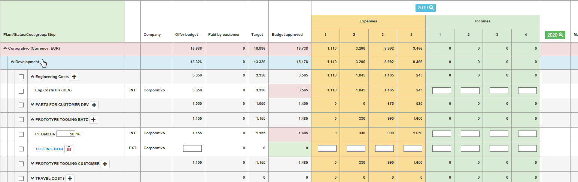
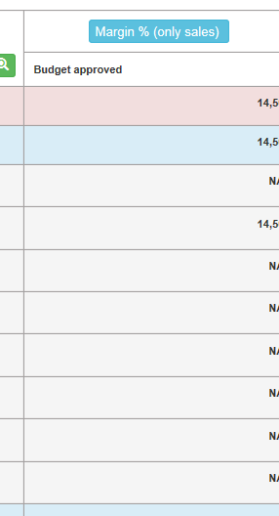
EDIT REQUEST - TABLE STRUCTURE - II
Offer Budget: Awarding offer budget.
Expenses: Amount expected to be spent in the indicated quarter. The "Budget Approved" column is the summation of its values and is the amount requested for that step.
Incomes: The payment expected to receive in the indicated quarter. The column "Paid by customer" is the summation of its values.
Target: Automatic depending on the type of step / expense.
Margin (relative to Sales)

Slide 9
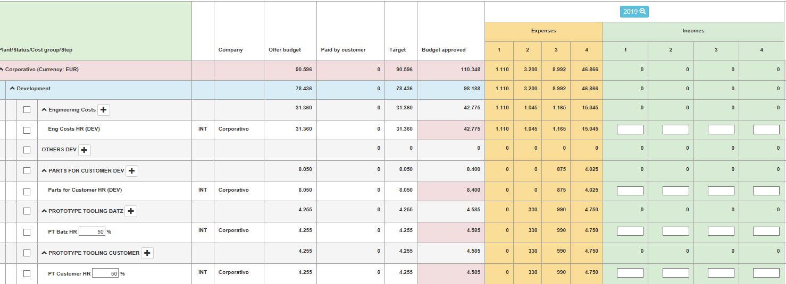
TO CREATE NEW STEPS→ 1. TYPE A1: TIMECARDS
The type of the steps is recognized by its color
A→ Black: The step has been created AUTOMATICALLY, the origin of the information automatically filled in is in ANOTHER APPLICATION.
TYPE A1→ TIMECARDS type step. Step’s name contains the text HR (Human Resources) or HR-MR (Human and Machine resources). For these steps, Offer Budget and Expenses columns must be updated from TIMECARDS APPLICATION. Incomes, on the other hand, should be updated from here in case the customer pays in CASH for these concepts.
UNEDITABLE. ORIGIN APPLICATION TECHNICAL OFFER- BUDGET
EDITABLE
Some cost groups are divided in two (Batz property or Customer property), they are timecards related to tooling set-up and design. The budget of these activities is carried out globally and not divided by tooling owner, that’s why it must be the user who, depending on the costs of Batz tooling and Customer tooling, applies a percentage and divides timecards budget between these two cost groups

Slide 10
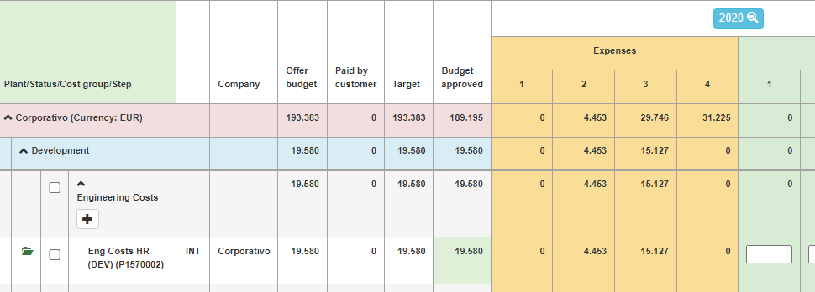
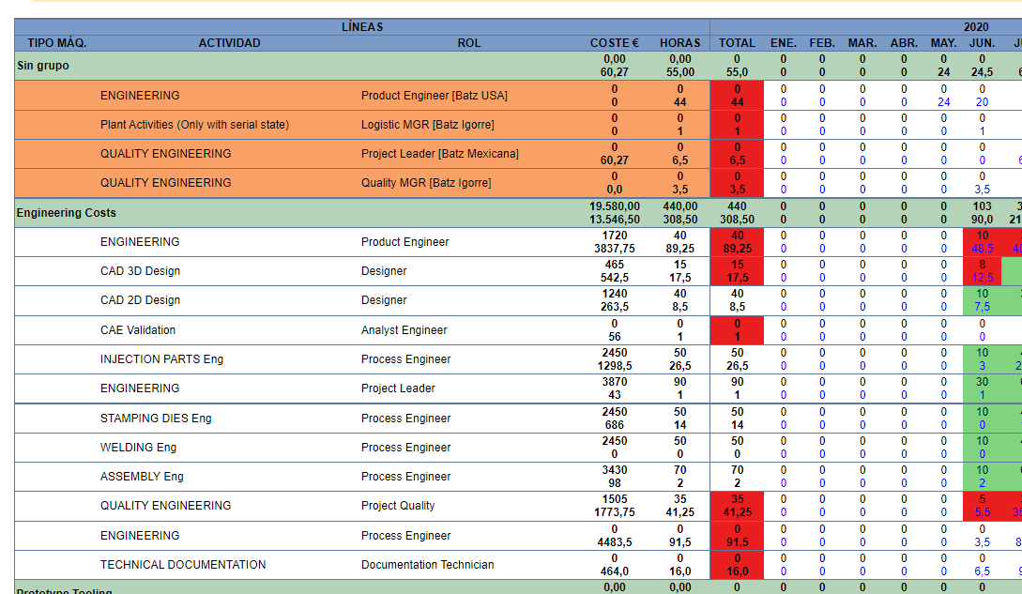
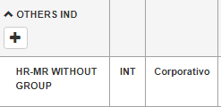
TO CREATE NEW STEPS→ 1. TYPE A1: TIMECARDS II
The Offer Budget column shows what is established in the TIMECARDS BUDGET
Budget Approved and Expenses, display by cost group what is established in the LAST TIMECARDS PLANNING, grouped by quarter.
APP CC
The applicant must fill in Incomes if customer pays IN CASH for these concepts.
APP BONOS
Within the OTHERS cost group there is one step for which budget is NOT requested, “HR-MR WITHOUT GROUP”. This step is necessary to be able to track the real cost through the CC report, since there are
Activity/Role combinations that do not exist in the planning and when the team members enter Timecards they stay “Without group”
The project lead should update the planning ordering these lines within existing cost groups.

Slide 11
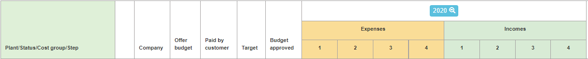
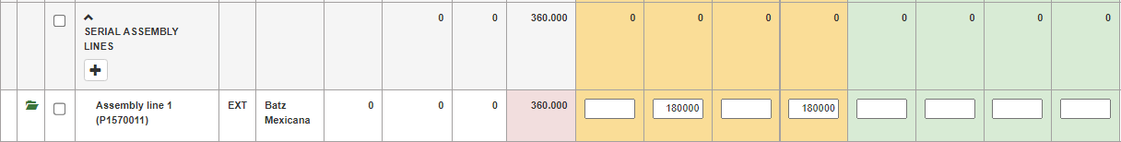
TO CREATE NEW STEPS→ 1. TYPE A2: TECHNICAL OFFER- BUDGET I
The type of the steps is recognized by its color
A→ Black: The step has been created AUTOMATICALLY, the origin of the information automatically filled in is in ANOTHER APPLICATION
A2 TYPE→ Expenses will be invoices.
The origin of the Budget approved and Paid by customer columns is the TECHNICAL OFFER – BUDGET APPLICATION.
The applicant must fill in the Cost Carriers Expenses/Incomes app, scheduling the income and expenses established in the technical offer/budget.
To allow sending to validation the following formula must be true:
∑Expenses = Budget approved
∑Incomes = Paid by customer
UNEDITABLE. ORIGIN APPLICATION TECHNICAL OFFER- BUDGET
EDITABLE

Slide 12
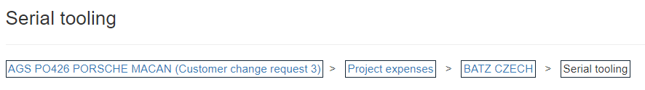
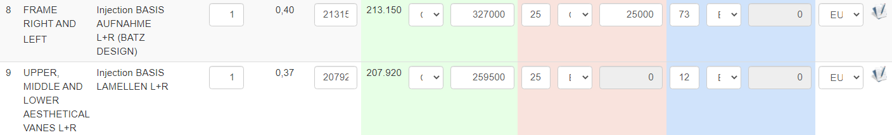
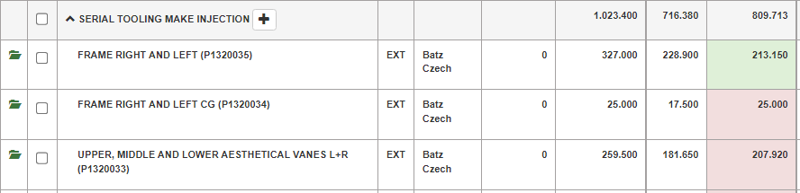
TO CREATE NEW STEPS→ 1. TYPE A2: TECHNICAL OFFER- BUDGET II
When updating the Budget, all the means will automatically appear in CC, such as the assembly line, toolings, etc. required. The Step Name, Offer Budget, Paid by customer, and Budget approved must be set/modified from within that application.
APP BUDGET
APP CC

Slide 13
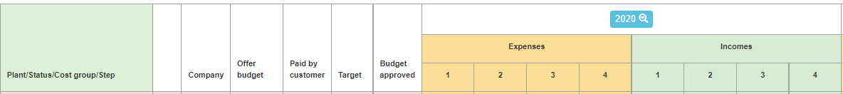
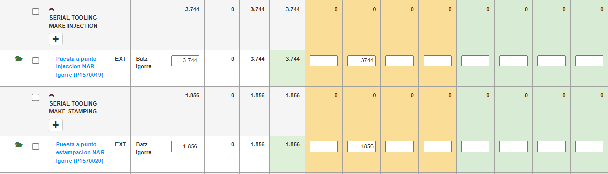
TO CREATE NEW STEPS →3. TYPE B: MANUAL I
B→ AZUL: The step has been created MANUALLY
TIPO B→ All the information that is required in the x-axis must be filled in by the requester and is displayed as an editable text box.
EDITABLE

Slide 14

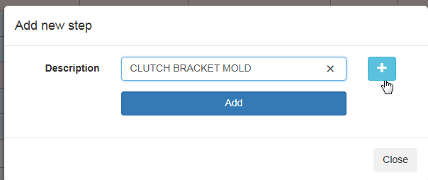
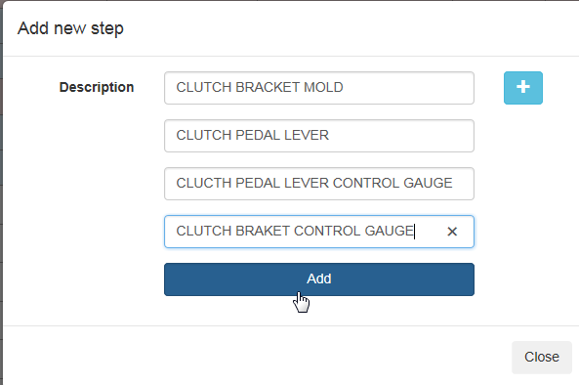
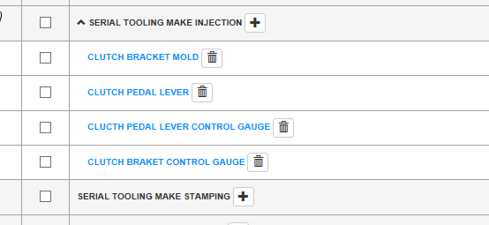
TO CREATE NEW STEPS →3. TYPE B: MANUAL II
1
To create another line.
2
To add a new step to the cost group
Add all the steps to the cost group
3

Slide 15
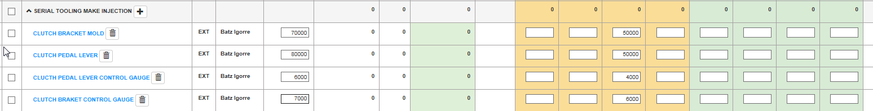
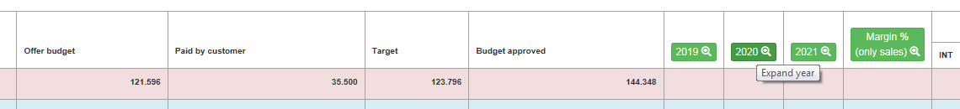
TO CREATE NEW STEPS →3. TYPE B: MANUAL III
Fill in the fields:
Offer Budget: With the budget of the awarding offer
Expenses: Amount expected to be spent in the indicated quarter.
Incomes: Payment expected to receive in the indicated quarter.
4
Offer Budget
Expenses
Incomes
Columns "expenses" and "incomes" are collapsed by default . They become visible when you click on the year.

Slide 16
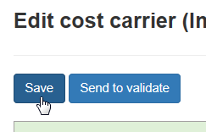
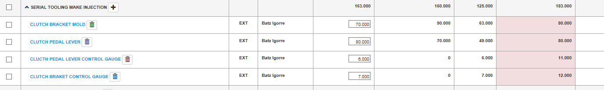
TO CREATE NEW STEPS →3. TYPE B: MANUAL VI
5
When saving, these fields are automatically filled in:
Paid by customer →summation of the incomes of all years
Budget Approved → summation of the expenses of all years
Target →applies a formula depending on the type of cost: hours, tooling, investment
Save data
Target
Paid by customer
Budget Approved
16

Slide 17
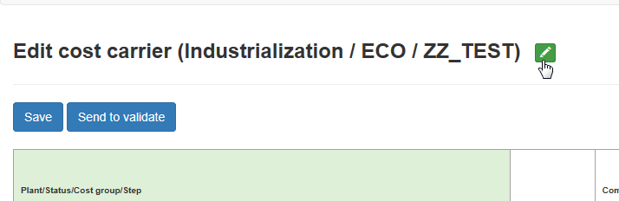
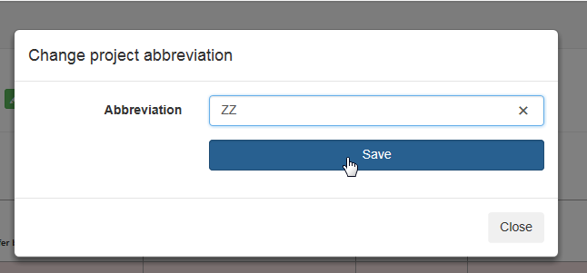
EDIT REQUEST - PROJECT SHORT NAME
The abbreviation of the project (short name) is the name that will precede all the steps in XPERT. The limitation of Xpert to name a step is 40 characters in which the code and this abbreviation of the project must be included.
Edit project abbreviation
10

Slide 18
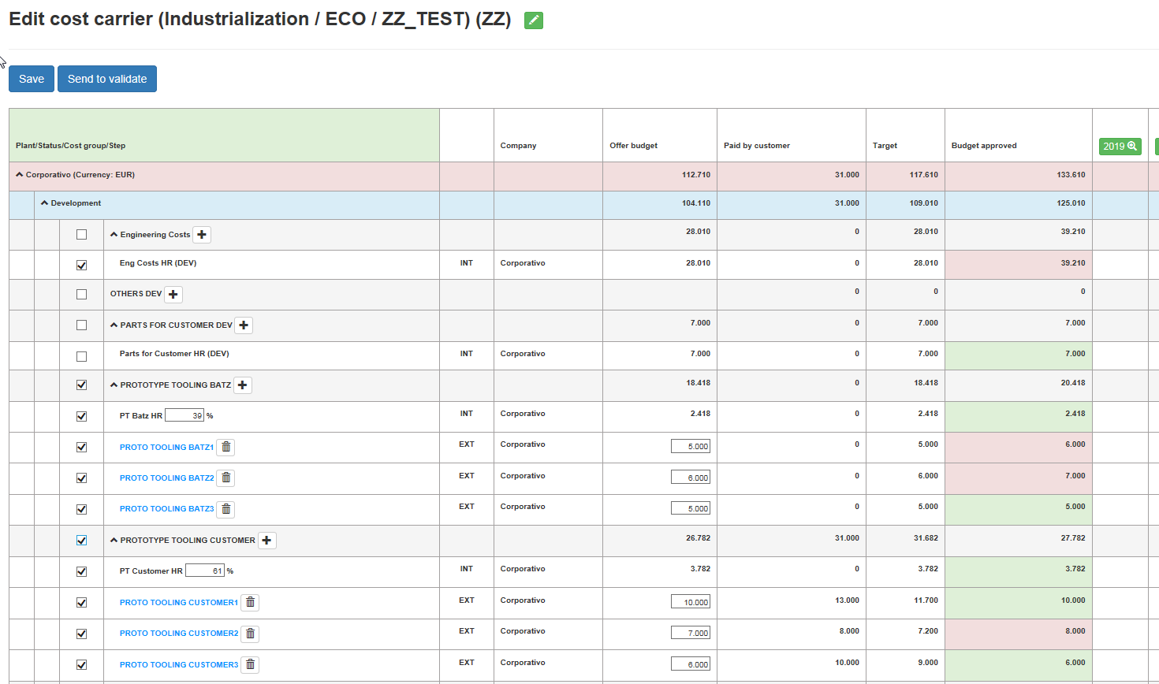

SENDING TO VALIDATION (STEPS) - SELECT STEPS
12
Send to validate
Select all the steps that are requested in this validation
11

Slide 19
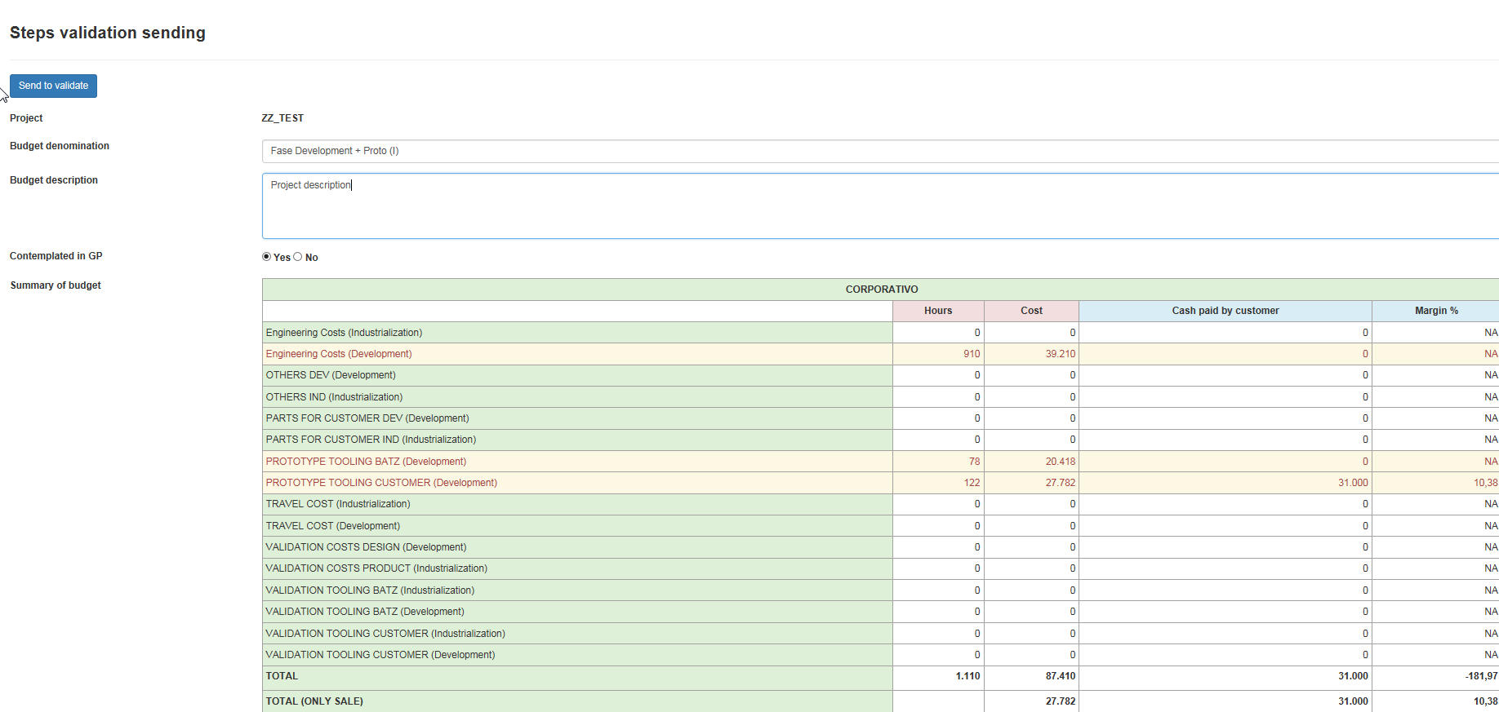
SENDING TO VALIDATION (STEPS) - STEPS VALIDATION SENDING PAGE - I
Fields to fill:
Budget Denomination
Budget Description
General Info (only for industrialization or modification projects)
13
Included in Management plan: The field is filled in automatically depending on whether or not project has a planning with the label PG CURRENT YEAR in the tImecards app
Summary of Budget: Amount requested per cost group and its margin
Put the mouse over new quantity in order to see how much has been already validated
Budget Denomination: Label or name with which this request will be saved (the name of the project should not be included)
Budget Description: In industrialization projects it is used to explain the deviations of the economic concepts collected in General info table of the previous validation (if it is the first validation, it would be the Awarding offer) and the current request. In the other types of projects it is used to describe projects.

Slide 20
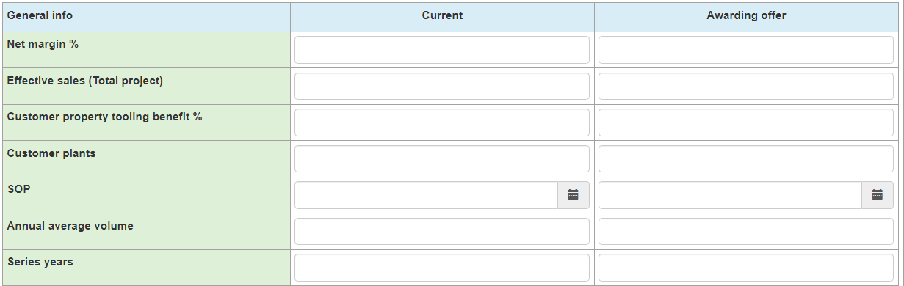
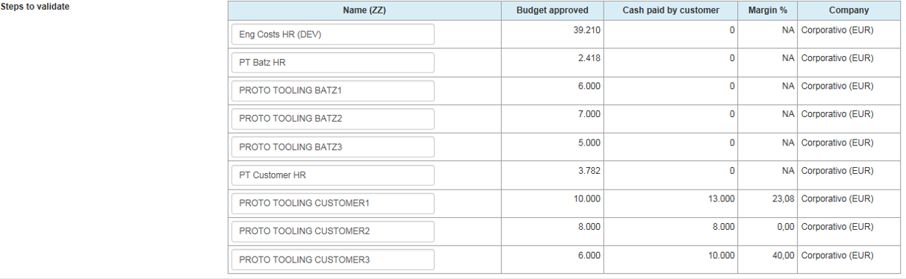
SENDING TO VALIDATION (STEPS) - STEPS VALIDATION SENDING PAGE - II
General Info: “Awarding offer” and “Current” columns must be filled in. In the next sending to validation you only have to fill in one column, the "Current", but in the first one you must fill in both.
General Info fields for Industrialization:
Net margin %
Effective sales (Total project)
Customer property tooling benefit%
Customer plants
SOP
Annual average volume
Series years
General Info fields for ECO:
Δ Piece price benefit %, Formula→ 1 - Δ Costs/Δ Effective Sales
Where →Δ Costs: ΔCosts_PN1*Total Volume_PN1 + ΔCosts_PN2*Total Volume_PN2 +…
→Δ Effective Sales: Δ Sale price_PN1*Total Volume_PN1 + Δ Sale price_PN2*Total Volume_PN2+…
Δ Effective sales (Total project)
Customer property tooling benefit %
SOP
Annual average volume
Series years
14
STEPS TO VALIDATE: Those are all the steps requested in this validation. The Name column will be the name given in Xpert application (preceded by code and project abbreviation). If the name given to the step in the "Edit cost carrier" table is too long, here it is shortened automatically. Name column must be edited if the concept is not well understood after automatic shorting.
Revise and modify the name in case of being necessary

Slide 21
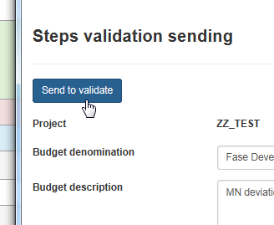
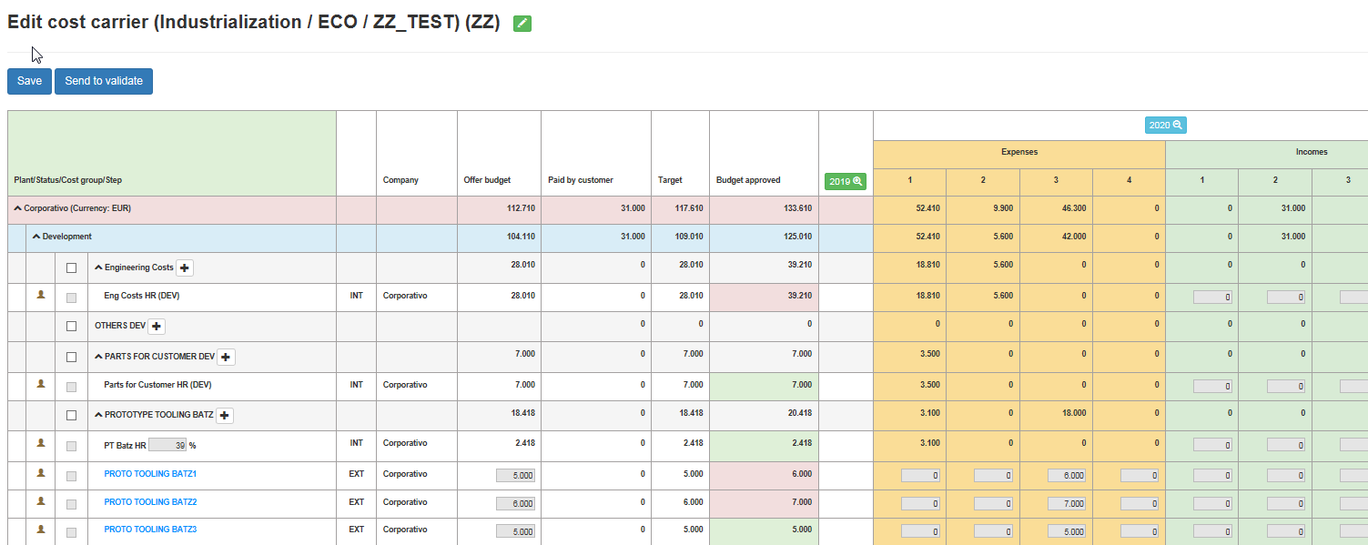
SENDING TO VALIDATION (STEPS) - STEPS VALIDATION SENDING PAGE - III
15
Send to validate the request
If the request is not sent to validate, what is written on this page is not saved
The steps that have been sent to validate can not be modified until the request has a response ( approved or rejected)

Slide 22
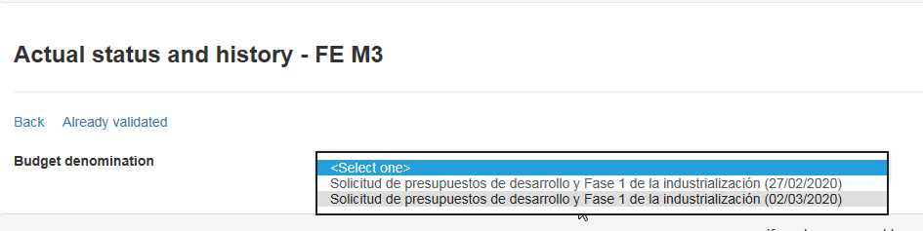

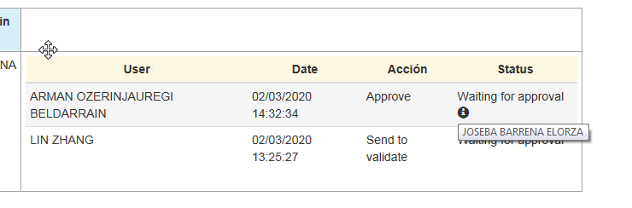
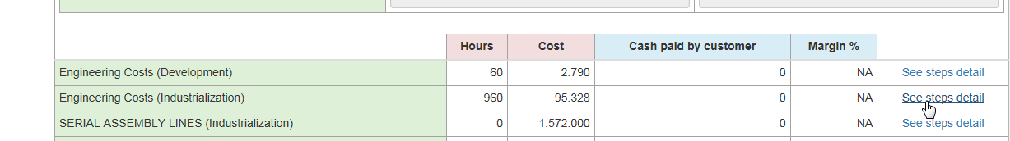
SENDING TO VALIDATION - FLOW
Validation flow depends on the project type. 4 Flows:
INDUSTRIALIZATION PROJECTS:
Project Owner creates & sends to validate > Project Manager validation > Internacional¹ Or National² Operations Director validation > Technical Director validation > Plant General Manager³ validation > Corp. and Plant Financial Resp. CC code creation in the system. ⁴
ECO INDUSTRIALIZATION PROJECTS:
Project Owner creates & sends to validate^{5,6} > Plant Engineering Resp. validation > Plant General Manager validation > Plant Financial Resp. CC code creation in the system.
PREDEVELOPMENT PROJECTS:
Project Owner creates & sends to validate > Product Manager validation > Technical Director validation > Corp. Financial Resp. CC code creation in the system.
R_D PROJECTS:
Project Owner creates & sends to validate > Advance Manager validation > Technical Director validation > Corp. Financial Resp. CC code creation in the system.
¹Projects for: CZ-KU-GU-MX
²Projects for: ZA-IG
³Not required if there is a previous validation of the same person
⁴ In case of being Batz Corporative the productive plant of the project, the flow changes to: Project Owner creates & sends to validate > Project manager validation > Technical Director validation > Corp. Financial Resp. CC code creation in the system
⁵If they belong to Corporative , follows the flow →A. INDUSTRIALIZATION PROJECTS
⁶ If the Project has PTKSIS attribute “Indicators” with Yes value, will follow→A. INDUSTRIALIZATION PROJECTS flow
In order to see where the validation is within this flow:
Actual Status and history→ Last validation

Slide 23
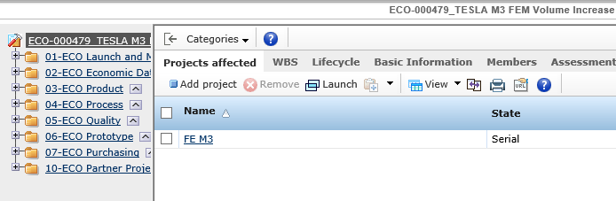
MESSAGES WHEN SENDING TO VALIDATE: YOU MUST REPORT THE AFFECTED PROJECT (FOR ECO'S)
Whenever possible, in cost carriers, the modification Project will be assigned the same code of the Project that is being modified, continuing correlatively with the numbering with which the Project that has to be modified ended. Thus will be possible to have a total cost reading.
So it is necessary to inform in PTKSIS about which is the project that has to be modified by the ECO.

Slide 24
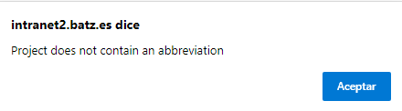
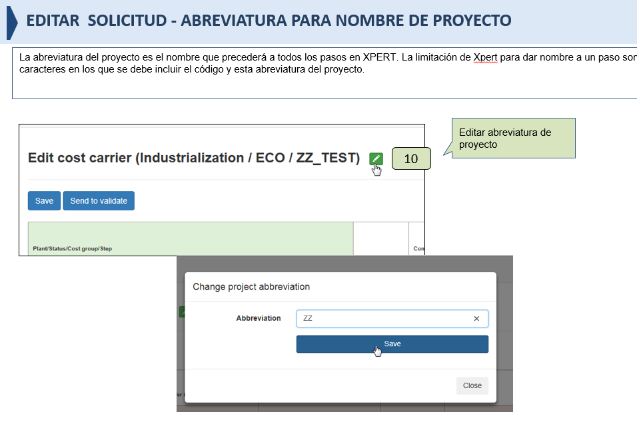
MESSAGES WHEN SENDING TO VALIDATE: THE PROJECT DOES NOT CONTAIN ABBREVIATION
If we have not written an abbreviation for the name of the project, we will get this message when sending to validate so that we can do it at that moment (by clicking OK, it will take us to the menu to edit the name). We can enter a maximum of 10 characters. After filling it out we can return to Send to validate
More about the project abbreviation on slide:

Slide 25
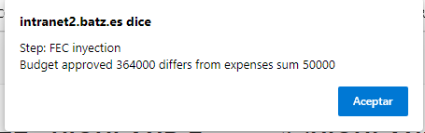

MESSAGES WHEN SENDING TO VALIDATE: BUDGET APPROVED DIFFERS FROM THE SUMMATION OF EXPENSES
When the step is of type A2 (Origin technical offer or budget), this is the message that is output if this condition is not met
.
∑Expenses = Budget approved
∑Incomes = Paid by customer
See slide

Slide 26
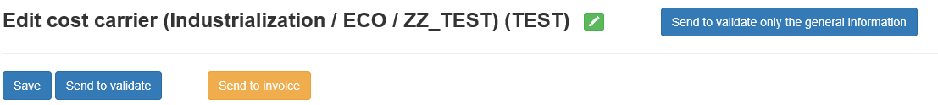
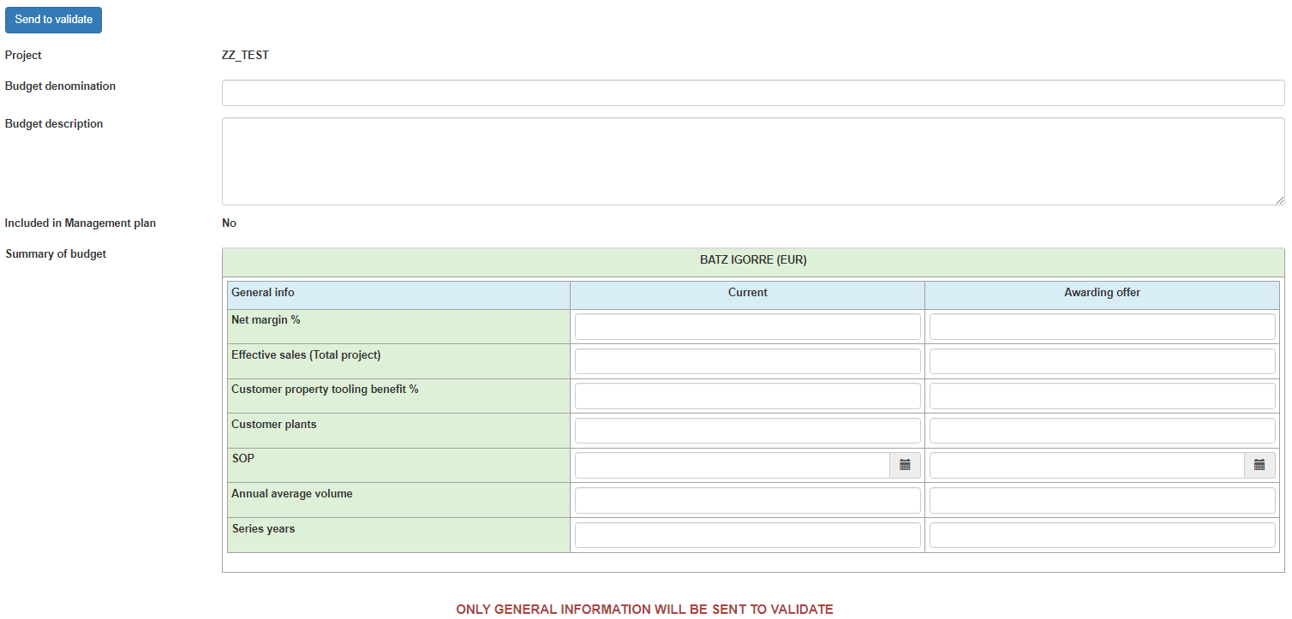
SENDING TO VALIDATION (GENERAL INFO) – UPDATING I
This validation request does not contain steps, only the data collected in the General Info box (for industrialization projects, as the net margin, effective sales, etc. and for modification projects, as Δ piece price benefit, Δeffective sales, etc.) is sent to validate.
1
Fill in the following fields:
Budget Denomination: Label or name with which this request will be saved (the name of the project should not be included).
Budget Description: We usually use to explain deviations of the economic concepts of General info table of the previous validation (if it is the first validation, it would be the Awarding offer)
General Info
2
Included in Management plan: The field is filled in automatically depending on whether or not project has a planning with the label PG CURRENT YEAR in the tImecards app

Slide 27
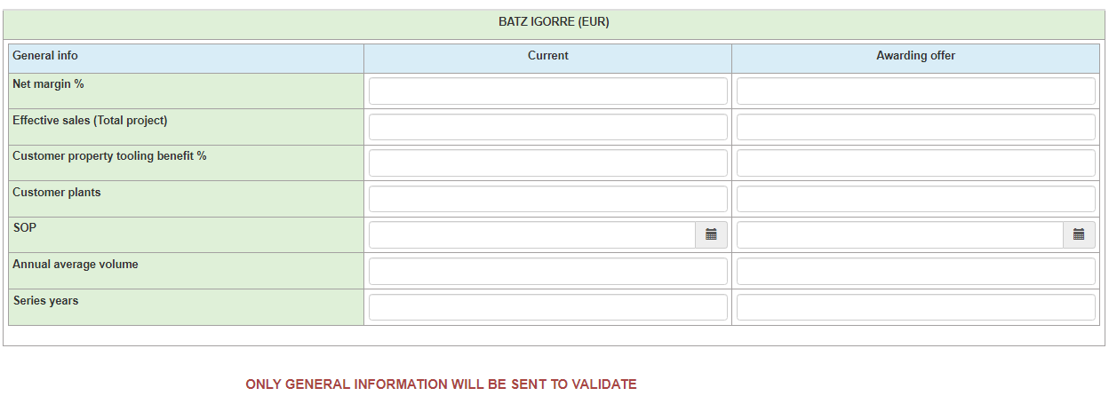
SENDING TO VALIDATION (GENERAL INFO) – UPDATING II
GENERAL INFO: The Awarding offer and Current value of the different fields must be filled in. In the next sending, only the current column will have to be filled in.
Campos General Info para Industrialization:
Net margin %
Effective sales (Total project)
Customer property tooling benefit%
Customer plants
SOP
Annual average volume
Series years
Campos General Info para ECO:
Δ Piece price benefit %, Formula→ 1 - Δ Costs/Δ Effective Sales
Donde →Δ Costs: ΔCosts_PN1*Total Volume_PN1 + ΔCosts_PN2*Total Volume_PN2 +…
→Δ Effective Sales: Δ Sale price_PN1*Total Volume_PN1 + Δ Sale price_PN2*Total Volume_PN2+…
Δ Effective sales (Total project)
Customer property tooling benefit %
SOP
Annual average volume
Series years

Slide 28
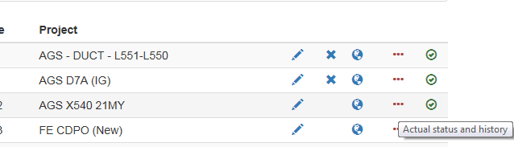
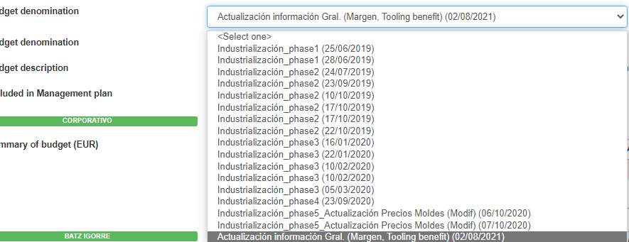
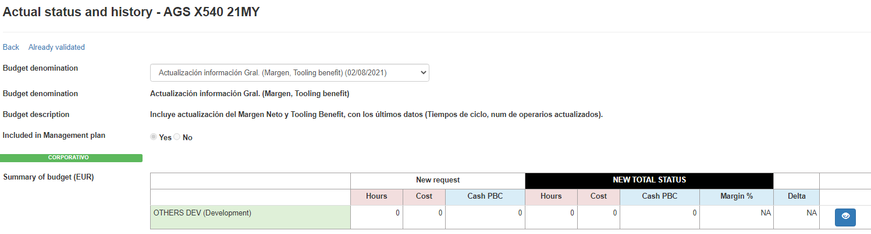
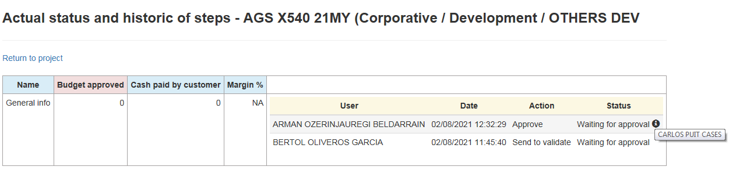
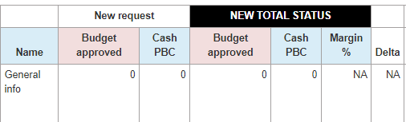
SENDING TO VALIDATION (GENERAL INFO) - FLOW
This validation applies only to industrialization and to ECO projects. The validation flow is the same but does not arrive to finance department:
INDUSTRIALIZATION PROJECTS:
Project Owner creates & sends to validate > Project Manager validation > Internacional¹ Or National² Operations Director validation > Technical Director validation > Plant General Manager³ validation. ⁴
ECO INDUSTRIALIZATION PROJECTS:
Project Owner creates & sends to validate⁵ > Plant Engineering Resp. validation > Plant General Manager validation.
¹Projects for: CZ-KU-GU-MX; ²Projects for: ZA-IG; ³Not required if there is a previous validation of the same person; ⁴ In case of being Batz Corporative the productive plant of the project, the flow changes to: Project Owner creates & sends to validate > Project manager validation > Technical Director validation ; ⁵If project owner belongs to Corporative , follows the flow →A. INDUSTRIALIZATION PROJECTS;
The general info, internally is managed as another step within OTHERS DEV cost group and thus you can see where it is in the validation flow.

Slide 29
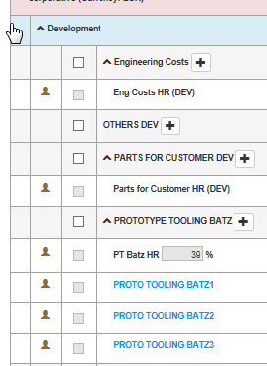

STATES OF THE STEP
Pending Approval→ Request waiting for validator response
Approved→ The validator has approved this step. The step has been
sent to financial to open it in Xpert
Rejected→ The validator has rejected this step
Put the mouse over the icon to see the reason→
Opened→ Cost carrier opened by Financial department. . T .The code is automatically added to the step name

Slide 30


REAL DATA
We use Cost carrier report to follow up project real expenses
Link to the report:
Amount validated through CC application for Budget and Paid by customer
Cost Carriers report (batz.es)
REAL DATA/TOTAL
XPERT: TOTAL amount of orders
BONOS: TOTAL amount of Human – Machine Resources
TOTAL AMOUNT INVOICED: TOTAL Invoices send to customer
PAID: It takes 1 value when the invoice is paid.
REAL DATA/MONTHLY
XPERT: Amount of orders per month
BONOS: Amount of Human – Machine Resources per month
TOTAL AMOUNT INVOICED: Amount invoices send to customer per month
You can see cost carrier detail clicking on the number (new window opens)

Slide 31

MODIFICATION OF REJECTED STEP
In rejected state the step can be modified. The status icon will change when it is submitted for validation. To update it, you will have to take into account which is the step type in order to do it from the proper application.
Step type A1: Modify the planning in Timecards
Step type A2: Modify the technical offer/Budget
Step type B: Modify it directly in CC
In the example the step is type B (blue). We modify Expenses/Incomes and click on Save. The Budget Approved and Paid by customer columns are updated.
15
Modify quantity

Slide 32

MODIFICATION OF APPROVED STEP
In the open state, the step can be modified, and when it is done, an eye is drawn in the cell that informs of the value that was previously approved. This icon disappears if the modification is accepted. To update it, you will have to take into account which is the step type and do it from the corresponding application
Step type A1: Modify the planning in Timecards
Step type A2: Modify the technical offer/Budget
Step type B: Modify it directly in CC
In the example the step is type B (blue). We modify Expenses/Incomes and click on Save. The Budget Approved and Paid by customer columns are updated.

Slide 33


IMMEDIATE SYNCHRONIZATION OF PTKSIS INFO
In Cost carriers, updating the PTKSIS information or other applications (Project owner, affected projects...) is done automatically through a nightly process. If you don't want to wait for the next day, you can force immediate synchronization from the timecards app→

Slide 34
BATZ
AUTOMOTIVE SYSTEMS
Meeting your challenges
Request for
invoicing
February 2021

Slide 35



OBJETIVE, SCOPE AND ACCESS
OBJETIVE: Control the invoicing process for customer-property items.
SCOPE: For all those concepts owned by the customer (toolings, assembly lines, development costs, etc
An icon in the status column of the step will show its order lines in Sent to invoice (black icon) or Invoiced (green icon) status
ACCESS
Cost Carriers Report:Amount invoiced and if it has been paid.

Slide 36



SENDING TO INVOICE - I
On the "Edit Cost Carriers" page select the steps that can be invoiced
1
2
If the order does not exist, it must be created
Click on “Send to invoice”
3

Slide 37


SENDING TO INVOICE - II
Add selection to the order
4
Fill in the order number, the TOTAL amount of the order (TWO decimal places allowed) and the CURRENCY in which it must be invoiced.
5

Slide 38


SENDING TO INVOICE - III
Items: Number of position or positions of the customer order that matches with the carrier
%: Percentage invoiced . The default value is 100
Amount: Amount to be invoiced. If the value is 0, that carrier should not appear on the invoice. TWO decimal places allowed.
8
6
7
9
Additional Instructions: Instructions or additional info for the invoicing person.
10
After clicking on “Send to invoice” the status column will change to “Invoiced”

