Slide 1


BATZ
AUTOMOTIVE SYSTEMS
Meeting your challenges
COST CARRIERS APPLICATION
INVOICING
February 2021

Slide 2
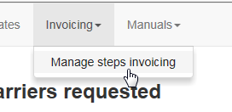
OBJETIVE, SCOPE AND ACCESS
OBJETIVE: Control the invoicing process for customer-property items.
SCOPE: For all those concepts owned by the customer (toolings, assembly lines, development costs, etc)
ACCESS:

Slide 3
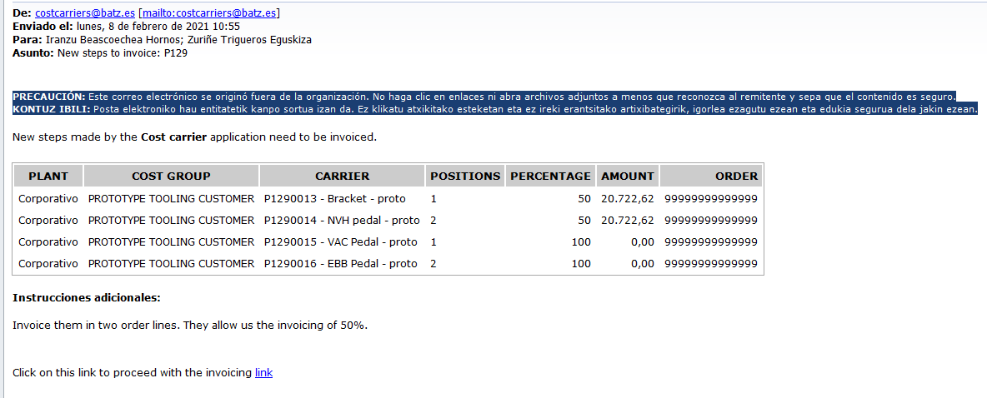
INVOICING I
The person responsible for invoicing will receive a new email when the project leader requests the invoicing of some project carriers.
Additional Instructions:
1
Click on the message link

Slide 4
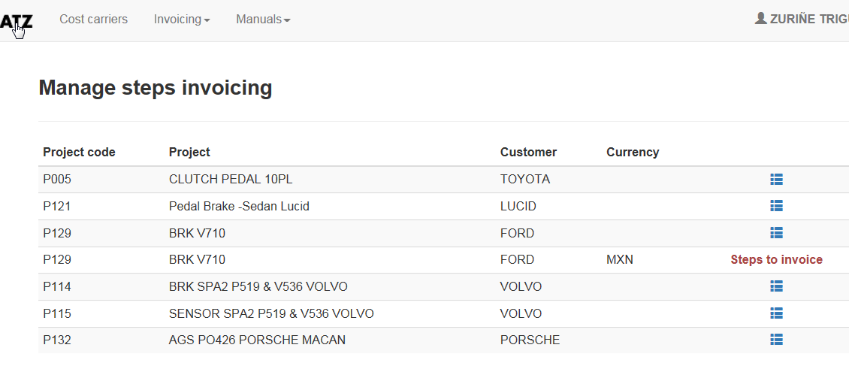
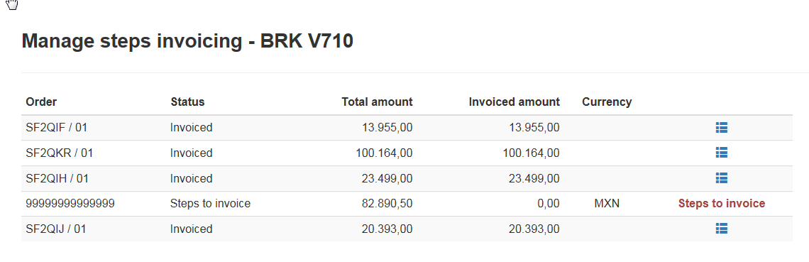
INVOICING II
This project has some steps to invoice.
2
Show the order lines to be invoiced.
3

Slide 5
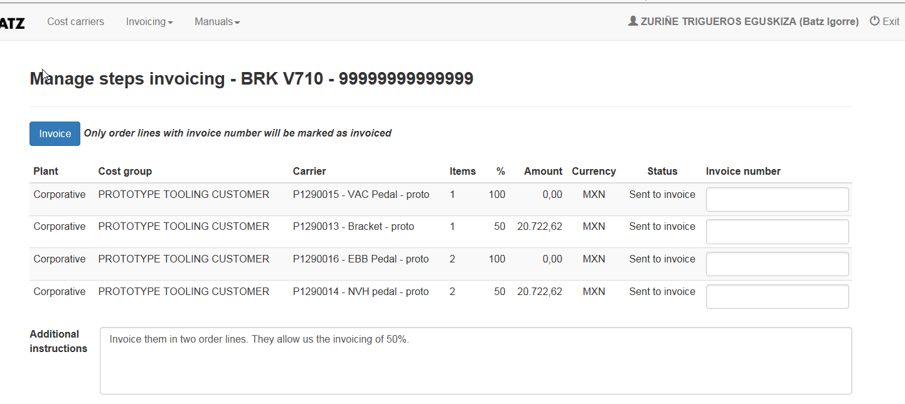
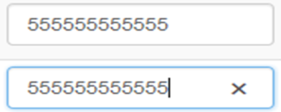
INVOICING III
Items: Position/Item number (one or more) of the customer order that matches with the carrier
%: Percentage invoiced . The default value is 100
Amount: Amount to be invoiced. If the value is 0, that carrier should NOT appear on the invoice. TWO decimal places allowed.
Currency: Currency in which it must be invoiced.
Additional Instructions: Instructions or additional info for the invoicing person.
Enter the invoice number, after sending the invoice.
5
Click on “Invoice”
4

