Slide 1


BATZ
AUTOMOTIVE SYSTEMS
Meeting your challenges
COST CARRIERS APPLICATION
COST CARRIERS OPENING
July 2020

Slide 2
OBJETIVE, SCOPE AND ACCESS
OBJECTIVE: Associate more information (metadata) with the cost carriers (budget, SOP, amount paid by customer, etc.), than can be filled in from the ERP (Xpert or Navision depending on the plant). The cost carriers will be created in BOTH APPLICATIONS (in Cost carriers and in the ERP) and will be associated by carrier code. The main objective is to improve substantially in data analysis capacity, making easy data exploitation because it is digitized.
SCOPE: All cost carriers regarding to Industrialization, Predevelopment, Modification and Advance projects will be requested through this application.
ACCESS: Intranet icon.

Slide 3
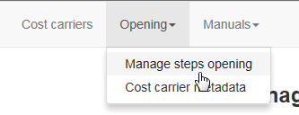
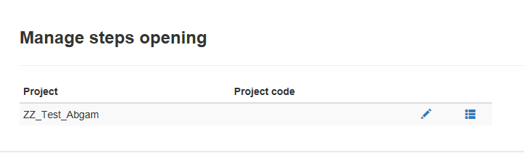
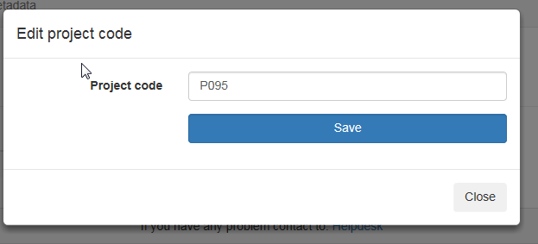
MANAGE STEPS OPENING - I
2
“Opening” + “Manage steps opening”→ List of projects with steps already approved waiting for code.
1
The first thing to do is to assign the project code. This is carried out always by financial CORPORATIVE clicking on the pencil.
3
2-Write the code+ “Save”
4

Slide 4
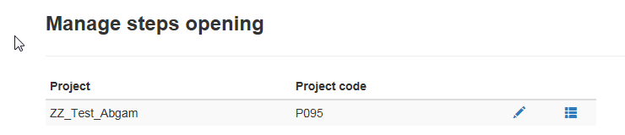
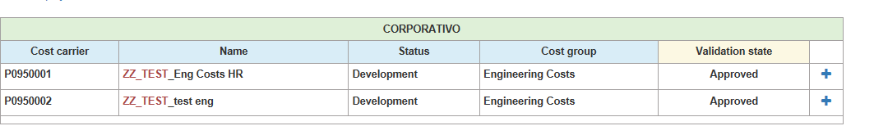
MANAGE STEPS OPENING - II
“Manage Steps Opening” view shows:
“Steps to Open”→ By project, steps that should be created in the ERP (Xpert/Navision) because they have been approved.
_{(Go to steps detail)}→ It shows all the steps that have been opened for that project. At the moment, there are no pending steps to open.
Steps to OPEN→All these steps must be opened in the ERP. It is recommended to use the code + name that the list proposes
5
AFTER CREATING THE COST CARRIERS IN XPERT.
select “+” to create their metadata within this application
6

Slide 5
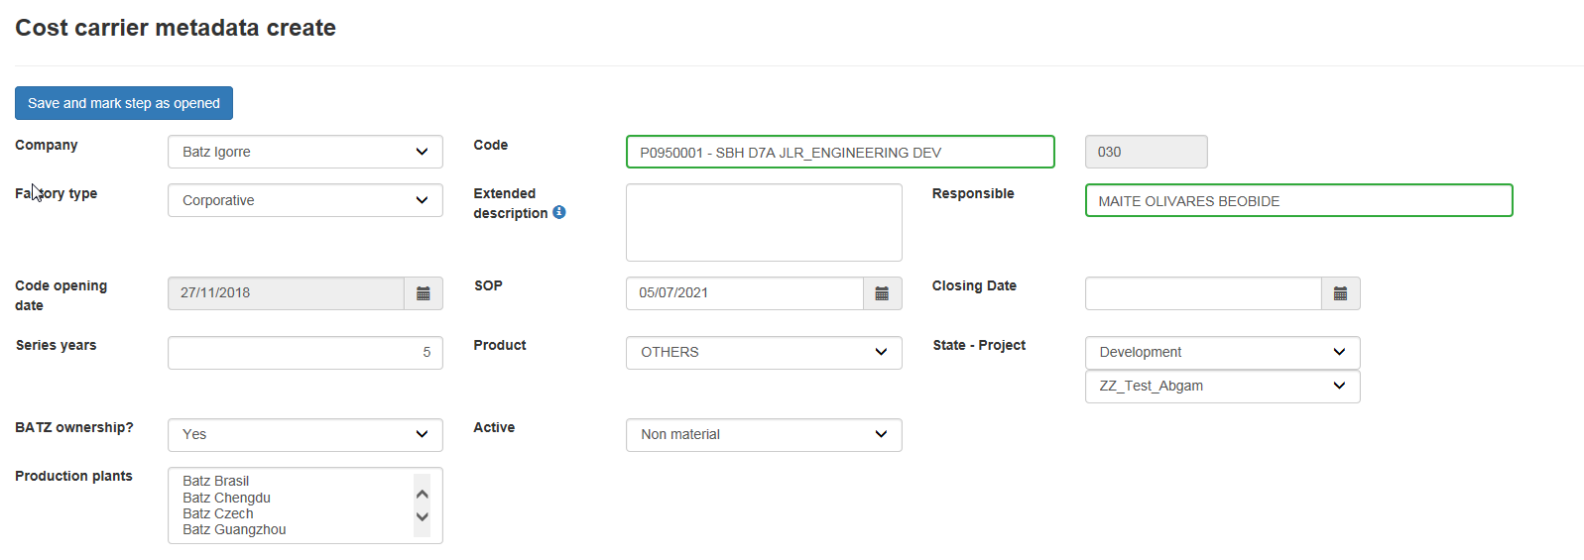
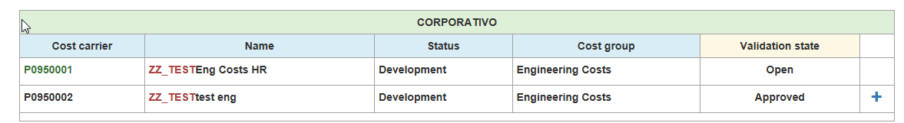
MANAGE STEPS OPENING - III
5-Click “Save and mark step as opened”
7
All fields are already filled in. The "Code" field shows the step that XPERT has with that code.
Repeat 6 (“+”) and 7 ("Save and mark step as opened“) until all steps are in opened state
8

Slide 6
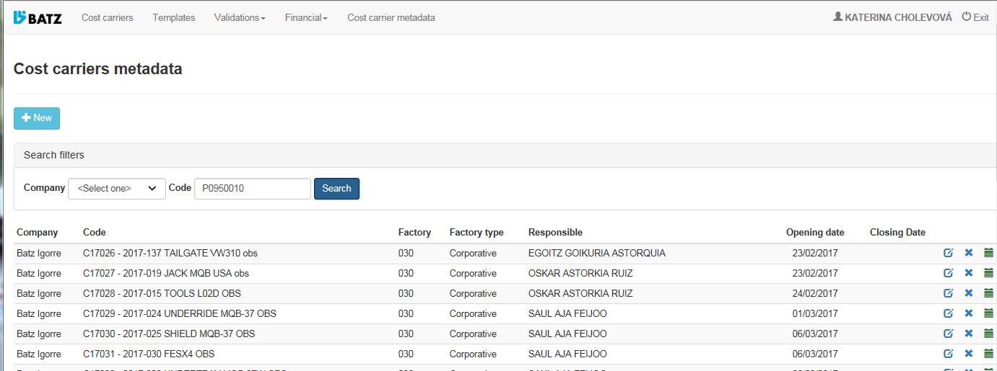
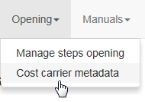

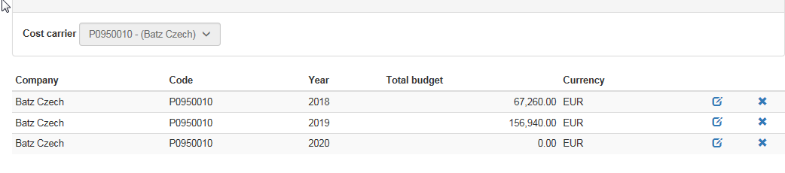
COST CARRIERS SEARCH
1
Write Code+ “Search”
2
Search result
Annual Budget

