Slide 1


BATZ
AUTOMOTIVE SYSTEMS
Meeting your challenges
COST CARRIERS APPLICATION
VALIDATOR
August 2022

Slide 2
OBJETIVE, SCOPE AND ACCESS
OBJETIVE: Improve the cost carrier request process for new projects or modifications. Improve the economic monitoring of the project, reduce the time to obtain indicators.
SCOPE: All cost carriers regarding to Industrialization, Advance, Predevelopment and ECO (change) projects will be requested through this application.
ACCESS: Intranet icon

Slide 3
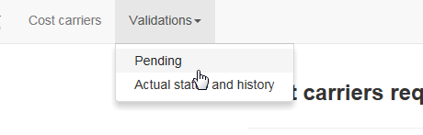
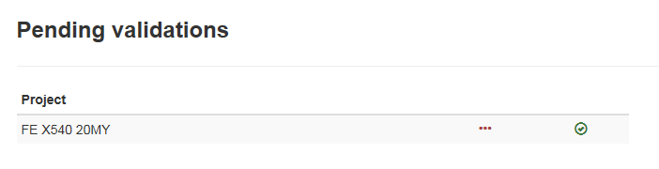


PENDING VALIDATIONS. ACCESS.
“Validations” + “Pending”. List of projects with expenses pending my approval.
2
1
Pending validations.
Pending validations: To see the new request regarding that project
Totals: All approved project expenses

Slide 4
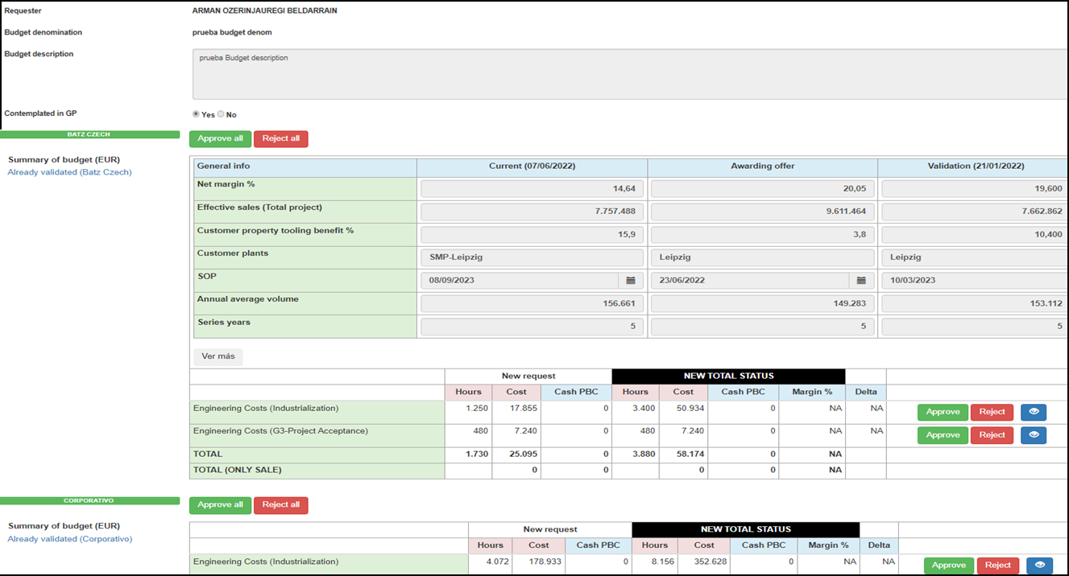
PENDING VALIDATIONS. VALIDATION DETAILS.
Label or name with which this request will be saved
In industrialization projects it is used to explain the evolution of the economic concepts collected in General info table of the previous validation. In the other types of projects it is used to describe projects.
Only for industrialization projects, It shows the evolution of the concepts of the table in the validations that have been approved and their value in the current validation.
each PLANT, amount requested and its margin (steps grouped by cost group, to see all the steps, click on “See steps details”). If this part is empty (no expenses are requested) it is because the validation of the "General info" box is required
New Request: Amount requested in the current validation
NEW TOTAL STATUS:
Amount already approved + New request

Slide 5
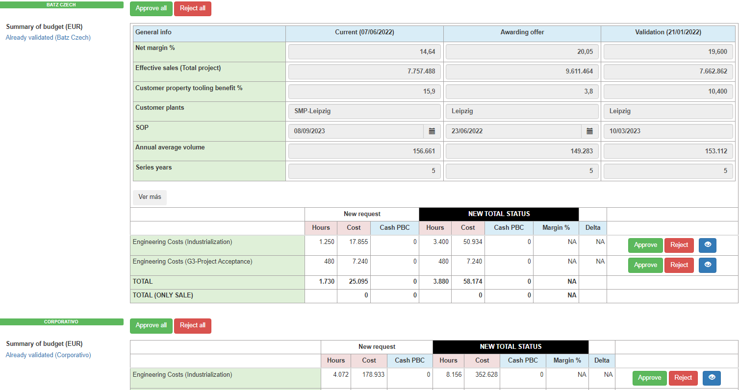
PENDING VALIDATIONS. OPTIONS TO APPROVE/REJECT I.
4
Option A
4
Options to Approve/Reject
OPTION A: Approved / Rejection of all PLANT expenses
OPTION B: Approved / Rejection of all expenses of the COST GROUP
OPTION C: Approved / Rejection of each STEP
Option B
Option A
Option B

Slide 6
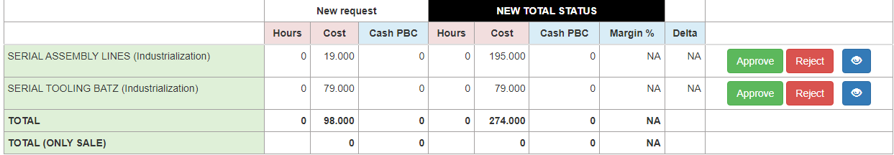
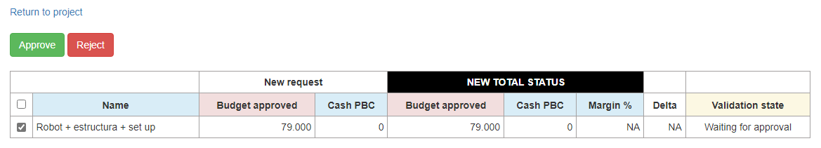
PENDING VALIDATIONS. OPTIONS TO APPROVE/REJECT II.
Options to Approve/Reject
OPTION A: Approved / Rejection of all PLANT expenses
OPTION B: Approved / Rejection of all expenses of the COST GROUP
OPTION C: Approved / Rejection of each STEP
4
Option C

Slide 7
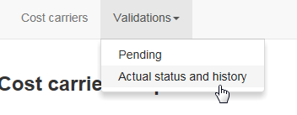
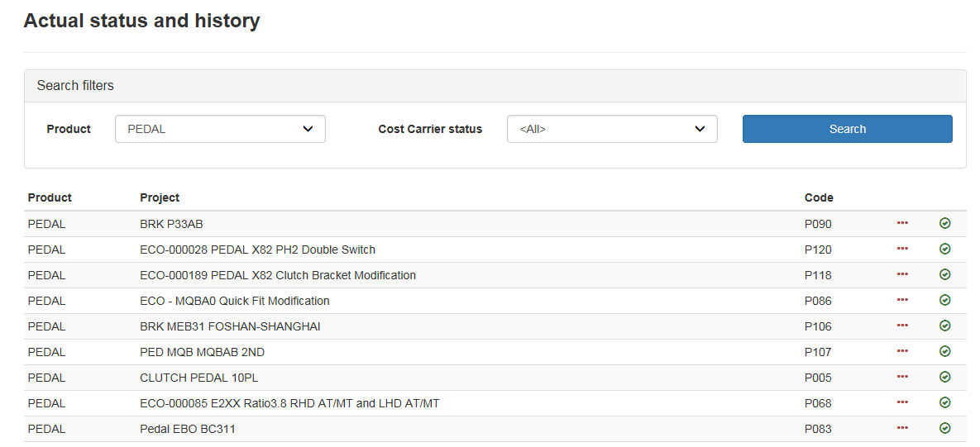
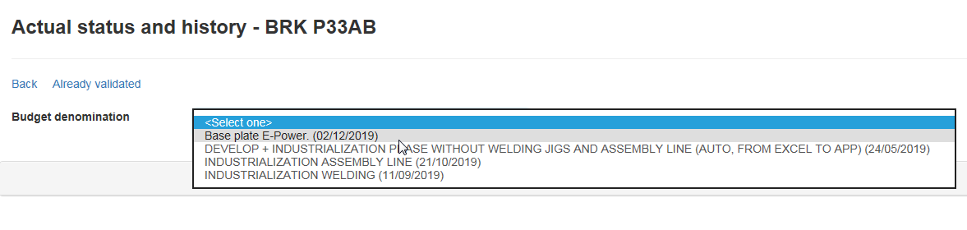
VALIDATIONS HISTORY. ACCESS.
2
“Validations” + “Actual status and history”. List of projects with their validation history and current status
1
Select Product and / or status + “Search”
3
4

