Slide 1

787,000 moved households
9 million documents
£18k per year
The software management system for independent letting agencies
Easy. Organised. Sorted.

Slide 2



Meet Dave
Meet Sam

Slide 3


Reserving by Phone

Slide 4

Paying the Deposit

Slide 5


Emailing Personal Details

Slide 6
Meet Robin
Notes: Robin’s demographic is parent to act as guarantor since
sam is a student or young person

Slide 7

Posting Robin's Details
Notes: Robin the guarantor uses the post. He sends guarantor information like passport, bank statement and bills as proof of money/address

Slide 8

Sending Tenancy Agreement
Notes: Dave the agent gives tenancy agreement to sam the tenant to take home, read and sign

Slide 9

Dave is out of the office…
Meet Andy!
Notes: Sam the tenant goes to the office to hand in his signed tenancy Agreement. Dave the agent is out. Andy is another estate agent at the same agency who takes the paper tenancy agreement.

Slide 10
Sending Guarantor Form
Notes: Dave the agent is back and emails Robin the guarantor a guarantor form to sign.

Slide 11
Receiving Guarantor Form
Notes: Robin the guarantor posts it back to Dave the agent

Slide 12

What about for 5 tenants?
What about 100 properties…???
Notes: this is only for 1 property that the estate agency lets. What if the estate agency had 100 properties?

Slide 13





Meet The Team…
Murat FINANCE
Hamish MARKETING
Peter DESIGN
Aimen OPERATIONS
Harry CUSTOMER RESEARCH

Slide 14
What if Dave had Rent-2-End?
Tenants
Guarantors

Slide 15
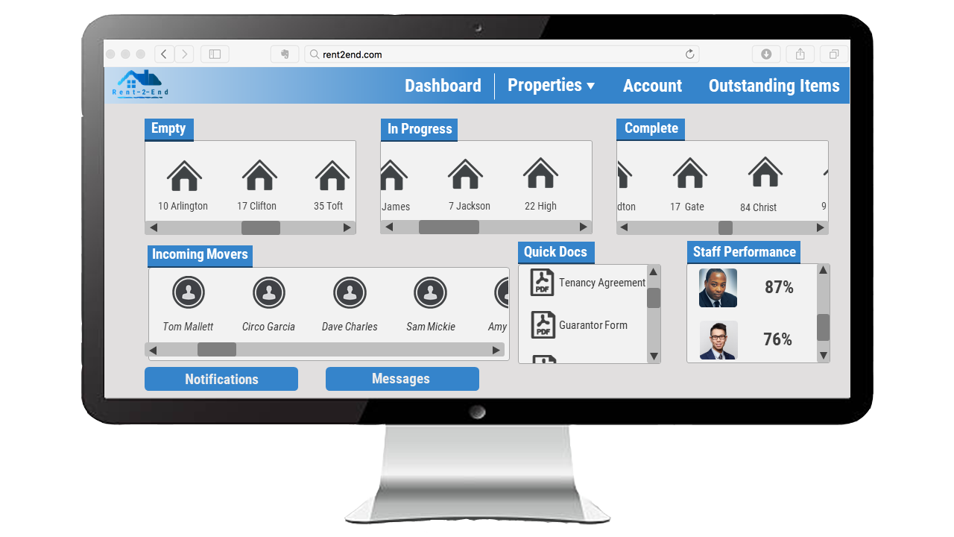



What if Dave had Rent-2-End?
Easy. Organised. Sorted.
Tenants
Guarantors

Slide 16




Market
TAM
9500 Agencies
7.2 million
2025
SAM
5700 Agencies
5.4 million
2014
SOM
800 Agencies

Slide 17

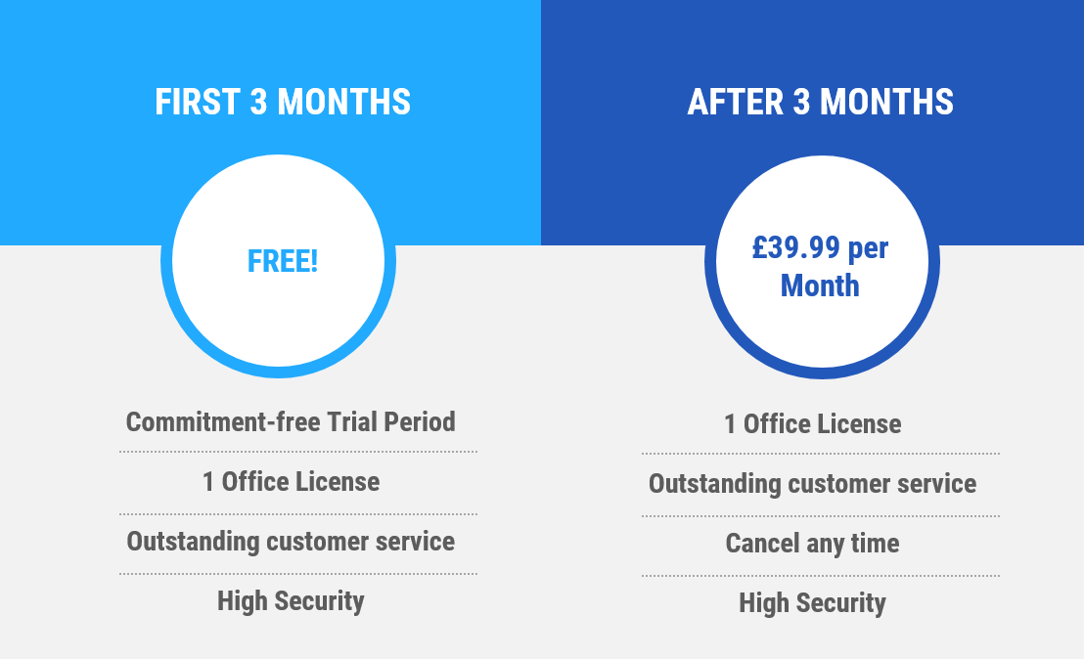


Pricing
Standard Practice
‘Goodlord’
Automated
Strategy
Lock-in Strategy
Out Price
Out Compete
Trial Period
Hassle-Free UI
Excellent
Customer Service
Price per month
£1500
£50 + fees
£39.99

Slide 18


Finances
£25k investment
3 months
Phase 1
£150k investment
9 months
Phase 2
Revenue
2+ years
Phase 3

Slide 19
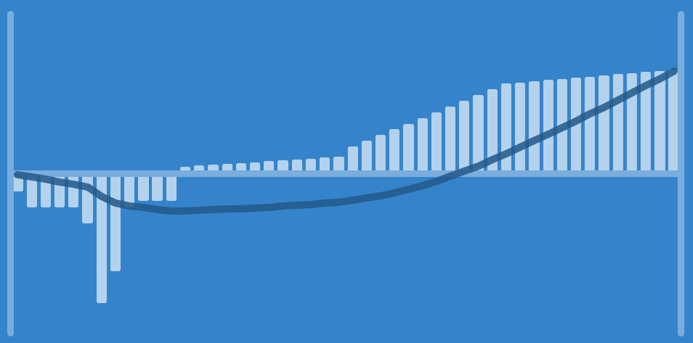
Finances
Year 4
50
700
Sales: 890
Profit: £360.6k
350
25
Cumulative Cash Flow (£1000s)
Net Cash Flow (£1000s)
0
0
-350
-25
Loss: £170k
Profit: £38.6k
Profit: £213.8k
Sales: 50
Sales: 170
Sales: 770
-700
Year 1
Year 2
Year 3
-50
1
2
3
Year

Slide 20
Thank you. Any questions?
£150k for 20%
Valuation of £1.8 Million in 4 Years
140% ROI

Slide 21
Annex: Costs Breakdown

Slide 22
Annex
Risk
Mitigation
Market share reduced by competition
S.W.O.T to stay competitive
Functional requirements unfit
Understand market- Beta testing
Unforeseen technical challenges
Agile software development
Unqualified management
Mentoring contacts
Low customer acquisition
Marketing

