Slide 1
Agenda
August 8, 2019

Slide 2
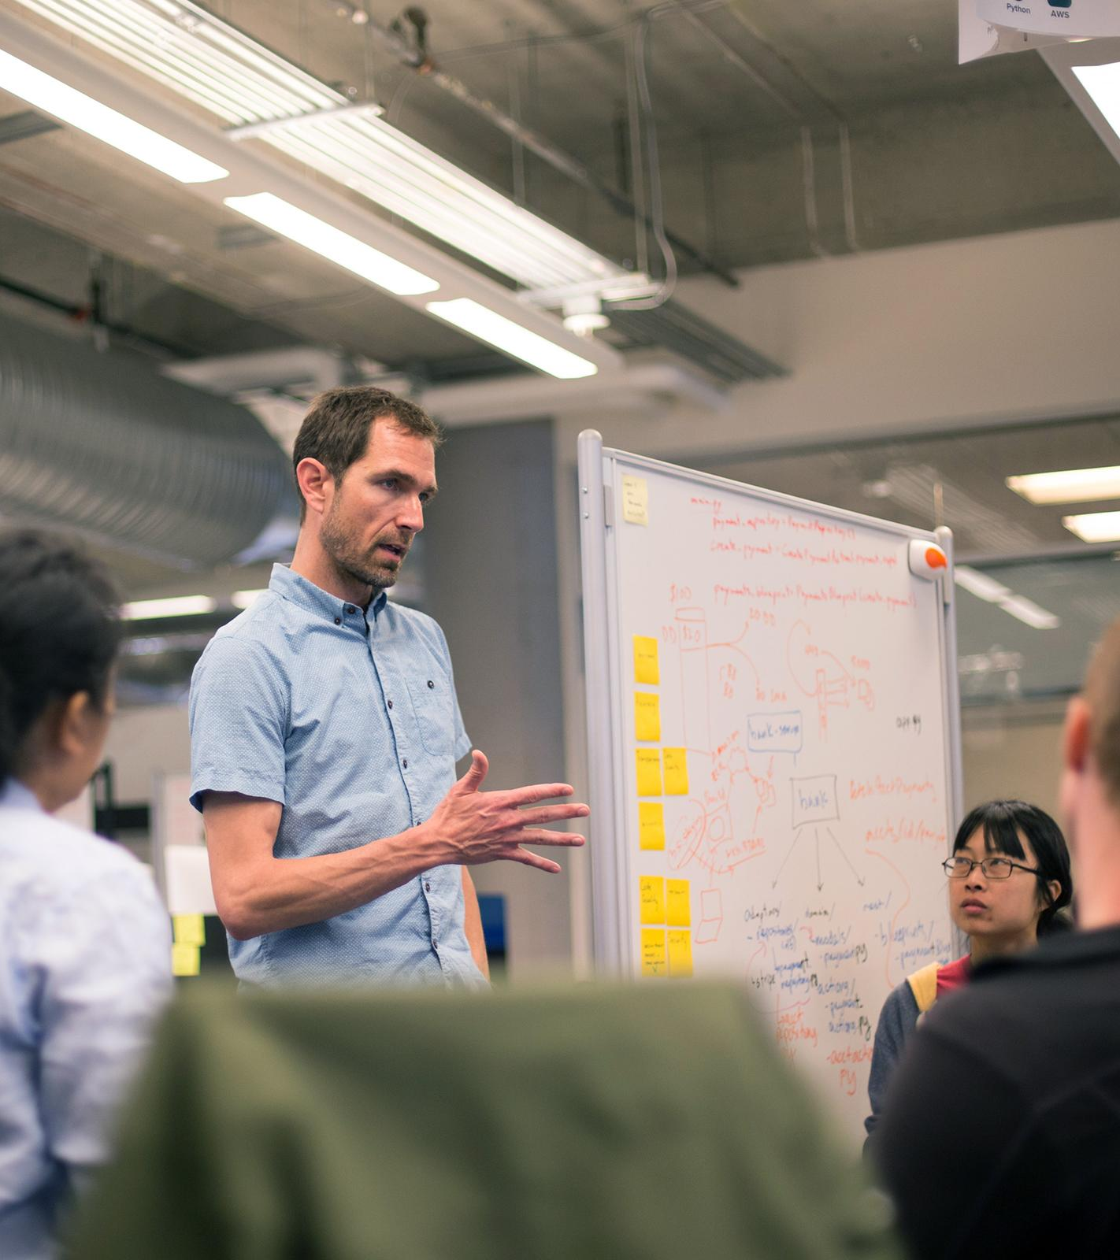
Agenda
 | Start | End
PCF 101 (Platform, Apps Manager, Services, etc) | 9:00 | 9:45
.NET on PAS | 9:45 | 10:15
Steeltoe Overview | 10:15 | 10:30
Lab 0 - Environment Setup | 10:30 | 10:45
Break | 10:45 | 10:55
LAB 1 - Connectors | 10:55 | 12:00
Lunch | 12:00 | 1:00
Configuration Overview and Demo | 1:00 | 1:15
Lab 2 - Configuartion | 1:15 | 2:00
Service Discovery Over and Demo | 2:00 | 2:15
Lab 3 - Service Discovery | 2:15 | 3:00
Break | 3:00 | 3:15
Fault Tolerance Overview and Demo | 3:15 | 3:30
Lab 4 - Circuit Breaker | 3:30 | 4:15
Overflow/Open Topics and Discussion | 4:15 | 4:45
Retro | 4:45 | 5:00

