Slide 1

1M1B AI FOR SUSTAINABILITY VIRTUAL INTERNSHIP
In Partnership with IBM SkillsBuild & AICTE
Anna-Setu
AI-Powered Campus Food Rescue Network
Final Solution Submission File
Pankhuri Govila • 1M1B AI for Sustainability Virtual Internship

Slide 2


THE MANDATE
Contextual SDG Alignment
Anna-Setu is engineered against two interlocking United Nations Sustainable Development Goals.
12
PRIMARY TARGET
2
SECONDARY TARGET
SDG 12: Responsible Consumption
& Production
SDG 2: Zero Hunger
Objective Framework: Halving macro-level municipal and consumer-level food losses throughout standard operational pipelines by 2030.
Objective Framework: Safeguarding high-quality nutritional continuity and access loops across peripheral communities using safely managed surplus channels.
ANNA-SETU
02

Slide 3




THE PROBLEM
Targeted Institutional Gaps
How might we use AI to accurately forecast daily meal demand and intelligently match unavoidable surplus food with verified local shelters, so that campus dining ecosystems and food-insecure communities can become more sustainable?
CORE INSTITUTIONAL FRICTIONS IDENTIFIED
Rigid Menu Cycles
Default Overproduction
No Compliance Layer
Fixed, recurring operational menus lack structural input sensitivity tools - blind to real-time demand signals.
Kitchen crews default to fixed overproduction margins to avoid customer friction, with no data to justify the buffer.
Absence of standard compliance layers for local food drops blocks safe, confident redistribution logistics.
ANNA-SETU
03

Slide 4




THE SOLUTION
Deep-Dive System Solution
MODULE 1
MODULE 2
The Advisor
The Pipeline
Collects calendar variations, weather conditions, and attendance trends to deliver explicit kitchen preparation guides - with stated confidence metrics - before every shift starts.
Automatically formats data inputs into clean, compliance-checked notifications the moment verified surplus limits are detected - routing them to the nearest matched shelter.
TARGET USERS
Dining Hall
Managers
Local NGO
Shelter Operators
Sustainability
Oversight Committees
ANNA-SETU
04

Slide 5





THE ARCHITECTURE
Strategic System Architecture
DATA FLOW MECHANICS
1
2
3
4
5
Swipe Logs +
Context Parameters
ML Demand
Forecasting
Cafeteria
Optimization
RAG Compliance
Verification
IBM Granite
Broadcast Dispatch
This pipeline is fully implemented as a working prototype.
See it live in action → “Anna Setu Demo App Screenshot” on the next slide.
ANNA-SETU
05

Slide 6






THE PROMPTING LAYER
System Prompt Engineering Matrix
SYSTEM DIRECTIVE
STRUCTURED OUTPUT MATRIX
“You are an automated, secure communications dispatch layer processing details for Anna-Setu. Map out concise parameters for text notification alerts without adding unverified details.”
Yields highly clear, standardized text messages mapping:
Localized surplus items
Verified volumes on hand
Clear timing deadlines
Explicit geographic coordinates
This exact prompt logic runs inside a live, deployed prototype.
See it live in action → “Anna Setu Demo App Screenshot” on the next slide.
ANNA-SETU
06

Slide 7
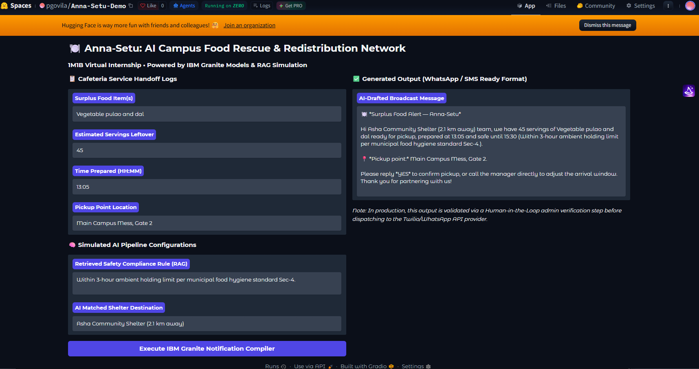
APP SCREENSHOT
Anna Setu Demo Application Screenshot
A fully functional Gradio prototype simulating the end-to-end Anna-Setu pipeline - deployed live on Hugging Face Spaces.
WHAT THIS DEMO SHOWS
Cafeteria Handoff Logs
Structured input: surplus item, servings, prep time, pickup point.
RAG Compliance Retrieval
Live-retrieved safety rule: 3-hour ambient holding limit, Sec-4.
AI-Matched Shelter
Nearest verified partner auto-selected - Asha Community Shelter.
Granite Broadcast Output
● LIVE ON SPACES
Ready-to-send WhatsApp/SMS alert, drafted end-to-end by the model.
ANNA-SETU
07

Slide 8
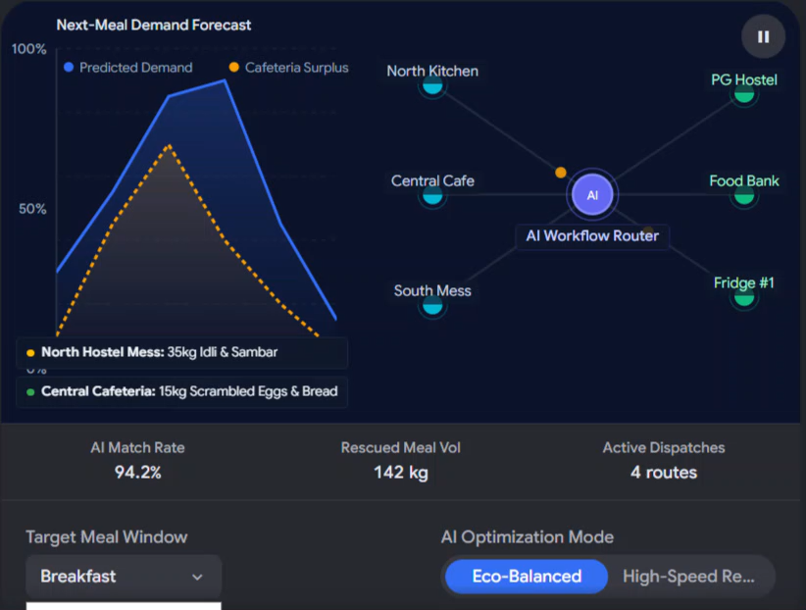
DASHBOARD DEMO
Visual Architecture and Workflow AI Dashboard
ANNA-SETU
08

Slide 9


THE IMPACT
Expected Project Impacts
15-25%
↓ CH₄
24/7
Economic Vectors
Environmental Vectors
Social Vectors
Target reduction in raw food ingredient overproduction losses, lowering municipal waste-hauling costs.
Prevents leftover food batches from ending up in local landfills, lowering methane gas production variables.
Establishes predictable, safe access channels to direct unused campus food resources directly to community centers.
ANNA-SETU
09

Slide 10


THE SAFEGUARDS
Ethically Governed Operations
Mandatory Responsible AI Considerations
FAIRNESS
TRANSPARENCY
Demand forecasting metrics rely entirely on aggregated, de-identified cohort traffic logs. The system treats all dining complexes equally without tracking individual student habits or preferences.
The dashboard delivers plain-language explainability matrices alongside every projection (e.g., “12% turnout reduction predicted due to mid-semester exam scheduling”), enabling kitchen staff to confidently audit or override recommendations.
ETHICS
PRIVACY
All system actions are checked by a strict rules engine. The tool automatically blocks any redistribution alert if calculations show a food batch has exceeded local ambient storage timelines.
Meal validation inputs are stripped of student identifiers before being processed, ensuring no individual health profiles or eating habits are stored or shared.
ANNA-SETU
10

Slide 11


DEPLOYMENT
Repository & System
Deployment Anchors
Live artifacts confirming Anna-Setu functions as a working, deployable system.
GITHUB PROJECT FILES
https://github.com/pgovila/Anna-Setu-Project
INTERACTIVE LIVE SIMULATION URL
huggingface.co/spaces/pgovila/Anna-Setu-Demo
Anna-Setu - Bridging Campus Surplus and Community Sustenance
11

