Slide 1
Karpagam College of Engineering (Autonomous)
School of Computer Applications
O₃
Air Quality Analysis using R
Predicting ground-level ozone from weather conditions
GOWTHAMRAJ P
MCA | II Year / III Sem / Sec A
23CAP317 – R Programming | Mini Project 2025-2026

Slide 2
Problem Statement
Ground-level ozone forms when sunlight, heat and pollutants react; it harms lungs and is hard to anticipate by eye.
Ozone depends on several interacting weather factors: solar radiation, wind speed and temperature.
Problem: build predictive models that estimate the ozone level (ppb) of a day from its weather, and flag high-ozone days.
Use: early warnings and health advisories for sensitive groups.
153
4
daily records
(May–Sep 1973)
measured variables
+ Month, Day
3
R
model families:
linear, forest, logistic
all analysis
in one script

Slide 3
Objectives of the Project
1
Load, inspect and clean the New York air quality dataset
2
Explore patterns and relationships using statistics and plots
3
Identify statistical problems: missing data, skew, outliers, collinearity
4
Build regression models for Ozone: linear, log-linear, polynomial, random forest
5
Classify high-ozone days with logistic regression and predict new days

Slide 4
Data Structures Used in the Project
temp_vec <- c(67, 72, 74, 62, 56) # vector
month_fct <- factor(c("May","Jun","Jul",
"Aug","Sep")) # factor
sample_mat <- matrix(c(41,190,7.4,
36,118,8.0),
nrow = 2, byrow = TRUE) # matrix
sample_lst <- list(station = "New York",
year = 1973,
pollutant = "Ozone") # list
air <- read.csv("aq.csv") # data frame
Vector: one column of readings
Factor: Month as a category
Matrix: numeric block of days × variables
List: dataset metadata and model outputs
Data frame: the main table (153 × 6)

Slide 5
Loading the Dataset
> air <- read.csv("aq.csv")
> head(air)
Ozone Solar.R Wind Temp Month Day
1 41 190 7.4 67 5 1
2 36 118 8.0 72 5 2
3 12 149 12.6 74 5 3
4 18 313 11.5 62 5 4
5 NA NA 14.3 56 5 5
6 28 NA 14.9 66 5 6
Rows 5 and 6 already show NA (missing) values.
Ozone is the target; Solar.R, Wind, Temp and Month are predictors.
37
7
missing Ozone values
missing Solar.R values

Slide 6
Anatomy of the Dataset
153 rows × 6 columns. Source: New York State Dept. of Conservation (ozone) and the National Weather Service (weather), 1973; loaded from the Rdatasets CSV of R's airquality data.
Variable | Meaning | Unit | Role
Ozone | Mean ozone, 1–3 pm (Roosevelt Island) | ppb | Target
Solar.R | Solar radiation, 8 am–12 pm (Central Park) | Langley | Predictor
Wind | Mean wind speed, 7–10 am (LaGuardia) | mph | Predictor
Temp | Maximum daily temperature (LaGuardia) | °F | Predictor
Month, Day | Calendar month (5–9) and day (1–31) | – | Predictor / ID

Slide 7
Structure of the Dataset
> str(air)
'data.frame': 153 obs. of 6 variables:
$ Ozone : int 41 36 12 18 NA 28 23 19 8 NA ...
$ Solar.R: int 190 118 149 313 NA NA 299 99 19 194 ...
$ Wind : num 7.4 8 12.6 11.5 14.3 14.9 8.6 13.8 20.1 8.6 ...
$ Temp : int 67 72 74 62 56 66 65 59 61 69 ...
$ Month : int 5 5 5 5 5 5 5 5 5 5 ...
$ Day : int 1 2 3 4 5 6 7 8 9 10 ...
Ozone, Solar.R, Temp, Month, Day are integers; Wind is numeric (decimal).
All predictors are numeric, so no encoding is needed for the models.

Slide 8
Summary of the Dataset
> summary(air)
Ozone Solar.R Wind Temp
Min. : 1.00 Min. : 7.0 Min. : 1.700 Min. :56.00
1st Qu.: 18.00 1st Qu.:115.8 1st Qu.: 7.400 1st Qu.:72.00
Median : 31.50 Median :205.0 Median : 9.700 Median :79.00
Mean : 42.13 Mean :185.9 Mean : 9.958 Mean :77.88
3rd Qu.: 63.25 3rd Qu.:258.8 3rd Qu.:11.500 3rd Qu.:85.00
Max. :168.00 Max. :334.0 Max. :20.700 Max. :97.00
NA's :37 NA's :7
Month Day
Min. :5.000 Min. : 1.0
1st Qu.:6.000 1st Qu.: 8.0
Median :7.000 Median :16.0
Mean :6.993 Mean :15.8
3rd Qu.:8.000 3rd Qu.:23.0
Max. :9.000 Max. :31.0
Ozone: mean 42.1 but median 31.5, so it is right-skewed (max 168 ppb).
Temp ranges 56–97 °F; Wind 1.7–20.7 mph.
NA counts: Ozone 37, Solar.R 7.

Slide 9
Control Structures and Functions
ozone_category <- function(x) {
if (is.na(x)) "Unknown"
else if (x <= 30) "Good"
else if (x <= 60) "Moderate"
else if (x <= 90) "Unhealthy"
else "Very Unhealthy"
}
for (nm in c("Ozone","Solar.R","Wind","Temp"))
col_means[nm] <- mean(air[[nm]], na.rm=TRUE)
i <- 1 # while loop
while (i <= nrow(air) &&
(is.na(air$Ozone[i]) || air$Ozone[i] <= 100))
i <- i + 1
Good Moderate Unhealthy Very Unhealthy Unknown
57 28 20 11 37
Column means (for loop):
Ozone Solar.R Wind Temp
42.13 185.93 9.96 77.88
First row with Ozone > 100 ppb (while loop): row 30 | Month 5 Day 30 Ozone 115
if / else if / else classifies each day into an ozone band.
for loop computes column means; while loop finds the first day above 100 ppb (30 May, 115 ppb).
57 days Good, 28 Moderate, 20 Unhealthy, 11 Very Unhealthy; 37 Unknown (NA).

Slide 10
Lists and Data Frames in the Model
describe_var <- function(v) {
v <- v[!is.na(v)]
list(n = length(v), mean = mean(v),
sd = sd(v), min = min(v), max = max(v))
}
stats_list <- lapply(air[, c("Ozone","Solar.R",
"Wind","Temp")], describe_var)
monthly <- air %>% group_by(Month) %>%
summarise(days = n(),
mean_ozone = mean(Ozone, na.rm = TRUE),
mean_temp = mean(Temp),
mean_wind = mean(Wind))
The list stores n, mean, sd, min and max per variable.
The data frame groups days by month.
July and August average about 59 ppb, over twice May (24 ppb): ozone follows the hot, still summer months.
Month days mean_ozone mean_temp mean_wind
1 5 31 23.61538 65.54839 11.622581
2 6 30 29.44444 79.10000 10.266667
3 7 31 59.11538 83.90323 8.941935
4 8 31 59.96154 83.96774 8.793548
5 9 30 31.44828 76.90000 10.180000

Slide 11
Stage 1: Data Cleaning
Cleaning decisions
Ozone Solar.R Wind Temp Month Day
37 7 0 0 0 0
Duplicate rows: 0
Complete rows: 111 of 153
Duplicates: none found.
Solar.R (7 NA): filled with the median, 205 Ly.
Ozone (37 NA): rows dropped for modelling. The target is not imputed, to avoid inventing the value being predicted.
Result: 116 complete rows, 0 NA left.
air$Solar.R[is.na(air$Solar.R)] <-
median(air$Solar.R, na.rm = TRUE)
model_df <- air %>% filter(!is.na(Ozone))
153 → 116
rows kept for modelling

Slide 12
Statistical Problems: Data Quality and Distribution
24%
1.21
2 + 3
of Ozone values missing
(37 of 153)
skewness of Ozone
(log scale: −0.55)
outliers by IQR rule
(Ozone, Wind)
Skewness of Ozone: 1.21 | log(Ozone): -0.548
data: air$Ozone
W = 0.87867, p-value = 2.79e-08
data: log(air$Ozone[!is.na(air$Ozone)])
W = 0.97168, p-value = 0.01471
Ozone Solar.R Wind Temp
2 0 3 0
Shapiro-Wilk rejects normality of Ozone (p = 2.8e-08); a log transform reduces the skew, although it stays slightly non-normal (p = 0.015).
Outliers are genuine high-ozone days, so they are kept, not removed.
Consequence: a log-linear model and a tree-based model are worth trying.

Slide 13
Statistical Problems: Relationships and Tests
Test | Result | Conclusion
Pearson: Ozone vs Temp | r = 0.70, p < 2.2e-16 | Strong positive link
Pearson: Ozone vs Wind | r = −0.61, p = 9.1e-13 | Strong negative link
Pearson: Ozone vs Solar.R | r = 0.35 | Moderate positive link
ANOVA: Ozone by Month | F = 7.69, p = 1.8e-05 | Monthly means differ
Welch t-test: Jul–Aug vs others | 59.5 vs 28.3 ppb, p = 1.3e-06 | Peak season much higher
VIF (Solar.R, Wind, Temp) | 1.10, 1.33, 1.43 | No harmful collinearity
Temperature and wind are the strongest signals; the predictors are not redundant (all VIF < 5), so they can sit in one model together.

Slide 14
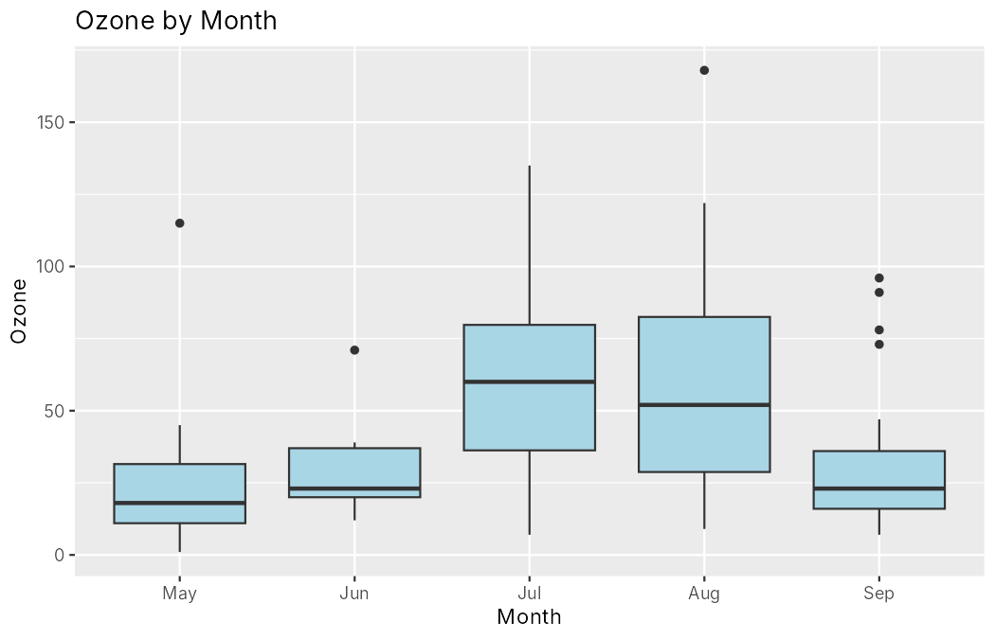
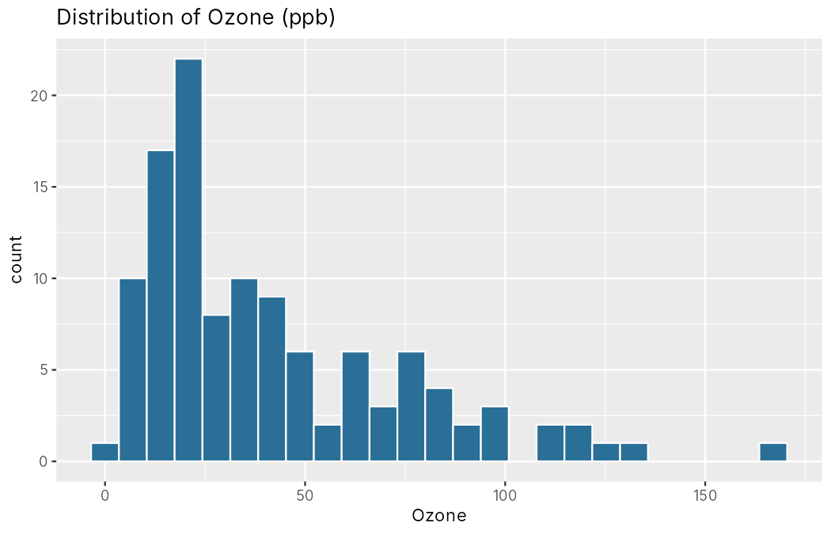
Stage 2: Data Visualization
ggplot(model_df, aes(Ozone)) +
geom_histogram(bins = 25)
Median ozone peaks in July and August.
Ozone is right-skewed; a few days exceed 100 ppb.

Slide 15
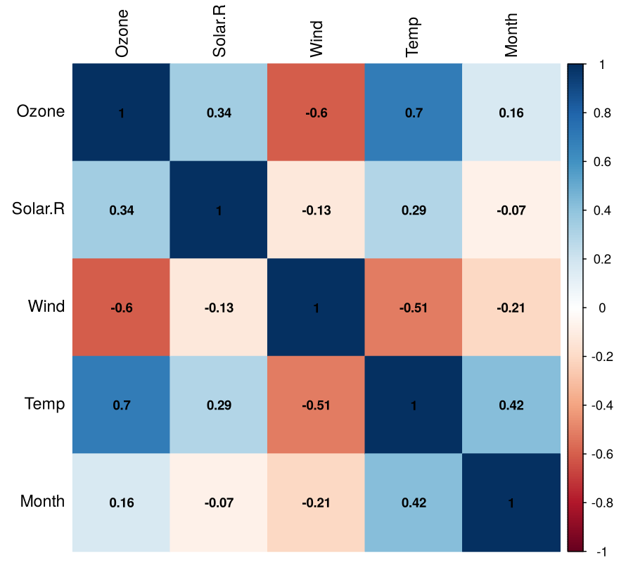
Stage 2: Data Visualization
cor_mat <- cor(model_df)
corrplot(cor_mat, method = "color",
addCoef.col = "black")
Correlation matrix of the numeric features.
Ozone rises with Temp (0.70) and Solar.R (0.34).
Ozone falls as Wind rises (−0.60).
Temp and Wind are themselves correlated (−0.51).

Slide 16
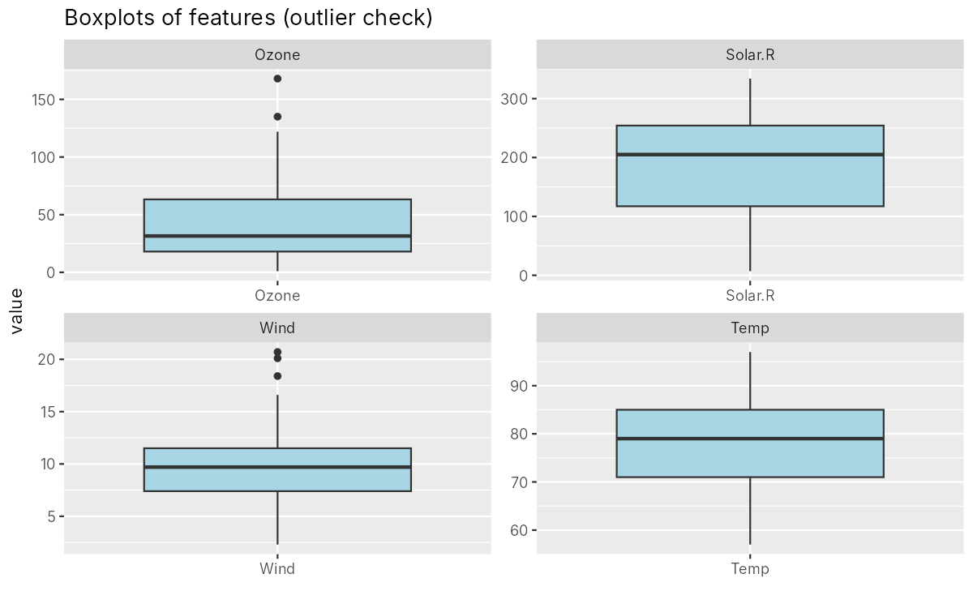
Stage 2: Boxplots for Checking Outliers
Ozone: 2 outliers (the two highest days).
Wind: 3 high-speed outliers.
Solar.R and Temp: none.
All are plausible measurements, so they are kept.

Slide 17
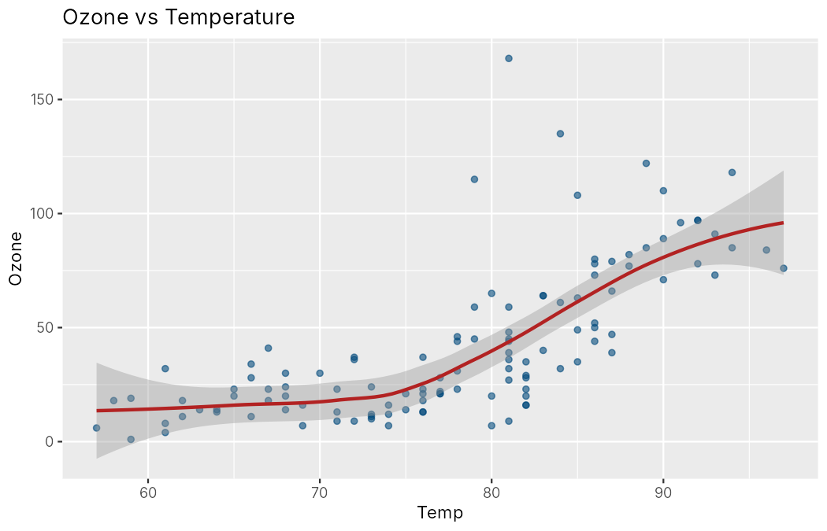
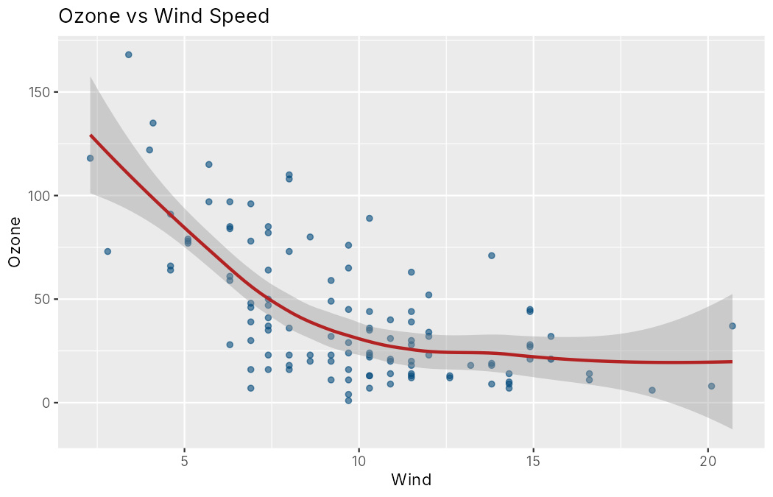
Stage 2: Ozone vs Temperature and Wind
Ozone climbs steeply above about 80 °F and drops as wind speed rises. The curves are not straight lines, which motivates polynomial and tree models.

Slide 18
Stage 3: Data Splitting
80% of the data is used for training and 20% for testing
idx <- createDataPartition(model_df$Ozone, p = 0.8, list = FALSE)
train <- model_df[idx, ]
test <- model_df[-idx, ]
Train rows: 95 | Test rows: 21
The test set is small, so 10-fold × 5 repeated cross-validation is also used for a fairer comparison.
95
21
training rows
test rows

Slide 19
Stage 4: Regression Models Used
A
Multiple Linear Regression
B
Log-Linear Regression
Ozone ~ Solar.R + Wind + Temp + Month
log(Ozone) ~ Solar.R + Wind + Temp
C
Polynomial + Interaction
D
Random Forest (ranger)
Adds Temp², Wind² and Temp×Wind
500 trees, permutation importance
Plus: Logistic Regression (GLM) to classify high-ozone days (> 50 ppb).

Slide 20
Model A: Multiple Linear Regression
> lm_a <- lm(Ozone ~ Solar.R + Wind + Temp + factor(Month), data = train)
> summary(lm_a)
Coefficients:
Estimate Std. Error t value Pr(>|t|)
(Intercept) -67.91402 31.00965 -2.190 0.0312 *
Solar.R 0.05426 0.02792 1.943 0.0552 .
Wind -3.11438 0.76184 -4.088 9.67e-05 ***
Temp 1.76904 0.40505 4.367 3.46e-05 ***
factor(Month)6 -13.71358 10.49560 -1.307 0.1948
factor(Month)7 -5.22338 9.21714 -0.567 0.5724
factor(Month)8 -5.27234 9.35060 -0.564 0.5743
factor(Month)9 -15.65063 7.94271 -1.970 0.0520 .
---
Signif. codes: 0 '***' 0.001 '**' 0.01 '*' 0.05 '.' 0.1 ' ' 1
Residual standard error: 21.96 on 87 degrees of freedom
Multiple R-squared: 0.6073, Adjusted R-squared: 0.5757
F-statistic: 19.22 on 7 and 87 DF, p-value: 2.709e-15
Wind (−3.1 ppb per mph) and Temp (+1.8 ppb per °F) are highly significant.
R² = 0.61 (adjusted 0.58) on training data.
Month dummies are not significant once weather is included.

Slide 21
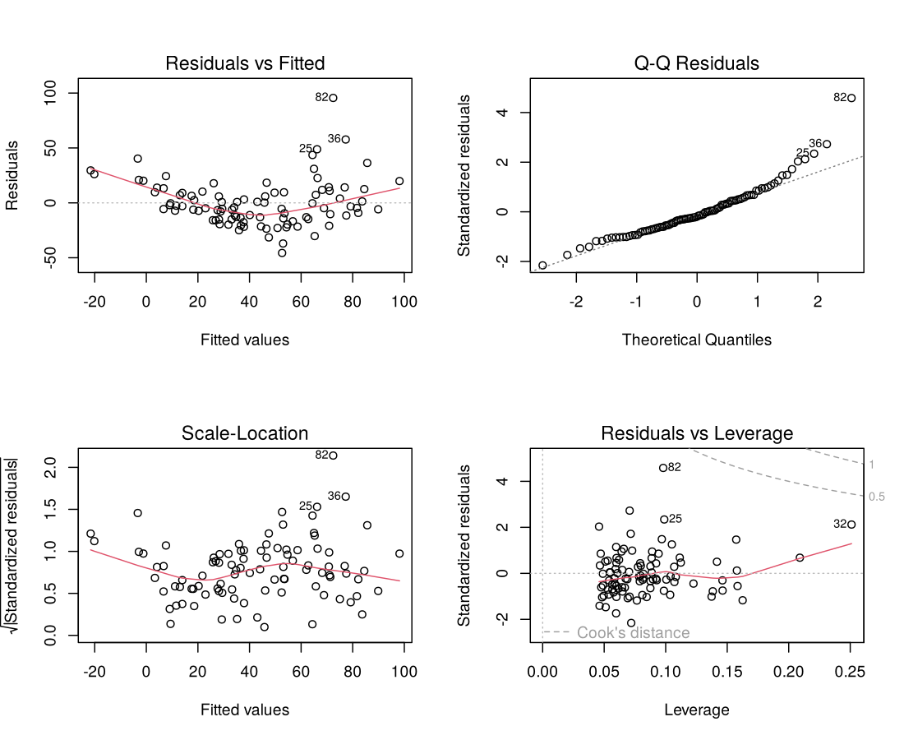
Linear Regression: Diagnostics
Residuals fan out and the Q-Q plot bends upward: right-skewed errors.
Residual Shapiro p = 3.9e-05 confirms non-normality.
A log transform (Model B) lifts training R² to 0.64 and fits better.

Slide 22
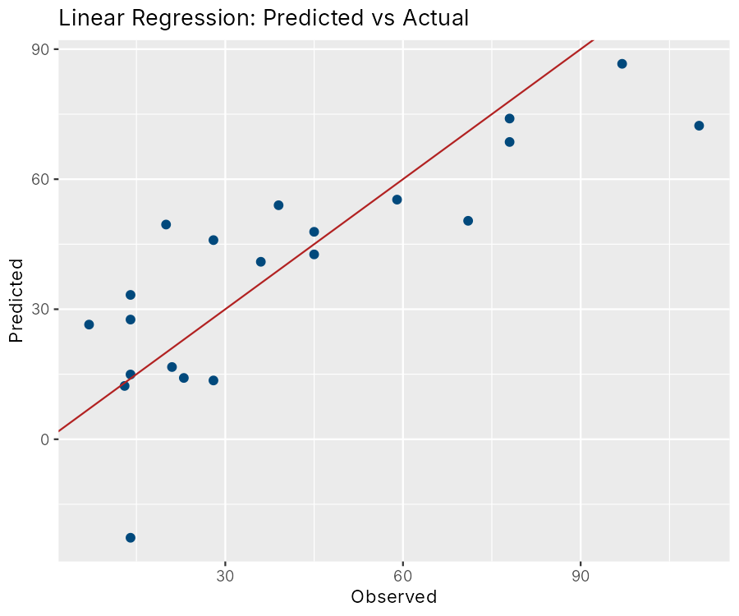
Linear Regression: Actual vs Predicted
Test-set metrics (Model A)
RMSE 17.069
MAE 13.180
R2 0.669
Points follow the line but spread widely, and the model under-predicts the highest days.
Log-linear Model B does better on the test set: RMSE 15.09, R² 0.75.

Slide 23
Model C: Polynomial and Interaction Regression
> lm_c <- lm(Ozone ~ Solar.R + Wind + Temp +
+ I(Temp^2) + I(Wind^2) + Temp:Wind)
Coefficients:
Estimate Std. Error t value Pr(>|t|)
(Intercept) 476.09840 228.71815 2.082 0.040284 *
Solar.R 0.06920 0.02376 2.912 0.004550 **
Wind -23.51669 11.20089 -2.100 0.038633 *
Temp -9.81134 4.83846 -2.028 0.045607 *
I(Temp^2) 0.06669 0.02650 2.517 0.013660 *
I(Wind^2) 0.57725 0.16433 3.513 0.000703 ***
Wind:Temp 0.09979 0.10716 0.931 0.354292
---
Signif. codes: 0 '***' 0.001 '**' 0.01 '*' 0.05 '.' 0.1 ' ' 1
Residual standard error: 19.27 on 88 degrees of freedom
Multiple R-squared: 0.6941, Adjusted R-squared: 0.6733
F-statistic: 33.29 on 6 and 88 DF, p-value: < 2.2e-16
Temp² and Wind² are significant: the effects are curved.
Training R² rises to 0.69 (adjusted 0.67).
Test RMSE 15.55, R² 0.73, better than the plain linear model.

Slide 24
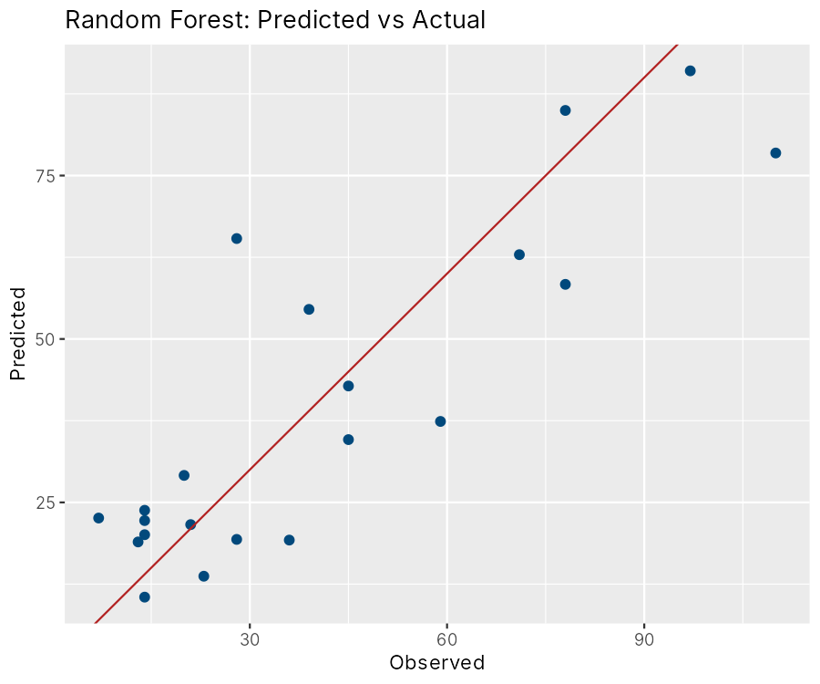
Model D: Random Forest Regression
> rf <- ranger(Ozone ~ ., data = train,
+ num.trees = 500,
+ importance = "permutation")
Type: Regression
Number of trees: 500
Sample size: 95
Number of independent variables: 4
Mtry: 2
Target node size: 5
Variable importance mode: permutation
Splitrule: variance
OOB prediction error (MSE): 326.8074
R squared (OOB): 0.7123916
Test set: RMSE 15.065
MAE 12.043
R2 0.742
Actual vs predicted (test set, 21 days)

Slide 25
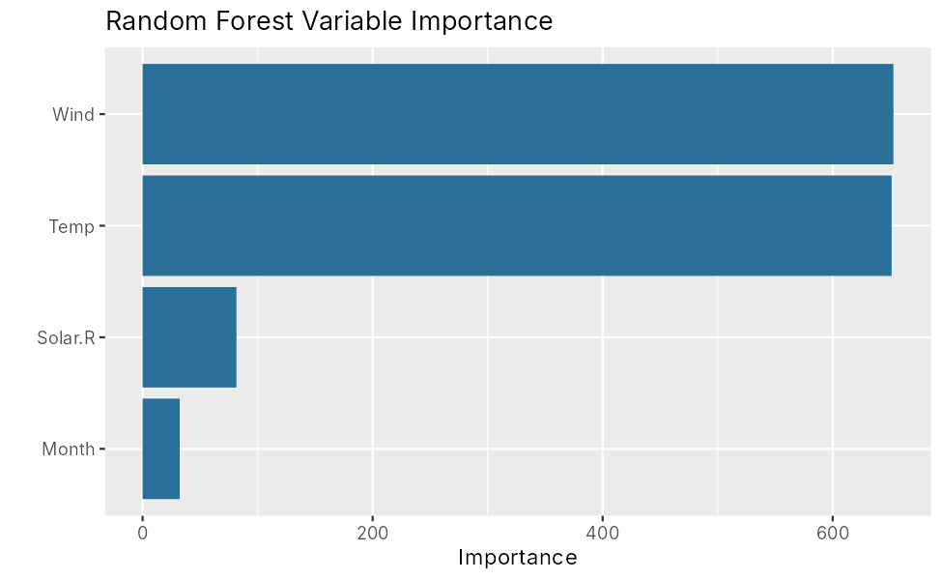
Random Forest: Variable Importance
Wind and Temp dominate, matching the correlation analysis.
Solar.R adds a smaller contribution.
Month adds little once weather is known.

Slide 26
Generalized Linear Model: Logistic Regression
> glm_fit <- glm(HighOzone ~ Solar.R + Wind + Temp,
+ family = binomial, data = train_c)
Coefficients:
Estimate Std. Error z value Pr(>|z|)
(Intercept) -2.980e+01 9.676e+00 -3.080 0.002072 **
Solar.R -1.824e-04 5.663e-03 -0.032 0.974309
Wind -5.087e-01 1.865e-01 -2.728 0.006373 **
Temp 4.059e-01 1.205e-01 3.369 0.000755 ***
Odds ratios
(Intercept) Solar.R Wind Temp
0.000 1.000 0.601 1.501
Reference
Prediction 0 1
0 15 2
1 0 4
Accuracy : 0.9048
Kappa : 0.7407
Sensitivity : 0.6667
Specificity : 1.0000
Balanced Accuracy : 0.8333
Odds of a high-ozone day multiply by about 1.5 for each extra °F and by 0.6 for each extra mph of wind. Test accuracy 90.5% (19 of 21): it never gave a false alarm, but missed 2 of the 6 high days.

Slide 27
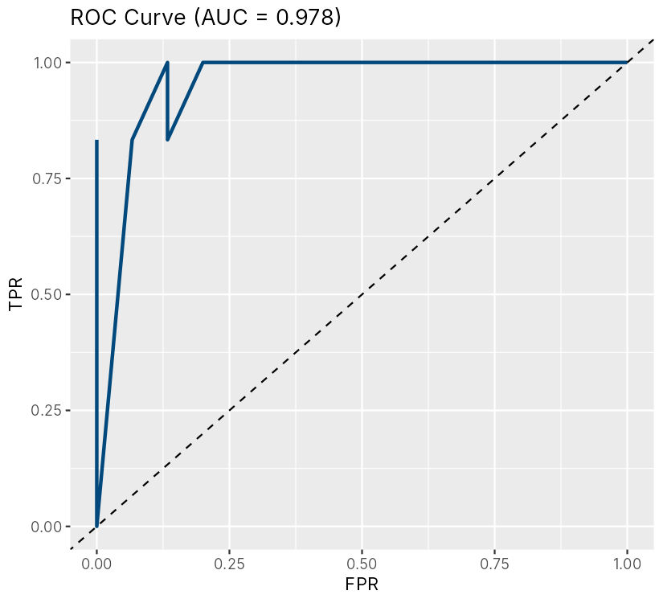
Logistic Regression: ROC Curve
AUC = 0.978 on the test set: the model separates high and low ozone days very well.
The test set holds only 21 days (6 high), so treat this as encouraging rather than final.
Threshold 0.5; lower it if missing a high day is costlier than a false alarm.

Slide 28
Comparison of Models
Model | Test RMSE | Test R² | CV RMSE | CV R²
Linear (A) | 17.07 | 0.669 | 20.58 | 0.636
Log-Linear (B) | 15.09 | 0.751 | – | –
Poly + Interact (C) | 15.55 | 0.728 | 18.58 | 0.736
Random Forest (D) | 15.07 | 0.742 | 16.63 | 0.771
Lower RMSE is better. CV = 10-fold × 5 repeated cross-validation on all 116 rows.
Logistic regression is a classifier, so it is judged separately: accuracy 90.5%, AUC 0.978.

Slide 29
Predicting Ozone for New Days
Solar.R Wind Temp Month Pred_Ozone_RF Pred_Ozone_Poly HighOzone_Prob
1 250 5 92 7 93.7 98.0 0.993
2 150 9 80 6 37.1 35.4 0.126
3 80 14 65 5 17.3 0.4 0.000
Category_RF
1 Very Unhealthy
2 Moderate
3 Good
Hot, calm, sunny July day (92 °F, 5 mph): about 94 ppb, Very Unhealthy; high-ozone probability 99%.
Warm June day (80 °F, 9 mph): about 37 ppb, Moderate; probability 13%.
Cool, windy May day (65 °F, 14 mph): about 17 ppb, Good. The polynomial model's 0.4 ppb here shows why forests are safer near the edge of the data.

Slide 30
Results and Discussion
Random Forest is the most reliable regressor: lowest cross-validated RMSE (16.6 ppb) and highest R² (0.77).
On the 21-day test set, Log-Linear and Random Forest tie (RMSE about 15.1), so the small test set cannot separate them; cross-validation is the better guide.
Wind and temperature drive ozone; solar radiation adds a little; month adds almost nothing.
A model R² of 0.7–0.8 is realistic: precursor emissions (NOx, VOCs) and traffic are not in this data.
Logistic regression flags high-ozone days with 90.5% accuracy and AUC 0.978.

Slide 31
Conclusion and Future Scope
Conclusion
Future scope
Ozone on a given day can be predicted from weather with RMSE of about 17 ppb.
Hot, still, sunny days are the high-risk days.
Honest evaluation (hold-out plus cross-validation) gave realistic scores.
Add NOx, VOC and traffic data, and more years.
Try gradient boosting and time-series features such as previous-day ozone.
Wrap the model in a Shiny app for daily alerts.
16.6 ppb
0.77
0.978
cross-validated RMSE (Random Forest)
cross-validated R² (Random Forest)
AUC of the logistic classifier

Slide 32
Project Reference
GitHub: Air Quality Analysis Project
https://github.com/<your-username>/air-quality-analysis-r
Repository contains the R script, dataset, console output, plots and README.
THANK YOU!!!

