Slide 1
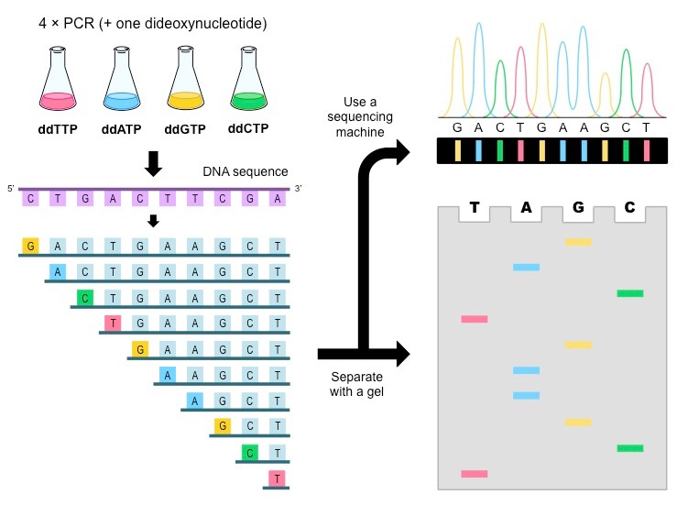
Sanger sequencing (70s-80s)
For resequencing, short reads work
http://www.onlinebiologynotes.com/sangers-method-gene-sequencing/
Jay Shendure
Human Genome Project (1990-2003)
Development of technologies for massively sequencing short tags (e.g. MPSS)
Brenner et al., Nat Biotech 2000
Development of currently used technologies (~2005)

Slide 2
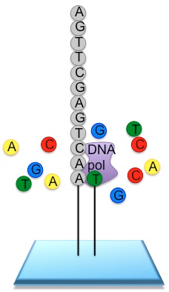
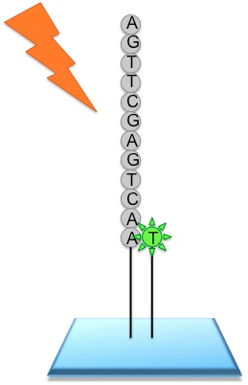
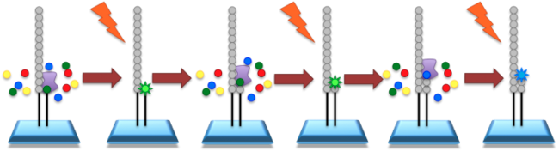
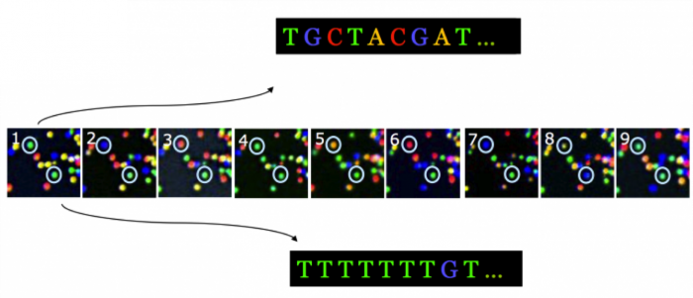
http://wiki.nmbu.org

Slide 3

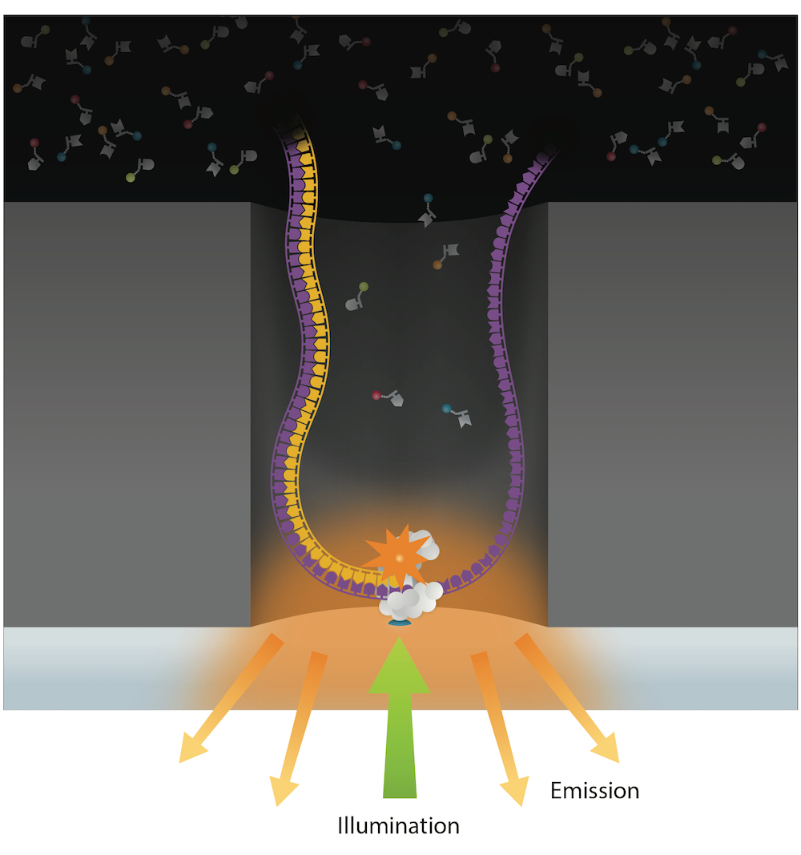
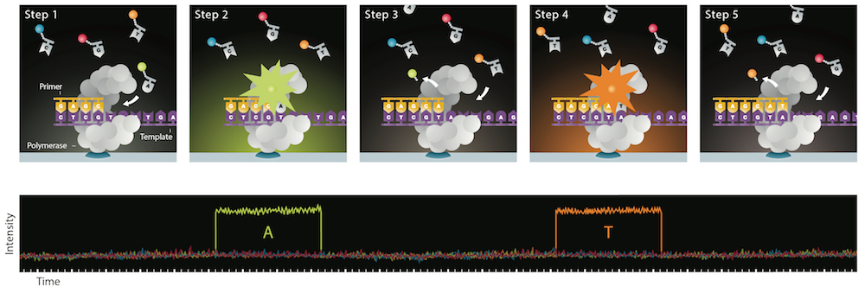
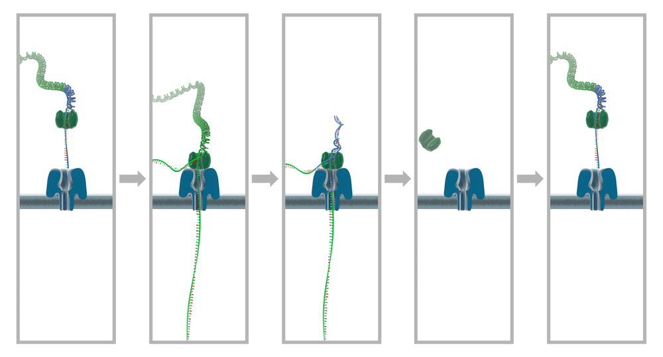
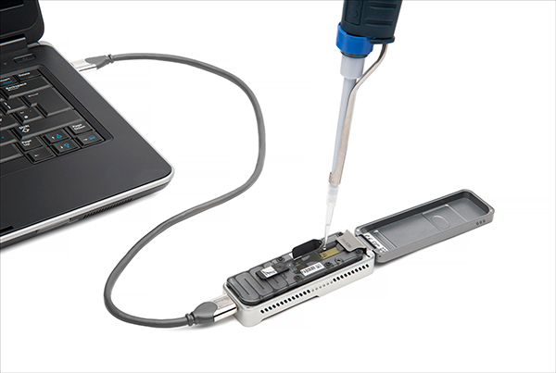

Single molecule real-time sequencing
Nanopore sequencing

