Slide 1
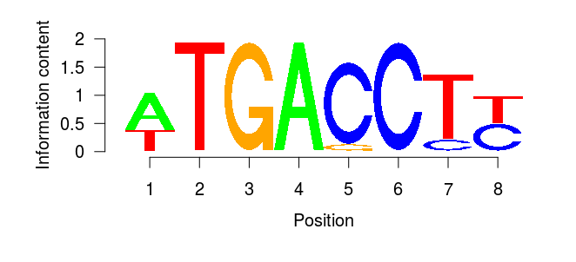
max score = .12 + .13 + .13 + .13 + .13 + .13 + .13 + .11 = 1
PWM:
Sequence logo:
1 2 3 4 5 6 7 8
A 0.12 0.00 0.00 0.13 0.00 0.00 0.00 0.00
C 0.00 0.00 0.00 0.00 0.13 0.13 0.07 0.11
G 0.00 0.00 0.13 0.00 0.05 0.00 0.00 0.00
T 0.10 0.13 0.00 0.00 0.00 0.00 0.13 0.11
score = .10 +.13 +.13 +.13+.05+.13+ .07 +.11 = 0.85
= 85 % of max score
...a c T T G A G C C T t g c...
DNA sequence subject
Using matchPWM function with parameter min.score="80%" => motif found
with parameter min.score="90%" => NO motif

