Slide 1


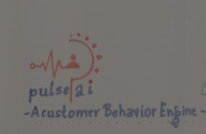
PULSE ai
A customer Behavior Engine
Submitted To : Prof. Abraham Thomas
TEAM MEMBERS
Submitted to : Prof. Abraham THOMAS
PINESH NARESH SINGAL
pgpwe21036@iiml.ac.in
ANUBHAV SHARMA
pgpwe21012@iiml.ac.in
SUNMEET SINGH RAJAN
pgpwe21057@iiml.ac.in
HEMANT KUMAR SINGH
pgpwe21021@iiml.ac.in
VIVEK PALIWAL
pgpwe21063@iiml.ac.in
NEHIL KUMAR
pgpwe21034@iiml.ac.in

Slide 2

Pulse AI
Simulate how real human populations respond to a decision — before it happens.
An AI-native platform where a fleet of agents designs the study, builds a grounded synthetic population, runs simulations, interviews respondents, and returns a recommendation with confidence and evidence.
"Fail safely in a controlled environment before you fail expensively in front of real customers."

Slide 3



THE PROBLEM
Big decisions are still made on guesswork.
Ships before anyone knows
Product launches, pricing strategies, marketing messages, and policies are deployed before anyone truly understands how real people will respond. Organizations rely on instinct, internal consensus, or outdated research — not evidence.
Traditional research can't keep up
Conventional research is slow, expensive, and structurally unable to reach niche or hard-to-recruit segments. By the time findings arrive, the window for action has closed.
Failure is discovered in-market
The most expensive place to learn is in front of real customers. Once a decision fails publicly, the cost is not just financial — it's reputational, competitive, and often irreversible.

Slide 4
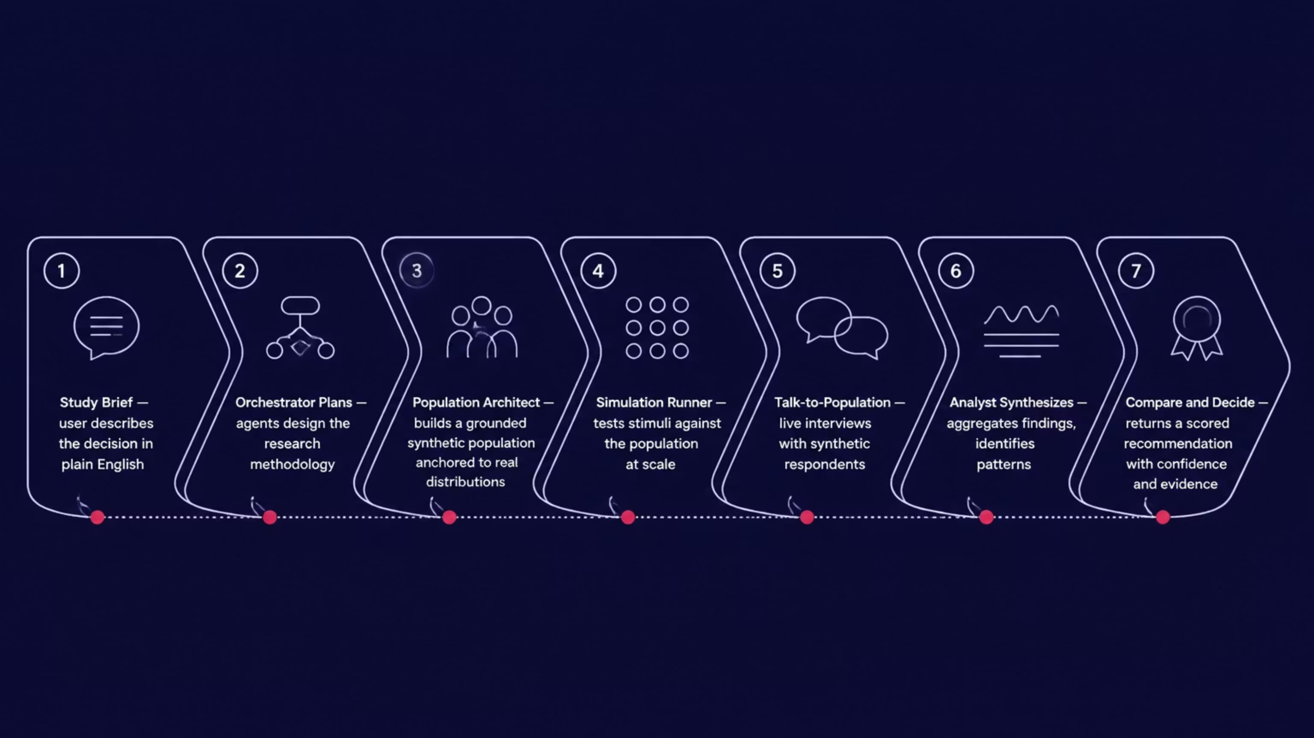
THE SOLUTION
Describe a decision in plain English. Agents do the rest.
Pulse AI's agentic pipeline transforms a single natural-language brief into a rigorous, evidence-backed recommendation — without a single human-hour of manual research design.
Every synthetic population is anchored to real, cited distributions — census data, panel studies, and published surveys. Transparent and replicable, not vibes.

Slide 5




TRUST & RIGOR
Calibrated estimates, never false precision.
Pulse AI is engineered for enterprise-grade trust. Every result is accompanied by its own provenance, uncertainty bounds, and audit trail — making it suitable for board-level decisions and regulatory scrutiny.
Grounding Manifest
Backtesting & Calibration
Full data provenance and citations for every population attribute — traceable to source datasets, with versioning and timestamps.
Every model is scored against known ground-truth outcomes. Calibration scores are surfaced alongside results so decision-makers understand model reliability.
Confidence & Blind Spots
Audit Log & Reproducibility
Confidence intervals and a blind-spot register accompany every result — surfacing what the model knows, what it doesn't, and where assumptions are strongest.
Full audit logs, human-in-the-loop approval gates, and reproducible runs. Seed plus config equals the same result — every time, for every stakeholder.

Slide 6

IN ACTION
From a plain-English question to a board-ready recommendation.
The Scenario
The Output
A European EV maker asks: Should we launch an entry-level mass-market EV or a premium EV in India?
One plain-English question. One board-ready output.
Pulse AI returns a Compare & Decide matrix — Entry-Level vs. Premium vs. Delay — each scored across six dimensions with rationale, confidence intervals, and blind-spot flags.
Entry-Level EV
Premium EV
What Populace Delivers
High TAM, tight margins, intense competition
Lower volume, strong brand fit, higher margin
Grounded Indian auto-buyer synthetic population
Four segments: metro upgraders, affluent early-adopters, tier-2 families, fleet buyers
Price and concept conjoint testing at scale
Live cohort interviews with synthetic respondents
Decision matrix scored on TAM, margin, competitive intensity, brand fit, and risk
Delay
Wait for infrastructure maturity; reduce risk
One click generates a board memo and deck. Every claim carries provenance and uncertainty.

Slide 7
Thank You
Team : All Tech

