Slide 1
Racing Cars Game
By CS17035

Slide 2
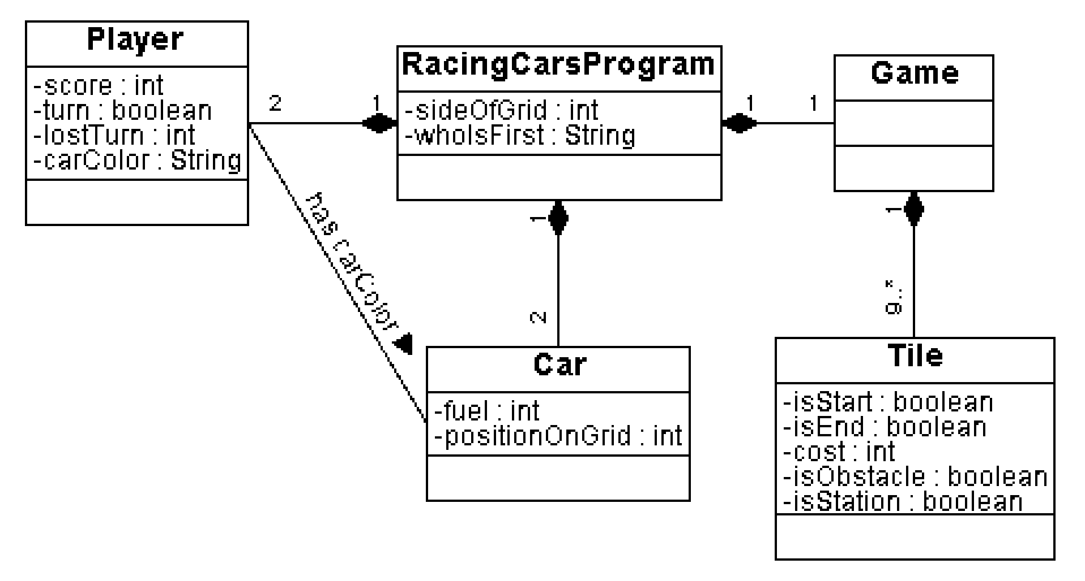
The UML Conceptual Class Diagram

Slide 3
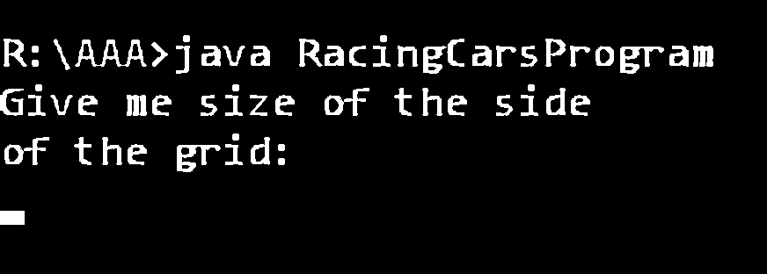
How the game works At the beginning
Prompt for the size of the side of the grid

Slide 4
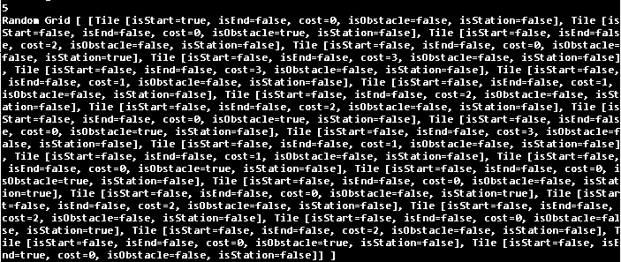
How the game works At the beginning
Generation of random grid

Slide 5
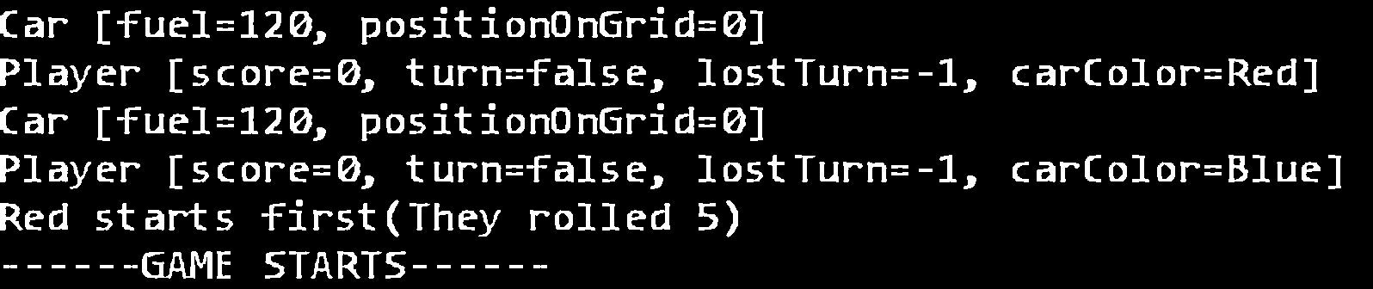
How the game works Just before we start
Decision of who plays first with die roll

Slide 6
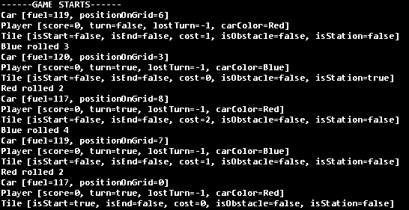
How the game works Game starts!
The flow of the game

Slide 7
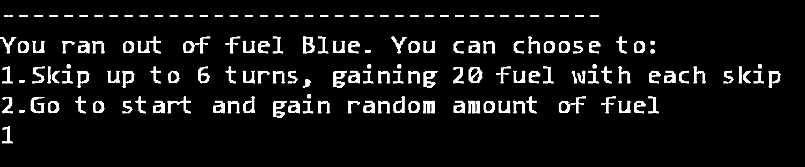
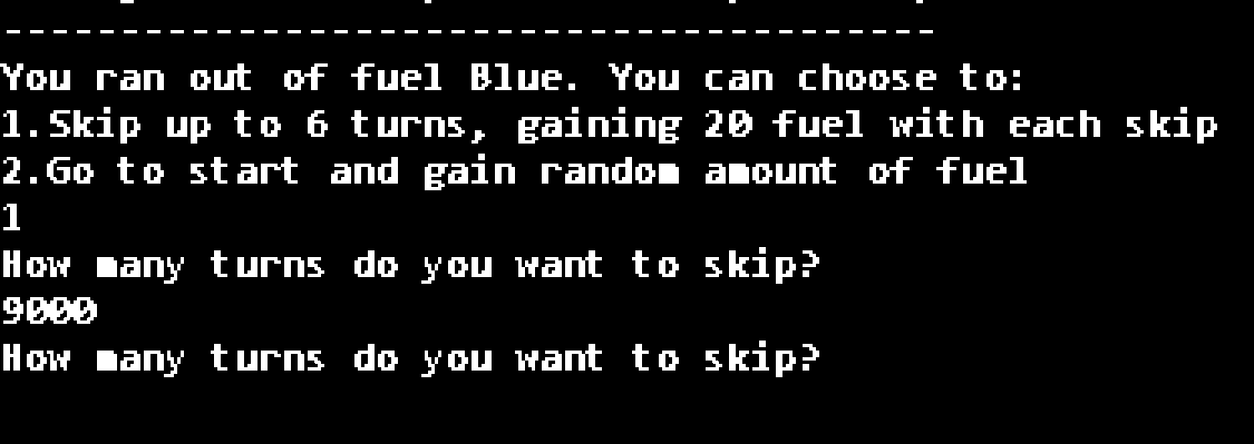
How the game works Out of fuel
Prompts and options

Slide 8
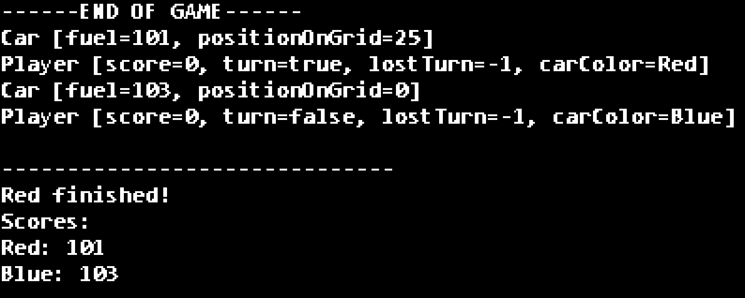
How the game works At the End
Winner and info

Slide 9
Difficulties
Development is tough with time ticking

Slide 10
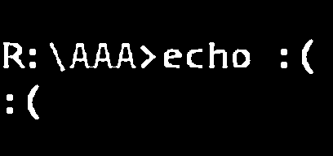
No GUI
I was especially interested in making the game function as it should have under random map generation conditions. This took much time off the project in the backend, eliminating the possibility of a front end in time.

Slide 11
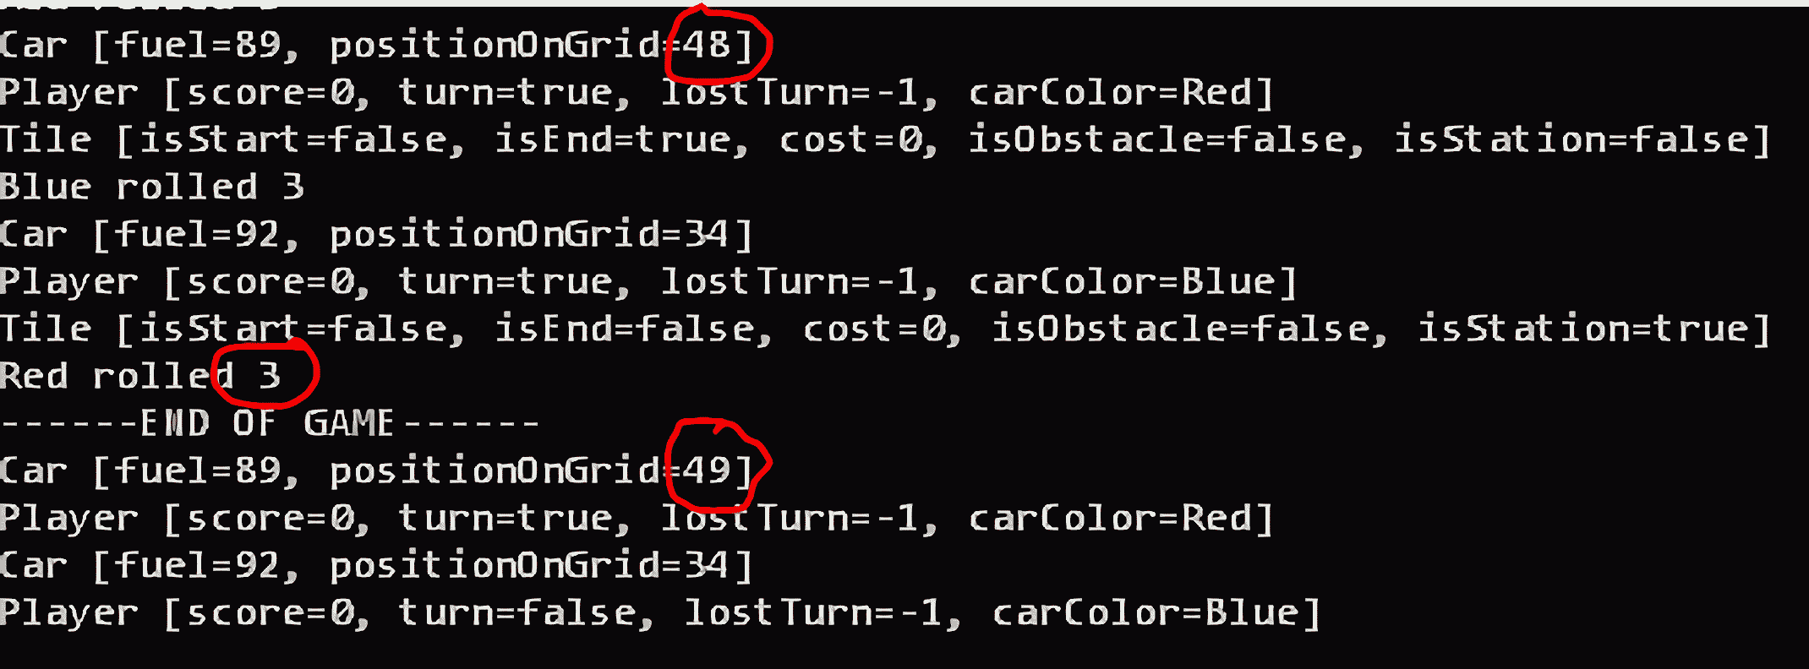
Ending die throw
A very special but tricky move

Slide 12
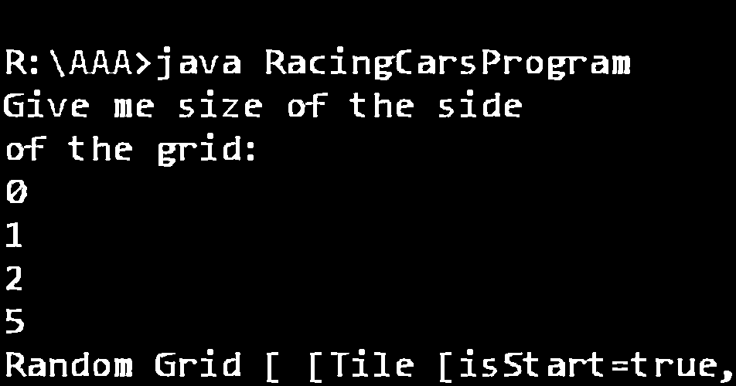
Players’ choice
They’d better not have it ☺ People mess up their inputs more strategically than playing the game

Slide 13
Thank you for your time

