Slide 1

Citi Bike Usage Balancing through Congestion Pricing
Milestone 1 Presentation
Paul Griffioen and Anthony Jin

Slide 2
Overview
Unidirectional flow of bikes at different times of the day causes congestion in bike sharing systems such as the Citi Bike system in NYC
Prior work has proposed monetary incentive systems based on future traffic prediction, repositioning with trucks, and inventory management of bike stations
Our approach
Approach the problem from a network perspective
Formulate a convex optimization problem
Introduce a congestion-based pricing scheme
Project Overview

Slide 3
Building Dynamic Citi Bike Network
Nodes = bike stations
Edges = trips between two bike stations
Node attributes
Latitude and longitude
Congestion level (number of stored bikes vs. maximum capacity)
Edge attributes
Physical distance of the trip
The network
Directed
Weighted links
Dynamic
Need an initialization procedure to estimate number of stored bikes at each station…
Station A
Bike trip 3
Bike trip 1
Station B
Bike trip 2
Approach

Slide 4
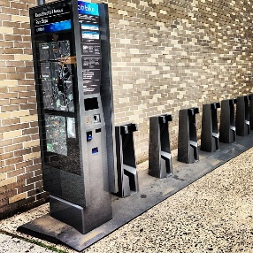
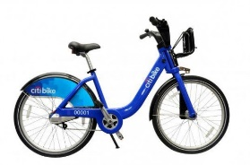
Initialization Procedure
Station A
Station B
Bikes at Each Station |  | Bikes in the System
A
B
C
Bike 3
Bike 1
1
0
1
Bike 1
2
1
Bike 2
Bike 2
1
Bike 3
2
Bike 3
Station C
Bike 3
Approach

Slide 5

Citi Bike Network in 24 Hours
Observations
538 nodes
38,187 edges over 24-hour period
A scale-free network
Node Degree Legend
Selected Network Properties
Time Interval | Average Node Degree | Clustering Coefficient | Modularity | Number of Communities
6AM to 7AM | 3.389 | 0.014 | 0.489 | 203
12PM to 1PM | 9.043 | 0.031 | 0.411 | 89
6PM to 7PM | 20.148 | 0.042 | 0.302 | 34
12AM to 1AM | 2.230 | 0.008 | 0.640 | 234
Citi Bike Network – September 1, 2016
Preliminary Results

Slide 6
Conclusion and Future Work
Proposed basic methodology to build the Citi Bike network and estimate congestion level
Next Step
Improve proposed methodology
Construct complete Citi Bike network
M2 Sneak Peek
Network analysis and incentives identification
Formulate convex optimization problem
Conclusion

