Slide 1
Everlasting privacy and efficient coercion resistance in remote electronic voting
12th Athens Colloquium on Algorithms and Complexity ACAC '17
Panagiotis Grontas, Aris Pagourtzis and Alexandros Zacharakis
Notes:
I am Panagiotis Grontas and I am going to talk to you about our joint work with Aris Pagourtzis and Alexandros Zacharakis. It is focused on a different topic from the rest of the talks, namely cryptographic protocols, so you can think of it as an interesting break.

Slide 2
In a nutshell...
We propose a new electronic voting framework that provides:
Efficient coercion resistance
Everlasting privacy
By combining:
The coercion resistance framework of Juels, Catalano and Jakobsson (JCJ)
The blind signature based protocol of Fujioka, Okamoto and Ohta (FOO)
Using a new primitive:
Conditional Blind Signatures
Notes:
Our work introduces a new electronic voting framework that provides Efficient Coercion Resistance And Everlasting Privacy in electronic voting.
Our work is built on 2 very well know voting frameworks:
-The JCJ framework that describes how to make electronic voting coercion resistant
-The FOO protocol, which is one of the most privacy focused electronic voting protocols.
In order to implement our scheme we introduced in a previous paper a new cryptographic primitive - Conditional Blind Signatures.

Slide 3
Electronic Voting is hard
Voting is a general decision making process that follows each era’s technology
Why can’t we vote with our computers?
Because voting is inherently hard, as it must reconcile many conflicting properties
Integrity: The result reflects the aggregate choices of the voters
No votes are altered, deleted or inserted by an adversary
Implemented by End-To-End-Verifiability
Cast as intended
Recorded as cast
Counted as recorded
Notes:
Let's talk about electronic voting in general at first. Voting and elections are in general heated topics as politics and conflicts of interest are involved, but in reality voting is a general decision making process that can be applied from the simplest of situations to the most complete. As it is applicable everywhere it always goes hand to hand with the technology available at the time.
So this begs the question - of why can't we vote with our computer. The answer to this is that voting is inherently hard to implement with computers as it must reconcile conflicting properties.
The most important of these properties are integrity and privacy. Integrity means that the result reflects the choices of the voters, namely that no votes were altered, inserted or deleted. It is implemented with the concept of end to end verifiability, which means that the system must generate evidence - there are many forms - that the votes where cast as intended, recorded as cast and counted as recorded.

Slide 4
Electronic Voting is hard
Privacy: A means to and end (the voters express their true opinion)
Secrecy: The vote is protected against the talliers – (anonymity will also do)
Receipt – Freeness: The vote is protected against malicious voters wanting to sell their votes
Coercion Resistance: Active adversary that can dictate voter behavior
Specific/Random Vote
Impersonation
Forced Abstention
Essential for remote electronic voting
Many more desirable properties
Fairness
Availability
Usability …
Notes:
An orthogonal but very important concept is privacy, which is not a goal in itself but a means to allow the voters to freely express their opinions. Privacy comes in many levels. The most basic level of privacy is vote secrecy which means that nobody can access the contents of the ballot. Note that a ballot can be open but anonymous. The next level protects the votes from corrupt voters that try to sell them. The system while providing evidence must do it in such a way that these elements do not serve as receipts. Finally the most secure version of privacy protects from active adversaries that control their behavior in a very strong way, meaning that they dictate a specific or random vote or impersonate the voter or force the voter to abstain from the process. It is easy to see that coercion resistance is essential to apply remote electronic voting. Of course in order to build voting systems many more properties must be in place such as fairness, availability and usability but these are considered implementation issues and are our of scope for our system.

Slide 5
Everlasting Privacy
Moran and Naor (2006)
Integrity is ephemeral - useful until all parties concede
Privacy has to outlast the election:
Fear of a future oppressive regime
Theoretical and practical advances work against computational assumptions
In 30 years time all current cryptographic keys will be useless (Adi Shamir ~ 2010)
Verifiability makes election data widely available
Information theoretic (everlasting) privacy is required
Notes:
Our work rests on the observation of Tal Moran and Moni Naor that integrity is ephemeral, lasts roughly the same as the election and is useful until all parties concede. However in the long run privacy is more important, as the vote contents can have important consequences for the voters and their families many years after the election ends. This is a problem as in order to achieve verifiability the voting system must make election data widely available. This means that in the long run anybody can have access to them. So a stronger kind of privacy is required, namely information theoretic or as it is called in the electronic voting literature everlasting privacy. Few proposals have tried to achieve everlasting privacy mostly using commitment schemes. Our proposal builds on blind signatures.

Slide 6
The JCJ Coercion Resistance Framework
Juels - Catalano - Jakobsson (2005)
Main idea: A coercer has no incentive to attack if he cannot tell if his attack succeeded or not.
Implementation: Each voter can cast many indistinguishable votes –fake and real
The validity is determined by an accompanying credential
A single credential is registered as valid during a one-time untappable registration process
Under coercion the voter generates a random but indistinguishable credential to cast an invalid vote
Using an assumed moment of privacy the voter casts the real vote using the correct credential
Before counting, invalid votes must be removed in a manner undetectable by the coercer
Notes:
Now let's talk about how one can implement the second component of our scheme: coercion resistance. The main framework to assists us was proposed by Juels,Catalano and Jakobsson in 2005. Their main insight wars that the coercer has no motive to complete the attack if he cannot find out if the attack succeeded or not. As a result we allow the voter to cast many votes. One of them will be the real vote. The rest will seem real but they will not be counted. This can be achieved by accompanying the vote with an anonymous credential. The valid one must be registered before the election while the fake ones will be generated by the voters when coerced. All these means that before counting the talliers must be filter out the votes that correspond to fake credentials.

Slide 7
The JCJ Coercion Resistance Framework
Registration
Vote
Casting
Vote Authorization
Tallying
Vote authorization:
The valid credentials are published encrypted during registration
The counters check them against the supplied ones – in encrypted form
If the check is ok the vote is counted
Complexity: Quadratic in the number of votes – very inefficient
Many efforts have tried to provide linear complexity
Our approach:
Uses 2 phases to reduce complexity
Combines coercion resistance with everlasting privacy
Notes:
So in the JCJ framework voting takes place in the following phases: Untappable Registration - Vote Casting - Vote Authorisation and Tallying

Slide 8
Cryptography and Voting
Cryptographic Primitives have been proposed to implement
Vote secrecy and anonymity (Mixnets, Blind Signatures, Homomorphic Encryption)
Integrity (Zero Knowledge Proofs)
Many schemes have been proposed but few have been applied in practice
The majority of proposals in the literature focus on integrity
Privacy is achieved under:
Computational Assumptions: Factoring, DLOG etc. have no PT algorithm
Distributed Trust Assumptions: We trust the majority of the voting authorities’ members
Notes:
Now cryptography provides techniques to address both the integrity and privacy properties. For vote secrecy and anonymity mixnets. blind signatures and homomorphic encryption. Zero knowledge proofs provide the evidence to implement integrity. Despite the proliferation of schemes few have been applied in practice. The common theme in most of the proposals is that integrity is pretty much unconditional, while privacy rests on computational assumptions and trust assumptions.

Slide 9
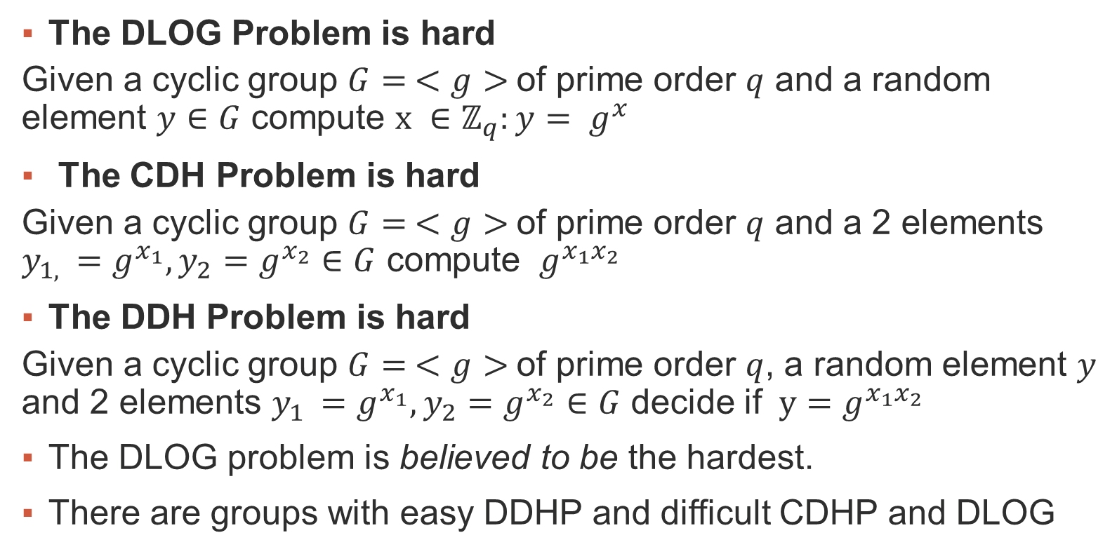
Basic Cryptographic Assumptions
The DLOG Problem is hard
Given a cyclic group $G= <g>$of prime order $q$ and a random element $y∈G$ compute $x ∈ℤ_{q}:y= g^{x}$
The CDH Problem is hard
Given a cyclic group $G= <g>$of prime order $q$ and a 2 elements $y_{1, }=g^{x_{1}}, y_{2}=g^{x_{2}}∈G$ compute $g^{x_{1}x_{2}}$
The DDH Problem is hard
Given a cyclic group $G= <g>$of prime order $q$, a random element $y$ and 2 elements $y_{1 }=g^{x_{1}}, y_{2}=g^{x_{2}}∈G$ decide if $y=g^{x_{1}x_{2}}$
The DLOG problem is believed to be the hardest.
There are groups with easy DDHP and difficult CDHP and DLOG
Notes:
Discrete Log in BQP
Discrete Log is in NP ∩ coNP
DDH<CDH<DLOG
DDH is at least as easy (or even easier) as CDH, and CDH is as least as easy as DL
DL is at least as hard as CDH, and CDH is at least as hard as DDH
Θεώρημα
To DDHP δεν είναι δύσκολο στην Z ∗p
Μπορεί να κατασκευαστεί αποδοτικός αλγόριθμος διαχωρισμού
τριάδας DH g a ,g b ,g ab από μια τυχαία τριάδα g a ,g b ,g c .
Πώς: Χρησιμοποιώντας το σύμβολο Legendre.
To σύμβολο Legendre διαρρέει το DLP parity
Από τον ορισμό: ( g
x
p
) = (g x )
p−1
2
Όμως: g p−1 = 1 (mod p)
Άρα: g
p−1
2
= −1 (mod p)
Δηλαδή: ( g
x
p
) = (−1) x
Αν x μονός τότε ( g
x
p
) = −1 (g x 6∈ QR)
Αν x ζυγός τότε ( g
x
p
) = 1 (g x ∈ QR)

Slide 10
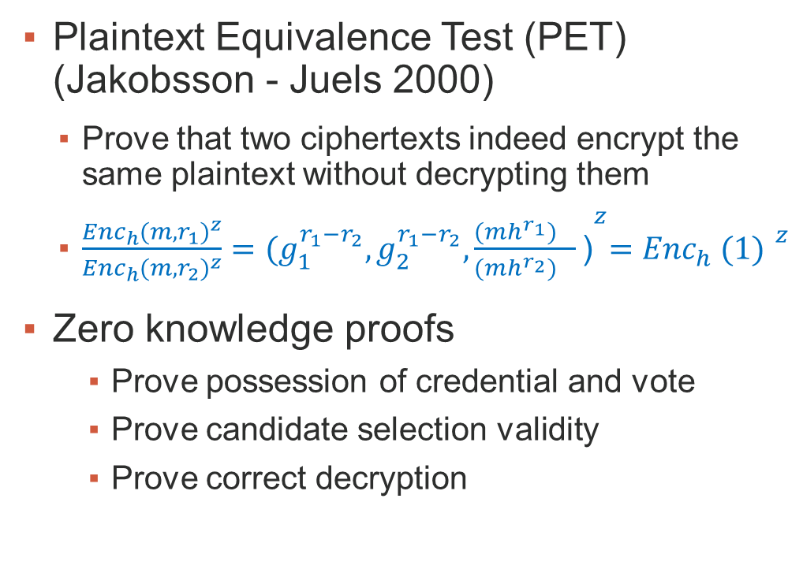
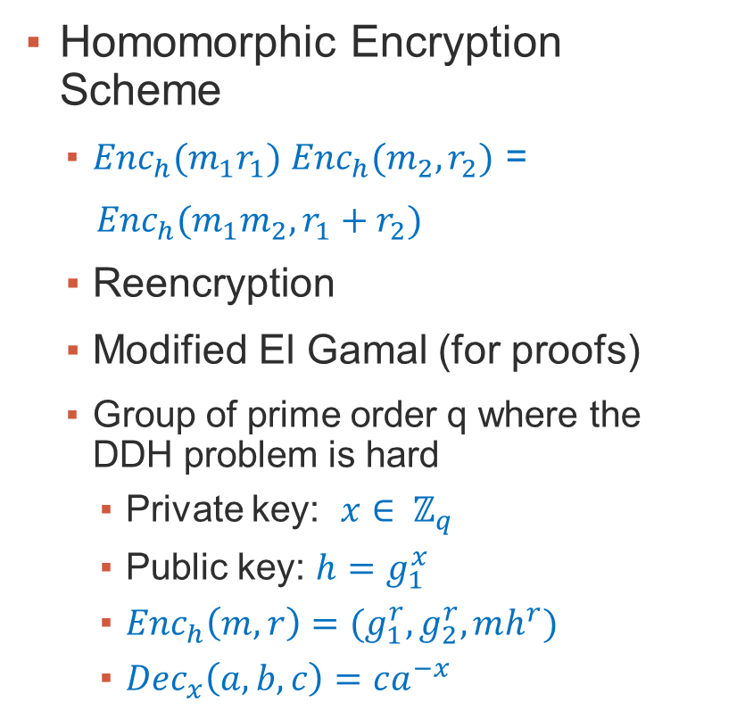
Basic Cryptographic Primitives
Homomorphic Encryption Scheme
${Enc}_{h}(m_{1}r_{1})$ ${Enc}_{h}(m_{2},r_{2})$ =
${Enc}_{h}(m_{1}m_{2},r_{1}+r_{2})$
Reencryption
Modified El Gamal (for proofs)
Group of prime order q where the DDH problem is hard
Private key: $x∈ ℤ_{q}$
Public key: ${h=g}_{1}^{x}$
${Enc}_{h}\left(m,r\right)=(g_{1}^{r},g_{2}^{r},mh^{r})$
${Dec}_{x}\left(a,b,c\right)=ca^{−x}$
Plaintext Equivalence Test (PET) (Jakobsson - Juels 2000)
Prove that two ciphertexts indeed encrypt the same plaintext without decrypting them
$\frac{{{Enc}_{h}(m,r_{1})}^{z}}{{{Enc}_{h}(m,r_{2})}^{z}}={(g_{1}^{r_{1}−r_{2}},g_{2}^{r_{1}−r_{2}},\frac{{(mh^{r_{1}})}^{}}{{(mh^{r_{2}})}^{}}\text{)}}^{z}={{Enc}_{h} (1) }^{z}$
Zero knowledge proofs
Prove possession of credential and vote
Prove candidate selection validity
Prove correct decryption

Slide 11
Blind Signatures
A variation of digital signatures for anonymity (Chaum 1982) with many instantiations
The signer receives and signs a blinded version of a message
The user unblinds the signature and obtains a regular one
Security properties:
Blindness: Cannot associate messages with signing sessions
Unforgeability: Cannot generate valid signatures without the private key
A useful real world analogy:
A message and a piece of carbon paper is placed in an envelope
The signer signs the envelope
Because of the carbon the signature is transferred to the message
The user removes the signed message from the envelope

Slide 12
Conditional Blind Signatures
Blind signatures that can only be verified by a designated verifier
Inject a secret bit of information to the signature
The designated verifier can use his secret key to extract this information
The signer passes embedded information to the verifier using the signature
This information is hidden from the user
Extra Security properties
Conditional Verifiability

Slide 13
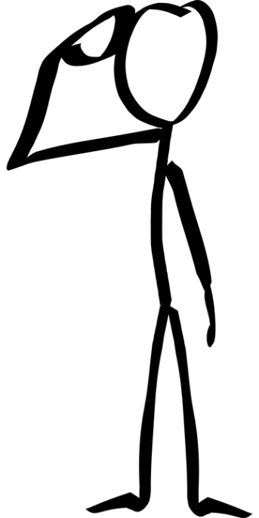







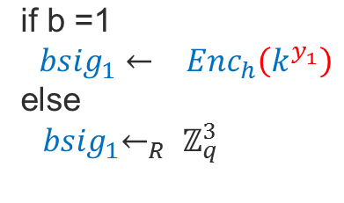












An instantiation using Okamoto – Schnorr Blind Signatures
$$<q,g_{1}^{},g_{2}^{},H>, v,h, k$$
$$m$$
$$(s_{1}^{},s_{2}^{}), b$$
$$r_{1},r_{2}←_{r}ℤ_{q}$$
$$x$$
$$x←_{} g_{1}^{r_{1}}g_{2}^{r_{2}}$$
$$u_{1},u_{2},d←_{r}ℤ_{q}$$
$$e$$
$$x^{∗}←_{} xg_{1}^{u_{1}}g_{2}^{u_{2}}v_{}^{d_{}}$$
$e^{∗}←_{}H(m,x^{∗}$)
$$e^{}←_{}e^{∗}−d$$
$y_{1}←_{}$ $r_{1}+es_{1}$
$y_{2}←_{}$ $r_{2}+es_{2}$
$${bsig}_{1},{bsig}_{2}$$
${sig}_{1}←_{}$ ${bsig}_{1 }{Enc}_{h}\left(k^{u_{1}}\right)$
$$\text{if} \text{b}\text{ =1}$$
${bsig}_{1}←_{}$ ${Enc}_{h}\left(k^{y_{1}}\right)$
else
${ bsig}_{1}←_{R}$ $ℤ_{q}^{3}$
${sig}_{2}←_{}$ ${bsig}_{2}+ u_{2}$
output$(x^{∗}$, $e^{∗}$, ${sig}_{1}$, ${sig}_{2})$
${bsig}_{2}←_{}$ $y_{2}$
Notes:
/* Select secret sk S and public vk S signature keys for S */
s 1 ,s 2 ← R Z q
v ← g −s 1 1 g −s 2 2
(sk S ,vk S ) ← ((s 1 ,s 2 ),v)
/* Select secret sk V and public vk V verification keys for V */
s ← R Z q
k ← g s 1
(sk V ,pk V ) ← (s,k)
/* Select secret sk E and public pk E encryption keys for V */
z ← R Z q
h ← h z 1
(sk E ,pk E ) ← (z,h)

Slide 14






An instantiation using Okamoto – Schnorr Blind Signatures
Signature Verification
Round Reduction
$m,(x^{∗}$, $e^{∗}$, ${sig}_{1}$, ${sig}_{2}), z,s$
The first step of the interaction can be removed:
The signer and the user preagree on a common way to generate the randomness
Security
Blindness: Information Theoretic
Unforgeability: CDHP
Conditional Verifiability: DDHP
$e^{∗′}←_{r}H(m,$ $x^{∗}$)
${y′}_{1}←_{}$ ${Dec}_{z} ({sig}_{1}$)
$${y′}_{2}←_{}{sig}_{2}$$
Check:
$$e^{∗′}=e^{∗}$$
$x^{∗s}$ = ${y′}_{1}g_{2}^{y_{2}^{′}s}v^{e^{∗}s}$

Slide 15
Using CBS for coercion resistance: Main idea
Vote authorization occurs during registration and not during counting
Each ballot is signed using a conditional blind signature
If the ballot carries the valid registration credential the bit 1 is embedded in the signature
If the ballot carries a random credential (coercion) then the bit 0 is embedded in the signature
Efficiency: We can use the voter id to retrieve the credential
Privacy: The blindness of the scheme hides the ballot contents

Slide 16
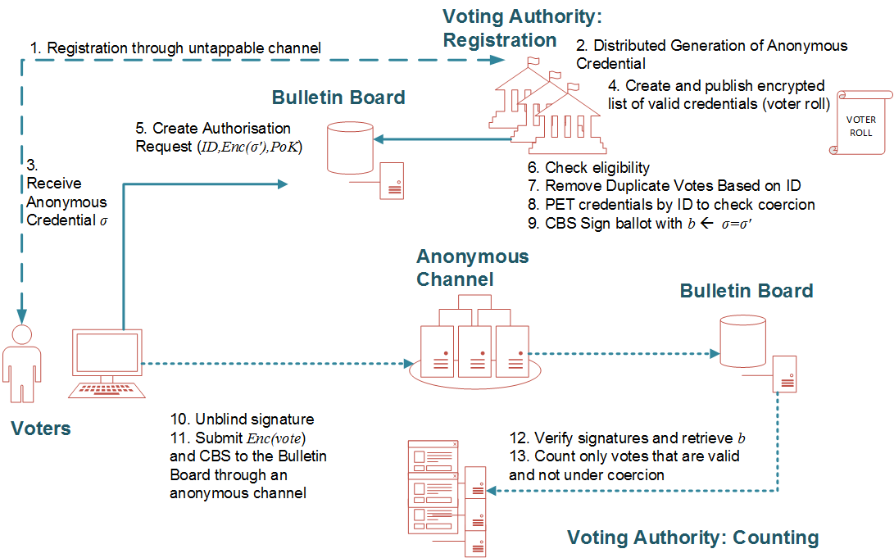
The protocol
Notes:
Registration aims for voters to acquire their private credentials
There are multiple registrars
Each voter interacts with each registrar and obtains a share of the credential
The voter reconstructs the credential himself from the shares

Slide 17
Security Analysis
Eligibility
Only the eligible voters vote
Based on the Unforgeability of CBS Scheme
Everlasting Privacy
Perfect Blindness of the CBS Scheme
Coercion Resistance
Simulation based argument based on the DDH Assumption
Verifiability
Standard Zero Knowledge Proofs
Voting Authority actions to be verified:
Registration: A vote is valid iff the credential is valid
Tallying: A vote is counted iff it is valid
Depends on Conditional Verifiability of CBS
Distributed Voting Authority
Threshold CBS with honest majority
Real world conflict of interest
This is the same assumption that most voting schemes do for privacy
Notes:
Coercion Resistance: if an adversary can detect coercion then he can break the DDH Assumption

Slide 18

Questions - Discussion
Notes:
Voting methods: No problem as to which are supported but we must be careful because some cannot avoid coercion
Write ins and ranked methods

