Slide 1
Secure two-party Computation Oblivious Transfer and Secure Function Evaluation
Panagiotis Grontas
Network Algorithms and Complexity
22.07.2014

Slide 2
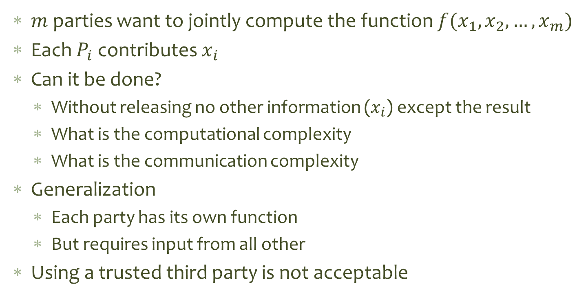
Secure Multi Party Computation
$m$ parties want to jointly compute the function $f(x_{1},x_{2}, …,x_{m})$
Each $P_{i}$ contributes $x_{i}$
Can it be done?
Without releasing no other information ($x_{i}$) except the result
What is the computational complexity
What is the communication complexity
Generalization
Each party has its own function
But requires input from all other
Using a trusted third party is not acceptable

Slide 3
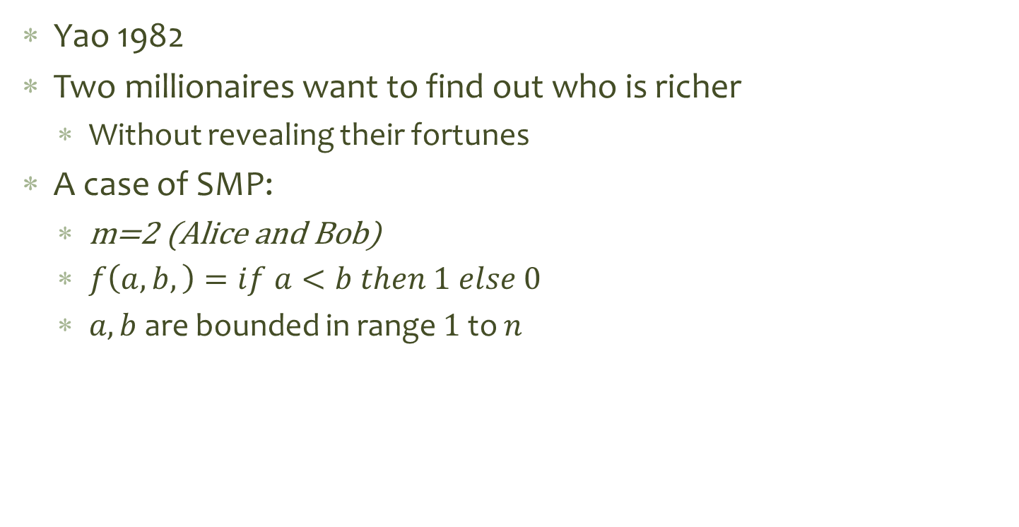
The millionaire problem
Yao 1982
Two millionaires want to find out who is richer
Without revealing their fortunes
A case of SMP:
m=2 (Alice and Bob)
$f\left(a,b,\right)=if a<b then 1 else 0$
$a,b$ are bounded in range $1$ to $n$

Slide 4
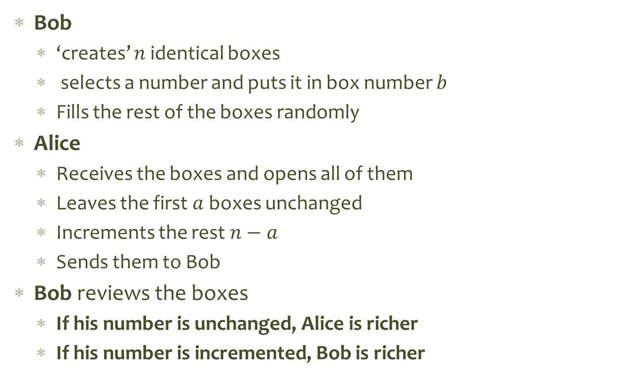
Yao’s First Solution
Bob
‘creates’ $n$ identical boxes
selects a number and puts it in box number $b$
Fills the rest of the boxes randomly
Alice
Receives the boxes and opens all of them
Leaves the first $a$ boxes unchanged
Increments the rest $n−a$
Sends them to Bob
Bob reviews the boxes
If his number is unchanged, Alice is richer
If his number is incremented, Bob is richer
Problems
Exponential Number Of Boxes
Somebody deviates from the protocol

Slide 5
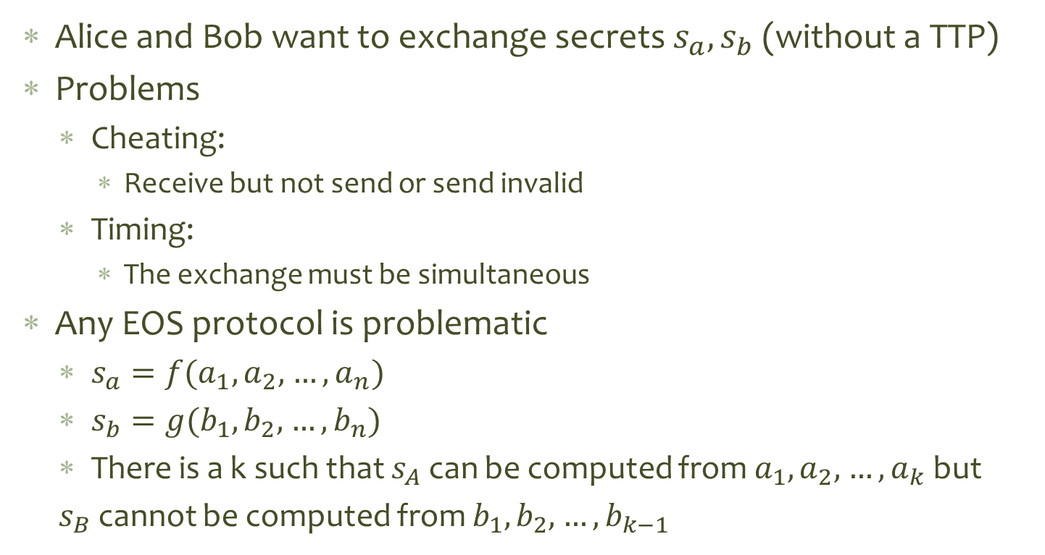
Exchange of secrets
Alice and Bob want to exchange secrets $s_{a},s_{b}$ (without a TTP)
Problems
Cheating:
Receive but not send or send invalid
Timing:
The exchange must be simultaneous
Any EOS protocol is problematic
$s_{a}=f(a_{1},a_{2},$ $…,a_{n})$
$s_{b}=g(b_{1},b_{2},$ $…,b_{n})$
There is a k such that $s_{A}$ can be computed from $a_{1},a_{2},$ $…,a_{k}$ but
$s_{B}$ cannot be computed from $b_{1},b_{2},$ $…,b_{k−1}$

Slide 6
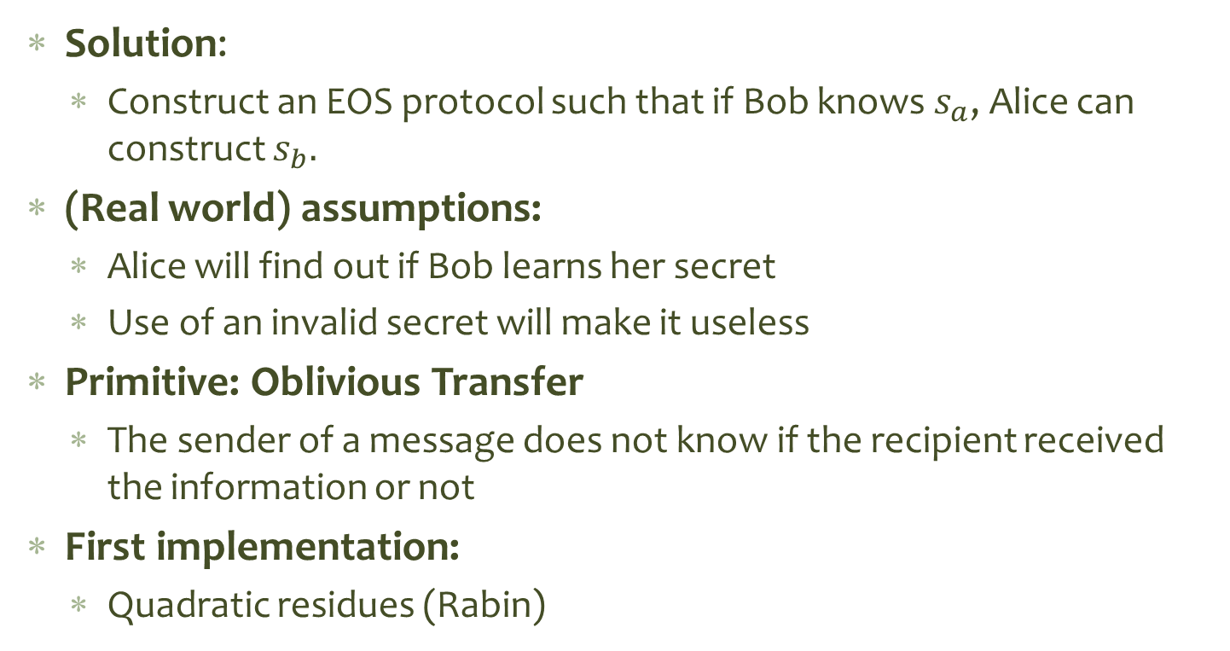
Oblivious transfer
Solution:
Construct an EOS protocol such that if Bob knows $s_{a}$, Alice can construct $s_{b}.$
(Real world) assumptions:
Alice will find out if Bob learns her secret
Use of an invalid secret will make it useless
Primitive: Oblivious Transfer
The sender of a message does not know if the recipient received the information or not
First implementation:
Quadratic residues (Rabin)

Slide 7
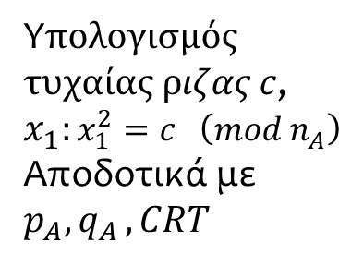

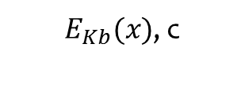

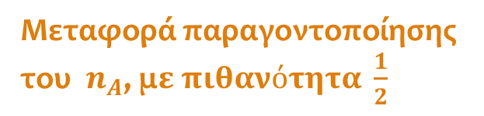

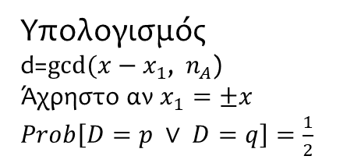
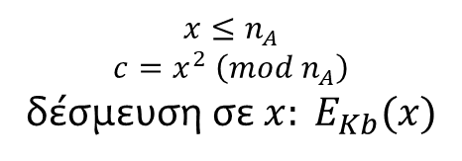

Rabin’s Protocol for OT
Alice
$$K_{b}$$
Bob
$$K_{a}$$
$$n_{A}=p_{A}q_{A}$$
$E_{Kb}(x)$, c
$$x≤n_{A}$$
$$c=x^{2} \left(mod{ n}_{A}\right)$$
δέσμευση σε ${x: E}_{Kb}(x)$
Υ$πολογισμός$
$τυχαίας ριζας c$, $x_{1}:{x_{1}^{2}=c }^{ } \left(mod{ n}_{A}\right)$
Αποδοτικά με $p_{A}{,q}_{A}, CRT$
$$x_{1}$$
Υπολογισμός
d=$gcd⁡(x−x_{1}$, ${ n}_{A}$)
Άχρηστο αν $x_{1}=±x_{}$ $Prob\left[D=p ∨ D=q\right]=\frac{1}{2}$
Μεταφορά παραγοντοποίησης του $n_{A}$, μ$ε πιθανότητα \frac{1}{2}$
Notes:
Alice can can carry out step 3 since she knows the factorization of n and can find all four square roots of a.
However, Alice has no idea which x Bob used to generate a. Hence, with probability 1/2, y ≡ ±x (mod n) and with probability
1/2, y 6≡ ±x (mod n).
If y not≡ ±x (mod n), then the two factors of n are gcd(x − y,n)
and n/gcd(x − y,n), so Bob factors n and decrypts c in step 4.
However, if y ≡ ±x (mod n), Bob learns nothing, and Alice’s
secret is as secure as RSA itself

Slide 8
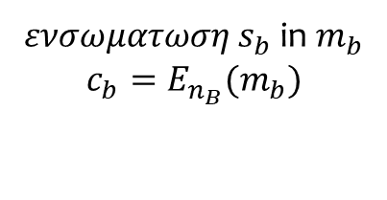


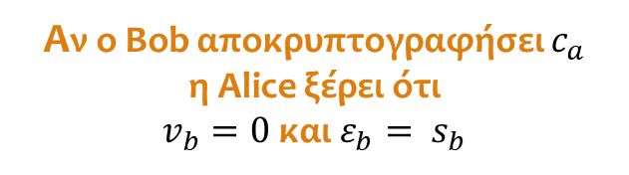



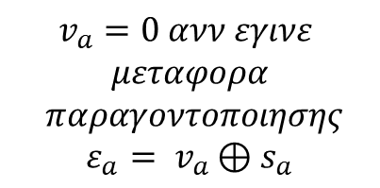

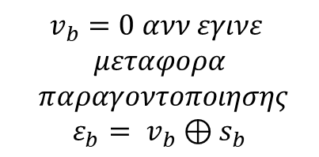

Rabin’s Protocol for EOS
Alice
Bob
Παραγοντοποίηση $n_{A}$
Παραγοντοποίηση $n_{B}$
$$v_{a}=0 ανν εγινε$$
$$μεταφορα$$
$$παραγοντοποιησης$$
$$ε_{a}= v_{a}⊕s_{a}$$
$$v_{b}=0 ανν εγινε$$
$$μεταφορα$$
$$παραγοντοποιησης$$
$$ε_{b}= v_{b}⊕s_{b}$$
$ε_{a}$, $ε_{b}$
$c_{a}$, $c_{b}$
$ενσωματωση{ s}_{b}$ in $m_{b}$
$$c_{b}=E_{n_{B}}(m_{b})$$
$ενσωματωση{ s}_{a}$ σε $m_{a}$
$$c_{a}=E_{n_{A}}(m_{a})$$
$$v_{a}=0 τοτε$$
$$αποκρυπτογραφηση$$
$$c_{b}$$
$$v_{b}=0 τοτε$$
$$αποκρυπτογραφηση$$
$$c_{a}$$
Αν ο Bob αποκρυπτογραφήσει $c_{a}$
η Alice ξέρει ότι
$v_{b}=0$και$ε_{b}= s_{b}$

Slide 9

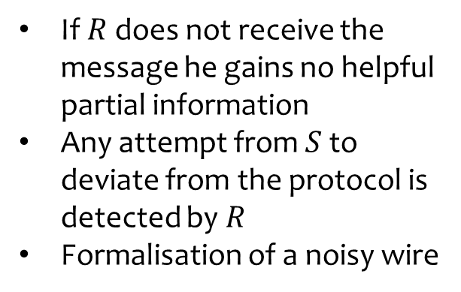






Formalisation (Even, Goldreich, Lempel)
An oblivious transfer $OT$($S,R,M$) of a message $M$is a protocol by which a sender $S$, transfers to a receiver $R$the message $M$st:
$R$gets $M$with probability ½
The a-posteriori probability that $R$ got $M$for $S$ is 1/2
If $R$ does not receive the message he gains no helpful partial information
Any attempt from $S$ to deviate from the protocol is detected by $R$
Formalisation of a noisy wire
$$M_{}^{}$$
$$M_{}^{}$$
$$S$$
$${OT}_{}^{}$$
$$R$$
$$\#_{}^{}$$

Slide 10








1-out-of-2 Oblivious Transfer
${OT}_{1}^{2} (S,R,M_{0},M_{1}):$A protocol by which a sender $S$ transfers ignorantly to a receiver $R$ one message out of two.
$R$ selects which message to receive without S learning it
$R$requests each message with probability 1/2
$$M_{0}^{}$$
$$b_{}^{}$$
$$S$$
$${OT}_{1}^{2}$$
$$R$$
$$M_{b}^{}$$
$$M_{1}^{}$$
$Result: OT and{ OT}_{1}^{2}$ are $equivalent$

Slide 11












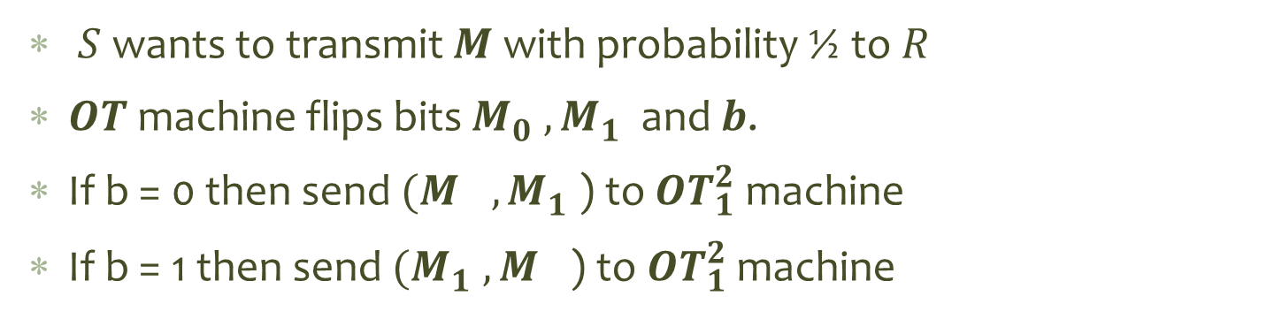
$OT from{ OT}_{1}^{2}$ (EGL)
$$M_{}^{}$$
$$M_{}^{}$$
$${OT}_{}^{}$$
$$b_{}^{}$$
$$M_{0}^{}$$
$${OT}_{1}^{2}$$
$$R$$
$$S$$
$$\#_{}^{}$$
$$M_{1}^{}$$
$$M_{b}^{}$$
$S$ wants to transmit $M$ with probability ½ to $R$
$OT$ machine flips bits $M_{0}^{}, M_{1}^{}$ and $b$.
If b = 0 then send ${(M}_{}^{}, M_{1}^{}$) to ${OT}_{1}^{2}$ machine
If b = 1 then send ${(M}_{1}^{}, M_{}^{}$) to ${OT}_{1}^{2}$ machine

Slide 12



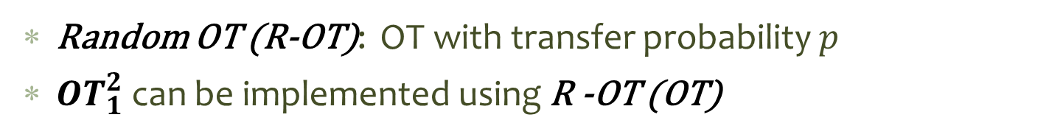






${OT}_{1}^{2} from OT$ (Crepeau)
Random OT (R-OT): OT with transfer probability $p$
${OT}_{1}^{2}$ can be implemented using R -OT (OT)
$${OT}_{1}^{2}$$
$$M_{1}^{}$$
$$b_{}^{}$$
$${OT}_{}^{}$$
$$S$$
$$R$$
$$M_{2}^{}$$
$$M_{b}^{}$$

Slide 13
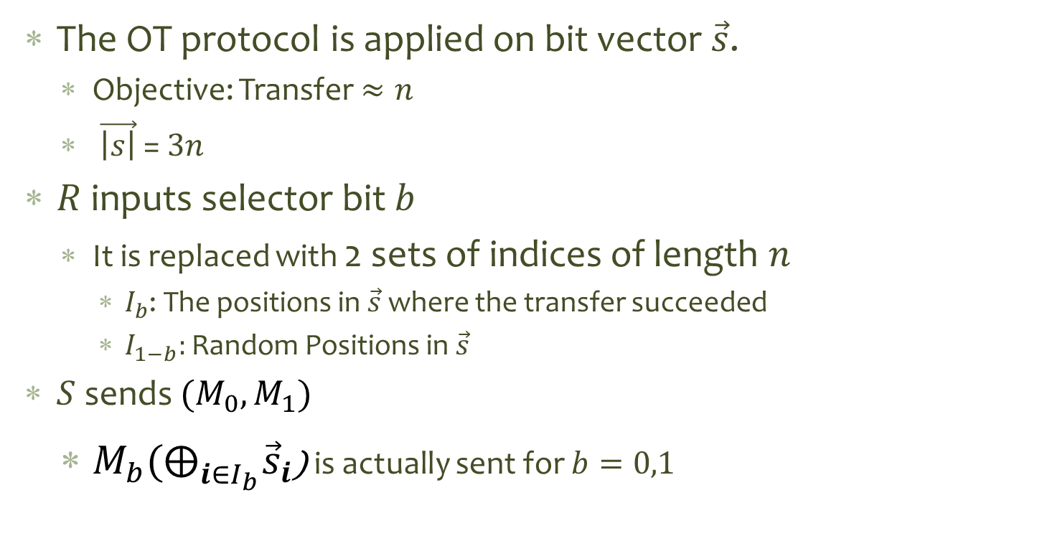
${OT}_{1}^{2} from OT$ (Crepeau)
The OT protocol is applied on bit vector $\vec{s}$.
Objective: Transfer $≈n$
$\vec{\left|s\right|}$ = $3n$
$R$ inputs selector bit $b$
It is replaced with 2 sets of indices of length $n$
$I_{b}$: The positions in $\vec{s}$ where the transfer succeeded
$I_{1−b}:$ Random Positions in $\vec{s}$
$S$ sends ${(M}_{0},M_{1})$
$M_{b}{(⨁}_{i∈I_{b}}^{}{\vec{s}}_{i}$) is actually sent for $b=0,1$

Slide 14

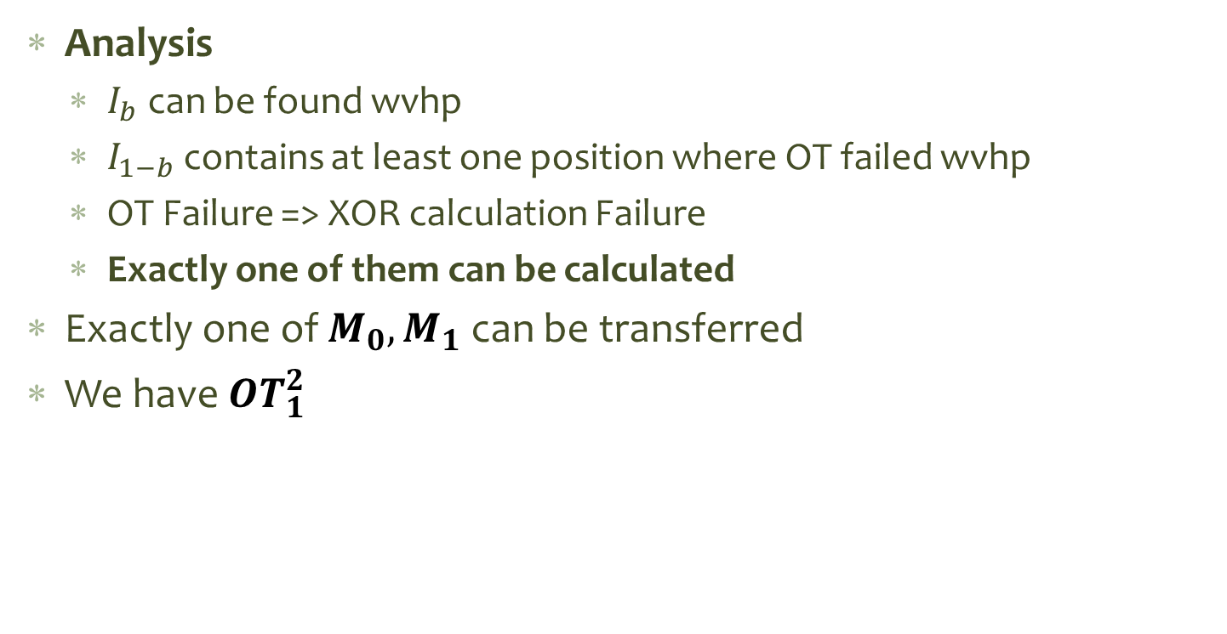
${OT}_{1}^{2} from OT$ (Crepeau, 1998)
Analysis
$I_{b}$ can be found wvhp
$I_{1−b}$ contains at least one position where OT failed wvhp
OT Failure => XOR calculation Failure
Exactly one of them can be calculated
Exactly one of $M_{0},M_{1}$ can be transferred
We have ${OT}_{1}^{2}$

Slide 15
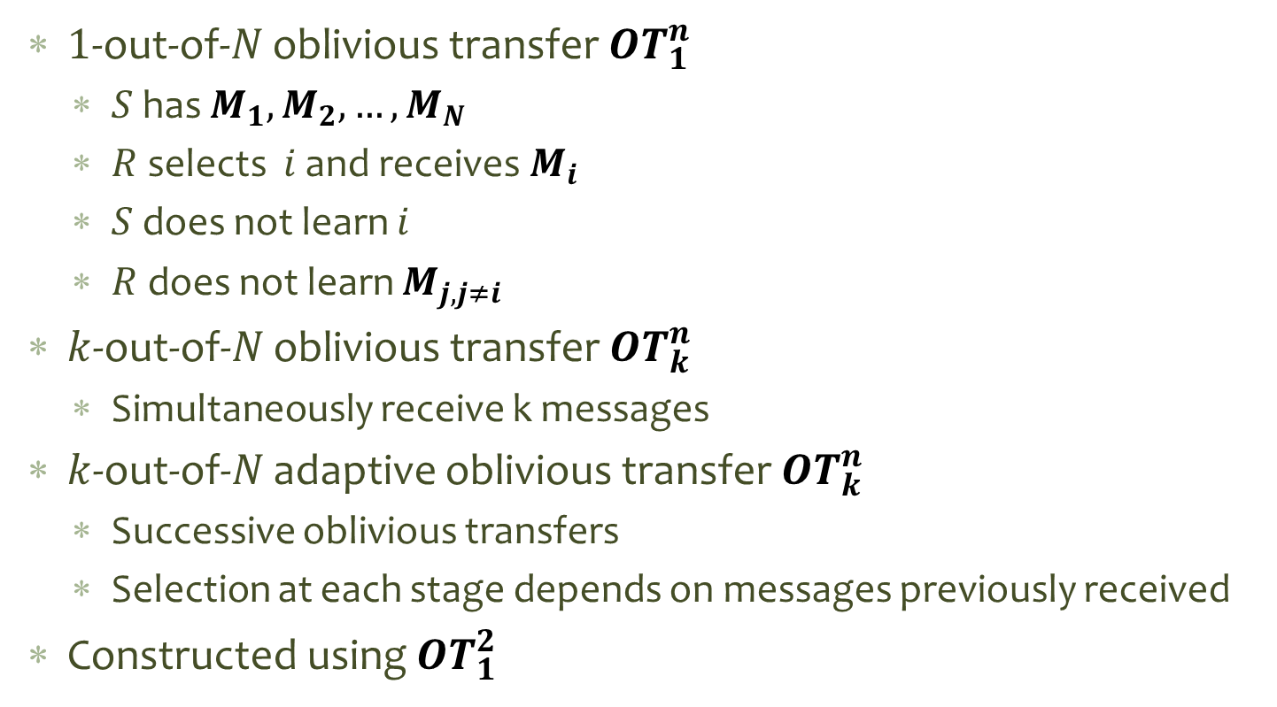
Other flavors
$1$-out-of-$N$ oblivious transfer ${OT}_{1}^{n}$
$S$ has $M_{1},M_{2}, …, M_{N}$
$R$ selects $i$ and receives${ M}_{i}$
$S$ does not learn $i$
$R$ does not learn $M_{j, j≠i}$
$k$-out-of-$N$ oblivious transfer ${OT}_{k}^{n}$
Simultaneously receive k messages
$k$-out-of-$N$ adaptive oblivious transfer ${OT}_{k}^{n}$
Successive oblivious transfers
Selection at each stage depends on messages previously received
Constructed using ${OT}_{1}^{2}$
Notes:
Information theoretically equivalent

Slide 16

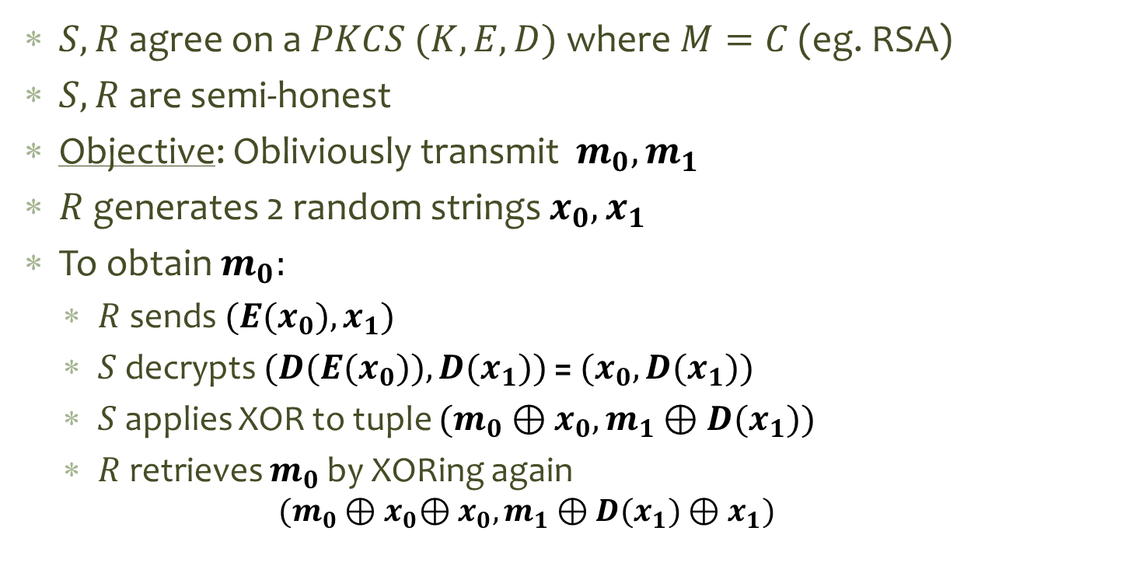
Generic Implementation of ${OT}_{1}^{2}$
$S,R$ agree on a $PKCS (K,E,D)$where $M=C$ (eg. RSA)
$S,R$ are semi-honest
Objective: Obliviously transmit $m_{0},m_{1}$
$R$ generates 2 random strings $x_{0},x_{1}$
To obtain $m_{0}:$
$R$ sends ${(E(x}_{0}),x_{1})$
$S$ decrypts ${(D(E(x}_{0})),D(x_{1}))$ = ${(x}_{0},D(x_{1}))$
$S$ applies XOR to tuple ${(m_{0}⊕x}_{0},m_{1}⊕D(x_{1}))$
$R$ retrieves $m_{0}$ by XORing again
$${(m_{0}⊕x}_{0}{⊕x}_{0},m_{1}⊕D(x_{1}){⊕x}_{1})$$

Slide 17
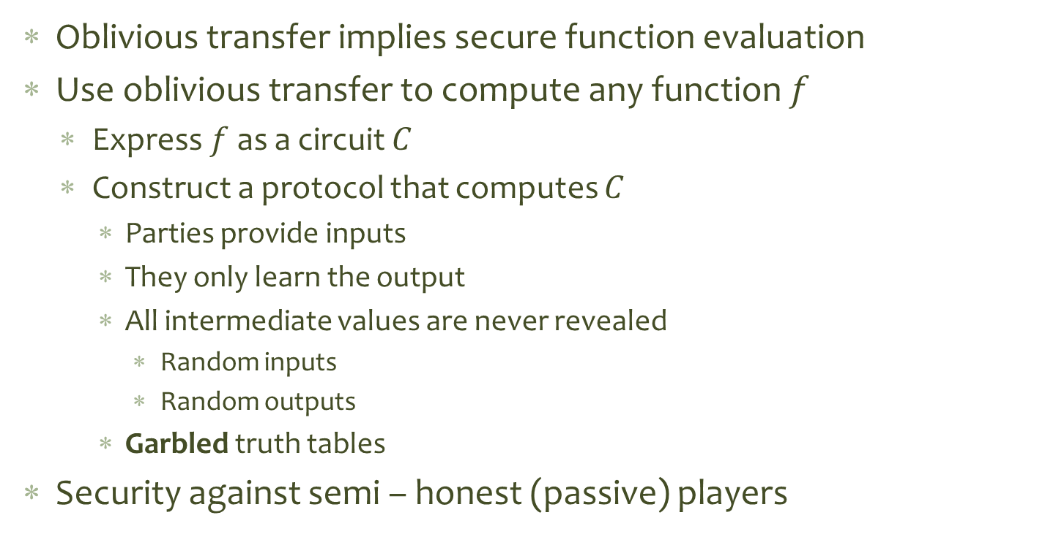
OT and SFE: Yao’s construction
Oblivious transfer implies secure function evaluation
Use oblivious transfer to compute any function $f$
Express $f$ as a circuit $C$
Construct a protocol that computes $C$
Parties provide inputs
They only learn the output
All intermediate values are never revealed
Random inputs
Random outputs
Garbled truth tables
Security against semi – honest (passive) players

Slide 18
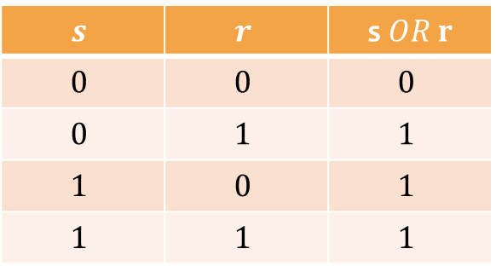
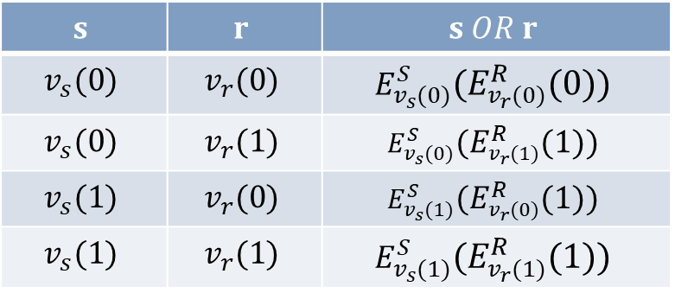
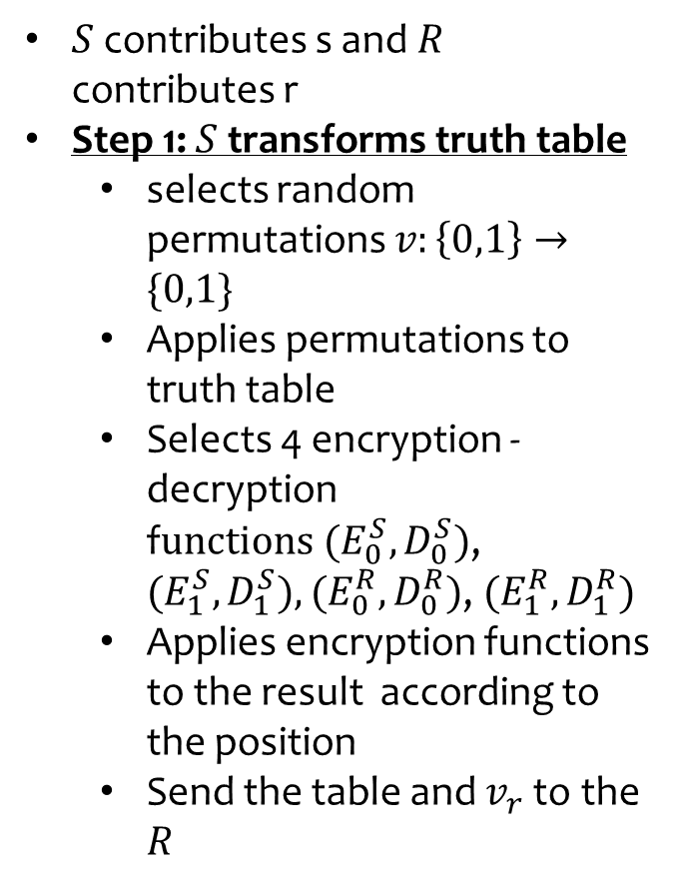
An OR Gate with OT
$S$contributes s and $R$ contributes r
Step 1: $S$transforms truth table
selects random permutations $v:\left\{0,1\right\}→\{0,1\}$
Applies permutations to truth table
Selects 4 encryption -decryption f$unctions {(E}_{0}^{S},D_{0}^{S})$, ${(E}_{1}^{S},D_{1}^{S}),{(E}_{0}^{R},D_{0}^{R})$, ${(E}_{1}^{R},D_{1}^{R})$
Applies encryption functions to the result according to the position
Send the table and $v_{r}$ to the $R$
$$s$$ | $$r$$ | s$OR r$
$$0$$ | $$0$$ | $$0$$
$$0$$ | $$1$$ | $$1$$
$$1$$ | $$0$$ | $$1$$
$$1$$ | $$1$$ | $$1$$
$$s$$ | $$r$$ | $$s OR r$$
$$v_{s}(0)$$ | $$v_{r}(0)$$ | $$E_{v_{s}(0)}^{S}{(E}_{v_{r}(0)}^{R}(0))$$
$$v_{s}(0)$$ | $$v_{r}(1)$$ | $$E_{v_{s}(0)}^{S}{(E}_{v_{r}(1)}^{R}(1))$$
$$v_{s}(1)$$ | $$v_{r}(0)$$ | $$E_{v_{s}(1)}^{S}{(E}_{v_{r}(0)}^{R}(1))$$
$$v_{s}(1)$$ | $$v_{r}(1)$$ | $$E_{v_{s}(1)}^{S}{(E}_{v_{r}(1)}^{R}(1))$$
Notes:
Sender constructs, Receiver computes

Slide 19
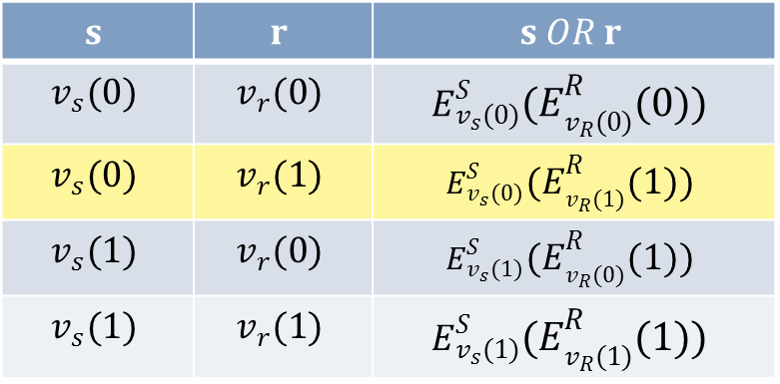
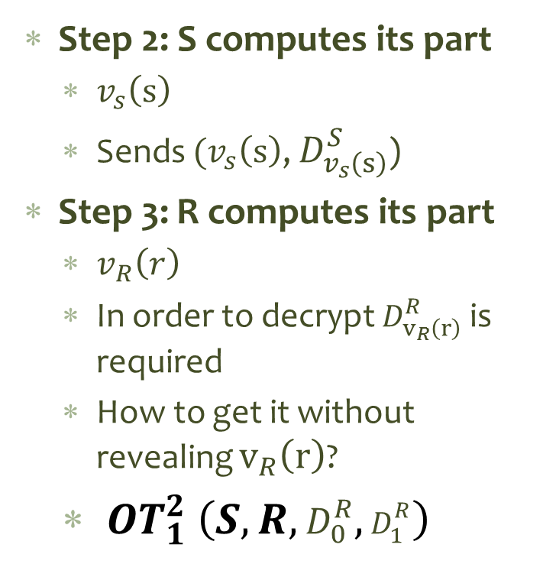
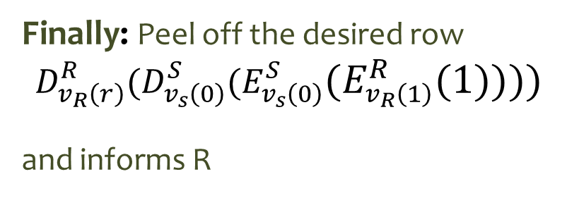
An OR Gate with OT (2)
Step 2: S computes its part
$v_{s}\left(s\right)$
Sends ${(v}_{s}\left(s\right)$, $D_{v_{s}\left(s\right)}^{S}$)
Step 3: R computes its part
$v_{R}\left(r\right)$
In order to decrypt $D_{v_{R}\left(r\right)}^{R}$ is required
How to get it without revealing $v_{R}\left(r\right)$?
${ OT}_{1}^{2} \left(S,R,D_{0}^{R},D_{1}^{R}\right)$
$$s$$ | $$r$$ | $$s OR r$$
$$v_{s}(0)$$ | $$v_{r}(0)$$ | $$E_{v_{s}(0)}^{S}{(E}_{v_{R}(0)}^{R}(0))$$
$$v_{s}(0)$$ | $$v_{r}(1)$$ | $$E_{v_{s}(0)}^{S}{(E}_{v_{R}(1)}^{R}(1))$$
$$v_{s}(1)$$ | $$v_{r}(0)$$ | $$E_{v_{s}(1)}^{S}{(E}_{v_{R}(0)}^{R}(1))$$
$$v_{s}(1)$$ | $$v_{r}(1)$$ | $$E_{v_{s}(1)}^{S}{(E}_{v_{R}(1)}^{R}(1))$$
Finally: Peel off the desired row
$${D_{v_{R}\left(r\right)}^{R}(D}_{v_{s}\left(0\right)}^{S}{(E}_{v_{s}\left(0\right)}^{S}{(E}_{v_{R}\left(1\right)}^{R}(1))))$$
and informs R
Question: Why not send both $D_{0}^{R},D_{1}^{R}$?

Slide 20
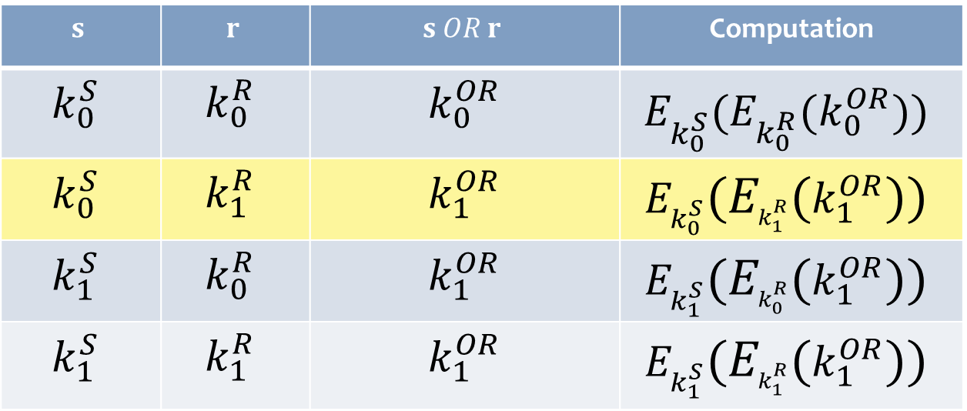
In reality …
The rows of the table are randomly permuted
The result is a random permutation as well
View everything as keys (6 keys / gate)
$$s$$ | $$r$$ | $$s OR r$$ | Computation
$$k_{0}^{S}$$ | $$k_{0}^{R}$$ | $$k_{0}^{OR}$$ | $$E_{k_{0}^{S}}^{}{(E}_{k_{0}^{R}}^{}(k_{0}^{OR}))$$
$$k_{0}^{S}$$ | $$k_{1}^{R}$$ | $$k_{1}^{OR}$$ | $$E_{k_{0}^{S}}^{}{(E}_{k_{1}^{R}}^{}(k_{1}^{OR}))$$
$$k_{1}^{S}$$ | $$k_{0}^{R}$$ | $$k_{1}^{OR}$$ | $$E_{k_{1}^{S}}^{}{(E}_{k_{0}^{R}}^{}(k_{1}^{OR}))$$
$$k_{1}^{S}$$ | $$k_{1}^{R}$$ | $$k_{1}^{OR}$$ | $$E_{k_{1}^{S}}^{}{(E}_{k_{1}^{R}}^{}(k_{1}^{OR}))$$

Slide 21
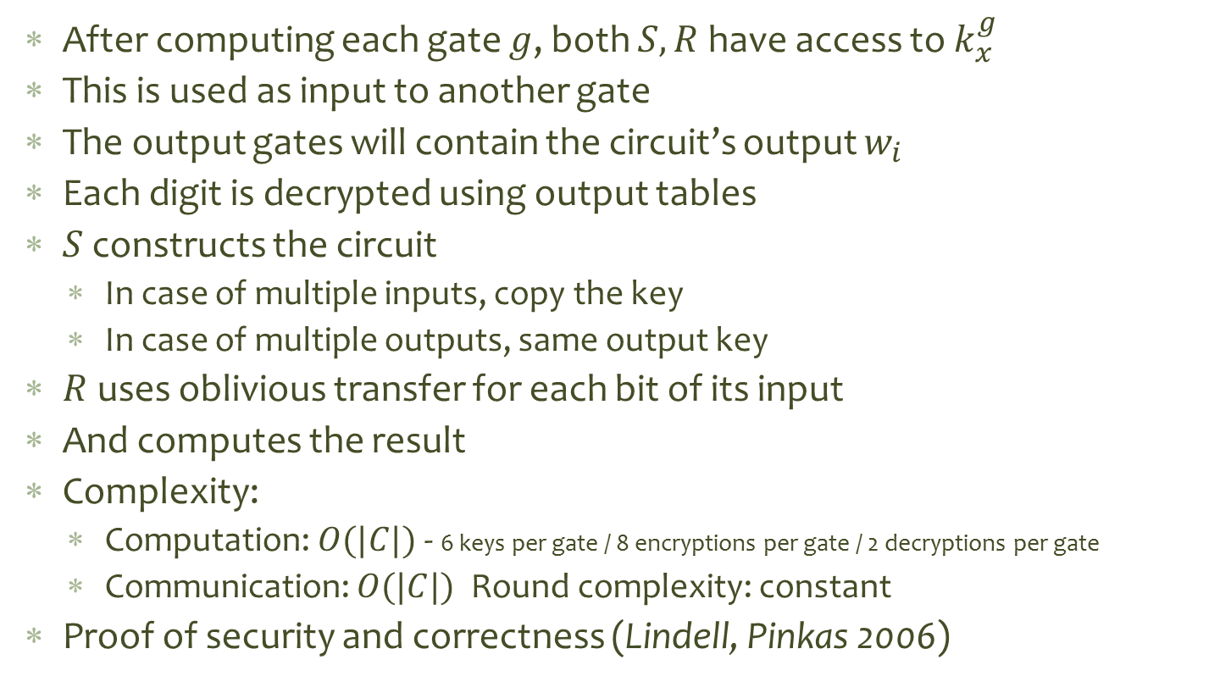
Building up the circuit
After computing each gate $g$, both $S, R$have access to $k_{x}^{g}$
This is used as input to another gate
The output gates will contain the circuit’s output $w_{i}$
Each digit is decrypted using output tables
$S$ constructs the circuit
In case of multiple inputs, copy the key
In case of multiple outputs, same output key
$R$ uses oblivious transfer for each bit of its input
And computes the result
Complexity:
Computation: $O(|C|)$- 6 keys per gate / 8 encryptions per gate / 2 decryptions per gate
Communication: $O(|C|)$ Round complexity: constant
Proof of security and correctness (Lindell, Pinkas 2006)

Slide 22
Bibliography
Yao, A. C. "Protocols for secure computations“ (FOCS 1982): 160–164
Rabin M. O. "How to exchange secrets by oblivious transfer." ,TR-81, Harvard University, 1981
S. Even, O. Goldreich, and A. Lempel. 1985. A randomized protocol for signing contracts. Commun. ACM 28, 6 (June 1985), 637-647
Claude Crépeau. 1987. Equivalence Between Two Flavours of Oblivious Transfers. In A Conference on the Theory and Applications of Cryptographic Techniques on Advances in Cryptology (CRYPTO '87, UK, 350-354.
Yehuda Lindell and Benny Pinkas. 2009. A Proof of Security of Yao’s Protocol for Two-Party Computation. J. Cryptol. 22, 2 (April 2009), 161-188
Ostrofski R., CS 282A/MATH 209A: Foundations of Cryptography, Lecture 10, Oblivious Transfer
Gabriel Bender, Cryptography and Secure Two-Party Computation, August 21, 2006, http://www.math.uchicago.edu/~may/VIGRE/VIGRE2006/PAPERS/Bender.pdf

