Slide 1

Playing with the shadows: The Tower of Brahma
Learning to think in a digital society
Grontas Panagiotis, Kotarinou Panagiota, Kouletsi Eirini, Milonis Konstantinos, Pliakou Maria, Hadzi Maria, Houpi Maria

Slide 2
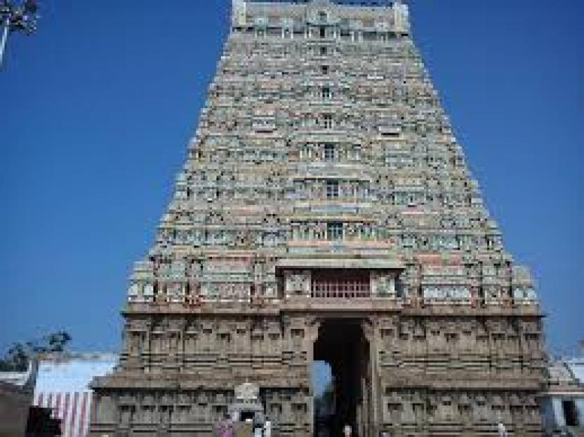
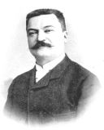
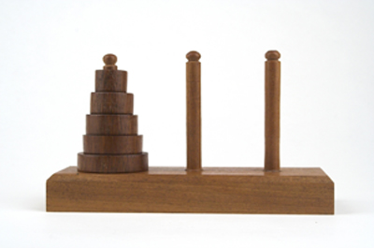
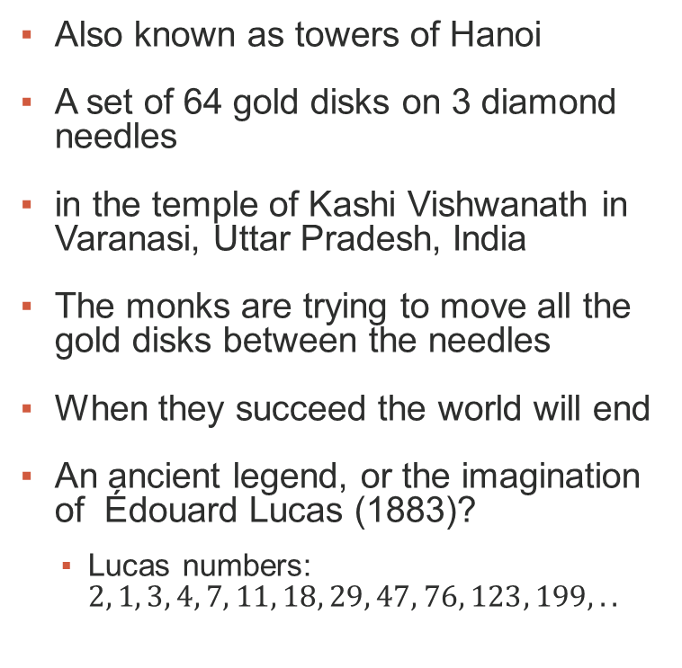
The towers of Brahma
Also known as towers of Hanoi
A set of 64 gold disks on 3 diamond needles
in the temple of Kashi Vishwanath in Varanasi, Uttar Pradesh, India
The monks are trying to move all the gold disks between the needles
When they succeed the world will end
An ancient legend, or the imagination of Édouard Lucas (1883)?
Lucas numbers: $2, 1, 3, 4, 7, 11, 18, 29, 47, 76, 123, 199,..$
Notes:
http://larc.unt.edu/ian/TowersOfHanoi/index64.html

Slide 3
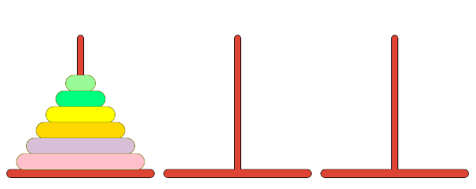
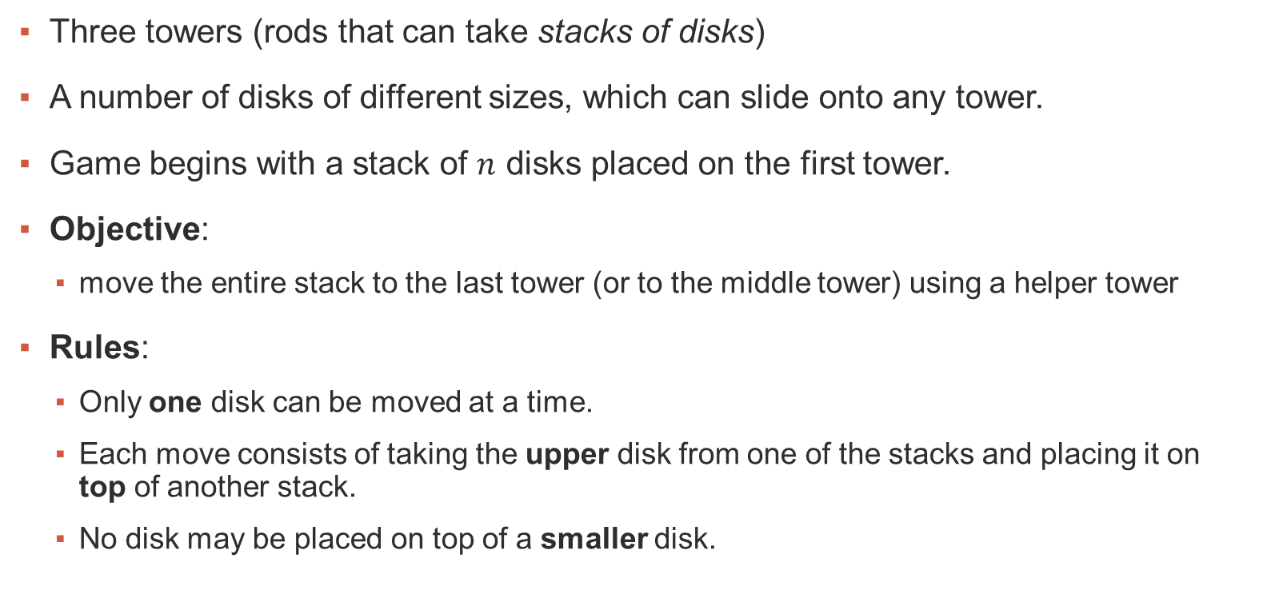
Problem statement
Three towers (rods that can take stacks of disks)
A number of disks of different sizes, which can slide onto any tower.
Game begins with a stack of $n$ disks placed on the first tower.
Objective:
move the entire stack to the last tower (or to the middle tower) using a helper tower
Rules:
Only one disk can be moved at a time.
Each move consists of taking the upper disk from one of the stacks and placing it on top of another stack.
No disk may be placed on top of a smaller disk.

Slide 4
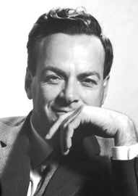
Solution:
The Feynman ‘Method’
Read the problem, carefully
Think very hard
Write down the answer
How to think very hard?
Apply methods from computational thinking

Slide 5
Computational Thinking
Computer Science is no more about (electronic) computers
than astronomy is about telescopes (Edsger W. Dijkstra)
than biology is about the microscope
than chemistry is about the test tube
Add your favorite science and its tools
Notes:
Add about chemistry, biology

Slide 6
Computational Thinking
the universal methods of computer science that can be applied to real world problems
the computing processes, whether they are executed by a human or by a machine (Jeannette M. Wing)
Answers and raises fundamental questions about:
What is computable (doable)
How difficult/efficient is it to compute something
What can humans/computers do better than computers/humans
Advanced by electronic computers in the same way that reading and writing was advanced by typography
Notes:
Add about chemistry, biology

Slide 7
Real world examples of computational processes
Finding the minimum and/or maximum in a sequence of numbers
Application in discovering the range of a musical score
Looking up a name in an alphabetically sorted list
start at the top or
start in the middle
Sorting a class of students by height
When all are in the same room
As they come through the door
Packing a bag with books/clothes
Abstraction
A lawyer tries to find a loophole to acquit a defendant
A programmer tries to find why the program does not work correctly
A doctor tries to explain an unusual symptom
In general: problem solving

Slide 8
Algorithm
The central concept of computer science
Describes the steps required to solve a problem
Consists of well defined actions
That execute in a particular order
Cause small changes
That add up to create the problem solution
We are more interested in the steps than the solution itself
Properties:
Correctness
Resource use

Slide 9
Algorithm Building Blocks
Sequence:
Put actions in order
Describe what must be done first, second etc.
Choice:
Select actions to perform based on criteria.
Satisfy problem constraints
Iteration - Recursion:
Identify patterns – actions that are repeated
Need not be identical – small differences are allowed
These structures describe our everyday life – nothing special about computers

Slide 10
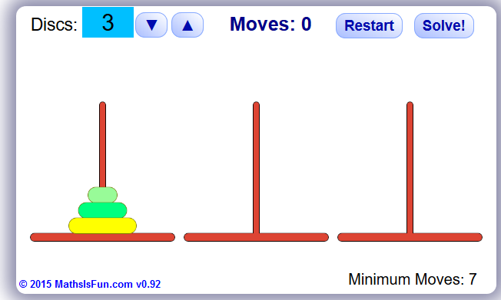
Back to Brahma - Practice
Visit:
https://www.mathsisfun.com/games/towerofhanoi.html
Try it for yourself some times
Increase the number of disks
4 and 5 will do
Retry
Record the number of moves

Slide 11
Keep in mind
Try not to move disks randomly
Think that you are playing in slow motion
Identify the basic steps
Identify the constraints
Identify the repetitions
Tip: Try to look some steps ahead:
What will it take for a particular disc to be placed on its final position
Can we do better?
What is the minimum number of moves?

Slide 12
Problem Analysis
Back to Feynman
How to think very hard at solving the towers game?
We can break the difficult problem, into smaller subproblems
Hopefully these smaller subproblems will be easier
If not, repeat
Break each subproblem to simpler subsubproblems
Until, we have reached problems that can be solved easily or even trivially

Slide 13
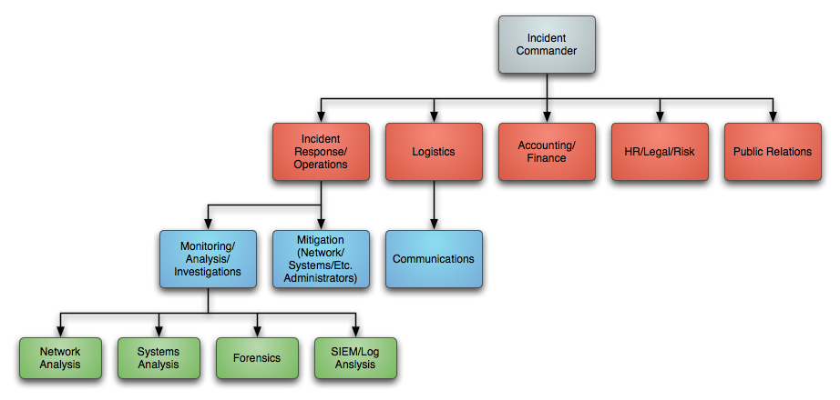
… and Synthesis
Having solved the trivial problems, we combine the solutions
Until we have solved the original problem
How do we identify the subproblems
Smaller scale
Different aspects
It takes practice
Computer science provides us with the vocabulary to transform our analysis into working computer instructions
This Photo by Unknown Author is licensed under CC BY-NC-SA

Slide 14

Abstraction
If a subproblem remains hard there is a magic trick:
Assume that we have solved it
Give it a name
Can we use the solution as a black box to solve more difficult problems
Black boxes are called functions in computer science
As a result the initial problem is transformed into:
A trivial problem that can be solved
A difficult problem that cannot be solved but can be utilized
Can we combine the two?

Slide 15
Case in point
What are the subproblems?
Since we are only moving disks the only possible subproblem is to move fewer disks
The full problem:
towers(n,A,C): move n disks from tower A to tower C
A smaller problem can be:
towers(n-1,A,B)
The trivial problem is:
towers(1,A,C): move 1 disk from tower A to tower C
How to combine

Slide 16
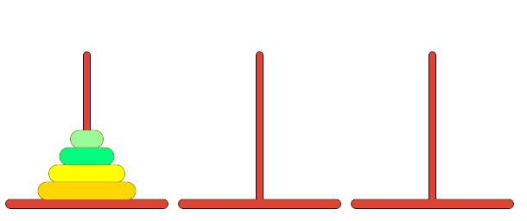
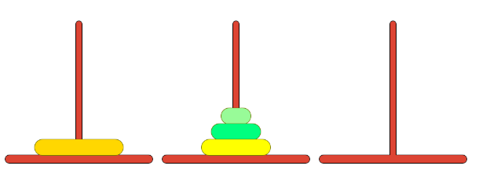
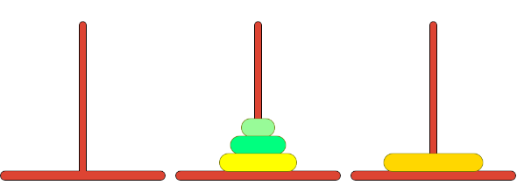
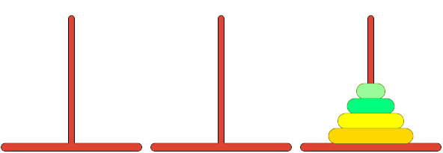
Subproblems: One less + One Move + One less
To solve towers(4,A,C)
Solve towers(3,A,B)
Tower B is used as a helper
Solve towers(1,A,C)
Move disk 4 to tower C
The trivial step
Solve towers(3,B,C)

Slide 17
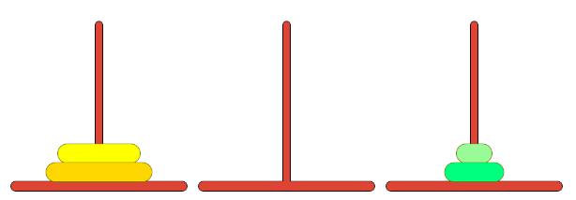
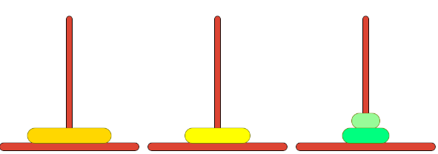
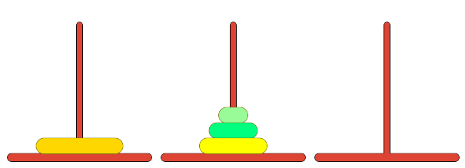
Repeat: One less + One Move + One less
But: how to solve towers(3,A,B) ?
Abstract!
Solve towers(2,A,C)
Solve towers(1,A,B)
Solve towers(2,C,B)

Slide 18
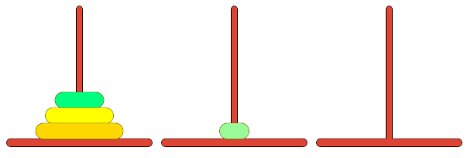
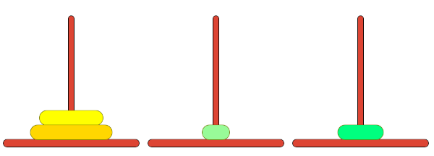
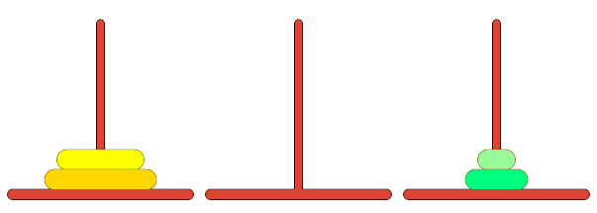
Repeat: One less + One Move + One less
Again: how to solve towers(2,A,C) ?
Abstract!
Solve towers(1,A,B)
Solve towers(1,A,C)
Solve towers(1,B,C)
Trivial problems: Move a single disk

Slide 19
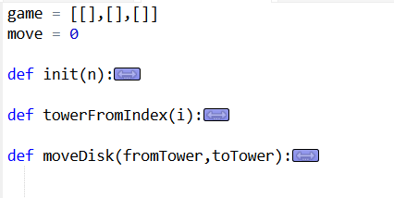
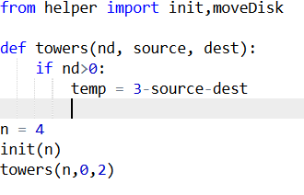
Coding Time
Visit https://repl.it/KiNR/11
A program in Python that solves the problem is presented
Press the fork button to create a duplicate to play
You have to complete the program using the presented analysis

Slide 20
Explanation & Instructions
Do NOT touch (helper.py)
Do touch (main.py)
game: represents the current state of the towers
moves: counts the moves
init: housekeeping before the game is played
moveDisk: moves the upmost disk between the towers specified
n: to adjust the number of disks
towers: the actions needed to solve the game
Hints:
0: tower A, 1: tower B, 2: tower C
They sum to 3, so to find temp tower subtract from 3 the sum of the other two
Use only the moveDisk and towers functions

Slide 21

Your turn
This Photo by Unknown Author is licensed under CC BY-NC-SA

Slide 22

Computational Complexity
How many steps did the algorithm perform in relation to the input?
Answer: For $n$ disks: $t\left(n\right)=2^{n}−1$
Why:
$$t\left(n\right)={2t(n−1)}^{}+1=$$
= $2(2t(n−2)+1)+1=$
=$4t\left(n−2\right)+3=$
= $8t\left(n−3\right)+7$ =
= … =
= $2^{n−1}t\left(1\right)+$ $2^{n−1}−1$ =
= $2^{n−1} 1+$ $2^{n−1}−1$ =
= $2^{n}−1$
Is this ok?

Slide 23
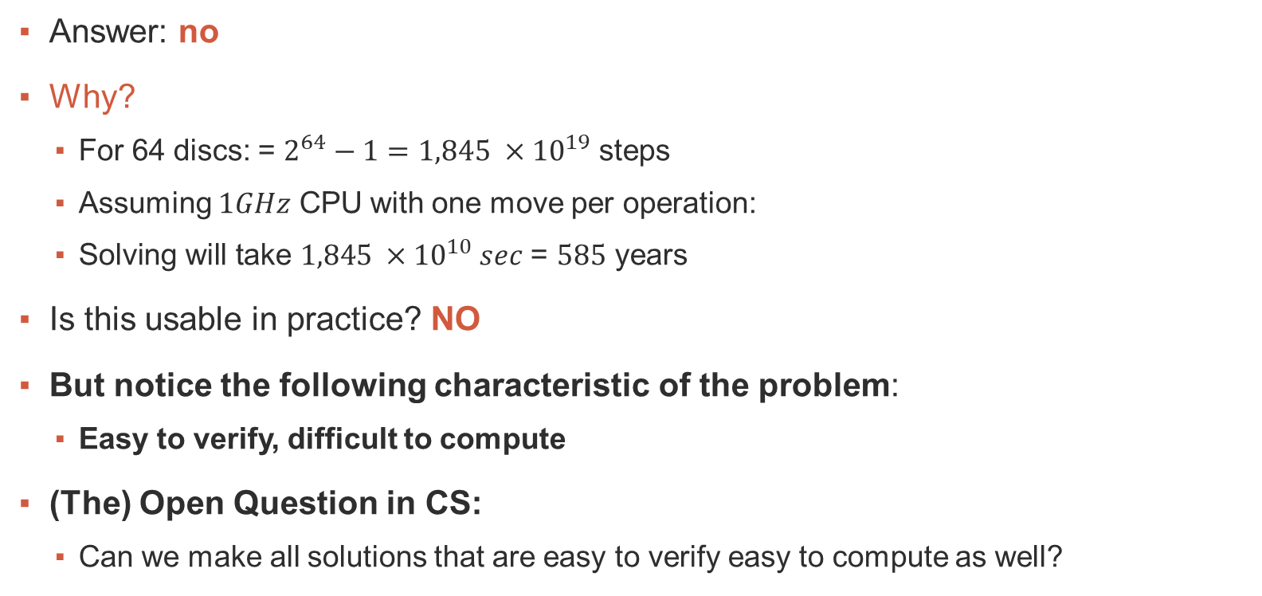
Computational Complexity
Answer: no
Why?
For 64 discs: = $2^{64}−1=1,845 ×{10}^{19}$ steps
Assuming $1GHz$ CPU with one move per operation:
$\text{S}\text{olving} \text{will} \text{take} 1,845 ×{10}^{10} sec$ = $585$ years
Is this usable in practice? NO
But notice the following characteristic of the problem:
Easy to verify, difficult to compute
(The) Open Question in CS:
Can we make all solutions that are easy to verify easy to compute as well?

