Slide 1
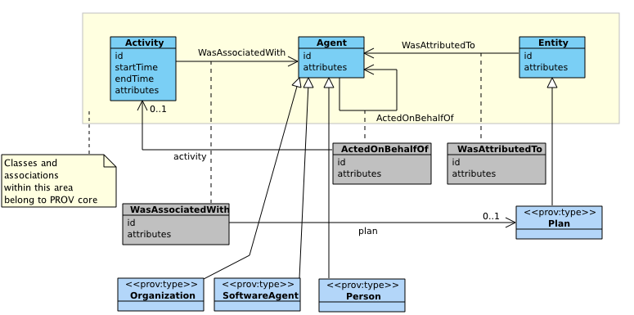
PROV Data Model - RDF Interoperability – Data Properties, Object Properties, UML Attributes, UML Associations Luc Moreau
In PROV-O, prov:atLocation, rdf:type, prov:hadRole:
are object properties
are not data properties
expect an URI as object
ex:Monalisa a prov:Entity, ex:StillImage;
prov:hadLocation ex:Paris.
entity(ex:MonaLisa,
[ prov:location=”Paris",
prov:type="StillImage" ])
In PROV-DM/PROV-N: prov:location, prov:type, prov:role:
are defined as attributes
are not association between top-level classes
allow for strings as values.
provtoolbox roundtrip conversion require a map from the other, and vice-versa
Solution directions:
Both data/object properties?
Both UML attributes/associations?
Adhoc translations?
Learn from JSON-LD context?

