Slide 1
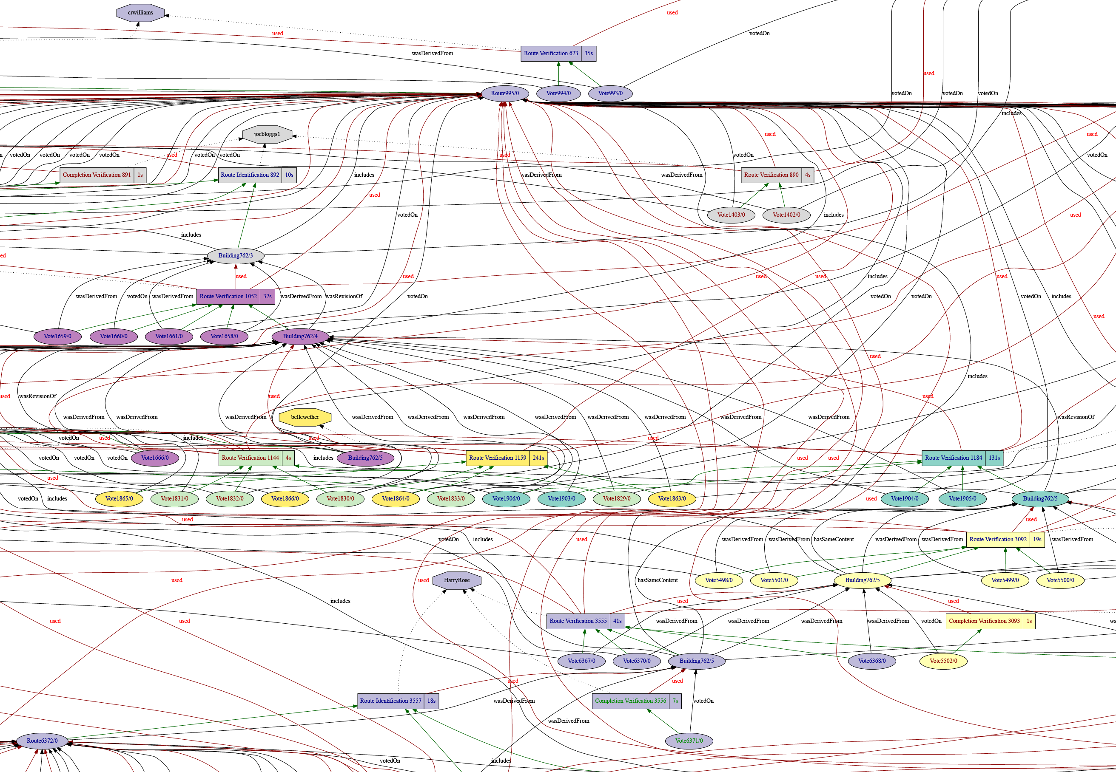
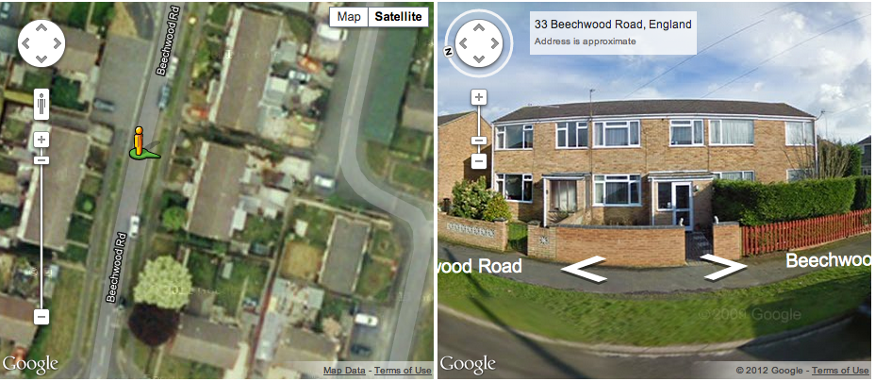
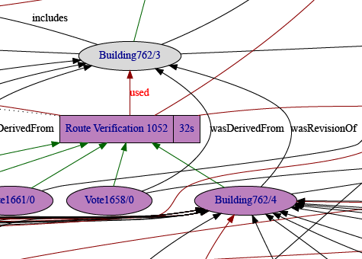
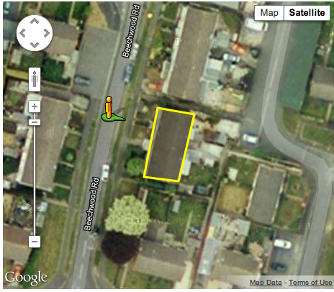
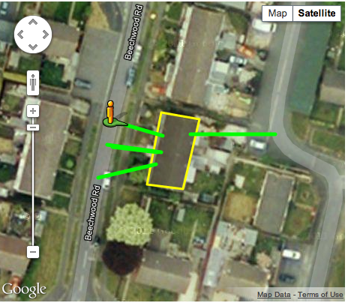
CollabMap: Provenance for data quality assessment
www.collabmap.org
Notes:
A brief introduction about CollabMap: a crowdsourcing application to build evacuation route map for Fawley
A provenance graph from the application: over 5,000 graphs in total, up to 200 nodes in each graph
Decision tree to classify data quality based on the network metrics of their provenance graphs: over 95% accuracy

