Slide 1
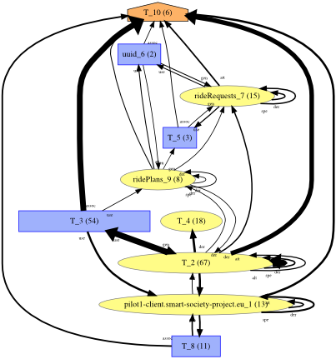
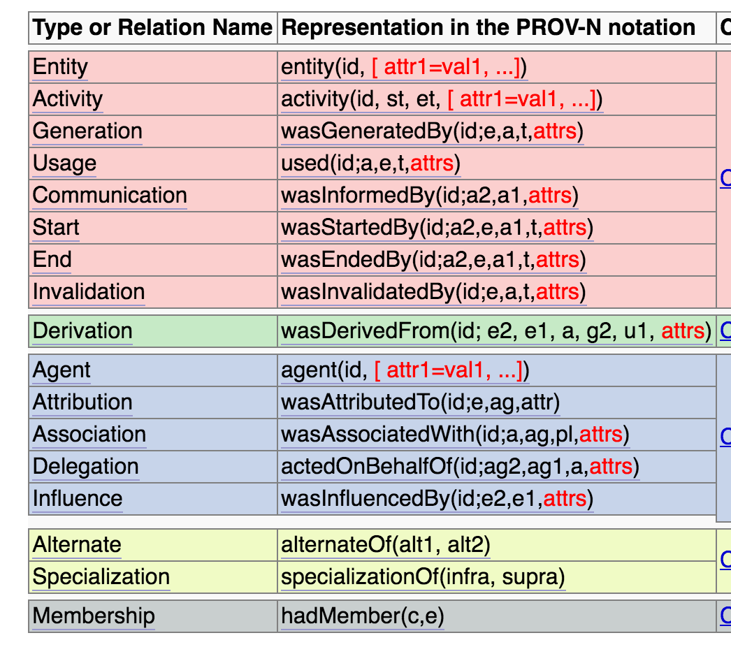
Directed Qualified Pattern, Influence, Non-Influence Relations, Optional Attributes Luc Moreau
In PROV-DM, most terms are equipped with optional attribute-value pairs “representing additional information”.
In PROV-O, most properties are accompanied by the “directed qualified pattern”
Except SpecializationOf, AlternateOf, and HadMember
Size of
edges is
encoded as
attribute
Solution
Define the directed qualified pattern in a standalone fashion, independently of the notion of influence in PROV
Make Influence follow the Directed Qualified Pattern.
Make SpecializationOf, AlternateOf, HadMember extensible. This means,
optional identifiers and attributes in PROV-DM,
follow the Directed Qualified Pattern in PROV-O.
SpecializationOf, AlternateOf, HadMember are not an influence.

