Slide 1
Workflow Modelling & Process Management MR3
TVGrabber Group 10

Slide 2
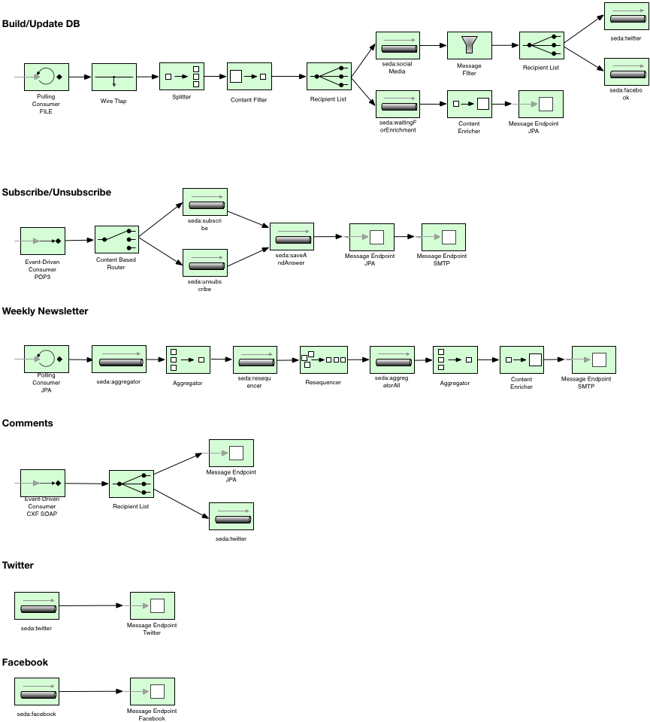

Slide 3

Component | Status
File
Sql
Facebook
Twitter
Rest
Smtp
Mock
Cxf
Notes:
file Read Guide.xml file sql Read/Save from/to SQL Database facebook Post to Facebook twitter Post Twitter rest Request IMDb via REST smtp Receiving/Sending emails mock OR test mock or test component for Unit testing (depends on impl.) cxf Receiving SOAP messages

Slide 4
Status
EIP | Status
Resequencer
Content Filter
WireTap
Polling Consumer
Content Enricher
Throttle
Recipient List
Message Filter
Dead Letter Channel
Aggregator
Message history
Event driven consumer
Multicast
…
Notes:
Wire Tap Backup series Publish Subscribe Newsletter Polling Consumer Fetch/Update series data every day at 00:00 Content Enricher Attach official ratings to series (eg. from imdb.com) Normalizer Normalize ratings from different sources Recipient List Updates: Twitter, Facebook, Database Message Filter Discard duplicate records Dead Letter Channel If exceptions occur, send message to dead letter channel Aggregator Aggregate series for newsletter Message History Backtrace messages Event driven consumer Process incoming mails (event-based)

Slide 5
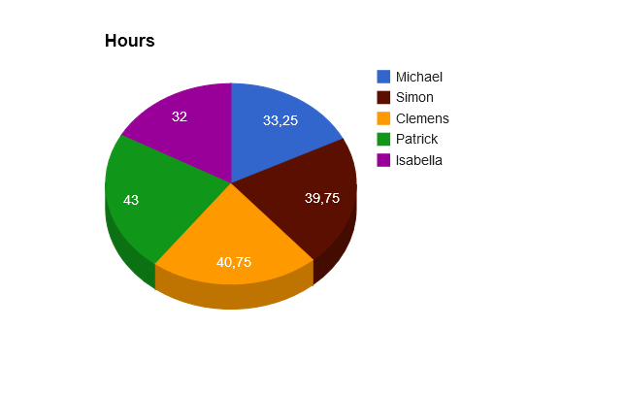
Hours list

