Slide 1
TV-Grabber
Michael Bertsch
Clemens Felder
Patrick Grutsch
Isabella Knappe
Simon Stammler

Slide 2

Idea
Precise Information
Commenting
Update
Schedule changes
New releases
Recommendation

Slide 3
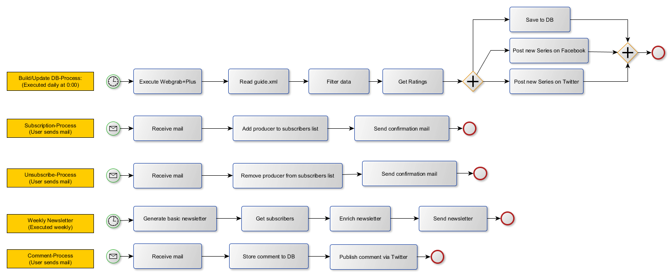
Workflows

Slide 4
Enterprise Integration Pattern
Resequencer
Content Filter
Wire Tap
Publish Subscribe
Polling Consumer
Content Enricher
Normalizer
Reorder series for newsletter depending on air time
Filter uninteresting data (eg. video/aspect from xml file)
Backup series
Newsletter
Fetch/Update series data every day at 00:00
Attach official ratings to series (eg. from imdb.com)
Normalize ratings from different sources

Slide 5
Enterprise Integration Pattern
Control Bus
Recipient List
Message Filter
Dead Letter Channel
Aggregator
Message History
Test messages
Monitoring our system
Updates: Twitter, Facebook, Database
Discard duplicate records
If exceptions occur, send message to dead letter channel
Aggregate series for newsletter
Backtrace messages
Test purpose

