Slide 1
User Input
Robin slung the bow over his shoulder
Tokenisation
Robin
slung
the
bow
over
his
shoulder

Slide 2
User Input
Robin slung the bow over his shoulder
Tokenisation
Robin
slung
the
bow
over
his
shoulder
-1.65
2.32
4.77
-0.54
1.22
5.41
…
8.47
4.54
1.05
-0.25
-2.41
3.64
-1.22
…
2.46
-2.33
1.98
-1.85
1.11
-9.25
0.21
…
-2.56
-0.03
4.01
1.25
-1.68
-2.22
3.14
…
0.02
1.13
3.87
-0.58
-1.58
4.64
1.42
…
-1.47
-2.14
9.24
1.57
5.22
-1.54
2.31
…
3.16
-5.14
-2.32
-2.14
-1.24
3.33
1.41
…
2.74
Embeddings

Slide 3
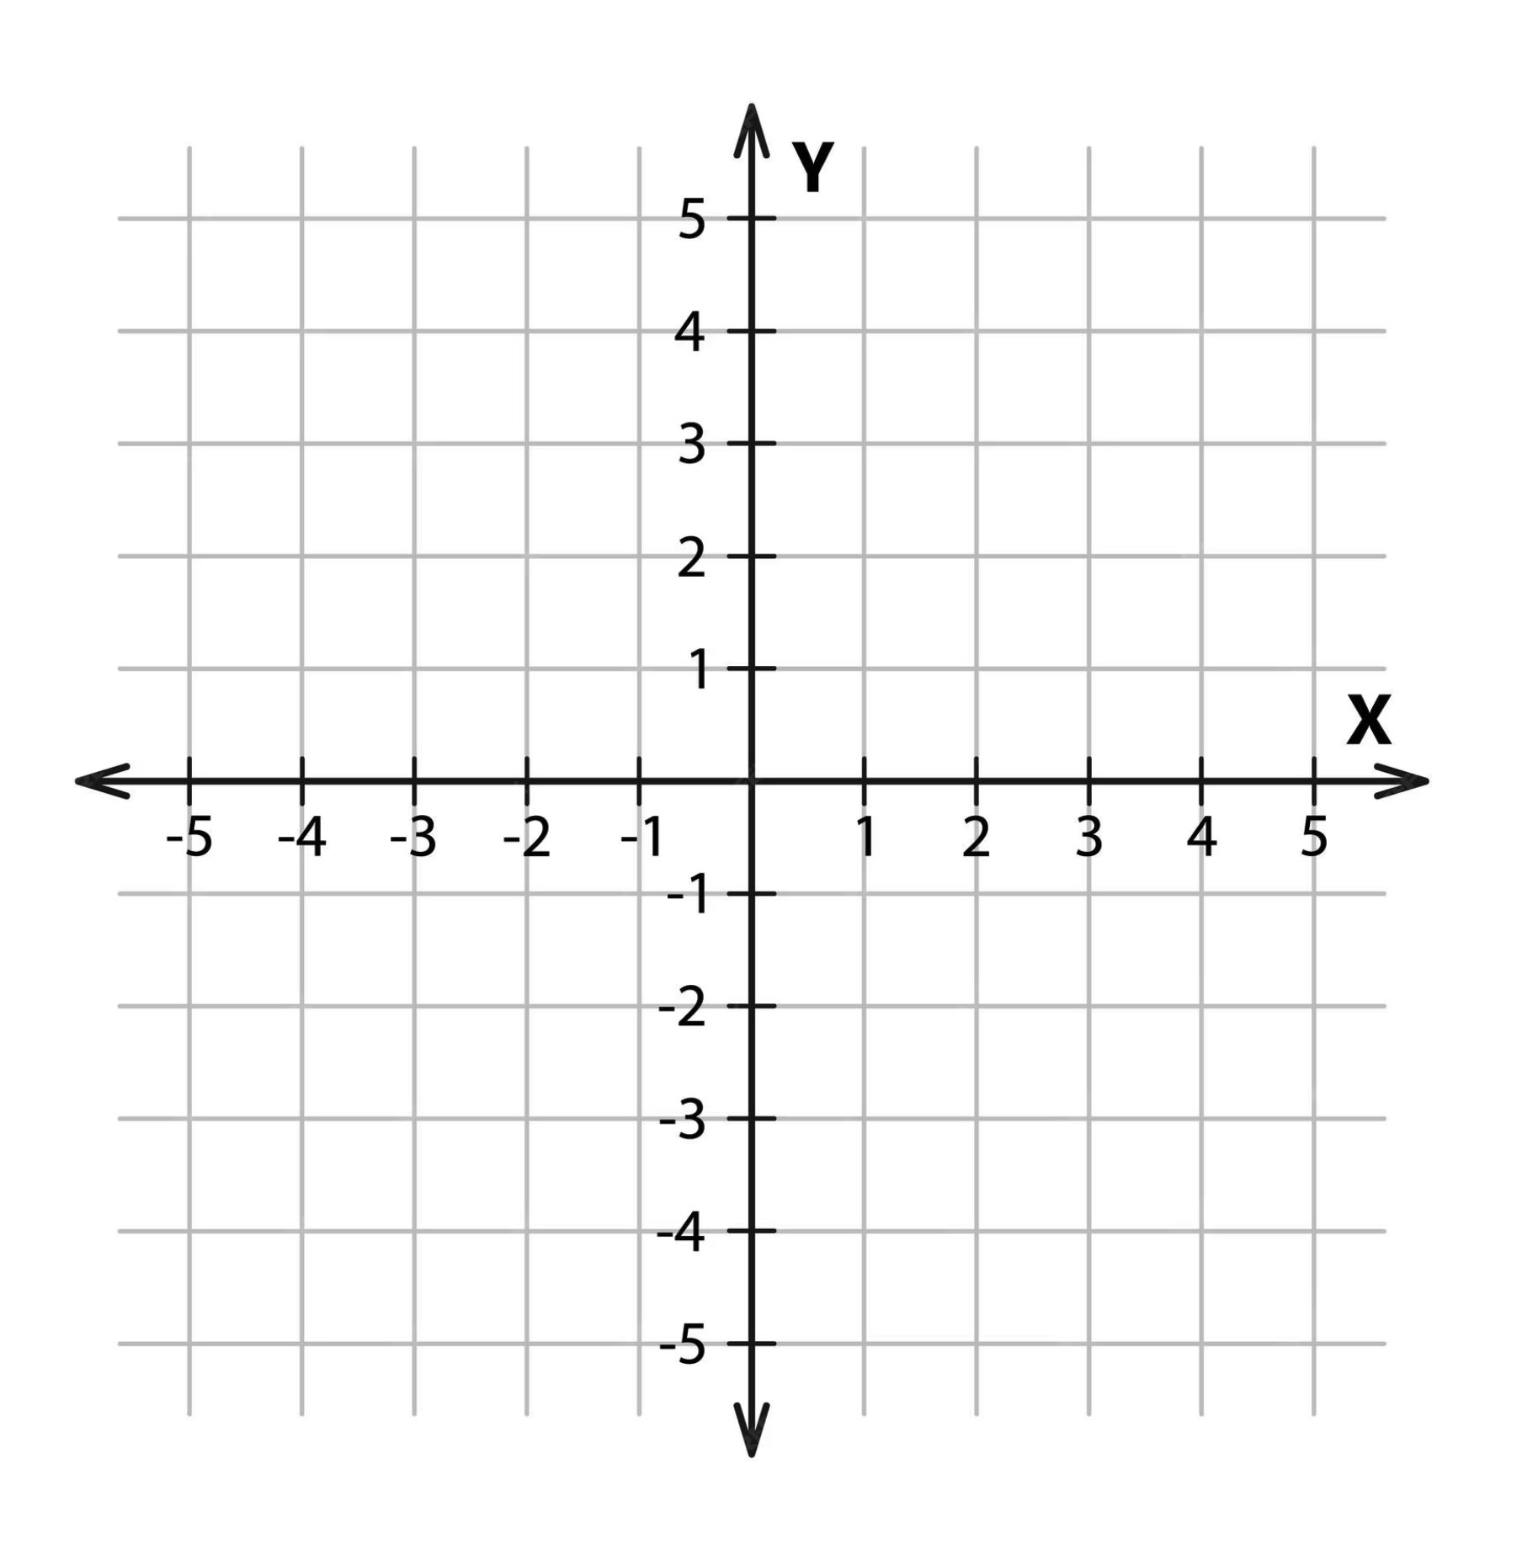
Doctor
Nurse
Apple
Banana

Slide 4
Robin slung the bow over his shoulder
She made a little bow for her hair
When Hiromi greets people, she will bow
Robin
slung
the
bow
over
his
shoulder
She
made
a
little
bow
for
her
hair
When
Hiromi
greets
people
,
she
will
bow
-0.03
4.01
1.25
-1.68
-2.22
3.14
…
0.02
-0.03
4.01
1.25
-1.68
-2.22
3.14
…
0.02
-0.03
4.01
1.25
-1.68
-2.22
3.14
…
0.02

Slide 5
Robin slung the bow over his shoulder
bow
slung
bow
When Hiromi greets people, she will bow
greets
bow
She made a little bow for her hair
hair

