Slide 1

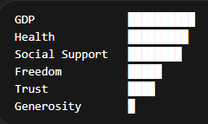
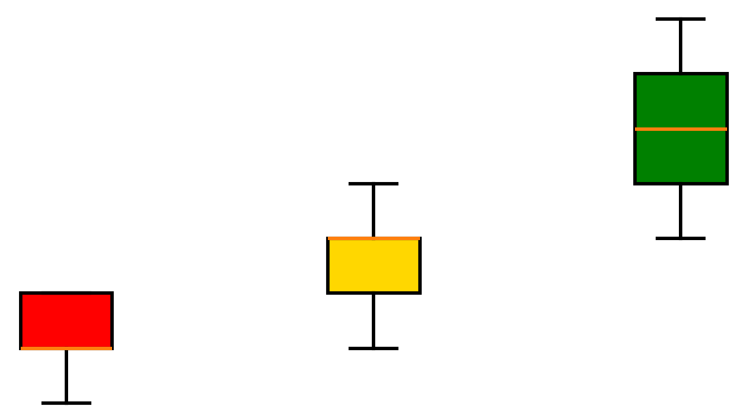
From Exploration to Insight: A Structured Approach to Identifying Key Drivers
Explore Relationships
Form Hypothesis
Validate through Segmentation
Reviewed correlations between key variables
Identified strongest associations with happiness
Hypothesis: “High-performing countries will consistently outperform across key drivers”
Segmented countries by happiness score (Bottom/Middle/Top)
Compared distributions across groups

Slide 2
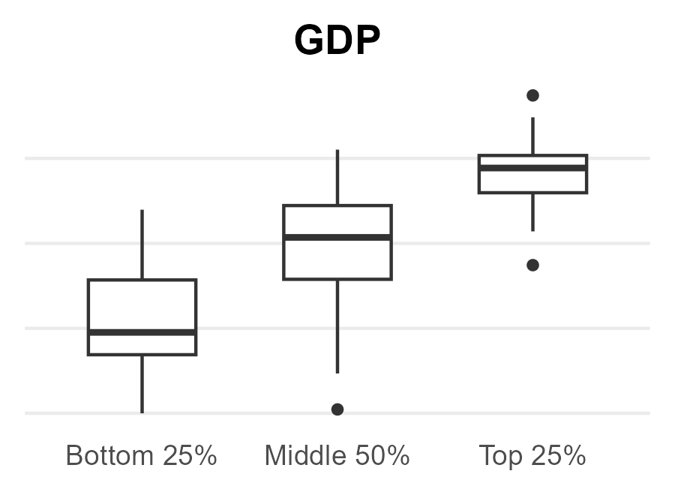
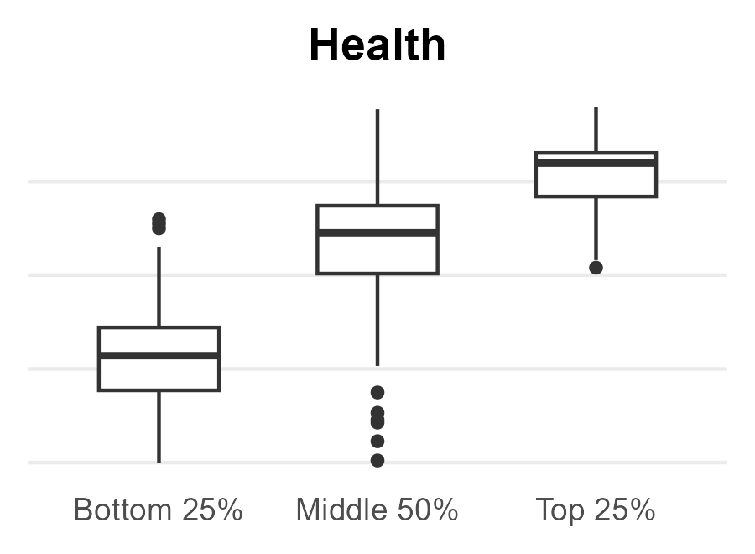
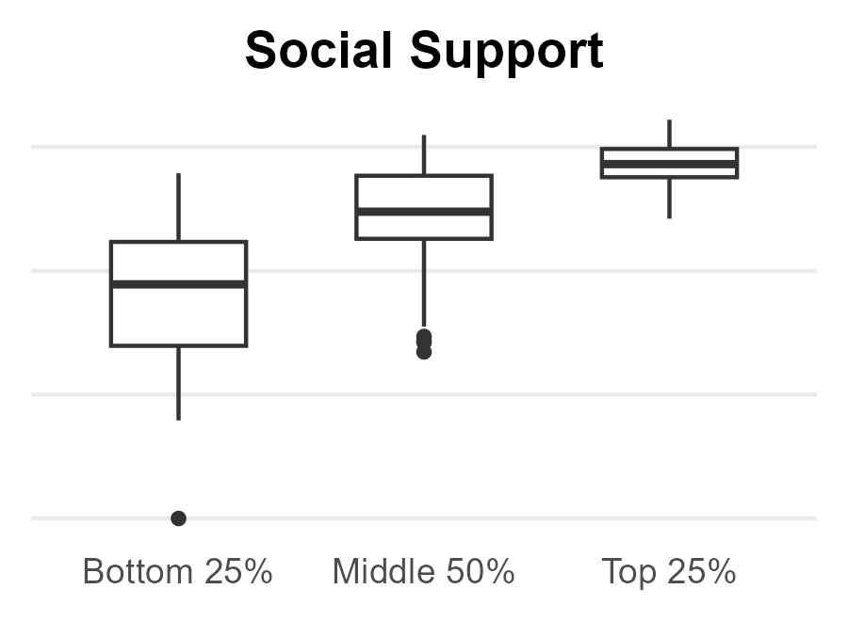
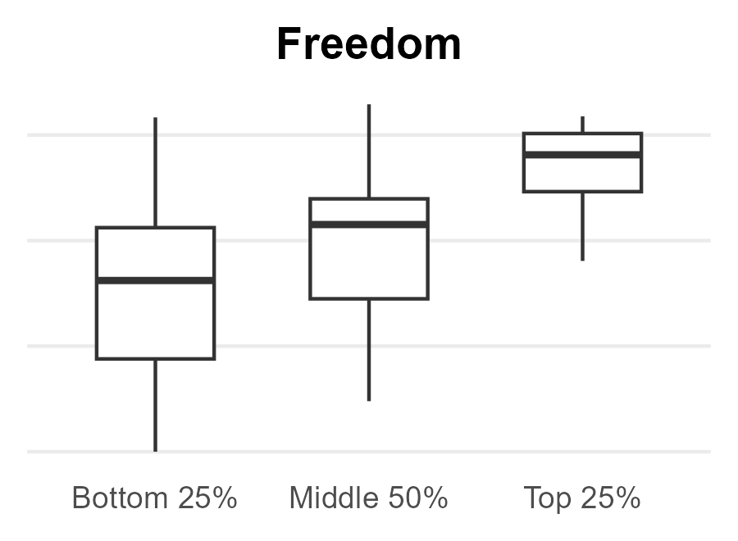
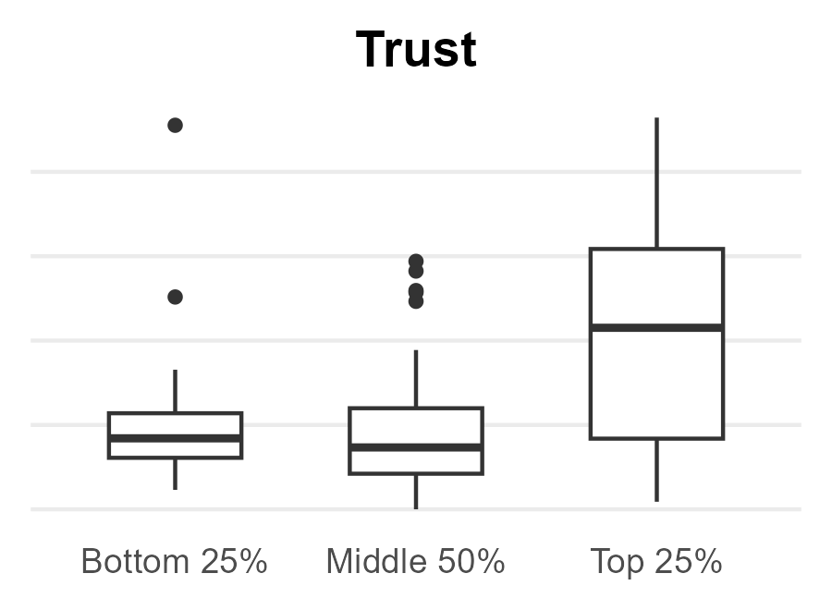
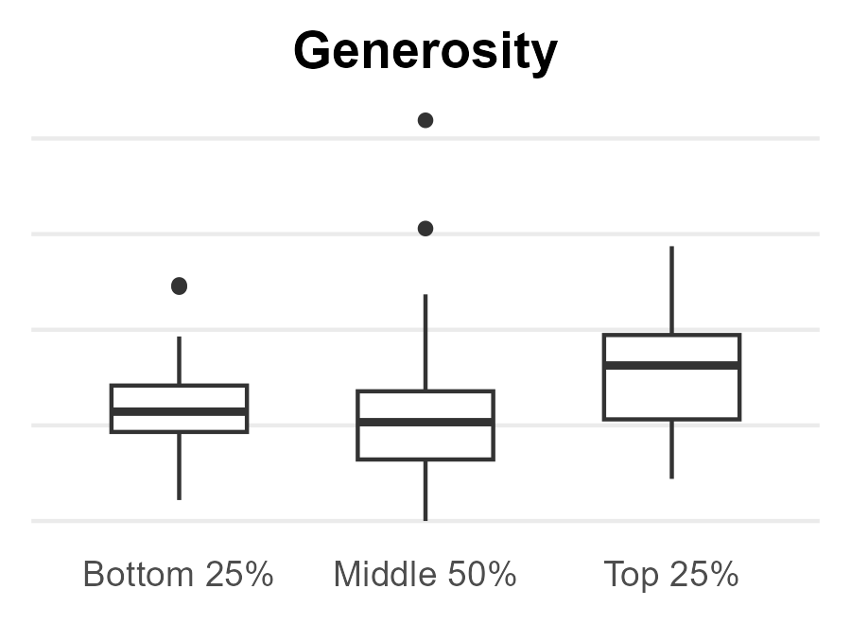
Happiness Is Driven by Foundational and Amplifying Factors
Foundational Drivers
Amplifying Factors
Minimal Impact

