Slide 1


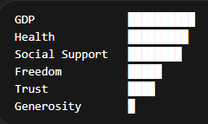
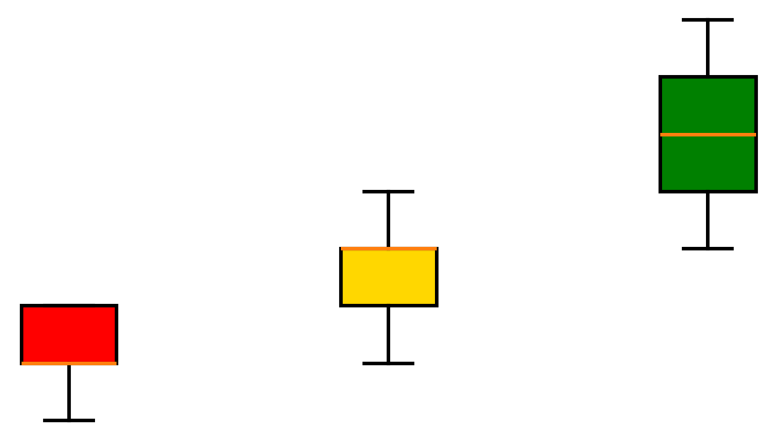
From Exploration to Insight: A Structured Approach to Identifying Key Drivers
Explore Relationships
Form Hypothesis
Validate through Segmentation
Analyzed correlations across key variables
Identified strongest drivers of happiness
Hypothesis: “High-performing countries will consistently outperform across key drivers”
Segmented countries by happiness score (Bottom / Middle / Top)
Compared driver distributions across groups

Slide 2
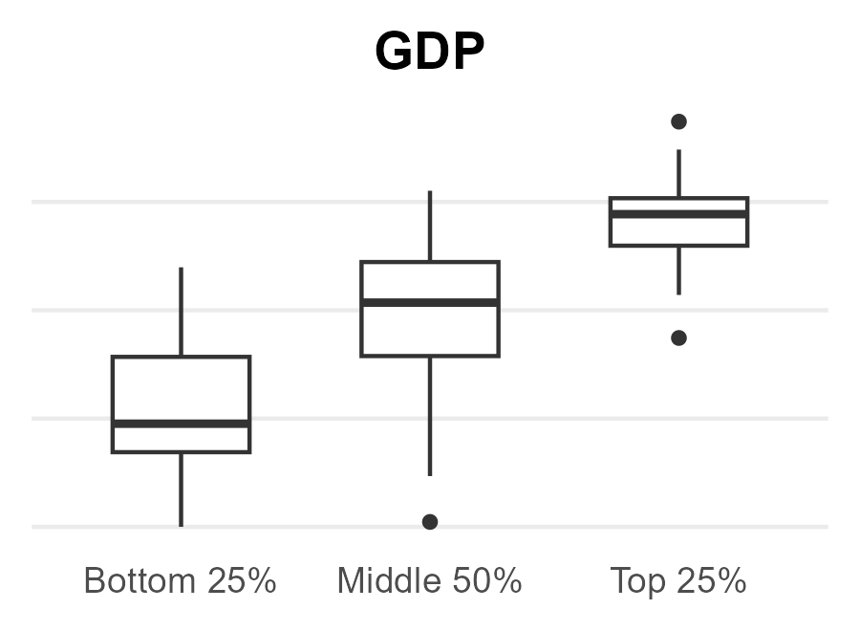
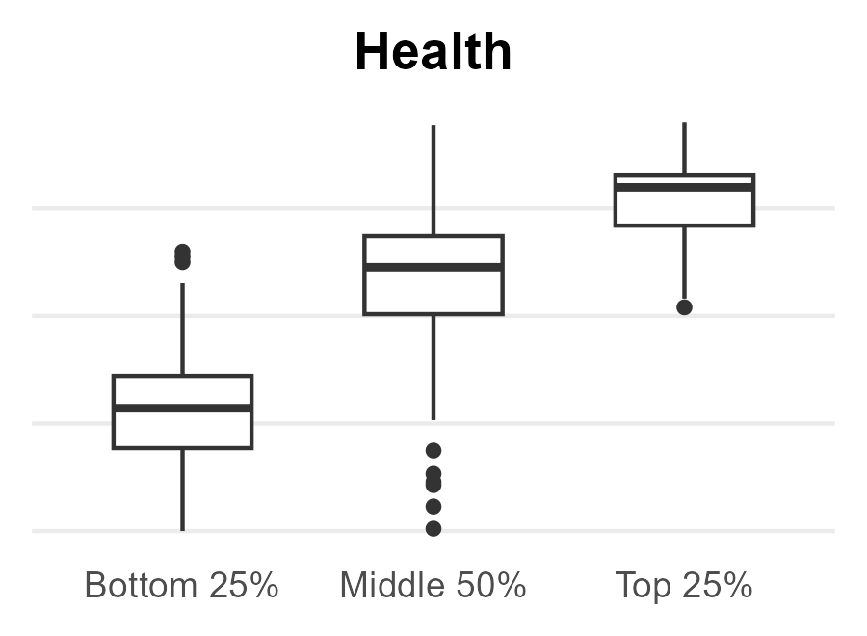
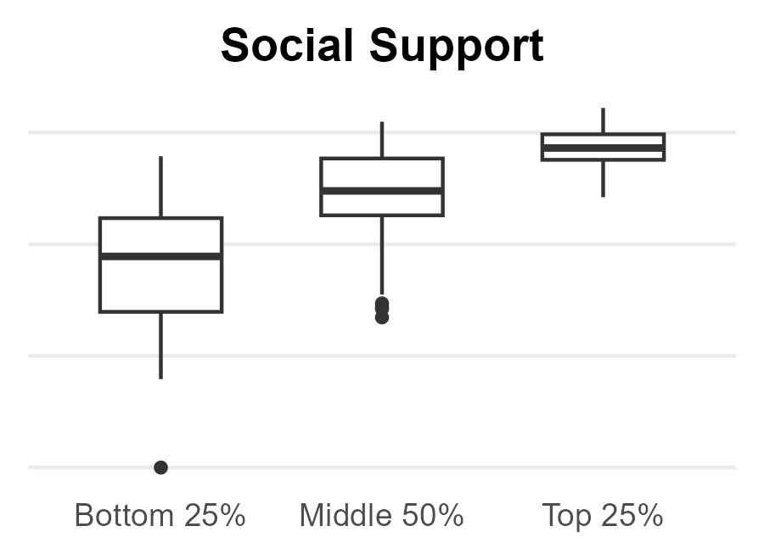
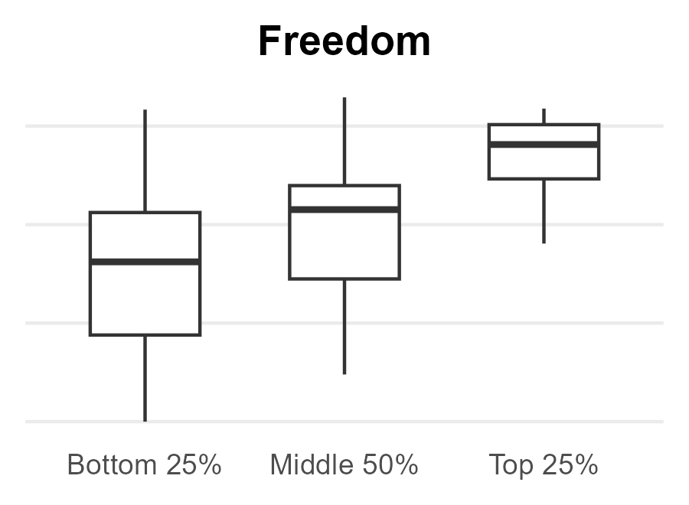
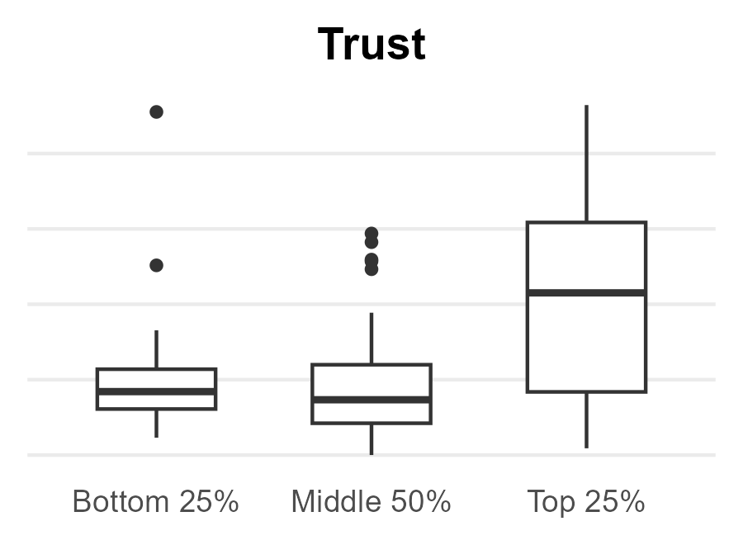
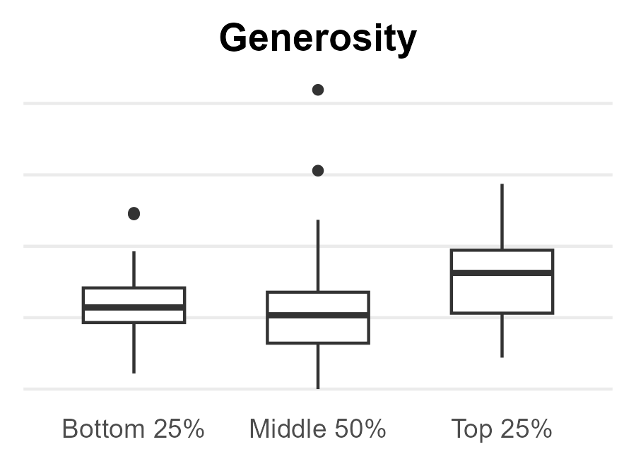
Foundational Drivers Define Outcomes; Amplifiers Enhance Them
Top-performing countries consistently show higher values across GDP, Health, and Social Support
Foundational Drivers
Amplifying Drivers
Minimal Impact Driver

Slide 3
What This Means for Business Performance
Strong core value drives outcomes; differentiation comes from trust and experience—not all intuitive levers meaningfully impact results.
Foundational Drivers
GDP
Health
Social Support
Foundational Drivers → Core Value
Product quality / reliability
Pricing & value proposition
Amplifying Drivers
Freedom
Trust
Amplifying Drivers → Experience & Trust
Ease of use / flexibility
Brand trust / transparency
Minimal Impact
Generosity
Minimal Impact → Low-impact levers
“Nice-to-have” features
Brand goodwill campaigns

