Slide 1


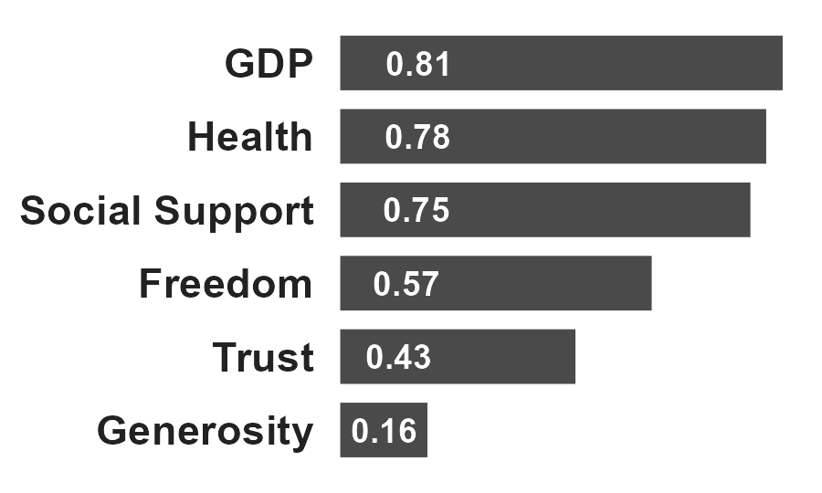
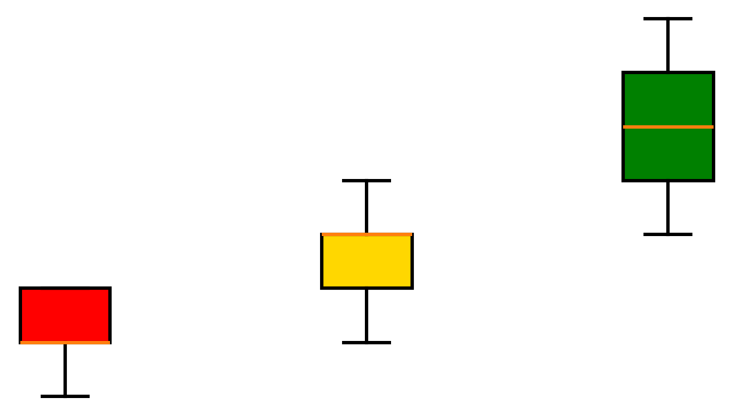
From Exploration to Insight: A Structured Approach to Identifying Key Drivers
Explore Relationships
Form Hypothesis
Validate through Segmentation
Analyzed correlations across key variables
Identified strongest drivers of happiness
Hypothesis: “High-performing countries will consistently outperform across key drivers”
Segmented countries by happiness score (Bottom / Middle / Top)
Compared driver distributions across groups

Slide 2
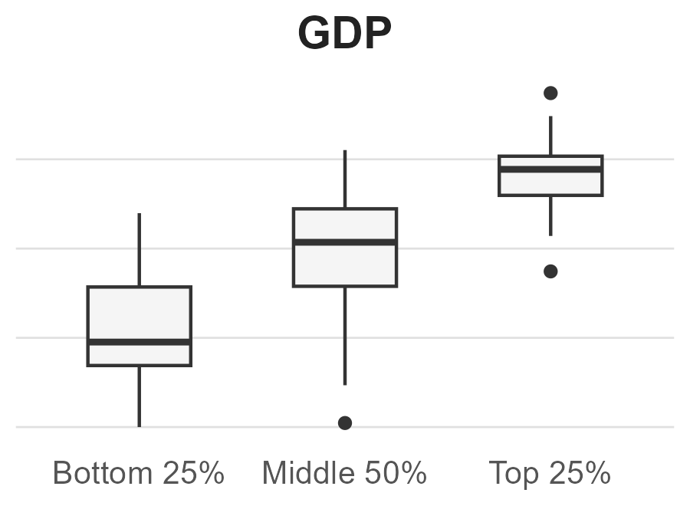
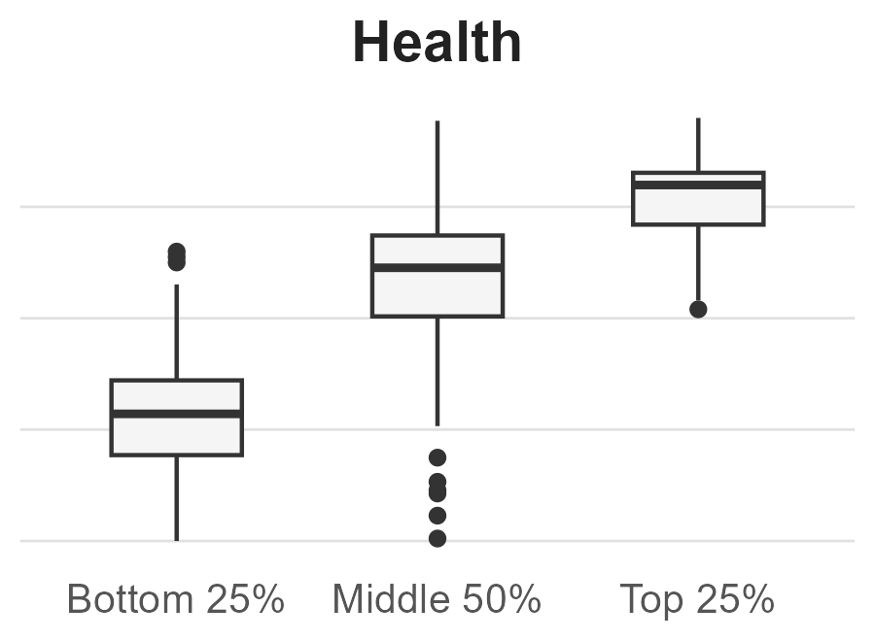
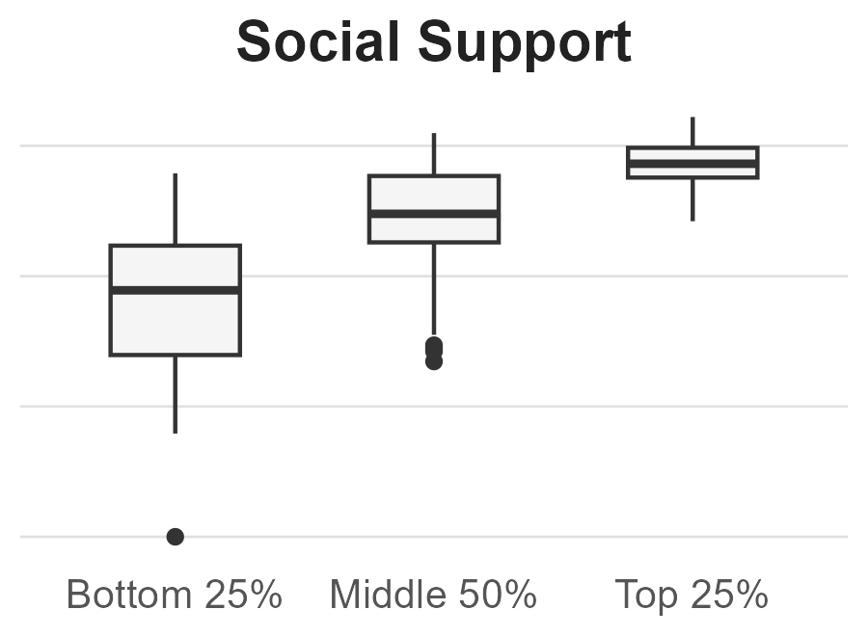
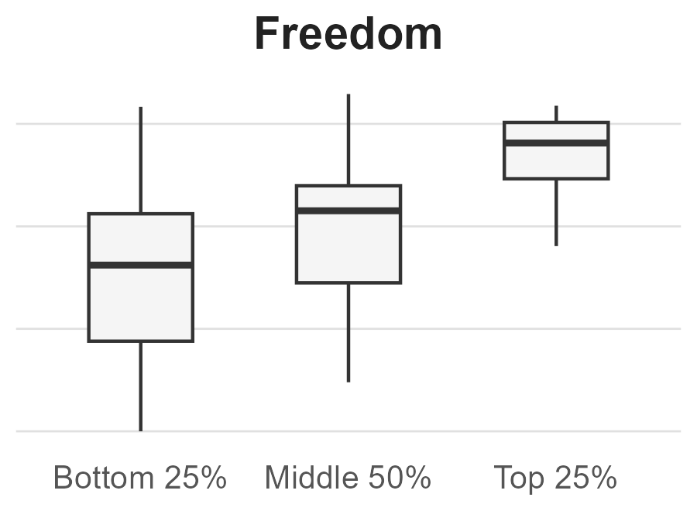
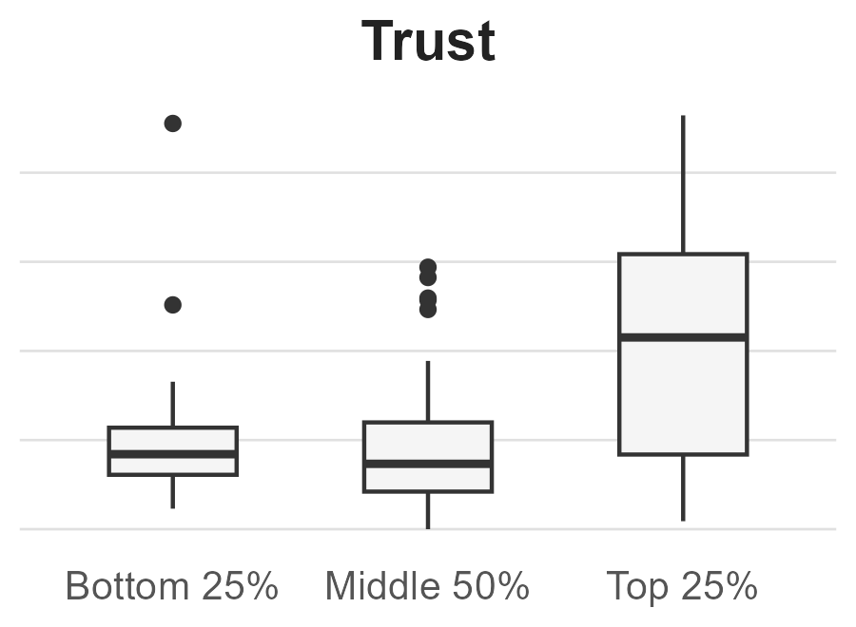
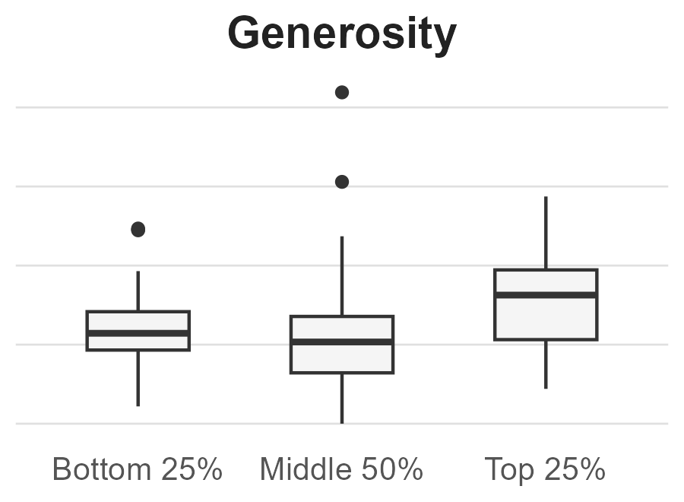
Foundational Drivers Define Outcomes; Amplifiers Enhance Them
Top-performing countries consistently show higher values across GDP, Health, and Social Support
Foundational Drivers
Amplifying Drivers
Minimal Impact Driver
“These patterns likely reflect that economic stability enables better health systems and social infrastructure, which more directly influence overall well-being.”

Slide 3
What This Means for Business Performance
Strong core value drives outcomes; differentiation comes from trust and experience—not all intuitive levers meaningfully impact results.
“This suggests prioritizing core value drivers before investing in experience-level enhancements.”
Foundational Drivers
GDP
Health
Social Support
Foundational Drivers → Core Value
Product quality / reliability
Pricing & value proposition
Amplifying Drivers
Freedom
Trust
Amplifying Drivers → Experience & Trust
Brand trust / dealership experience
Ease of use / research and purchase journey
Minimal Impact
Generosity
Minimal Impact → Low-impact levers
“Nice-to-have” features
Brand goodwill campaigns

