Slide 1
ADRINE
AI Infrastructure for Indian Healthcare
SSIP 2.0 — Quadrat Technologies | Gandhinagar, Gujarat

Slide 2
PROBLEM
Every hospital works differently.
No software adapts to that.
India has 70,000+ private hospitals. 85% are still running on paper or outdated tools — not because they don't want to digitize, but because every software forces them to change how they work to fit the software.
Rigid workflows
Constant custom dev
No scalability
85% undigitized
Software demands hospitals follow fixed flows — doctors, nurses, billing all resist adoption.
Every hospital requests changes. Builds become fragmented. No two deployments are alike.
A solution built for one hospital doesn't work for another. The business can't grow.
The market is massive and waiting — but current solutions are too rigid to serve it.
The market need is proven — 128,000+ organic impressions on Google Search without a single rupee in marketing.

Slide 3
SOLUTION
Adrine — software that adapts
to the hospital, not the other way.
Adrine is an AI-native Hospital Operating System — covering clinical operations, HR, and finance on a single platform. But the breakthrough is the infrastructure underneath: an adaptive AI system that learns how each hospital works and generates their software automatically.
HIMS
HRMS
Finance / ERP
Patient registration, OPD, IPD, lab, radiology, pharmacy — end-to-end clinical operations.
Staff records, biometric attendance, payroll, PF/ESI/TDS, performance appraisal.
Billing, accounts, TPA/insurance, procurement — SAP-equivalent for hospitals.
ABDM verified · ABHA ready · PMJAY compliant · Tally integration

Slide 4
TECHNOLOGY
The AI infrastructure — what makes
Adrine fundamentally different.
We are transitioning Adrine from a hospital management system to an AI infrastructure platform — a system that generates hospital software from intent, not code.
L3
Expression layer
Auto-generated UI, workflows, and logic — unique per hospital, built by AI
L2
AI expression engine
Onboards each hospital via conversation. Generates their software surface. Adapts continuously.
L1
Meaning layer (core)
Universal healthcare knowledge engine — the fixed intelligence shared across all hospitals
L0
Universal event ledger
Every action, structured identically across hospitals — foundation for India's healthcare data layer

Slide 5
INNOVATION
What no other HMS has done.
AI onboarding agent
Hospitals configure their entire system through a conversation — no developers, no manual setup.
Adaptive surface
The system watches real usage and evolves the UI automatically. Nurses don't train the software — it trains itself.
Agentic-as-a-service
We are developing AI agents that autonomously handle hospital workflows — billing reminders, lab alerts, supply reorders.
Meaning vs expression separation
Universal healthcare logic at the core. Infinite workflow variations at the surface. First time this has been done in healthtech.
ABDM verified
Fully compliant with Ayushman Bharat Digital Mission — ABHA ID creation, PHR connectivity, consent framework.

Slide 6
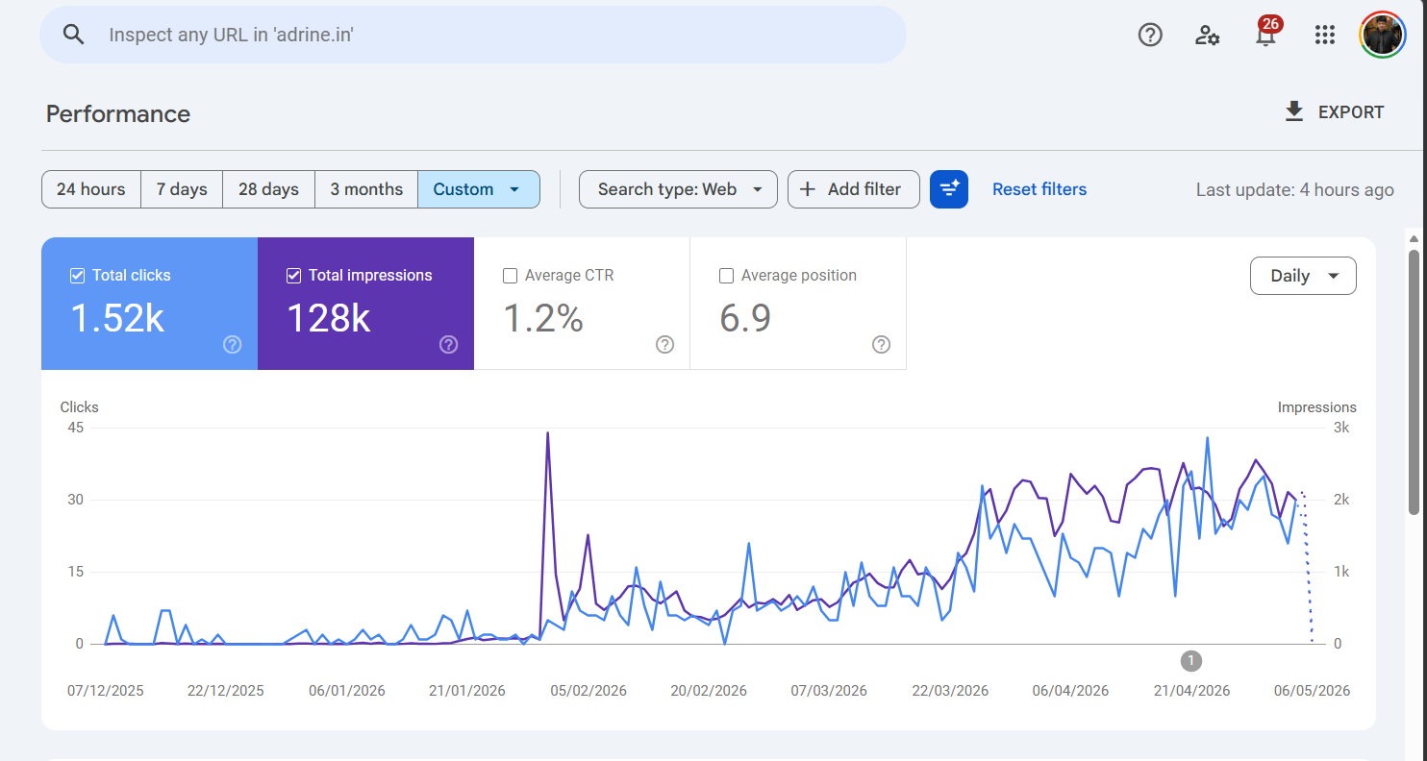
MARKET & VALIDATION
Large market. Proven demand.
Early traction.
70,000+
85%
Private hospitals in India
Not yet digitized
Pilot phase — hospitals currently evaluating Adrine:
128K+
₹8,400 Cr
Google impressions (organic)
Addressable market

Slide 7
FUNDING REQUEST
Development cost breakup
(SSIP 2.0 — ₹2.5 Lakhs)
Component
Purpose
Amount
Claude Max plan (Anthropic)
AI engine for onboarding agent, expression generator, agentic workflows
₹1,35,000
Total
₹1,35,000

Slide 8
PLAN
12-month development plan.
Q1
Q2
Q3
Q4
AI onboarding agent (v1)
Expression engine prototype
Claude API integration
Agentic workflow layer
Pilot deployment at 3 hospitals
Event ledger architecture
Adaptive surface (behavior loop)
ABDM full certification
HRMS + Finance AI layer
Cross-hospital intelligence layer
Scale to 10+ hospitals
Gujarat market expansion
Current status: pilot phase — system live in evaluation at multiple hospitals across Gujarat.

Slide 9
TEAM
The team.
Parthrajsinh
Founder & CEO
Age 19 · Quadrat Technologies
Product, strategy, sales
Faculty Advisor
Hari Sir

Slide 10
ADRINE
The OS layer for
Indian healthcare.
We are not building hospital software.
We are building the infrastructure that generates hospital software.
parthrajsinh@adrine.in · adrine.in · Gandhinagar, Gujarat

