Slide 1
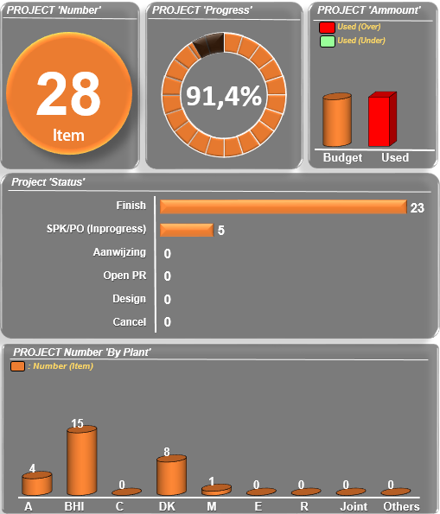
1
2
3
Entrance Page
Login Page
Home Page
Add New Project
Manage your project?
Project Year :
2020
2016
2017
2018
2019
2020
All Plant
Plant A
Plant BHI
Plant C
Plant DK
Plant M
Plant E
Plant R
Plant J
Others
Department Name :
Project Plant :
Plant A
LOGIN
JMU
JMU
JMI
JEI
JCW
JEM
Login as
Warehouse Dept?
Password :
*******
LOGIN
LOGIN
+ See Project List

Slide 2
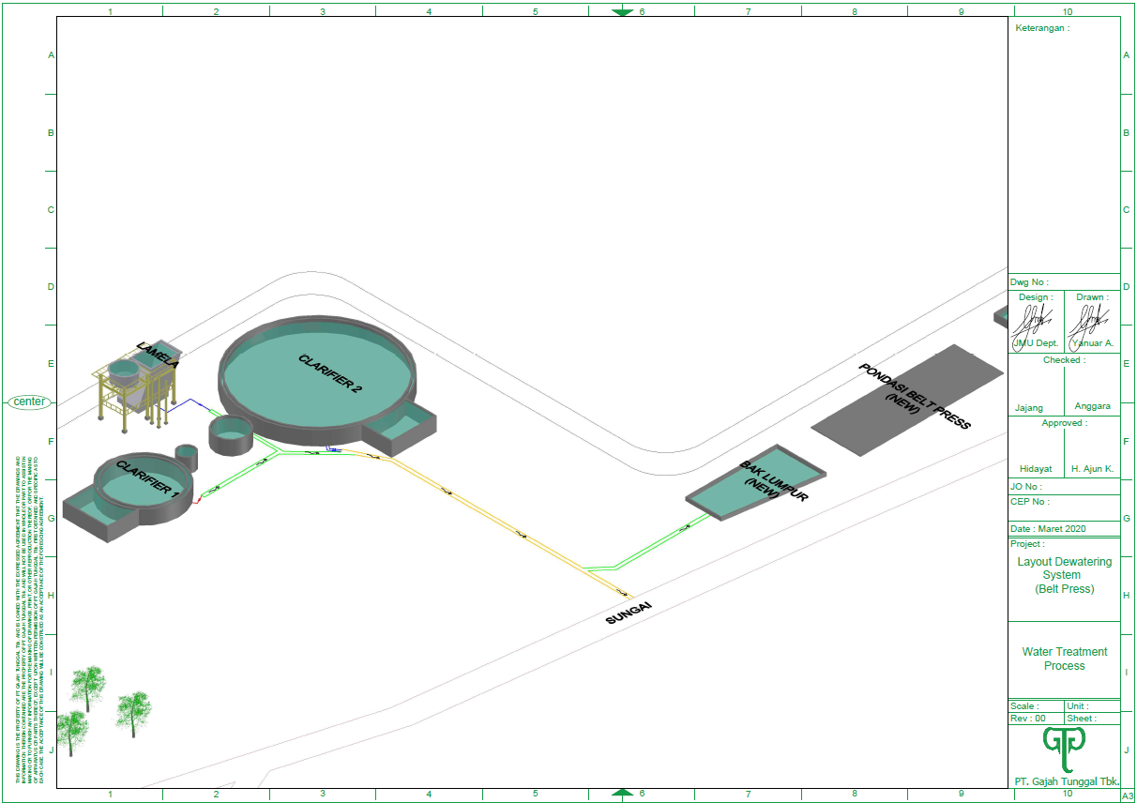
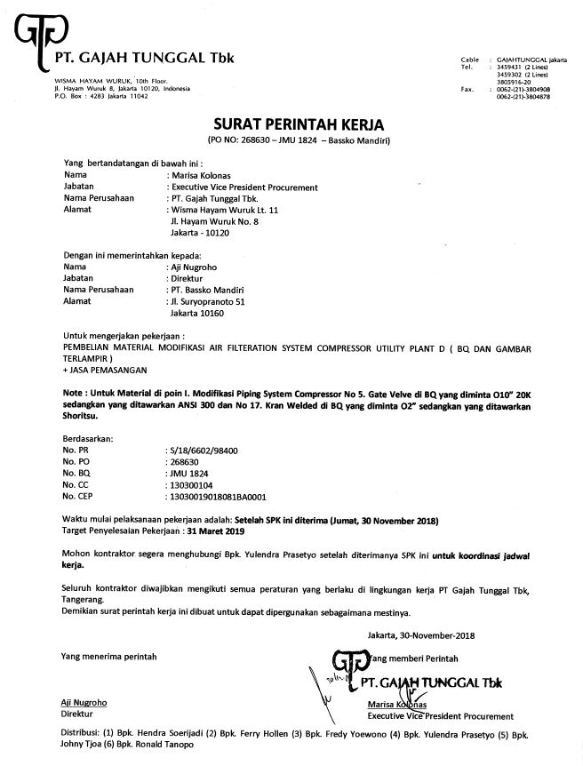
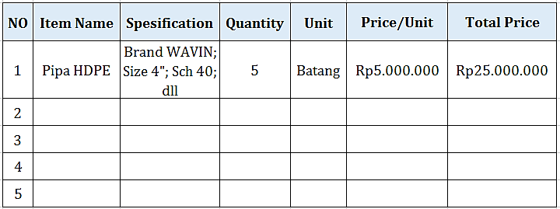
4
5
6
Add New Project
Add Bill of Quantity
Add Drawing
Item Name :
Spesification,
Brand :
Size :
Type :
Others :
Quantity :
Price/Unit :
7
Add SPK/PO
Project Year :
Project No :
Project Title :
User/CC :
Plant :
Add Bill of Quantity :
Add Drawing :
PR No :
Aanwijzing Date :
Bid Submission Date :
SPK/PO No :
Contractor :
Start Execution Date :
Estimate Finish Date :
Contract,
DP :
Termyn 1 :
Termyn 2 :
Termyn 3 :
Termyn 4 :
Termyn 5 :
Retensi :
Add
Add
Unit :
Add
Take a photo
Import from File
Add
Add SPK/PO
Back
Save
5%
Take a photo
Import from File
25%
25%
20%
Back
Save
Back
Save
5%
Back
Save

Slide 3
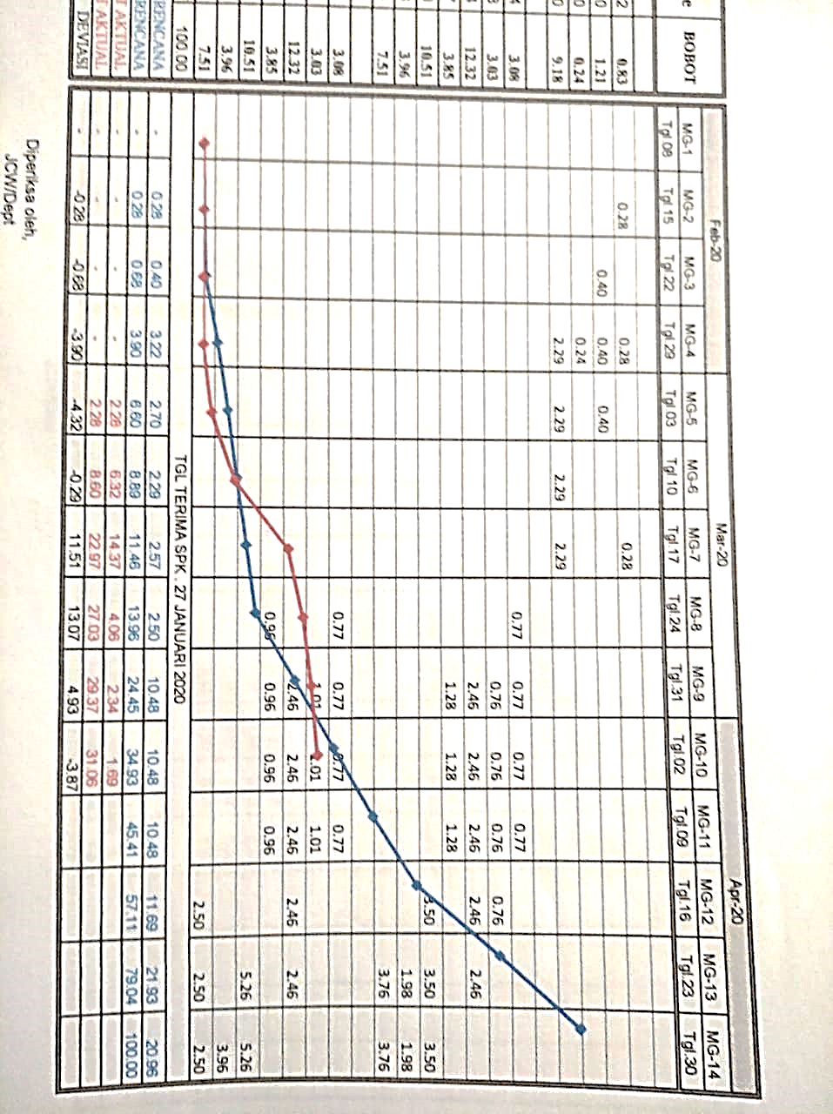
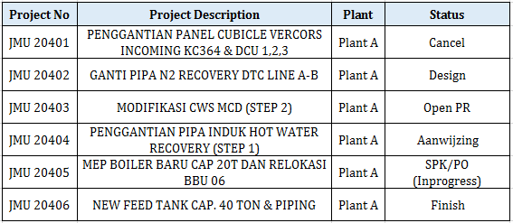
8
Project List
Add New Project
JMU 20401
Project Year :
2020
PENGGANTIAN PANEL CUBICLE VERCORS INCOMING KC364 & DCU 1,2,3
Project Plant :
Plant A
JMU 20401
Project Year : 2020
User/CC : DCU
Plant : Plant DK
Progress : 73% (On schedule)
PENGGANTIAN PANEL CUBICLE VERCORS INCOMING KC364 & DCU 1,2,3
+ See More
Project Year : 2020
User/CC : DCU
Plant : Plant DK
Progress : 73% (On schedule)
Bill of Quantity : See Detail
Drawing : See Detail
PR No : S/19/1213/98400
Aanwijzing Date : 11/06/2020
Bid Submission Date : 19/06/2020
SPK/PO No : 208109
Contractor : PT Grahaindo Jaya
Start Execution Date : 02/08/2020
Estimate Finish Date : 02/11/2020
Actual Finish Date :
Update Progress
+ Hide Project List
Project List
Short by:
Project No
See Detail
See Detail
See Detail
Project No
Plant
Status
See Detail
See Detail
See Detail

