Slide 1
Understanding about Modelling
1.Define a Problem
Identify the task – Face recognition System , Voice assistant
2.Choose an algorithm
Select a suitable Machine Learning algorithm, CNN for faces , NLP for voice ,Regression for prediction. (scikit learn module)
3.Mathematical & Logical Model
Implement the algorithm as a computational (equations , rules, etc) A specific implementation for problem
4. Code the Model
Programmer writes the code- Python
5. Train the Model
Feed the data to the Model (face images, voice samples)
6. Evaluation
Test the performance of the model
Modelling is the process of creating a mathematical and logical representation of a real world problems , so that an application learns patterns from the data and make predictions or decisions.

Slide 2

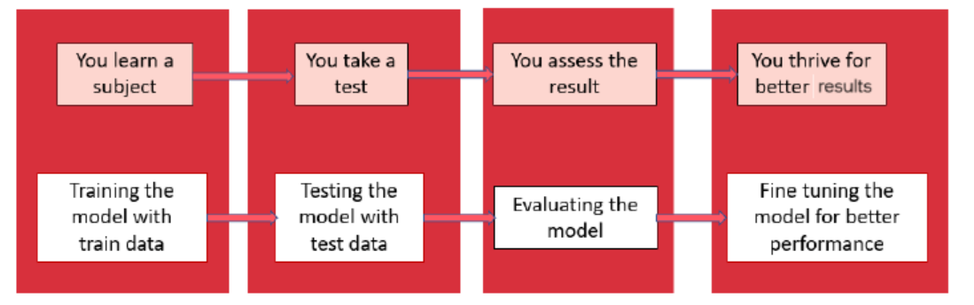

EVALUATION
Evaluation is the process of understand a machine learning model’s performance using different evaluation metrics
An AI model gets better with constructive feedback
We can build a model, get feedback from metrics, make improvements and continue until you achieve a desirable accuracy.

Slide 3
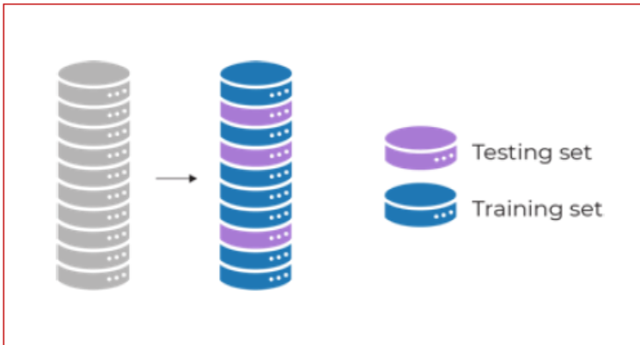
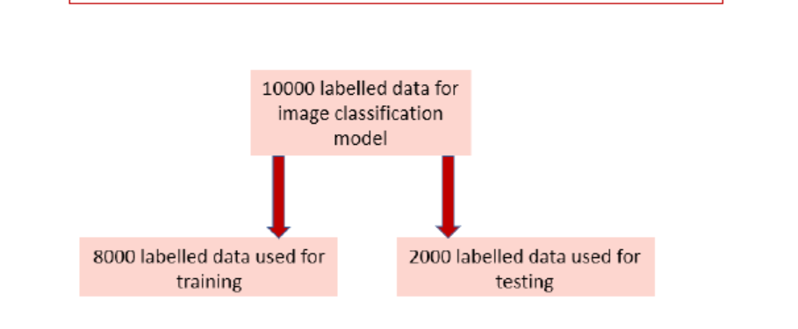
EVALUATION
3.2: Splitting the training set data for Evaluation : Train-test split :
The train-test split is a technique for evaluating the performance of a machine learning algorithm
It can be used for any supervised learning algorithm
The procedure involves taking a dataset and dividing it into two subsets: The training dataset and the testing dataset
The train-test procedure is appropriate when there is a sufficiently large dataset available .

Slide 4
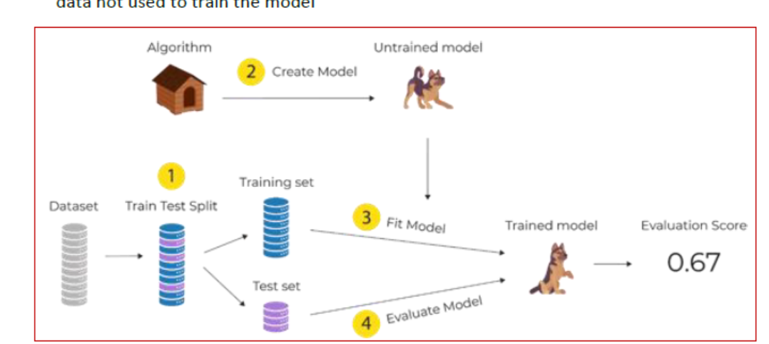
EVALUATION
Need of Train-test split
The train dataset is used to make the model learn
The input elements of the test dataset are provided to the trained model. The model makes predictions, and the predicted values are compared to the expected values
The objective is to estimate the performance of the machine learning model on new data: data not used to train the model

Slide 5
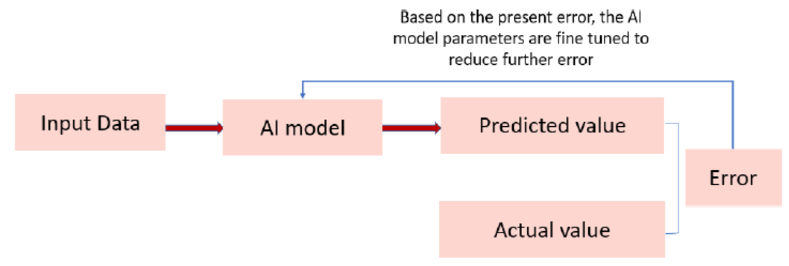
EVALUATION
Accuracy
Accuracy is an evaluation metric that allows you to measure the total number of predictions
a model right.
The accuracy of the model and performance of the model is directly proportional, and
hence better the performance of the model, the more accurate are the predictions.
Error:
Error can be described as an action that is inaccurate or wrong.
In Machine Learning, the error is used to see how accurately our model
can predict data it uses to learn new, unseen data.
Based on our error, we choose the machine learning model which performs best for a particular dataset.
Error refers to the difference between a model's prediction and the actual outcome.
It quantifies how often the model makes mistakes

Slide 6
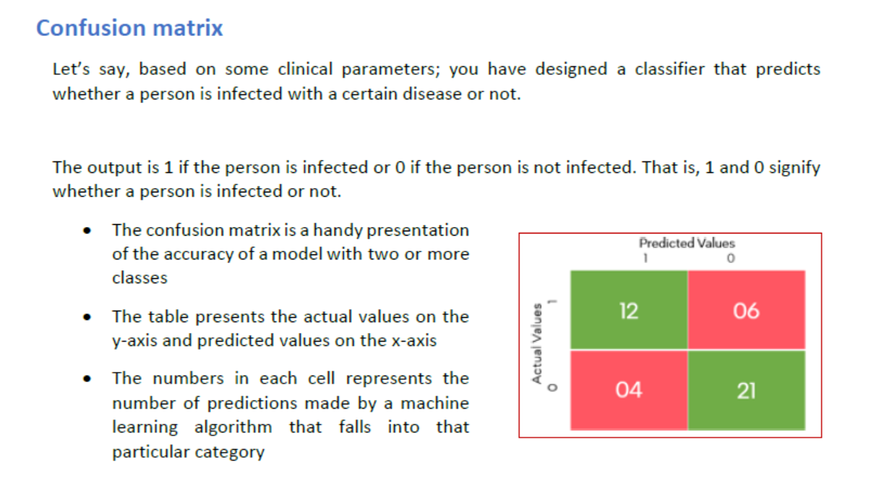
EVALUATION

Slide 7
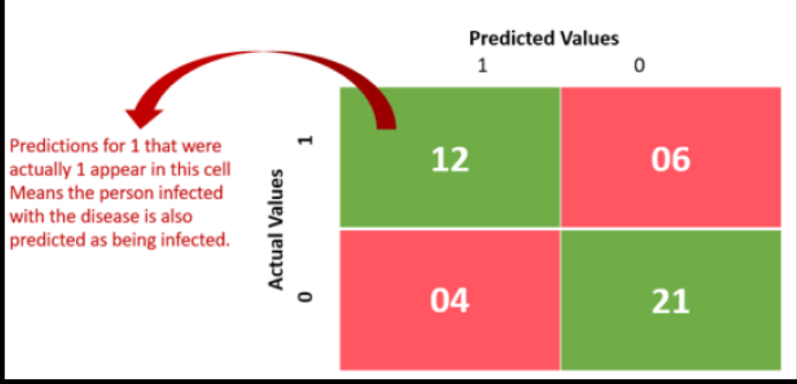
EVALUATION
True Positive scenario

Slide 8
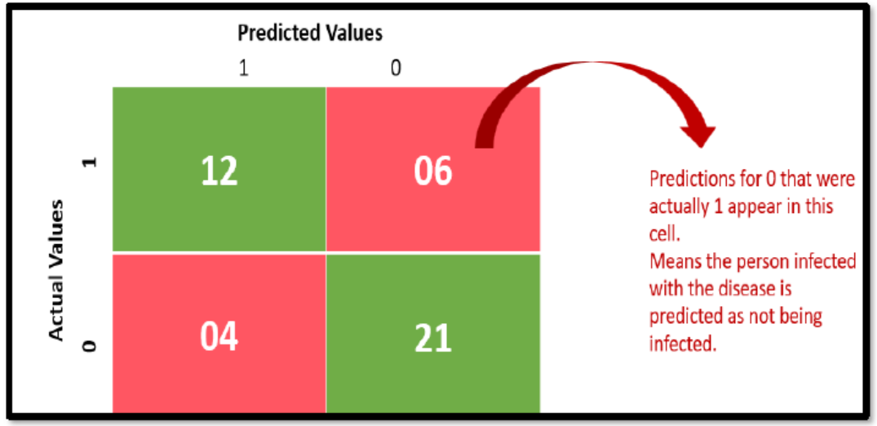
EVALUATION
False Negative scenario

Slide 9
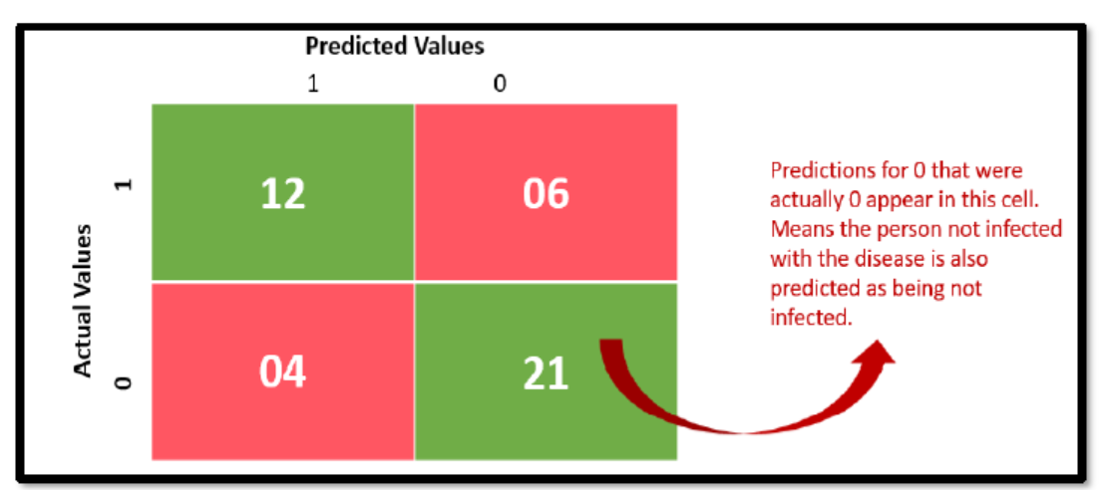
EVALUATION
True Negative scenario

Slide 10
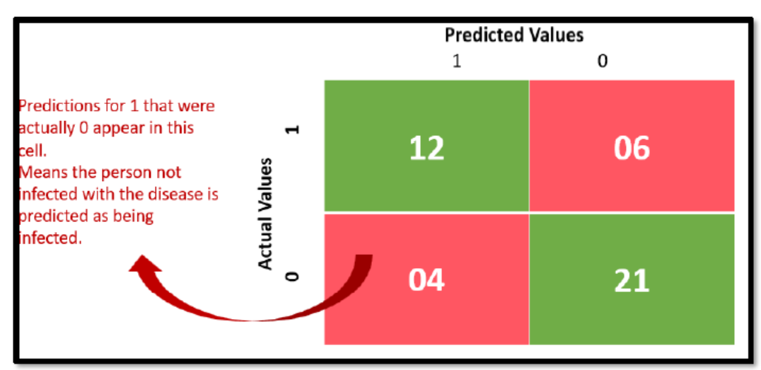
EVALUATION
False Positive scenario

Slide 11
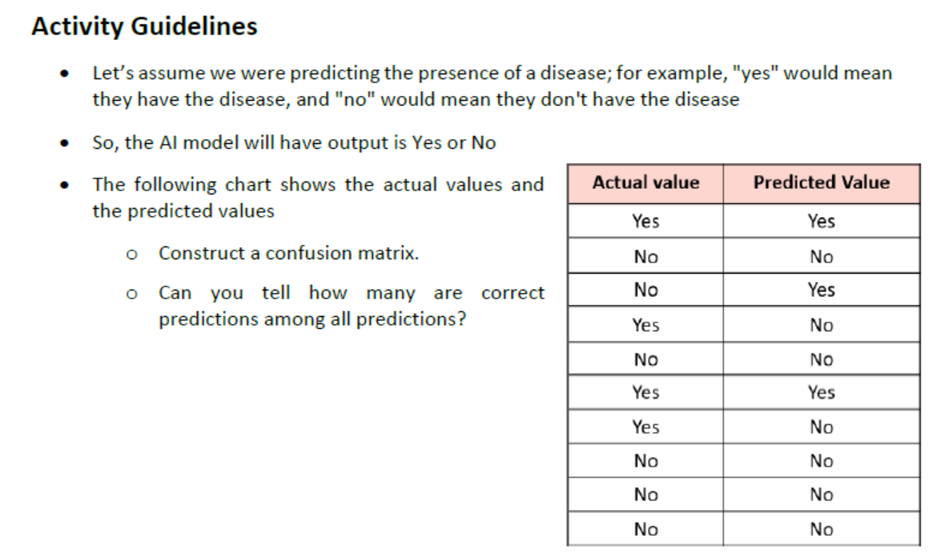
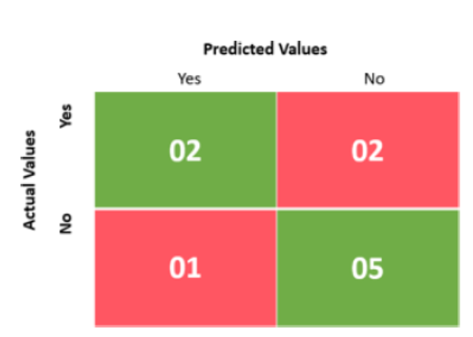
EVALUATION

Slide 12
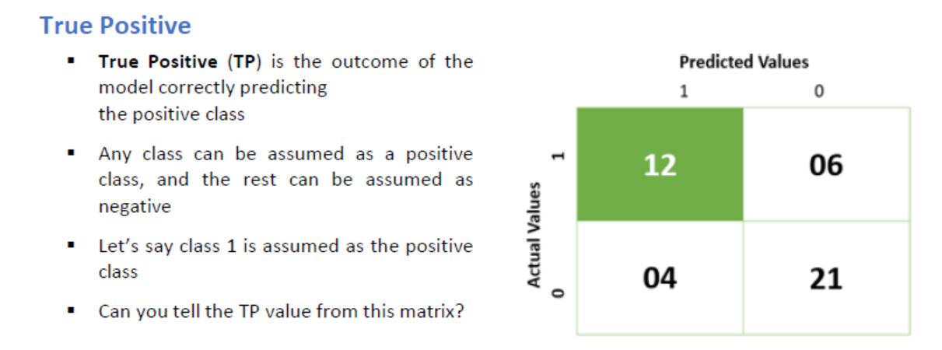
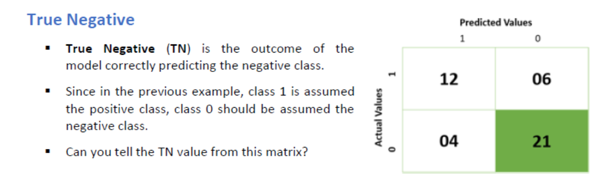

Slide 13
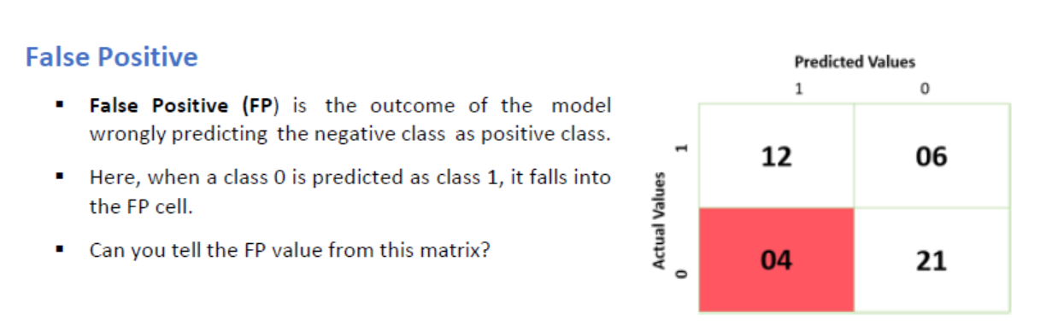
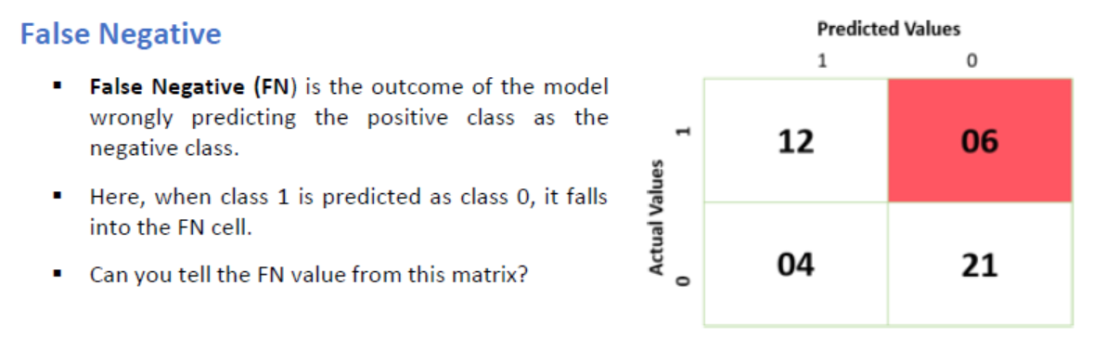

Slide 14
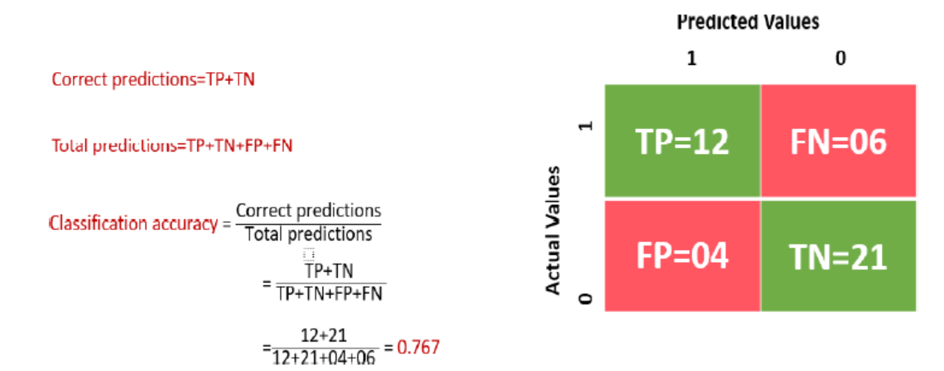
Accuracy

Slide 15
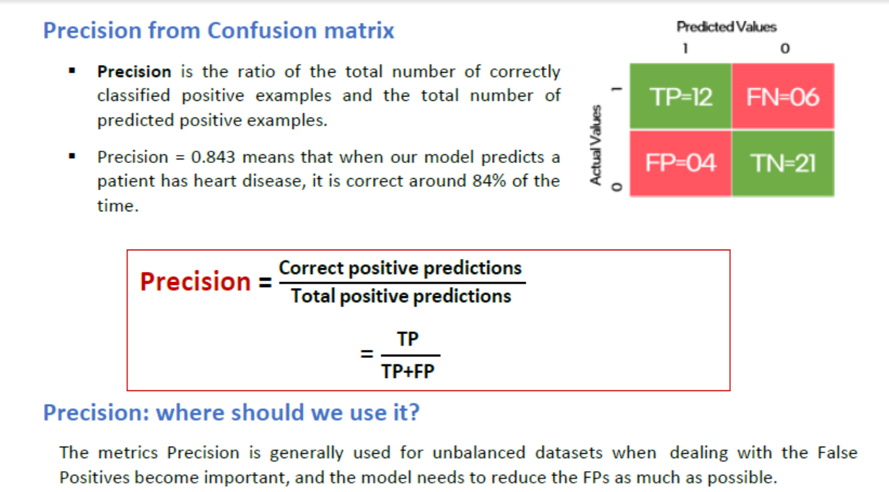
Precision

Slide 16
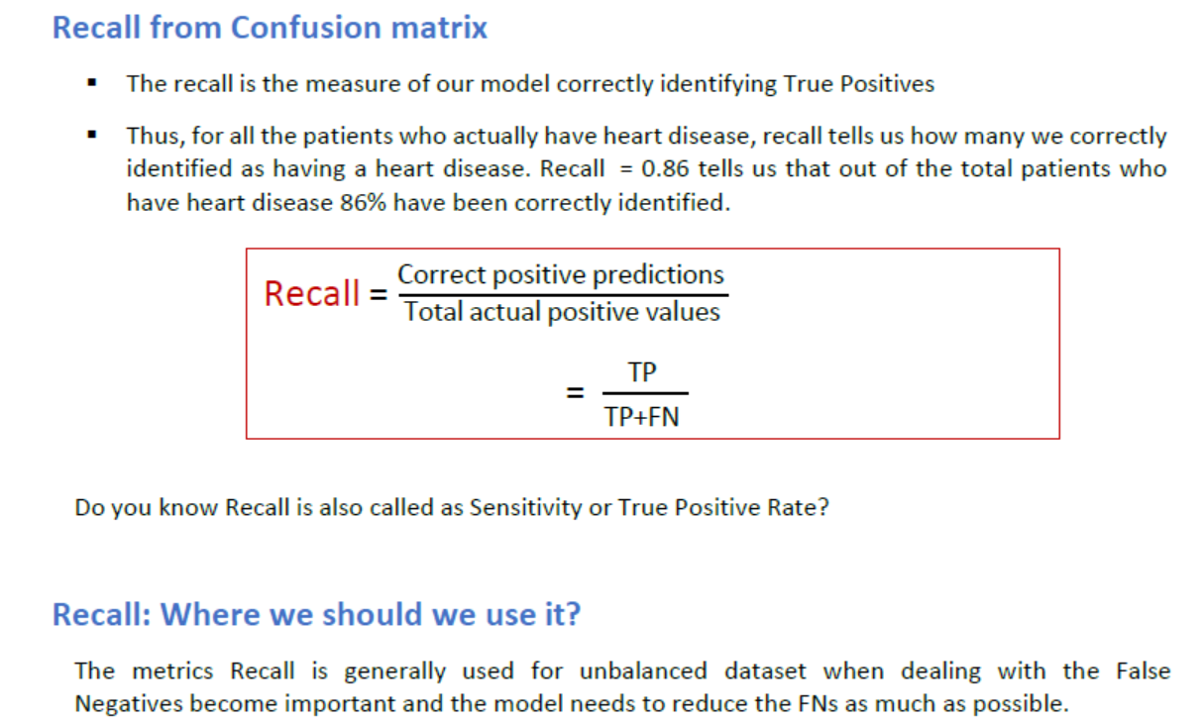
Recall

Slide 17
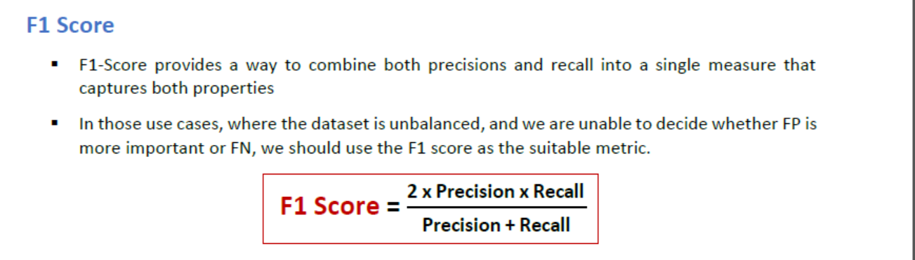
F1 Score

Slide 18
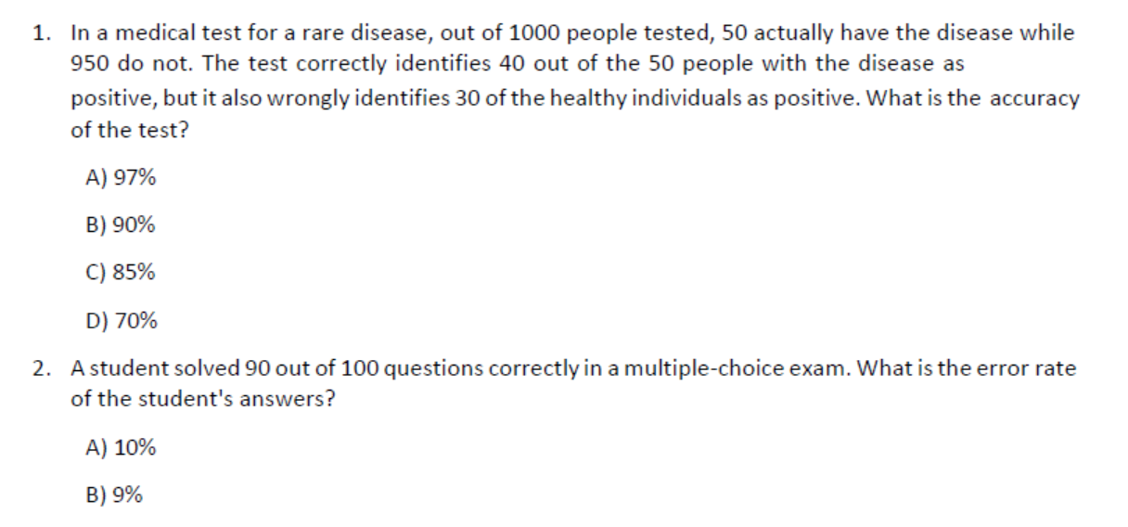
Try it your self

Slide 19
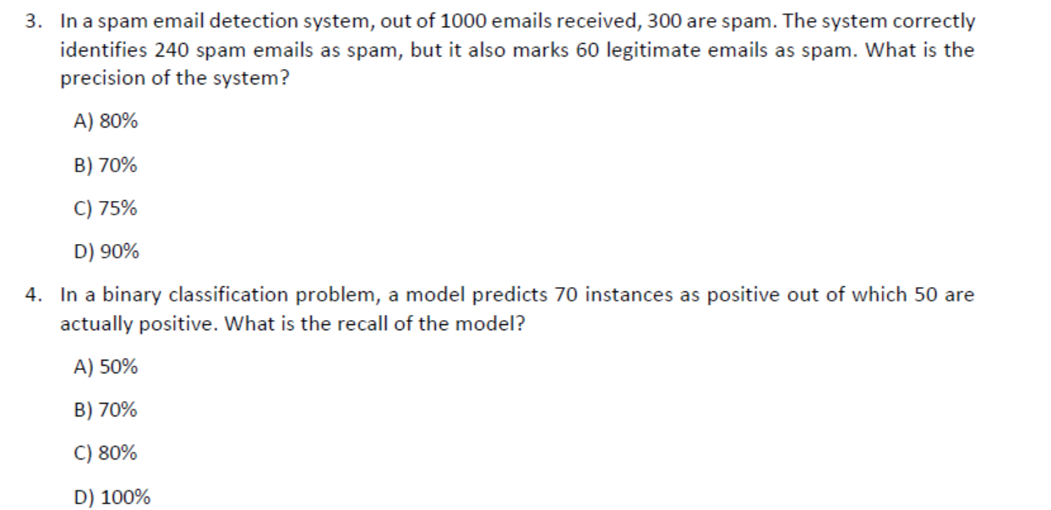
Try it your self

