Slide 1
User Knowledge Modeling
Team Freund
(Ratnendra P, Vivek S, Prasantha G, Nasa Q, Kausar K, Shyju K, Sowjanya L)

Slide 2

Introduction
User Activity Analysis - Knowledge level prediction
Notes:
Introduction: SL

Slide 3
Dataset : User Knowledge Modeling
Dataset source : http://archive.ics.uci.edu/ml/datasets/User+Knowledge+Modeling
Data type | Task Type | Attribute type | # of Instances | # Attributes | Study Area
Multivariate | Classification, Clustering | Integer (floating) | 403 | 5 | Web based learning
Attribute Information:
STG : The degree of study time for goal object materials
SCG : The degree of repetition number of user for goal object materials
STR : The degree of study time of user for related objects with goal object
LPR : The exam performance of user for related objects with goal object
PEG : The exam performance of user for goal objects
Target/Class Label
UNS : The knowledge level of user
Knowledge Level # of training samples
Very Low (Class 1) : 50
Low (Class 2) : 129
Middle (Class 3) : 122
High (Class 4) : 130
Notes:
SL
real dataset obtained from Phd thesis work about the students' knowledge status in the subject of Electrical DC Machines.

Slide 4
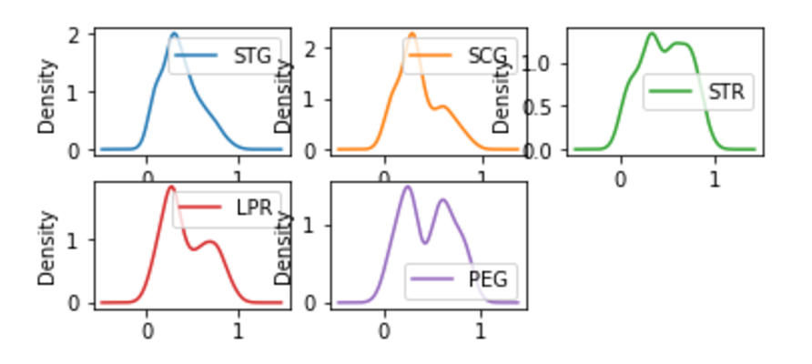
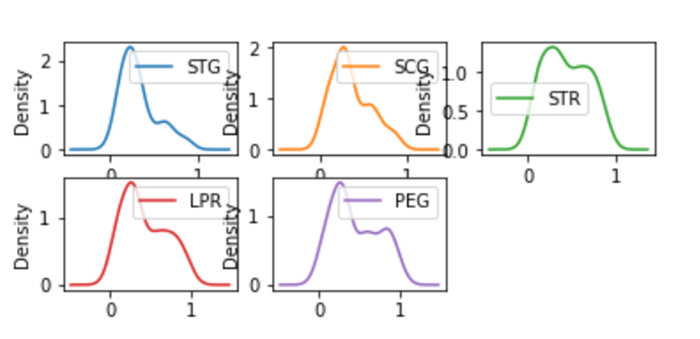
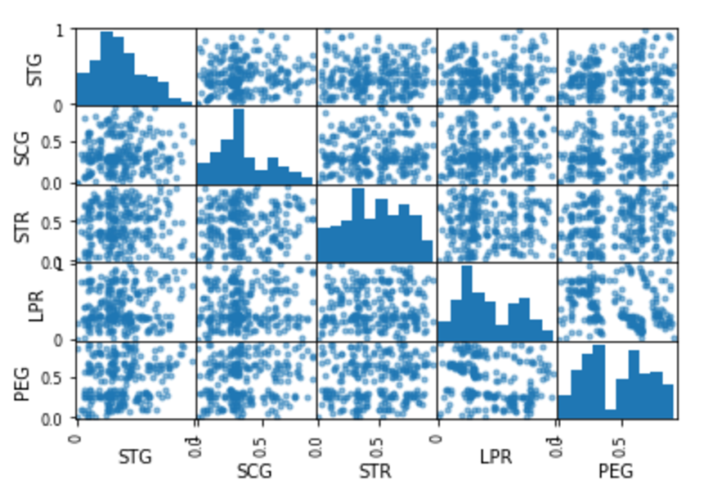
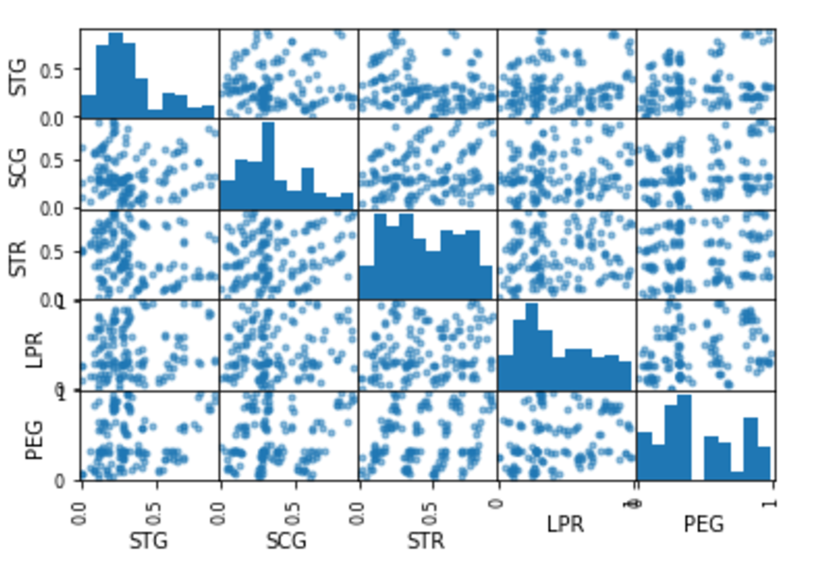
Dataset : Density, Scatter plots
Training dataset Test dataset
Density plot
Scatter matrix
Notes:
NQ/KK?
Scatter matrix
- https://pandas.pydata.org/pandas-docs/stable/visualization.html#scatter-matrix-plot
- https://en.wikipedia.org/wiki/Scatter_matrix

Slide 5
Objective
Study and compare accuracy of user knowledge levels predicted by various methods
Generative Methods:
Naive Bayes Classifier
PCA
Discriminative Methods:
pseudo inverse method
k-means clustering
Expectation Maximization
k Nearest Neighbours (kNN)
weighted-k-Nearest Neighbours (wkNN)
Notes:
RP?

Slide 6
Naive Bayes Classifier
Confusion Matrix for Bayesian Classifier
 |  |  | Classified as
 |  | High | Middle | Low | very_low | Total
True | High | 7 | 5 | 11 | 7 | 30
Class | Middle | 14 | 12 | 16 | 7 | 49
label | Low | 14 | 10 | 17 | 9 | 50
 | very_low | 8 | 2 | 5 | 1 | 16
 | Total | 43 | 29 | 49 | 24 | 145
Accuracy |  | PPV High | PPV Middle | PPV Low | PPV very_low |  | Highest PPV | Smallest PPV
0.255172 |  | 0.162791 | 0.413793 | 0.346939 | 0.041667 |  | 0.413793 | 0.041667
Accuracy High | Accuracy Middle | Accuracy Low | Accuracy very_low
0.455172 | 0.455172 | 0.565517 | 0.268966
Remarks: Accuracy is low because distribution of the training data is probably thin and not Normal PPV of a Class= TP/(FP + TP)
Notes:
RP
Please add accuracy values per class
Accuracy values per class:
High 0.455172
Middle 0.455172
Low 0.565517
very_low 0.268966
Same data in horizontal table
High Middle Low very_low
0.455172 0.455172 0.565517 0.268966

Slide 7
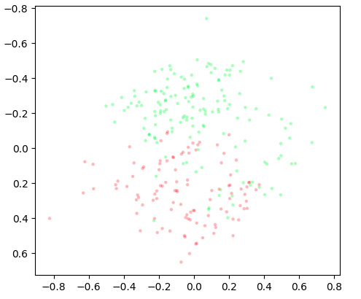
Principal Component Analysis
5-dimensional data reduced to its first 2 principal components
As can be seen the first two principal components are not quite well-separated after dimension reduction
Notes:
VS

Slide 8
Principal Component Analysis
Created Bayesian classifier using training data and applied it on test data of size N=145
Overall accuracy: 40.0%; Avg. per-class accuracy: 75.2%
Actual Class Label | Predicted Class Label
 |  | very_low | Low | Middle | High
 | very_low | 1 | 11 | 0 | 11
 | Low | 2 | 46 | 0 | 31
 | Middle | 0 | 0 | 0 | 0
 | High | 3 | 29 | 0 | 11
Accuracy | 81% | 71% |  | 49%
PPV | 0.16 | 0.53 | undef | 0.20
Notes:
VS
Please try N x3 P

Slide 9
Linear Classifier: Pseudoinverse
 |  | Classified as
 |  | Very low | High | Low | Middle
True class label | Very low | 0 | 1 | 8 | 7
 | High | 0 | 9 | 9 | 12
 | Low | 0 | 6 | 29 | 15
 | Middle | 0 | 6 | 22 | 21
Accuracy | 88.97% | 76.55% | 58.62% | 57.24%
PPV | Undef | 0.409091 | 0.426471 | 0.381818
Overall Accuracy: 40.69%
Average per class Accuracy: 70.34%
Notes:
PG
W:
[-0.90099936, -0.36527631, -0.29106895, -0.44265538],
[-0.00257046, -0.23051814, 0.01097865, 0.22210995],
[-0.27968785, 0.30794454, -0.14704245, 0.11878575],
[ 0.15036872, -0.5397035 , 0.29672762, 0.09260717],
[-0.08243858, 0.51246577, -0.20860431, -0.22142288],
[ 0.42324052, -0.52909049, -0.02487861, 0.13072858]
AIs:
Please publish weights,
confusion matrix for test data.
Overall accuracy

Slide 10
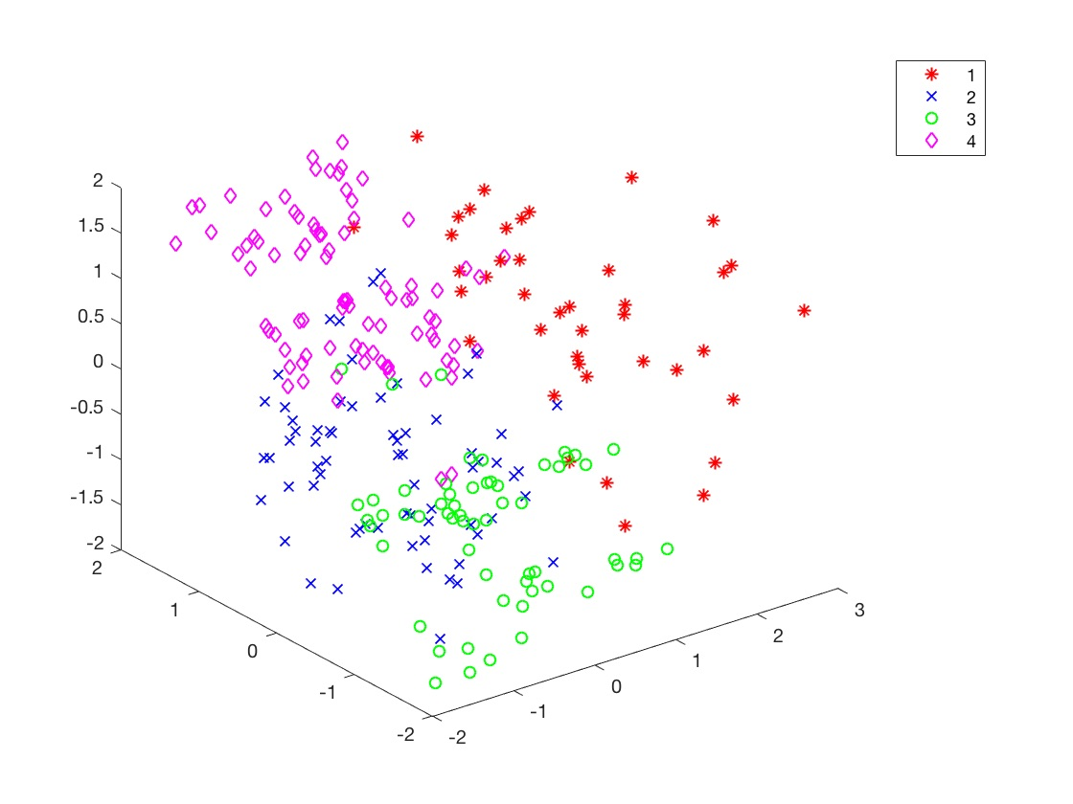
K-means clustering (K = 4)
3D plot of attributes STG,STR,PEG
Notes:
NQ
Attribute Lbls: STG,STR,PEG

Slide 11
K-means clustering
Accuracy
1st run | 2nd run | 3rd run | 4th run | 5th run
29.655 % | 20.0 % | 19.310 % | 34.482 % | 22.068 %

Slide 12
K-means clustering
Confusion Matrix
Accuracy
In five runs, it fluctuated from 19 % to 34 %
PPV
Highest PPV: 32.380952%
Lowest PPV : 0.000000 %
Predicted classes
Ground Truth |  | very_low | Low | Middle | High
 | very_low | 15 | 2 | 8 | 1
 | Low | 34 | 2 | 8 | 2
 | Middle | 29 | 1 | 7 | 2
 | High | 27 | 3 | 4 | 0
 | very_low | Low | Middle | High
accuracy | 0.42 | 0.68 | 0.74 | 0.73
ppv | 0.29 | 0.36 | 0.00 | 0.17
Notes:
NQ
K info

Slide 13
K-means
Observation
The PPV and accuracy changes because of random initial mu.
Increasing/decreasing the number of iterations did not have a linear effect on accuracy
How to initialize centroid (mu)?
Random
Run random multiple times and choose the best
Remove outliers
Select seed using an algorithm
Reference: http://www.cs.princeton.edu/courses/archive/spr08/cos435/Class_notes/clustering2_toPost.pdf
Notes:
NQ

Slide 14
Expectation Maximization
EM is mainly used for clustering like K-Means but used here for classification.
Unlike K-Means, it does not assign query to specific cluster but calculate the probabilities of belonging to different clusters. The cluster with max prob wins.
Observation
In python, sklearn module for EM is mixture. E.g. mixture. GaussianMixture(n_components=4, covariance_type=*)
Different types of covariance options are: full, tied, diag, spherical. Changing type, did not affect too much on the accuracy.
class sklearn.mixture.GaussianMixture(n_components=1, covariance_type='full', tol=0.001, reg_covar=1e-06, max_iter=100, n_init=1, init_params='kmeans', weights_init=None, means_init=None, precisions_init=None, random_state=None, warm_start=False, verbose=0, verbose_interval=10)
Notes:
KK

Slide 15
Expectation Maximization
Ground Truth | Predicted Classes
 |  | very_low | Low | Middle | High
 | very_low | 0 | 0 | 26 | 0
 | Low | 0 | 0 | 46 | 0
 | Middle | 1 | 18 | 10 | 5
 | High | 0 | 15 | 0 | 24
 | very_low | Low | Middle | High
Accuracy | 0.81 | 0.45 | 0.33 | 0.86
PPV | 0.0 | 0.0 | 12.19 | 82.75
Overall accuracy ~ 30 % (average of accuracy of all classes)
Observed result fluctuation - code run 10 times and accuracy changed from 0 % to 60 % approx
Notes:
KK

Slide 16
k Nearest Neighbors
kNN is an algorithm that will search through similar training set and predict the result based on k nearest neighbors. It is one of the simplest and still provides good accuracy. A vector is classified based on the voting of nearest neighbors. To find the nearest neighbor(s) different distance calculation methods are used eg Euclidean and ChiSquare.
K | Euclid | ChiSq
1 | 81.38 | 80.69
3 | 86.2 | 82.07
5 | 82.76 | 79.51
7 | 80 | 82.75
Notes:
Explain k-NN algo

Slide 17
k-NN Ground truth
Euclid - Actual - K=3
 | Very Low | Low | Med | High | Class accuracy
Very Low | 17 | 0 | 0 | 0 | 100%
Low | 9 | 43 | 6 | 0 | 74.13
Med | 0 | 3 | 26 | 0 | 89.65
High | 0 | 0 | 2 | 39 | 95.12
Overall accuracy = 125/145 = 86.2%
Notes:
who owns this, please put name - Shyju

Slide 18
Attribute Weighted k-NN
Weighted k-NN : computing weights
Load training data
Initialize attribute weights with random values
Example Weights: 0.3065 0.2372 0.3329 0.1181 0.0053
Set desired accuracy and maximum iteration values. Train the weights on the whole training data for maximum number of iterations (1000) or until desired accuracy (80%) is reached.
Training weights (for each training sample)
Find the K nearest neighbors based on the distance. Predicted class will be the class with maximum representation.
If predicted class does not match ground truth class apply gradient descent to adjust the weights
err = ground truth - predicted class
update all wts; wts_{i} = wts_{i} + alpha + err * test_data_attr_val
Use updated weights on the training data and calculate accuracy. If desired accuracy is reached stop otherwise continue for max iterations.
Notes:
SL

Slide 19
Attribute Weighted k-NN
Weighted k-NN : Predicting class
Load test data
Compute the distance using the trained weights
Example Weights: 0.3065 0.2372 0.3329 0.1181 0.0053
Find k nearest neighbors based on the distance
Predict the class : class with the maximum representation (k neighbors)
Compute overall accuracy
k-NN Accuracy
Accuracy for k = 1, 3, 5, 7
31.74% | 32.24% | 35.17% | 33.03%
Notes:
SL

Slide 20
Attribute Weighted k-NN
Distance Metric : Euclidean
Accuracy for k = 1, 3, 5, 7
Confusion Matrix ( K: 7, classes : 4)
31.17% | 32.41% | 40.06 | 44.13%
Classified as Ground Truth | v_low | Low | Middle | High
v_low (1) | 1 | 4 | 8 | 3
Low (2) | 2 | 21 | 20 | 7
Middle (3) | 1 | 16 | 24 | 8
High (4) | 1 | 15 | 7 | 7
Best Overall Accuracy , k
44.13% | 7
Best weights learnt from training data
(STG, SCG, STR, LPR, PEG)
0.318 | 0.173 | 0.302 | 0.195 | 0.010
Best PPV per class (1, 2, 3, 4) , k
20.00 | 37.5 | 40.67 | 28.00 | 7
Accuracy = (# of correctly classified samples/ # of testing examples) X 100
PPV = (# of correctly classified samples per class/ # of testing examples per class) x 100
Notes:
SL
Per class Accuracy
Over all accuracy

Slide 21
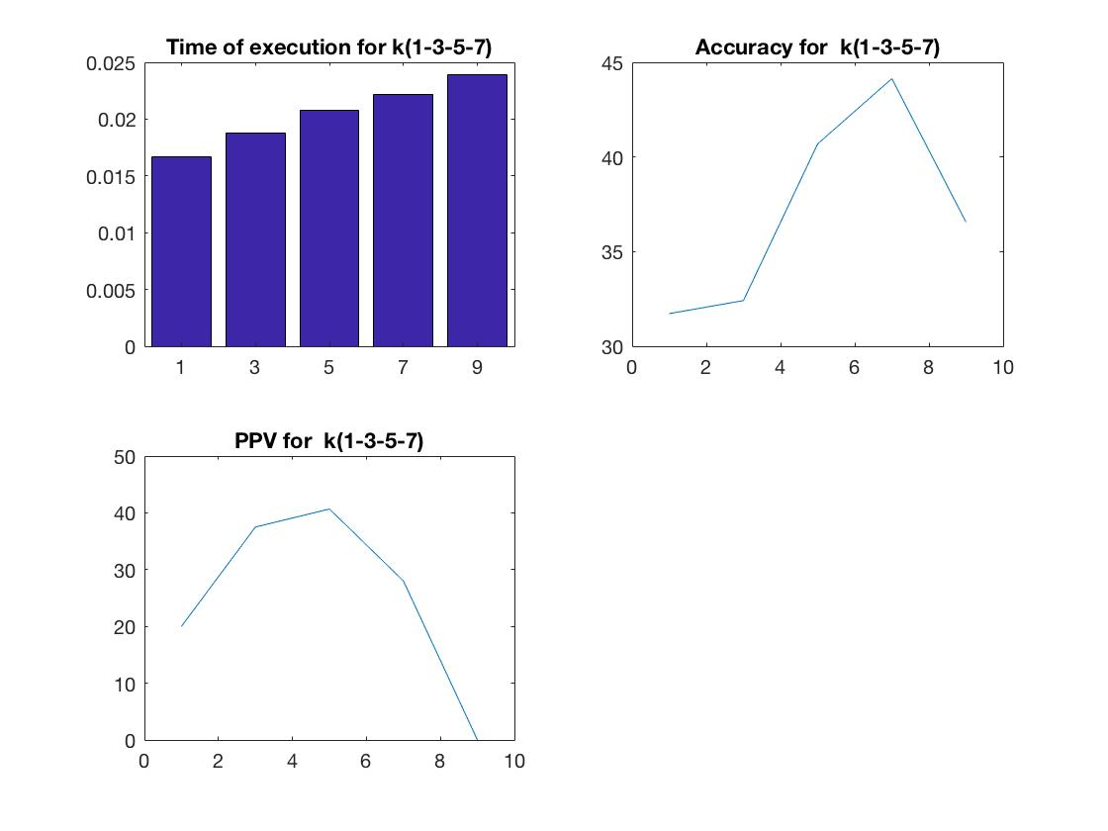
Wk-NN (Best wts, k = 1,3,5,7,9)
Overall Accuracy : ~44.00%
Notes:
SL

Slide 22
Observations
Accuracy comparison
User knowledge level data set | # Training samples | # Test samples | # attributes | # classes | Accuracy
Bayes | 248 | 145 | 5 | 4 | ~26%
PCA | 248 | 145 | ? | 4 | ~40%
Pseudo Inverse | 248 | 145 | 5 | 4 | ~40%
K-Means | 248 | 145 | 5 | 4 | ~25%
EM | 248 | 145 | 5 | 4 | ~30%
kNN | 248 | 145 | 5 | 4 | ~86%
w-kNN | 248 | 145 | 5 | 4 | ~44%

Slide 23
Thank you
Team Freund
Besides our team’s namesake Yoav Freund, freund is German for “friend”

