Slide 1
ECE 6276 – CDR Floating Point Arithmetic
Team Number: 3
Xiaoting Lai
Peng Guo
Shengwei Lyu
Dingxin Jin

Slide 2
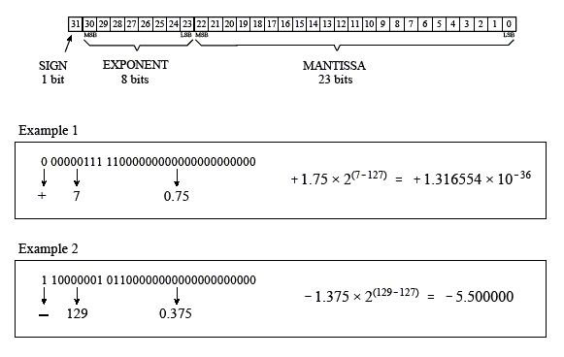
Background

Slide 3
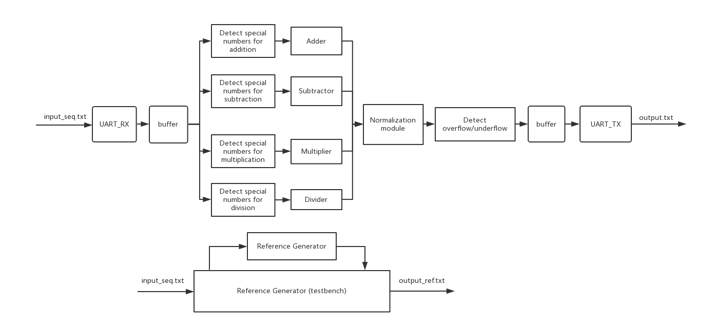
Overall Architectures

Slide 4
Current milestones
Completed cluster:
Multiplier, UART, Normalization & Denormalization,
Exception detection, Reference Generator, Testbench template
On-going cluster:
Adder/Subtractor, Divider, Input/Output Buffer

Slide 5
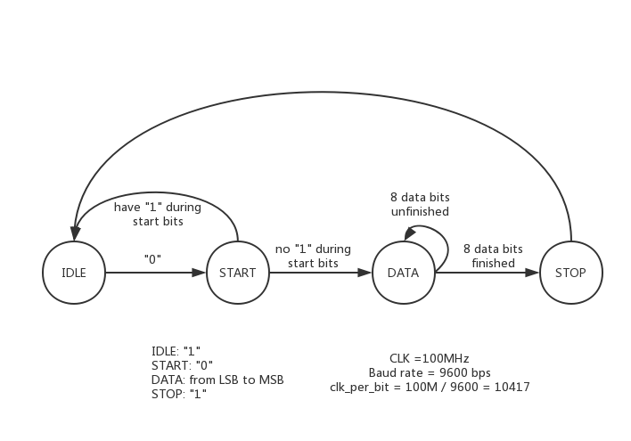
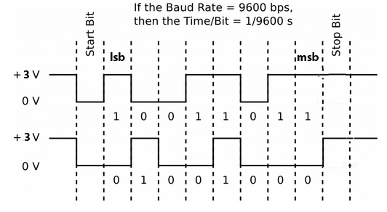
Cluster uArch: UART TX/RX
(uart_tx.vhd uart_rx.vhd)

Slide 6
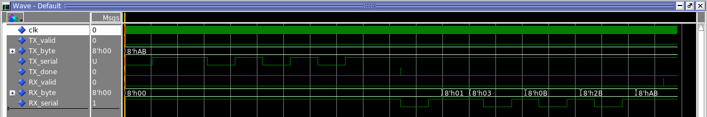
Cluster uArch: UART TX/RX
(uart_tx.vhd uart_rx.vhd)

Slide 7
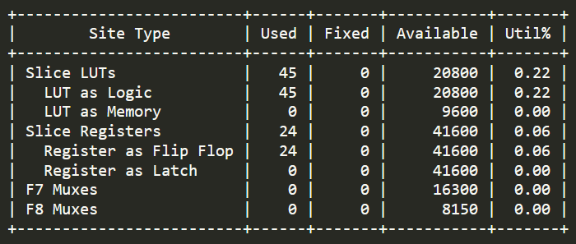
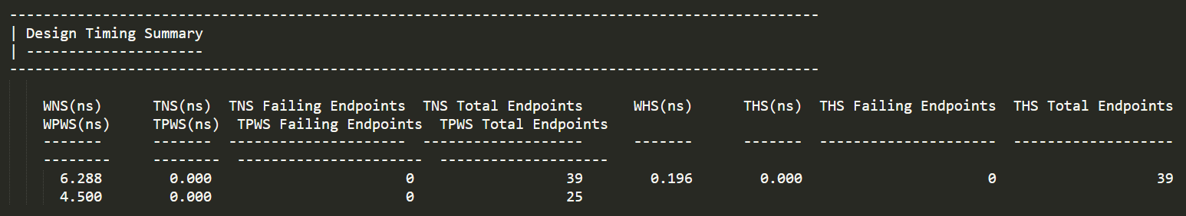
Cluster uArch: UART TX/RX
(uart_tx.vhd uart_rx.vhd)

Slide 8
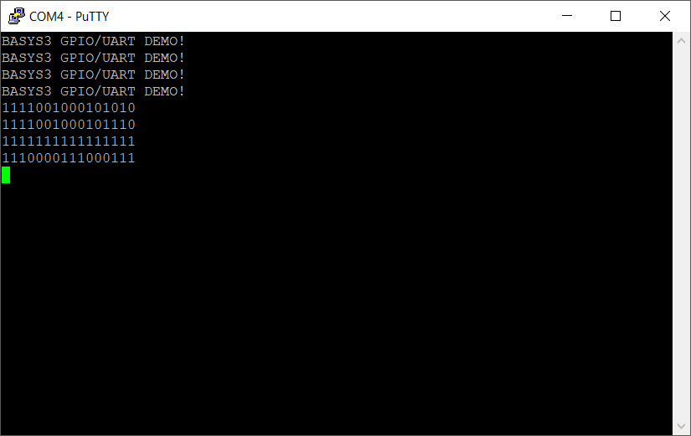
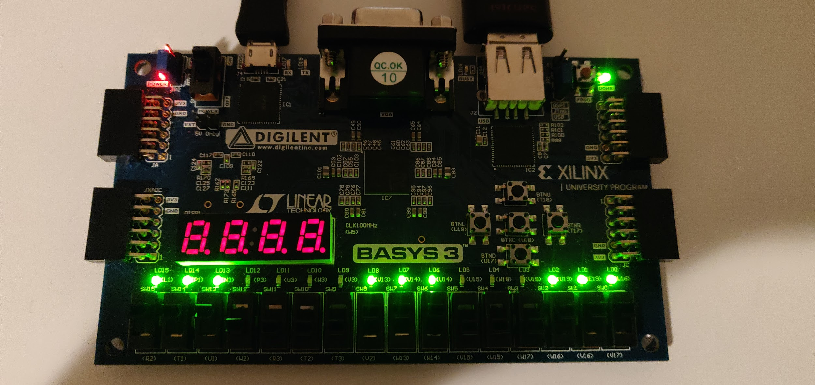
Cluster uArch: UART TX/RX
(uart_tx.vhd uart_rx.vhd)

Slide 9
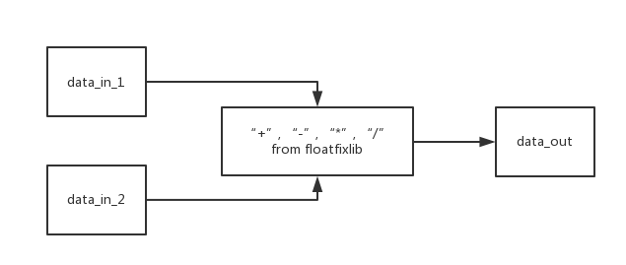
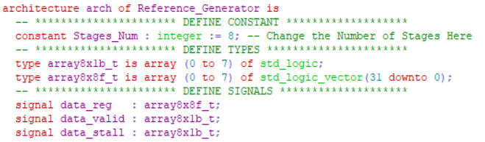
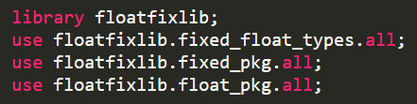
Cluster uArch: Reference Generator
(Reference_Generator.vhd)

Slide 10
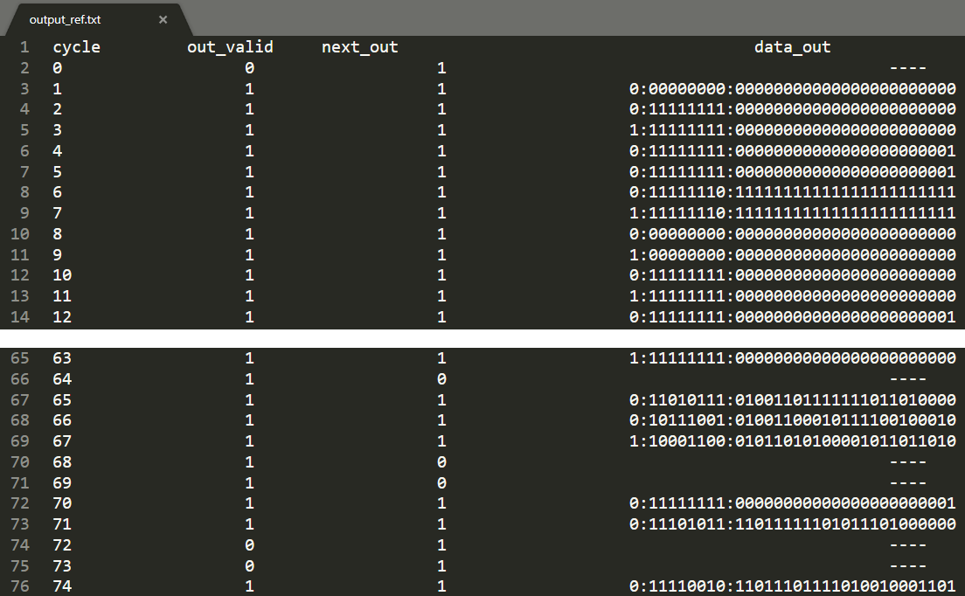
Cluster uArch: Reference Generator
(Reference_Generator.vhd)

Slide 11
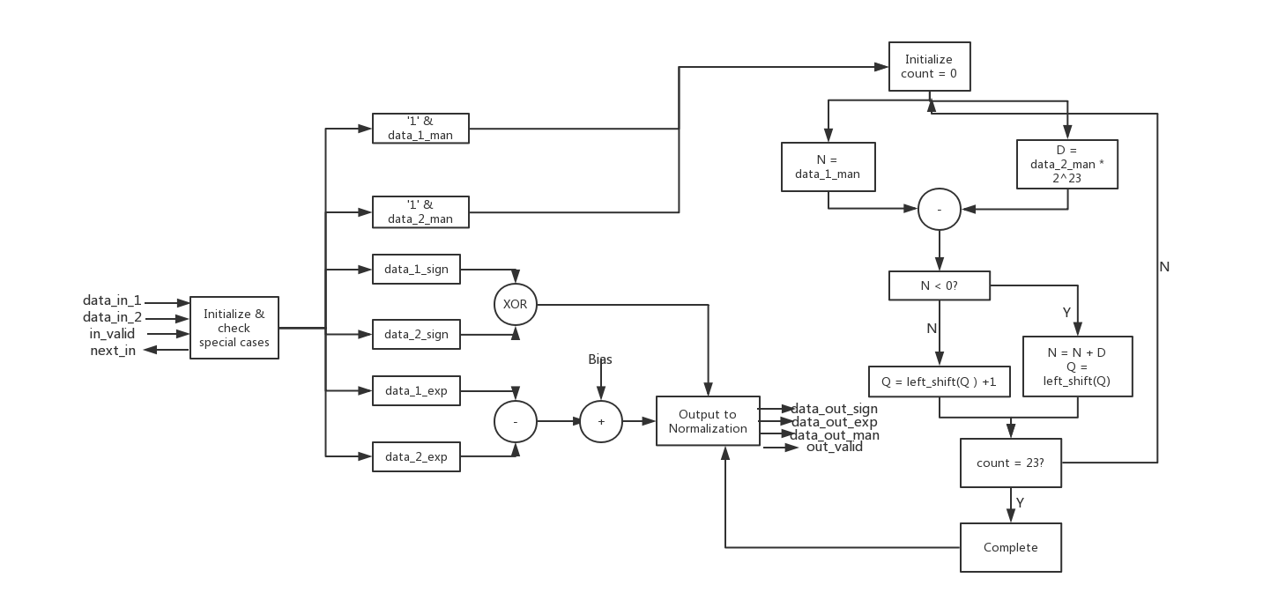
Cluster uArch: Floating point divider (FPP_DIVIDE.vhd)

Slide 12
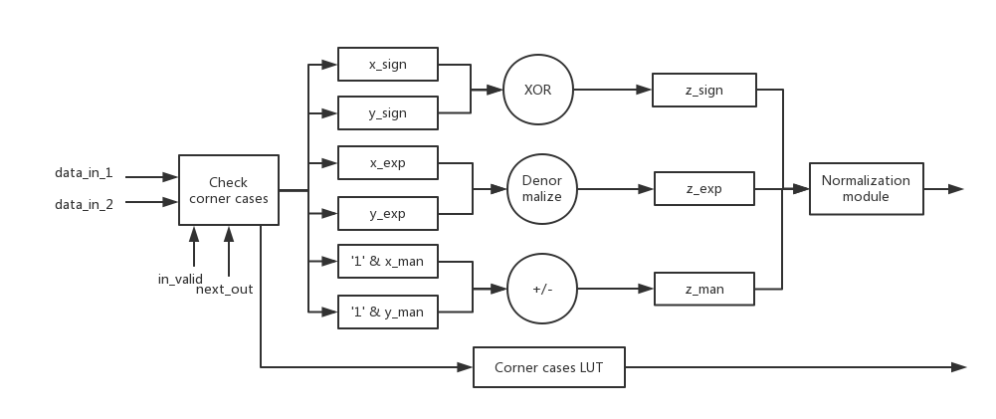
Cluster uArch: Floating point adder/subtractor (FP_add_sub.vhd)

Slide 13
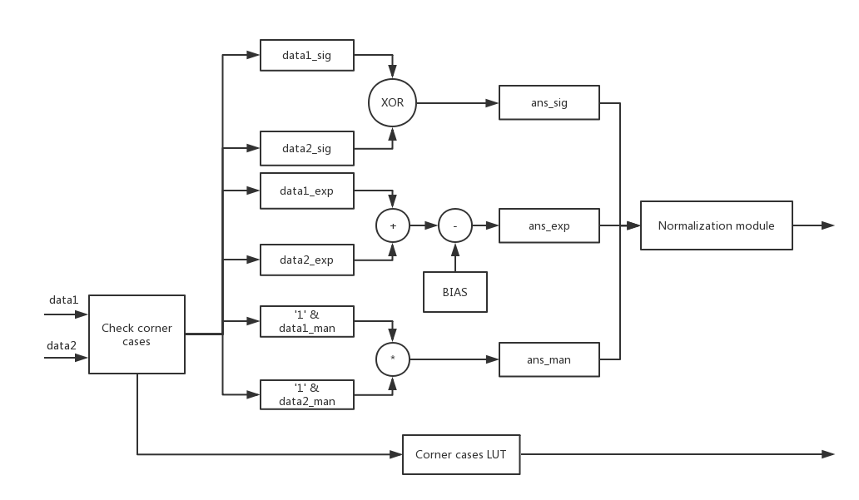
Cluster uArch: Floating point multiplier
(FP_mult.vhd)

Slide 14
Cluster uArch: Floating point multiplier
(FP_mult.vhd)
Corner cases for multiplier (QNaN: 0:11111111:000…001)
 | +0 | -0 | +∞ | -∞ | +NaN | -NaN | +LargeNum | -LargeNum | +SmallNum | -SmallNum
+0 | +0 | -0 | QNaN | QNaN | QNaN | QNaN | +0 | -0 | +0 | -0
-0 | -0 | +0 | QNaN | QNaN | QNaN | QNaN | -0 | +0 | -0 | +0
+∞ | QNaN | QNaN | +∞ | -∞ | QNaN | QNaN | +∞ | -∞ | +∞ | -∞
-∞ | QNaN | QNaN | -∞ | +∞ | QNaN | QNaN | -∞ | +∞ | -∞ | +∞
+NaN | QNaN | QNaN | QNaN | QNaN | QNaN | QNaN | QNaN | QNaN | QNaN | QNaN
-NaN | QNaN | QNaN | QNaN | QNaN | QNaN | QNaN | QNaN | QNaN | QNaN | QNaN
+LargeNum | +0 | -0 | +∞ | -∞ | QNaN | QNaN | +∞ | -∞ | Normal case | Normal case
-LargeNum | -0 | +0 | -∞ | +∞ | QNaN | QNaN | -∞ | +∞ | Normal case | Normal case
+SmallNum | +0 | -0 | +∞ | -∞ | QNaN | QNaN | Normal case | Normal case | +0 | -0
-SmallNum | -0 | +0 | -∞ | +∞ | QNaN | QNaN | Normal case | Normal case | -0 | +0

Slide 15
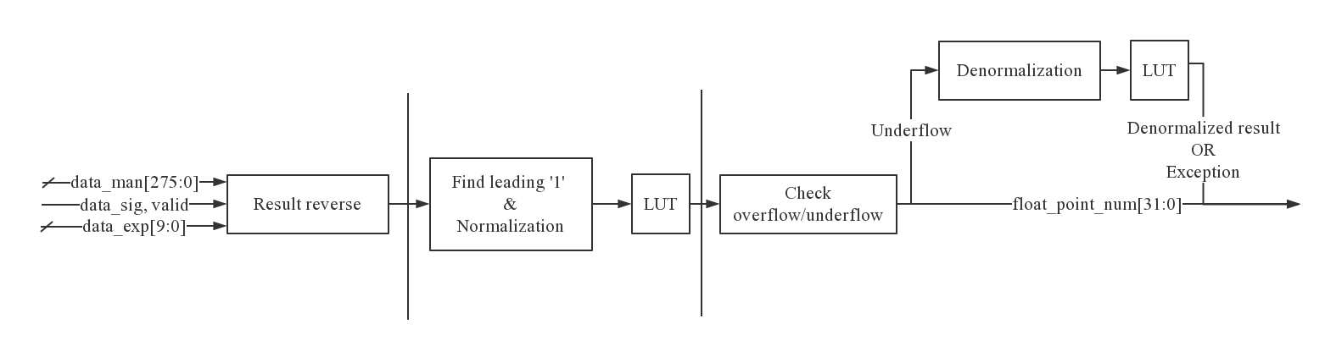
Cluster uArch: Normalization module
(Normalization.vhd)
Algorithm for Normalization: (e.g. find leading ‘1’ for b:00101001)
(1) Result reverse : [MSB to LSB] b:00101001 → d:10010100 [LSB to MSB]
(2) Find leading ‘1’ :
A. Decrement: d: 10010100 – 1 = d’: 10010011
B. XOR d with d’: 10010100 xor 10010011 = x :00000111
C. AND d with x : 10010100 and 00000111 = x’:00000100
Now we have an ‘one-hot’ code to show us the location of leading ‘1’, we can use it as an index for LUT to give us the distance for shifting.

Slide 16
Cluster uArch: Denormalization block
(Normalization.vhd)
Algorithm for Denormalization:
(1) Check if underflow happens (“01 & exp” for overflow, “11 & exp” for underflow)
(2) Calculate the distance d_Exp from exp to “00000000”.
(3) Check if underflow result can be recovered by denormalization
(d_Exp ≤ 23)
(4) Give the denormalized result using d_Exp as an index for a second LUT
The SP for either normalization or denormalization is 1

Slide 17
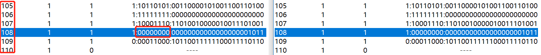
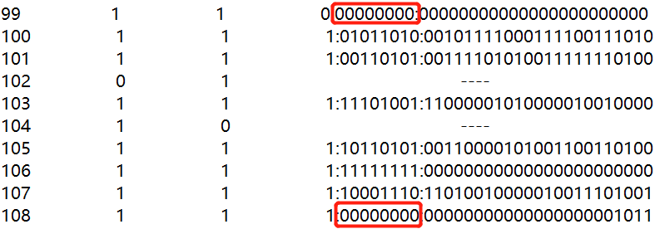
Cluster uArch: Normalization module
(Normalization.vhd)
SP = 1
Able to distinguish underflow cases with denormalized number

Slide 18
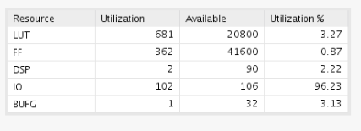
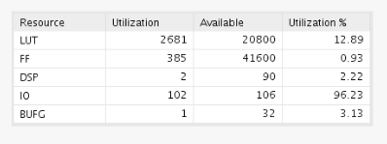




Cluster uArch: Normalization module
(Normalization.vhd)
Clock Constraint : 100 MHz
Without denormalization block
With denormalization block

Slide 19
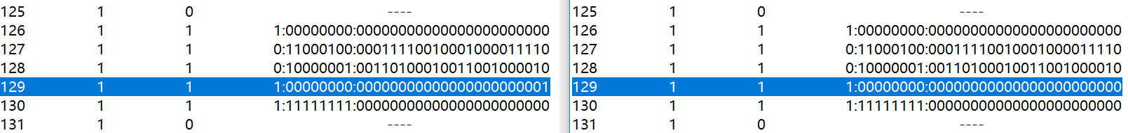
Risks Met
Rounding Issue
Judge Overflow & Underflow
The exponential will add/subtract an extra ‘1’ due to carry/borrow
Denormalization block needs to be optimized to meet the timing
Still have some difference between reference and simulation result on extreme situation

Slide 20
Plan for Final Design Review
Finish the remaining functional block
Optimize area and timing (if applicable)
Implement on FPGA and do on-board verification

Slide 21
Timeline
 | Work done so far | Remaining Work
Xiaoting Lai | Basic architecture of divider | Divider implementation, Check for corner cases and special cases, Test
Peng Guo | Basic architecture of adder and subtracter, Adder implementation | Corner cases test, Subtracter implementation
Shengwei Lyu | Basic architecture of multiplier, UART simulation | Multiplier implementation, UART configuration with FIFO
Dingxin Jin | Reference generator, Multiplier debugging, Testbench template, Normalization & Denormalization | Optimize normalization & denormalization, Help debug and implement modules

Slide 22
Appendix (This is a reminder)
Please write down the author of that code as well as the block description (like all your labs).
Attach a README file for your code:
Specifies the data flow or connections between different VHDL files (blocks),
the input/output file format and meanings
the pattern how TB feeds the data into design (ie, any wait cycles between two consecutive 8x8 pixel blocks)
the pattern how the design generates outputs.

