Slide 1
Introduction to Transformers
Definition: Transformers are a type of neural network architecture introduced in 2017 by Vaswani et al.
Key feature: Self-attention mechanism allowing for parallelization of sequential data processing · Primary application: Natural Language Processing (NLP) tasks such as machine translation, text classification, and language generation

Slide 2
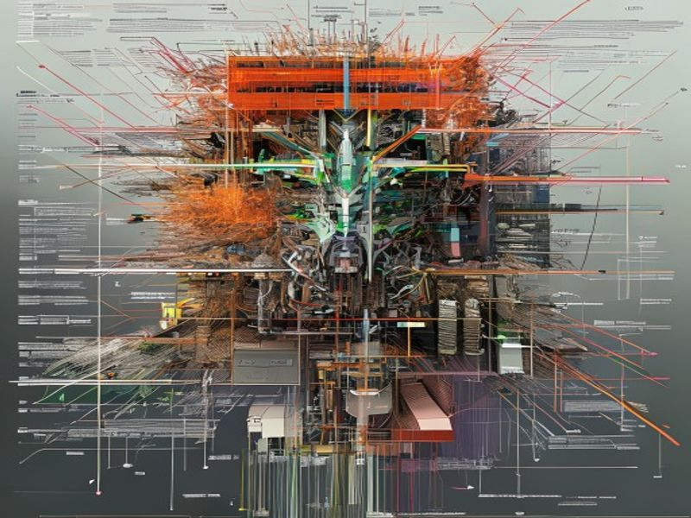
Architecture Overview
• Encoder-Decoder Structure: Both encoder and decoder consist of a stack of identical layers
• Layer Composition: Each layer includes two sub-layers - Multi-Head Self-Attention and Positionwise Feed-Forward Networks
• Normalization and Residual Connection: Applied to each sub-layer for stability and performance enhancement
Topic: Hey Pilot Generates Hey Pilot Generates Slide Deck For Transformers
Grid Dynamics | Slide 2 of 11

Slide 3

Self-Attention Mechanism
• Definition: A mechanism allowing the model to attend to all positions in the input sequence simultaneously and weigh their importance
• Components: Query, Key, and Value vectors, derived from the input embeddings
• Scalability: Enables efficient processing of long sequences by avoiding sequential computation
Topic: Hey Pilot Generates Hey Pilot Generates Slide Deck For Transformers
Grid Dynamics | Slide 3 of 11

Slide 4
Multi-Head Attention
• Extension of Self-Attention: Allowing the model to jointly attend to information from different representation subspaces at different positions
• Implementation: Multiple attention heads are applied in parallel, with outputs concatenated and linearly transformed
• Benefit: Captures a richer set of contextual relationships than single-head attention
Topic: Hey Pilot Generates Hey Pilot Generates Slide Deck For Transformers
Grid Dynamics | Slide 4 of 11

Slide 5
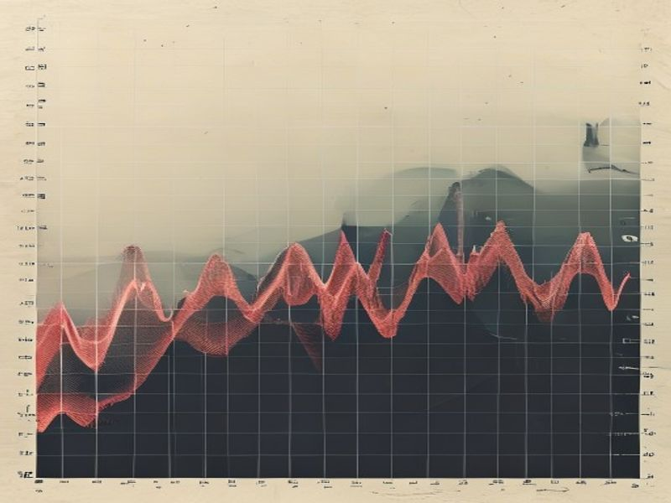
Positional Encoding
• Necessity: Since the transformer does not inherently capture sequence order, positional encoding is added to the input embeddings
• Method: Fixed or learned encodings that provide a way to preserve the order of the sequence
• Impact: Enables the model to understand the sequence and make use of the order of elements
Topic: Hey Pilot Generates Hey Pilot Generates Slide Deck For Transformers
Grid Dynamics | Slide 5 of 11

Slide 6
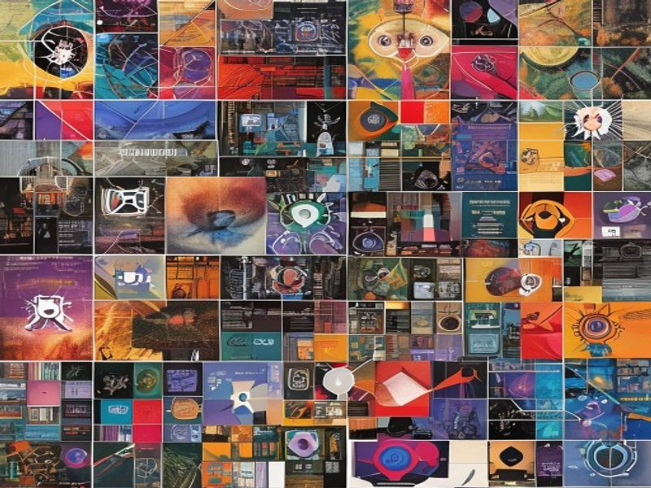
Transformer Applications
• Machine Translation: State-of-the-art results achieved with transformer-based models like BERT and its variants
• Text Classification: Transformers excel in tasks requiring understanding of long-range dependencies, such as sentiment analysis
• Language Generation: Used in chatbots, language translation, and content generation due to their ability to generate coherent and contextually relevant text
Topic: Hey Pilot Generates Hey Pilot Generates Slide Deck For Transformers
Grid Dynamics | Slide 6 of 11

Slide 7
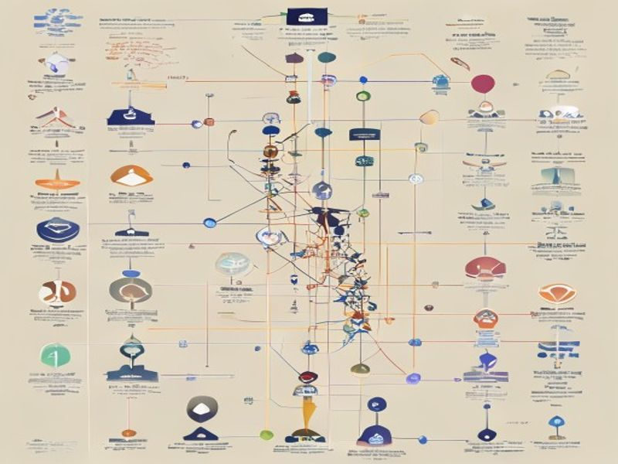
BERT and Its Variants
• Introduction: BERT (Bidirectional Encoder Representations from Transformers), a pre-trained language model that achieves state-of-the-art results in a wide range of NLP tasks
• Training: Masked language modeling and next sentence prediction tasks used for pre-training
• Variants: RoBERTa, DistilBERT, and ALBERT, each offering improvements or efficiencies over the original BERT model
Topic: Hey Pilot Generates Hey Pilot Generates Slide Deck For Transformers
Grid Dynamics | Slide 7 of 11

Slide 8
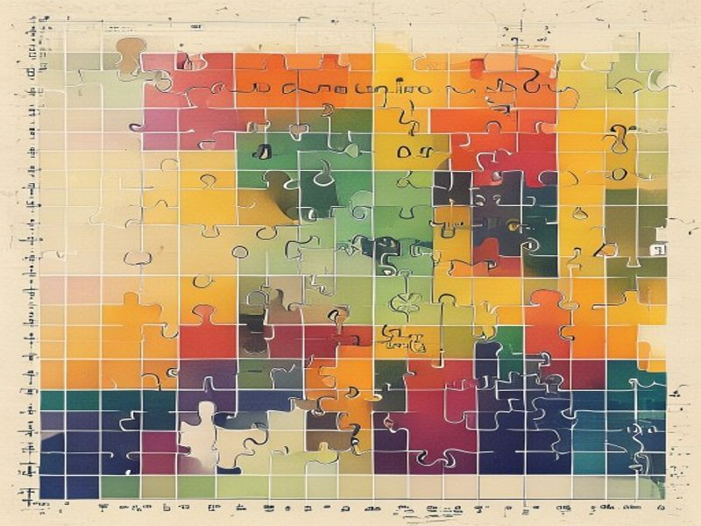
Challenges and Limitations
• Computational Complexity: The self-attention mechanism, although efficient, can be computationally expensive for very long sequences
• Interpretability: Understanding the decisions made by transformer models can be challenging due to their complex attention mechanisms
• Training Requirements: Large amounts of data and computational resources are required to train transformer models from scratch
Topic: Hey Pilot Generates Hey Pilot Generates Slide Deck For Transformers
Grid Dynamics | Slide 8 of 11

Slide 9
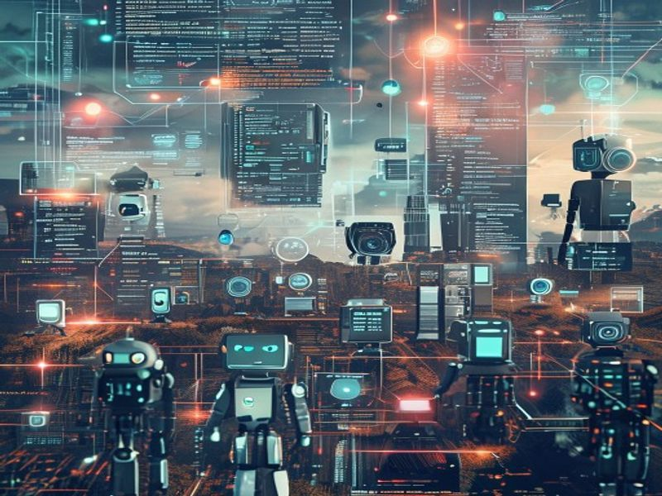
Future Directions
• Efficiency Improvements: Research into more efficient transformer architectures and training methods
• Multi-Modal Learning: Integrating transformers with other modalities like vision and speech to enable more comprehensive understanding and generation capabilities
• Explainability: Developing methods to make transformer models more interpretable and transparent in their decision-making processes
Topic: Hey Pilot Generates Hey Pilot Generates Slide Deck For Transformers
Grid Dynamics | Slide 9 of 11

Slide 10

Conclusion
• Recap: Transformers have revolutionized the field of NLP with their parallelization of sequential data and self-attention mechanism
• Impact: Achieved state-of-the-art results in numerous NLP tasks and paved the way for further research in AI and machine learning
• Future Prospects: Continuing advancements and applications in multi-modal learning, efficiency, and explainability
Topic: Hey Pilot Generates Hey Pilot Generates Slide Deck For Transformers
Grid Dynamics | Slide 10 of 11

Slide 11

References
• Vaswani, A., Shazeer, N., Parmar, N., Uszkoreit, J., Jones, L., Gomez, A. N., ... & Polosukhin, I. (2017). Attention is all you need. In Advances in neural information processing systems (pp. 5998-6008).
• Devlin, J., Chang, M. W., Lee, K., & Toutanova, K. (2018). BERT: Pre-training of deep bidirectional transformers for language understanding. In Proceedings of the 2018 Conference of the North American Chapter of the Association for Computational Linguistics: Human Language Technologies, Volume 1 (Long Papers) (pp. 1728-1743).
• Liu, Y., Ott, M., Goyal, N., Du, J., Joshi, M., Chen, D., ... & Stoyanov, V. (2019). RoBERTa: A robustly optimized BERT pretraining approach. arXiv preprint arXiv:1907.11692.
Topic: Hey Pilot Generates Hey Pilot Generates Slide Deck For Transformers
Grid Dynamics | Slide 11 of 11

