Slide 1
Introduction to Machine Learning
Machine learning is a subset of artificial intelligence (AI) that involves training algorithms to learn from data and make predictions or decisions
It has numerous applications across various industries, including healthcare, finance, and technology · Machine learning can be categorized into several types, including supervised, unsupervised, and reinforcement learning

Slide 2
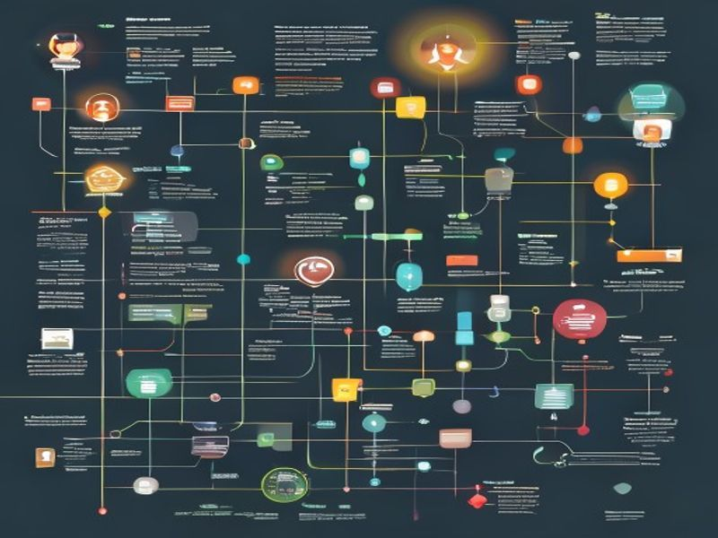
Supervised Learning
• Supervised learning involves training a model on labeled data, where the correct output is already known
• The goal is to learn a mapping between input data and the corresponding output labels
• Examples of supervised learning include image classification, sentiment analysis, and regression tasks
Topic: Generate Deck On Machine Learning Types.
Grid Dynamics | Slide 2 of 10

Slide 3
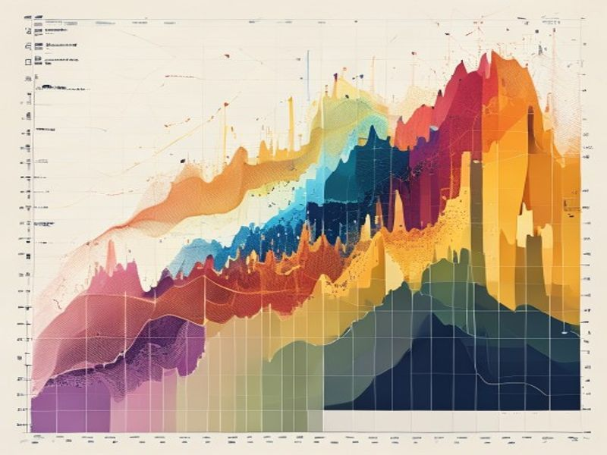
Unsupervised Learning
• Unsupervised learning involves training a model on unlabeled data, where the goal is to discover patterns or structure in the data
• Techniques such as clustering, dimensionality reduction, and anomaly detection are commonly used in unsupervised learning
• Unsupervised learning has applications in customer segmentation, gene expression analysis, and recommender systems
Topic: Generate Deck On Machine Learning Types.
Grid Dynamics | Slide 3 of 10

Slide 4
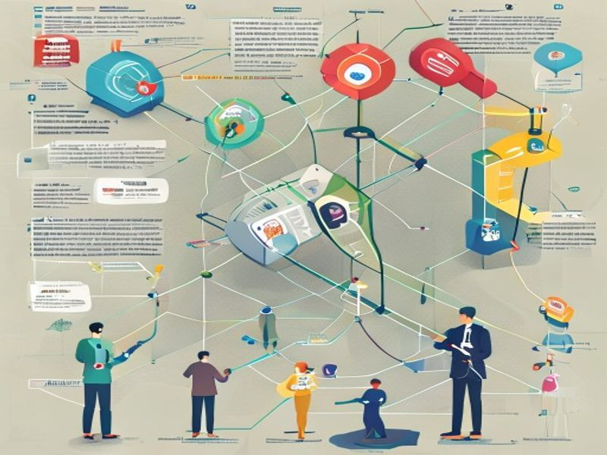
Reinforcement Learning
• Reinforcement learning involves training an agent to take actions in an environment to maximize a reward signal
• The agent learns through trial and error, using feedback from the environment to improve its decision-making
• Reinforcement learning has applications in robotics, game playing, and autonomous vehicles
Topic: Generate Deck On Machine Learning Types.
Grid Dynamics | Slide 4 of 10

Slide 5
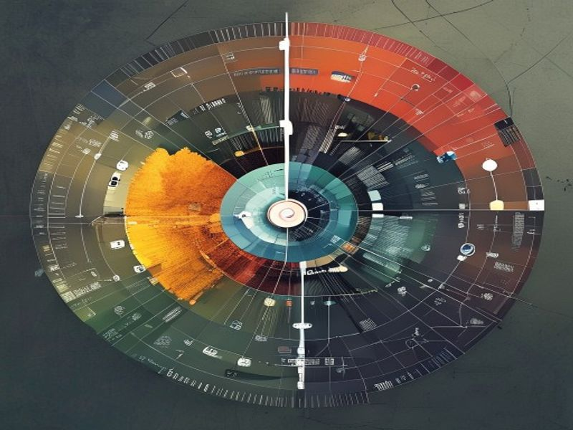
Semi-Supervised Learning
• Semi-supervised learning combines elements of supervised and unsupervised learning, using a small amount of labeled data and a large amount of unlabeled data
• The goal is to leverage the unlabeled data to improve the performance of the supervised model
• Semi-supervised learning has applications in image classification, natural language processing, and speech recognition
Topic: Generate Deck On Machine Learning Types.
Grid Dynamics | Slide 5 of 10

Slide 6
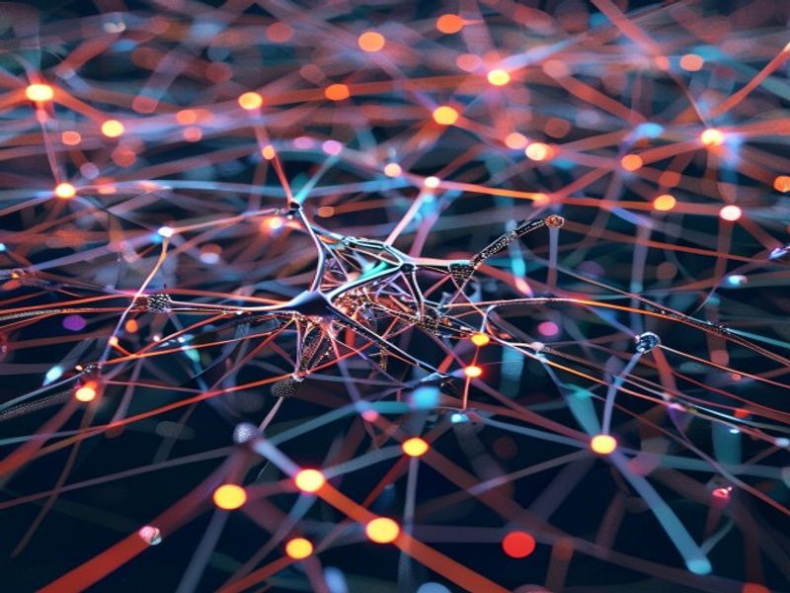
Deep Learning
• Deep learning involves the use of neural networks with multiple layers to learn complex patterns in data
• Deep learning has achieved state-of-the-art performance in various applications, including image classification, natural language processing, and speech recognition
• Techniques such as convolutional neural networks (CNNs) and recurrent neural networks (RNNs) are commonly used in deep learning
Topic: Generate Deck On Machine Learning Types.
Grid Dynamics | Slide 6 of 10

Slide 7
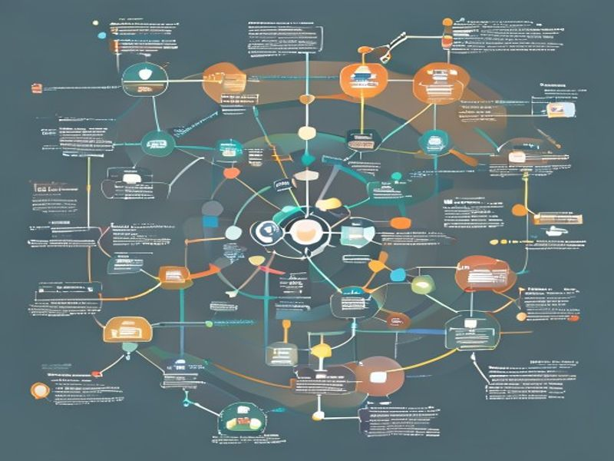
Machine Learning Workflow
• The machine learning workflow involves several steps, including data collection, data preprocessing, model selection, training, and deployment
• Each step is crucial to the success of the machine learning project, and requires careful consideration and attention to detail
• The machine learning workflow can be iterative, with multiple cycles of refinement and improvement
Topic: Generate Deck On Machine Learning Types.
Grid Dynamics | Slide 7 of 10

Slide 8
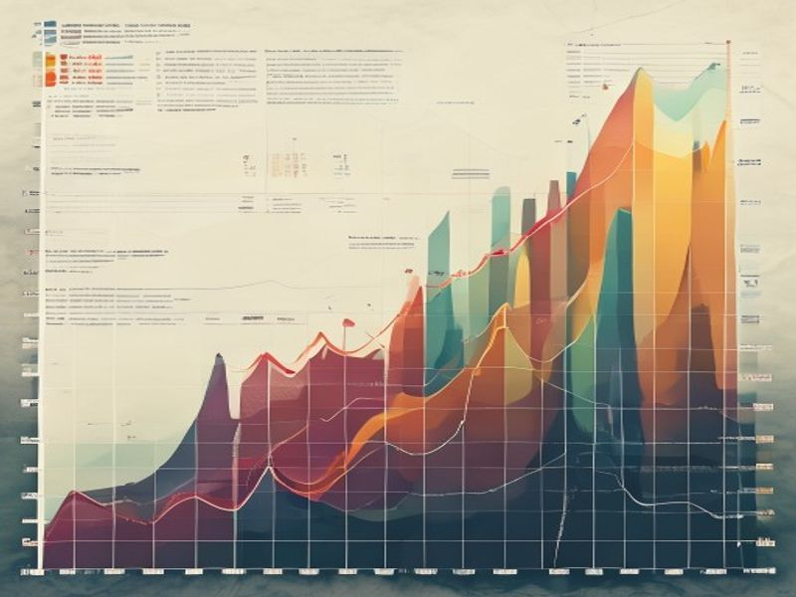
Machine Learning Challenges
• Machine learning faces several challenges, including data quality issues, model interpretability, and explainability
• The lack of transparency and accountability in machine learning models can lead to bias and unfairness
• Addressing these challenges requires careful consideration of the data, models, and deployment strategies used in machine learning projects
Topic: Generate Deck On Machine Learning Types.
Grid Dynamics | Slide 8 of 10

Slide 9
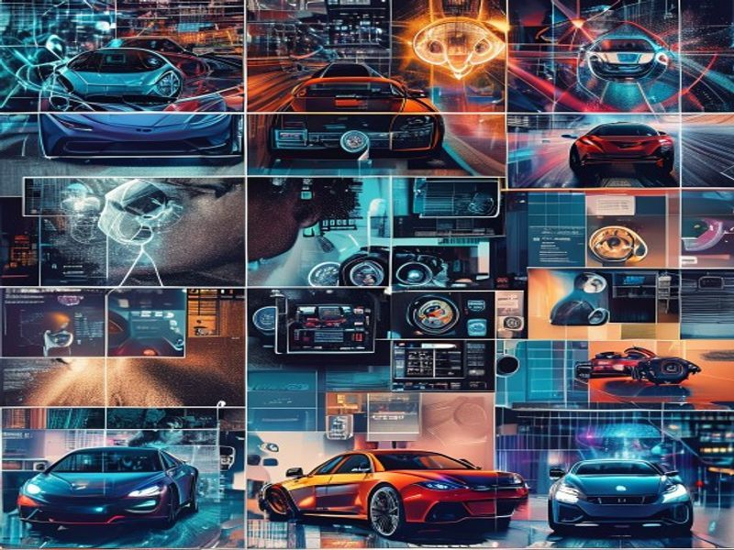
Real-World Applications of Machine Learning
• Machine learning has numerous real-world applications, including image recognition, natural language processing, and predictive maintenance
• Companies such as Google, Amazon, and Facebook are leveraging machine learning to drive innovation and improvement
• Machine learning has the potential to transform industries and revolutionize the way we live and work
Topic: Generate Deck On Machine Learning Types.
Grid Dynamics | Slide 9 of 10

Slide 10

Conclusion
• Machine learning is a powerful tool with numerous applications and potential benefits
• Understanding the different types of machine learning and their applications is crucial for harnessing its power
• As machine learning continues to evolve, it is essential to stay up-to-date with the latest developments and advancements
Topic: Generate Deck On Machine Learning Types.
Grid Dynamics | Slide 10 of 10

