Slide 1
Biosorption & Bioaccumulation

Slide 2
Potentially Toxic Elements – Heavy Metals
Heavy Metals
Heavy Metals are chemical elements with a specific gravity that is at least 5 times the specific gravity of water. Examples: Arsenic, Cadmium, Iron, Lead, Mercury
Toxic Heavy Metals
Heavy metals become toxic when they are not metabolized by the body and accumulate in the tissues.
Toxic Metals are Cu, Cr, Mn, Ni, Sn, and Zn.
Most heavy metal ions are water soluble and get dissolved in wastewater, which results in health hazards and harmful biochemical effects on human beings. Therefore it is essential to remove heavy metals in industrial wastewater and the environment to an acceptable level. The non-living biomass of algae, waste biomass originating from plants, and mycelial wastes from fermentation industries are potential biosorbents for the removal of heavy metals from industrial effluents.

Slide 3
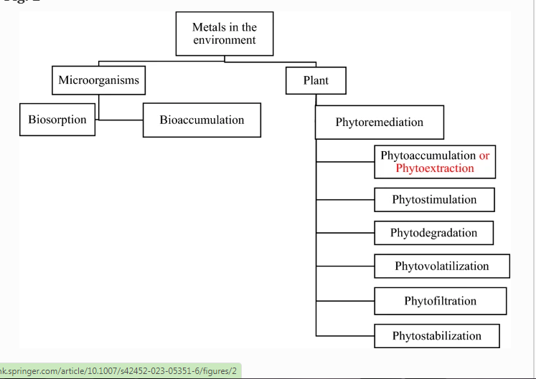
Bioremediation is a process that detoxifies pollutants in soil and other environments primarily by using microbes, plants, or microbial or plant enzymes.
It employs biological mechanisms inherent in plants and microorganisms to eliminate harmful pollutants and return the environment to its natural or original state.
The key principles of bioremediation are to lower the solubility of pollutants in the environment by altering pH, redox processes, and pollutant adsorption from a polluted environment

Slide 4
Biosorption and Bioaccumulation
Biosorption can be defined as the ability of biological materials to accumulate organic pollutants such as heavy metals, industrial discharge and dyes from wastewater through metabolically mediated or physico-chemical pathways of uptake.
It is a property of certain types of dead, inactive microbial biomass to bond and concentrate heavy metals from aqueous solutions such as water bodies.
Bioaccumulation is defined as accumulation of substances like pesticides and other organic chemicals in an organism or part of organism (cells or tissue). Chemicals are introduced into the organism through exposure to the abiotic environment (soil, water, air) or as dietary intake (trophic transfer).
It commonly refers to gradual build-up of pollutants in living organisms.

Slide 5
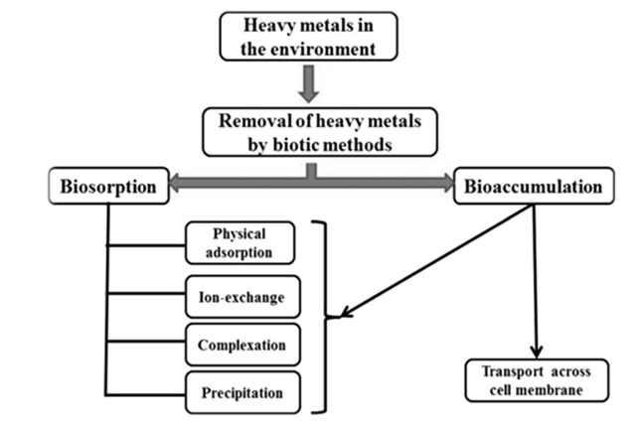
Figure: Mechanism of removal of Heavy metals through the process of Biosorption and Bioaccumulation

Slide 6
Biosorption and its mechanism
Biosorption is a passive process that occurs at a faster rate than bioaccumulation. Here, microorganisms use their cellular structure to capture HM ions, which they then sorb onto the cell wall’s binding sites.
The main attraction of biosorption is its potential ability to regenerate biomass, through the process called desorption. It can influence the price of the whole process and the possibility of metal recovering from the liquid phase as well, which is very important for the practical use of the process.
Adsorption, is a surface occurrence, whereas absorption affects the full volume of the substance.

Slide 7
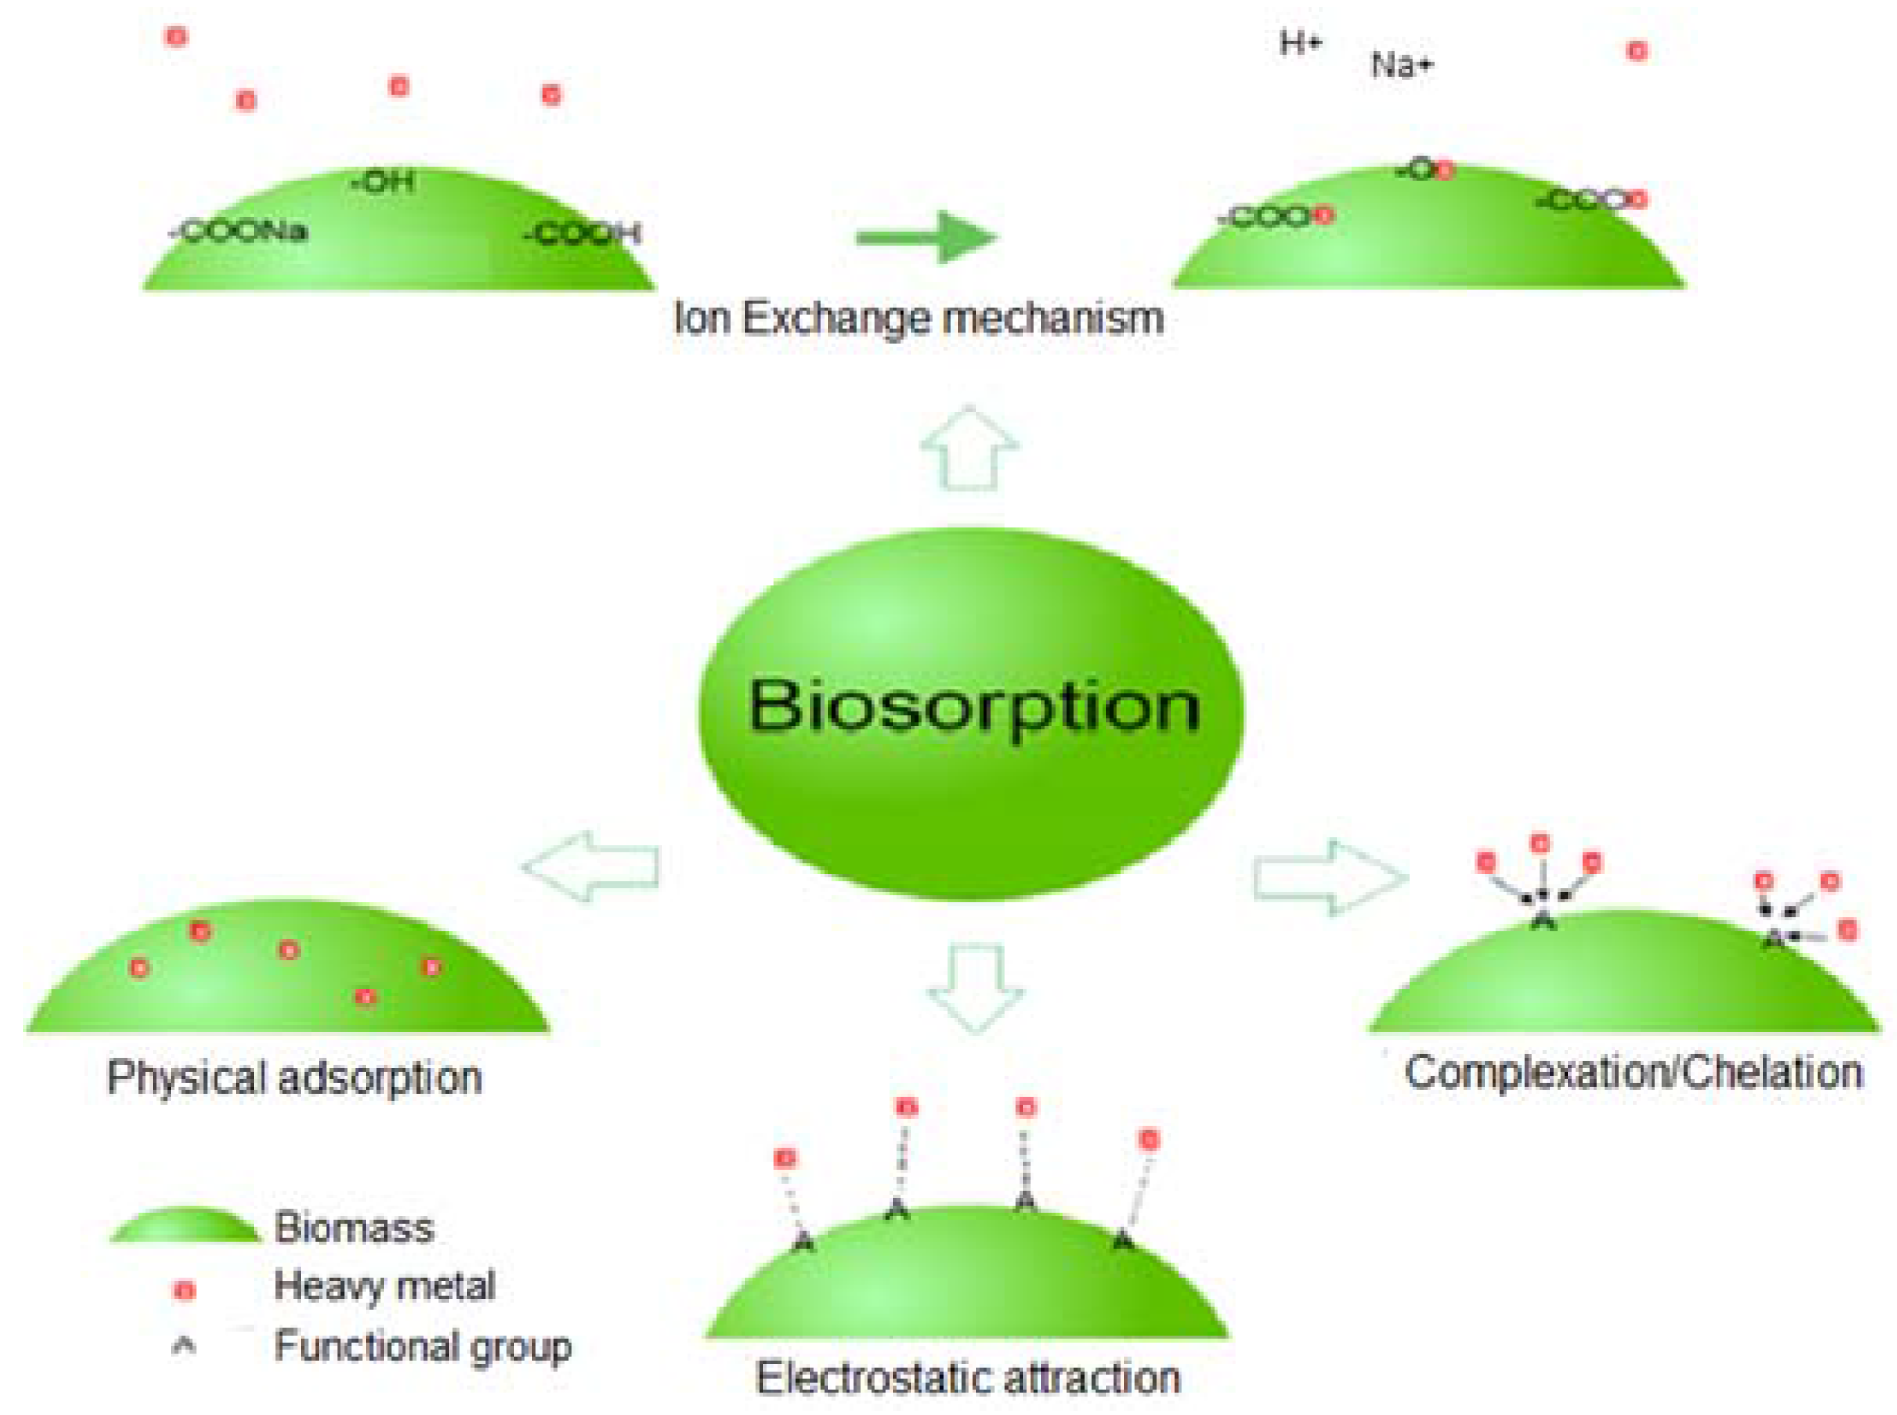
Figure: A schematic representation of the mechanisms involved in the biosorption of potentially toxic elements
Extra-cellular polymeric substances present on the biomass cell wall can attach to heavy metals by mechanisms like proton exchange or micro-precipitation of metals.
negative charge on bimass surfaces due to presence of carboxyl, amino, phosphoryl, and sulfo groups acts as potential ion exchange sites and metal sinks.
Microbes may initiate metal mobilization/immobilization by redox reactions by converting an element from its insoluble and stationary form in sediments into its mobile and soluble phase

Slide 8
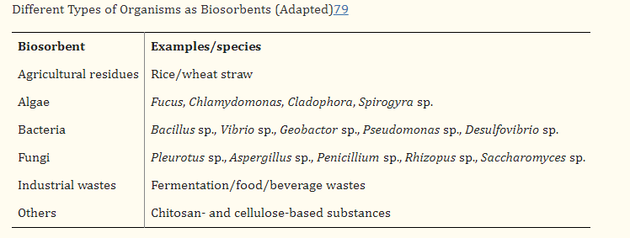
Potential Biosorbents
Bacteria, are regarded as the most exceptional biosorbents among all other creatures due to their high surface-to-volume ratios and numerous chemosorption active sites in their cell wall, such as teichoic acid.
Dead bacterial strains have also been considered as promising biosorbents, with biosorption abilities that exceed those of living cells of the same strain.
The functional groups like amide, amine, carbonyl, carboxyl, etc. facilitate the removal of heavy metals.

Slide 9
Factors governing Biosorption and its mechanism
The mechanism of biosorption usually depends on different factors such as:
The biomass that is going to be used for the removal of potentially toxic elements. For instance, the composition of the cell wall is different in bacteria (peptidoglycan), fungi (chitin), and algae (alginate, sulfonated polysaccharides); therefore, variation in the presence of functional groups on the surface of the cell wall is responsible for the difference in mechanisms.
Apart from the cell wall, extracellular polymer substances secreted by microorganisms are also found to play an important role in biosorption.

Slide 10
Factors Affecting
Biosorption
pH
temperature
Among these factors, pH is the most important factor.
Increase in pH also increases the biosorption of metal ions, however,
Too much increase in pH can cause precipitation
initial metallic concentration
contact time
competing ions/co-ions and
biosorbent dosage

Slide 11
Advantages & Disadvantages of Biosorption
ADVANTAGES | DISADVANTAGES
The advantages of an ideal biosorption process includes: | Biosorption also has some disadvantages such as:
Low cost | Early saturation
Short operation time | Limitation in biological process
Absence of toxicity limitations
Absence of requirements for nutrients
Avoidance of sudden death of biomass
Easy mathematical modelling of metal uptake by reactors
It is possible to remove ions from cell surfaces after biosorption by simple non-destructive methods.

Slide 12
Bioaccumulation and its mechanism
Bioaccumulation by microbes is metabolically active and relies upon the import-storage system.
It occurs when the amount of pollutant absorption surpasses the pollutant removal rate. As a result, the pollutant becomes trapped inside the organism and accumulates.
Heavy metal (HM) bioaccumulation is the process through which toxic metals or chemical compounds become bonded inside a cell structure.
In this system, HM ions are transported through the lipid bilayer of the cell membrane into the intracellular spaces or cytoplasm with the help of transporter proteins. This is known as active uptake or bioaccumulation.
Endocytosis, ion channels, carrier-mediated transport, complex permeation, and lipid permeation are all involved in HM bioaccumulation in the bacterial membrane

Slide 13
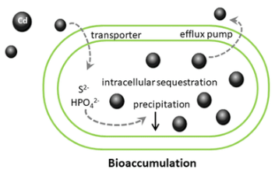
Bioaccumulation, also termed active biosorption, involves two processes:
The first step involves attachment of potentially toxic elements to the surface. This step which is identical to biosorption is a metabolism-independent and quick mechanism of metal uptake on the cell surface, known as extracellular binding.
The second step is metabolism dependent, relatively slow mechanism responsible for the penetration/transport of metal ions into the cell membrane released from binding sites of the surface and bound to intracellular structures termed intra-cellular binding.

Slide 14
Contd.….
A
B
C
Intracellular uptake of metal ions
via ATP-driven active transport and/or via bio-precipitation (release of sulfide or phosphate ions) associated with metabolic functions or biotransformation (oxidation,
reduction, methylation and demethylation)
Localization of the metal ions within specific organelles; enzymatic detoxification and efflux pump.
The concentration of the internalized metal is regulated by metal homeostasis system,
Cells form complexation of unwanted metal and sequester it into intracellular organelles for eventual export from the cell by efflux systems.

Slide 15
Bioleaching, uses microorganisms as reduction agents, forextract ion and recovery of heavy metals.
microorganisms convert the solid chemical within contaminated soil into a soluble substance that can be removed and recovered .
For example; Acidophiles are chemolithotrophs oxidize Fe (II) to Fe (III) and/or reduce sulfur to sulfuric acid and flourish in low pH environments, particularly 2.0 or below.
Sulfuric acid produces ferric ions and protons, which solubilize metal sulfides and oxides from ores aiding extraction of metal by segregating metals in the solid phase from the more water-soluble phase.
Biotransformation is a process in which structurally a chemical compound is altered, thereby relatively a more polar molecular is synthesized.
contact of metal and microorganisms causes toxic metals and organic compounds to get altered to a comparatively less hazardous form.
Microbial transformations can be attained through the production of new carbon bonds, isomerization, introducing functional groups, oxidation, reduction, condensation, hydrolysis, methylation, and demethylation.

Slide 16
Selection of Microorganisms for Bioaccumulation
Certain points should be considered for selection of microorganisms for bioaccumulation process, such as:
Isolation from polluted environment because bioaccumulation by adapted microorganisms is more efficient than by non-adapted microorganisms.
Resistant to high loads of pollutants and do not have mechanisms for protection from excessive accumulation inside the cell.
Presence of mechanism for intracellular binding.

Slide 17
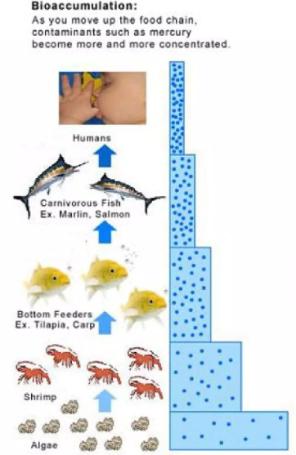
Biomass size
Factors Affecting Bioaccumulation
Biomass dosage
Initial
metal ion concentration
Nutrient
pH
Temperature
Time

Slide 18
Advantages & Disadvantages of Bioaccumulation
ADVANTAGES | DISADVANTAGES
The advantages of Bioaccumulation process includes: | Bioaccumulation process also has some disadvantages such as:
Simple process. | the cells metabolism responsible for the intracellular accumulation may result in interruption to the bioaccumulation process by death of biomass.
In bioaccumulation, it is possible to reach lower residual concentration of sorbate because cells offer binding sites on the surface and inside the cell. | Limitation in biological process.
It does not require separate biomass cultivation or harvesting model. | the metal ions can only be removed by destructive methods like incineration or dissolution into strong acids or alkalis.

Slide 19
Comparative features of Biosorption & Bioaccumulation
Features | BIOSORPTION | BIOACCUMULATION
Cellular growth | No cellular growth. | Cellular growth occurs.
Cost | Generally low as the biosorbents used are mainly industrial, agricultural and other type of waste biomass. | Usually high. The process involves living cells and hence, cell maintenance is cost prone.
Degree of uptake | Extremely high. | As living cells are sensitive to high toxicant concentration, uptake is usually low.
Maintenance/ Storage | Easy to store and use as the biomass is inactive. | External metabolic energy is needed for maintenance of the culture.
Process | Single stage passive process. | Double stage active process.
Reaction mode | Adsorption. | Absorption.
Rate of uptake | Most biosorption mechanisms are rapid due to extracellular accumulation. | Usually slower than biosorption. Since intracellular accumulation is time consuming.
Selectivity | Poor. However, selectivity can be improved by modification/processing of Biomass. | Better than biosorption.

