Slide 1
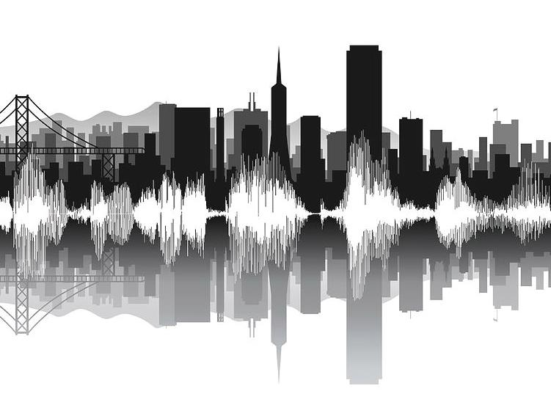
Urban Sound Classification
Pavani Guttula ,Reham Aburas, Habiba Farrukh, Aly Shehata

Slide 2
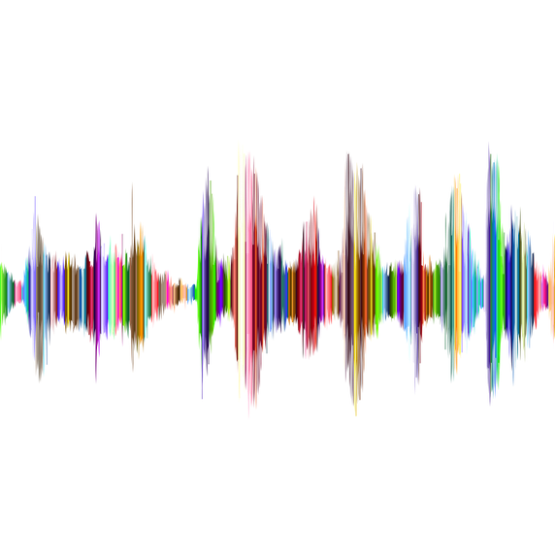
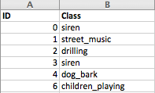
Introduction
Urban Sound Dataset
8732 labeled sound samples (<= 4s) from 10 classes
Classes include: Car Horn, Children Playing, Dog bark, etc…
Goal : Implement and evaluate different algorithms to classify a given urban sound.

Slide 3
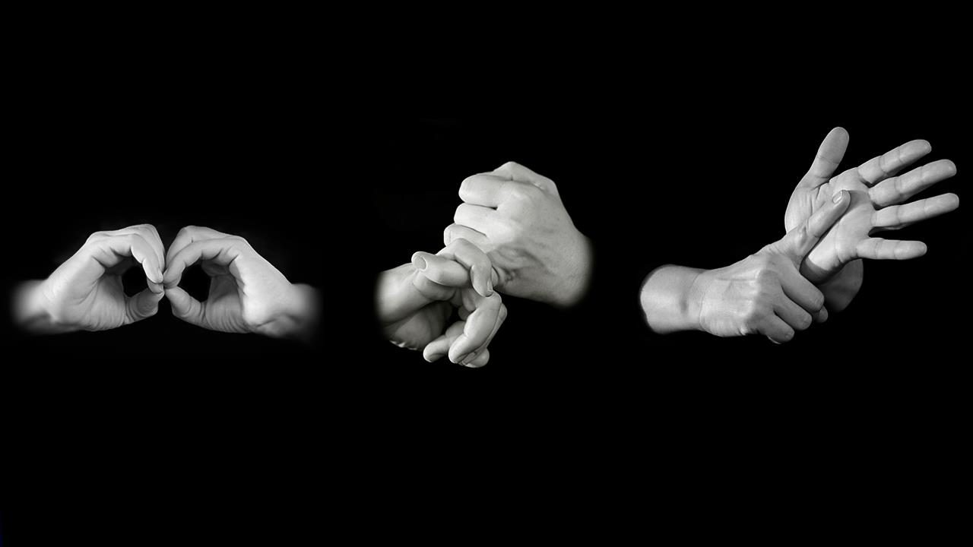


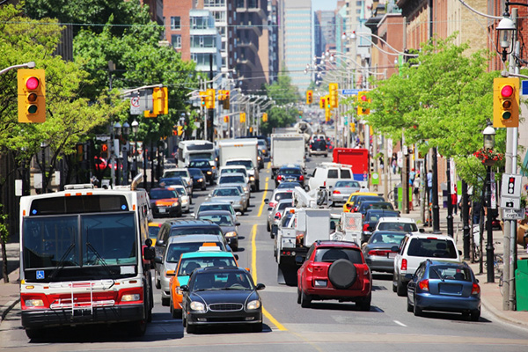
Applications
Notes:
Differently Abled Assistance - Deaf, Low-Hearing, etc…
Self-driving vehicles
Security and Law Enforcement
Noise level monitoring in crowded areas

Slide 4
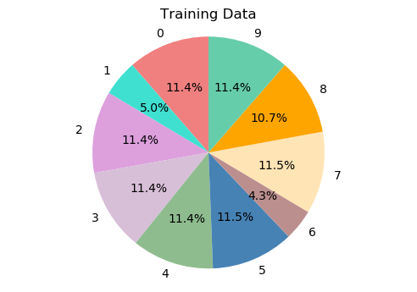
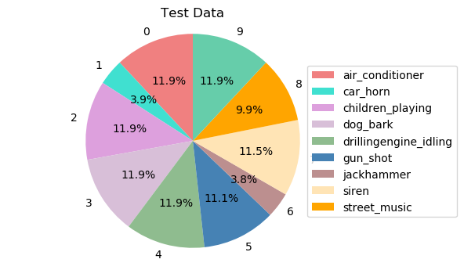
Data Exploration
Notes:
Noise level monitoring in crowded areas

Slide 5
Data Augmentation
Use MUDA Library for augmenting audio data files
Apply deformers including
Pitch shift
Time Stretch
Background Noise
Dynamic Range Compression
Uses labels of original training samples
Increase training data 10x sample 10% to double the training data

Slide 6
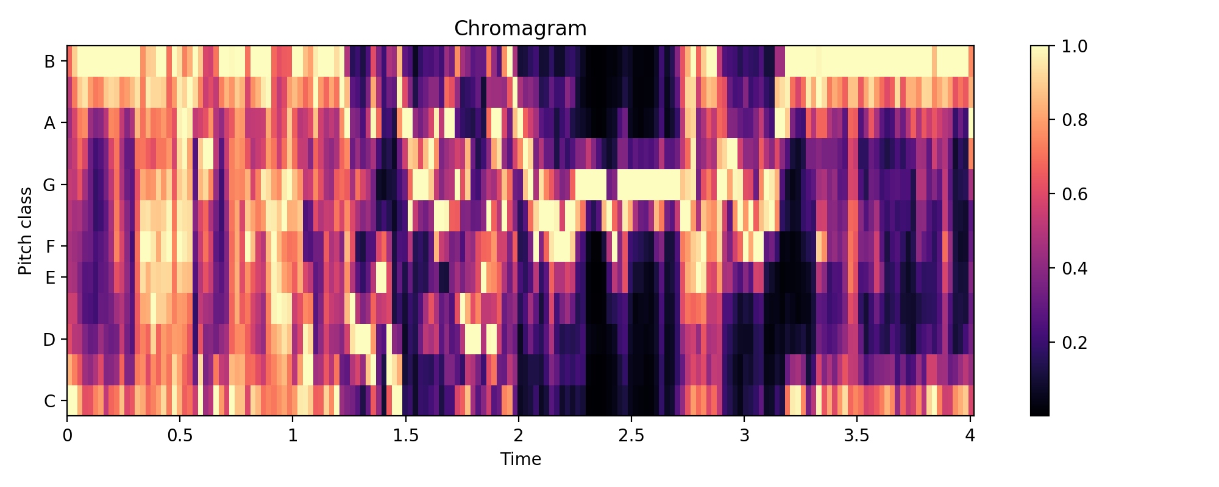
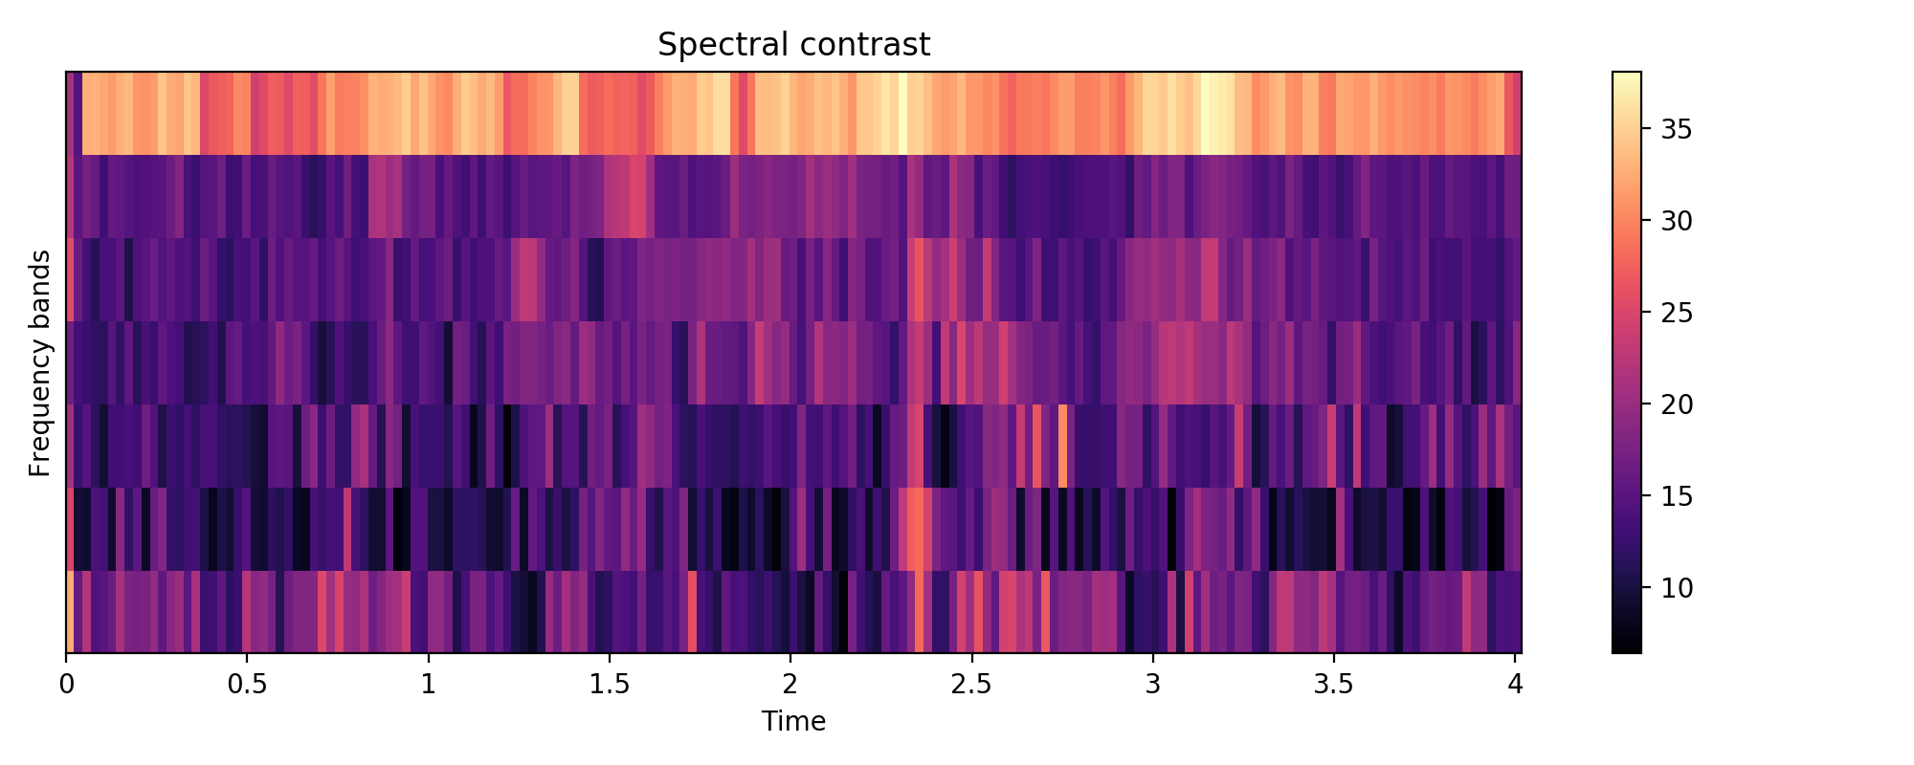
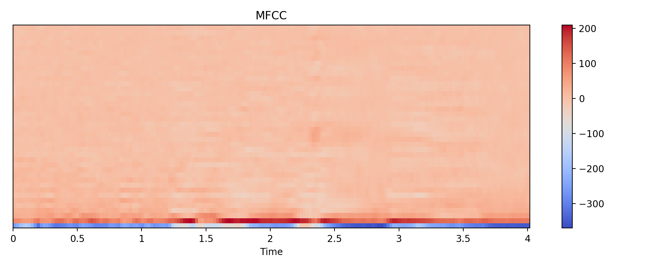
1D Feature Extraction
MFCC
Mel Spectrogram
Chromagram
Spectral Contrast
Notes:
List and describe features, and have pictures on the side.

Slide 7
Preprocessing
Dataset 1: Original dataset from Kaggle
Dataset 2: Original dataset + Augmented data
Training-Test split:
Training set: 70%
Test set: 30%
10-fold Cross Validation

Slide 8
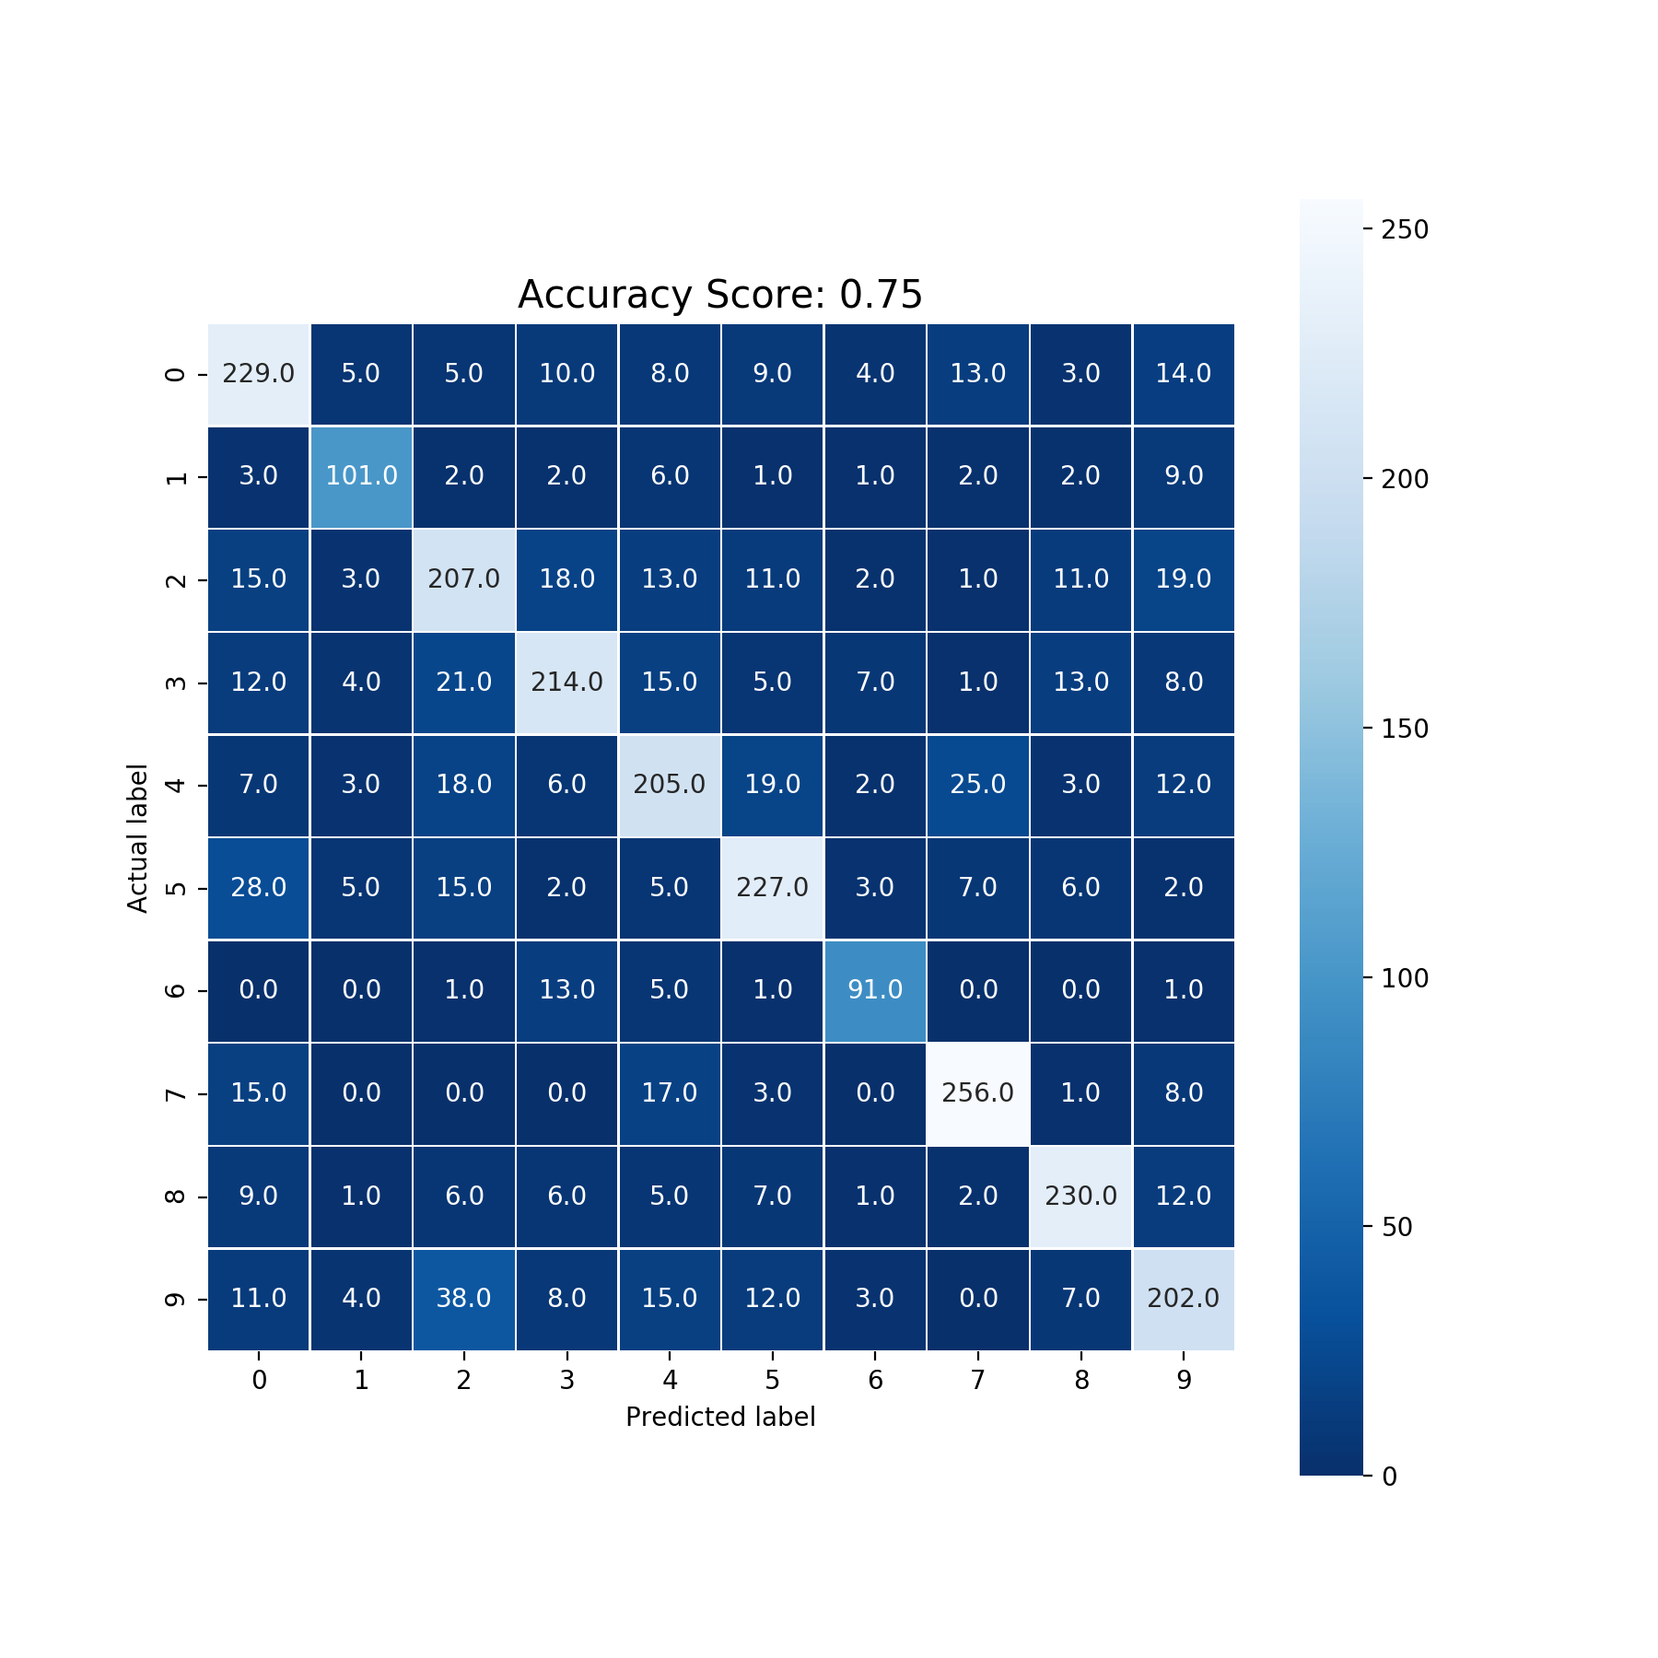
Logistic Regression
L2 regularization
Stopping criteria: max iterations = 10000
Dataset 1:
Accuracy: 0.75
Cross validation accuracy: 0.75
Dataset 2:
Accuracy: 0.71
Cross validation accuracy: 0.69
Notes:
Learning rate: 1 / (alpha_scaled + L + fit_intercept)

Slide 9
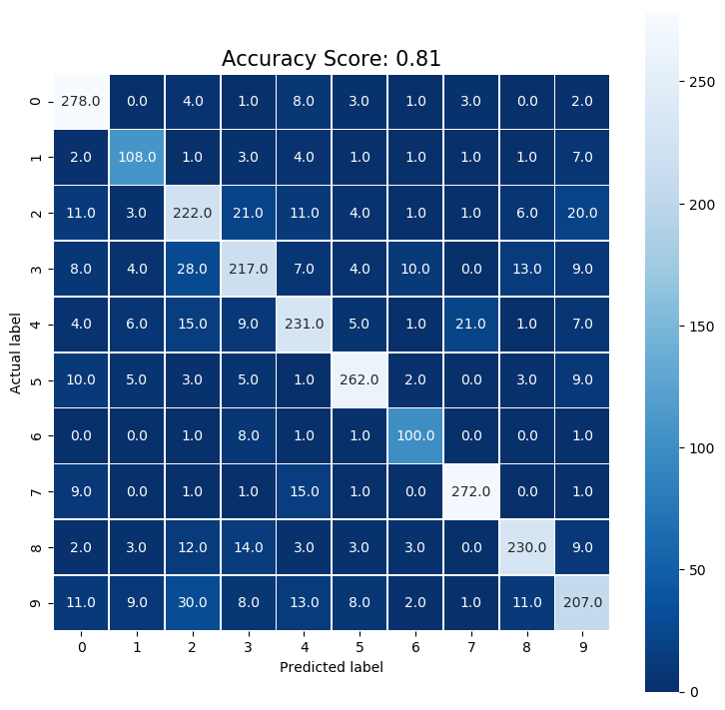
SVM
Stopping Criteria: L2 norm 1e-3
No iteration limit
Dataset 1:
Accuracy: 0.81
Cross validation accuracy: 0.82
Dataset 2:
Accuracy: 0.78
Cross validation accuracy: 0.76
Notes:
Noise level monitoring in crowded areas

Slide 10
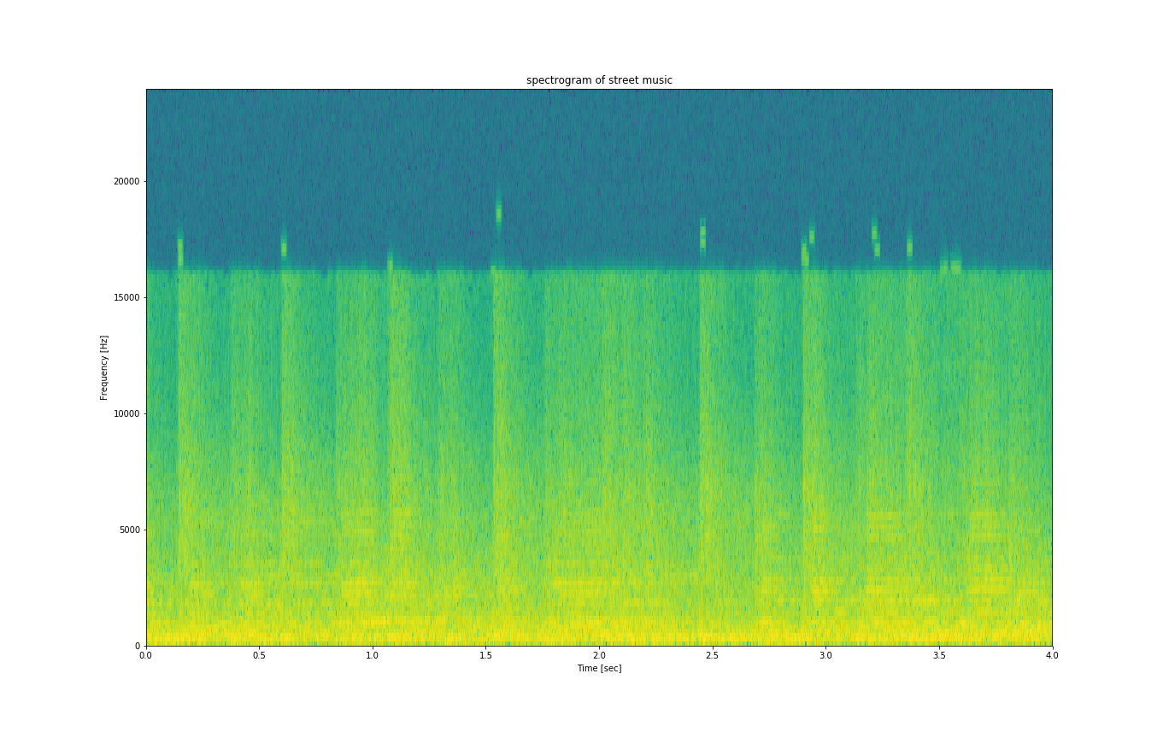
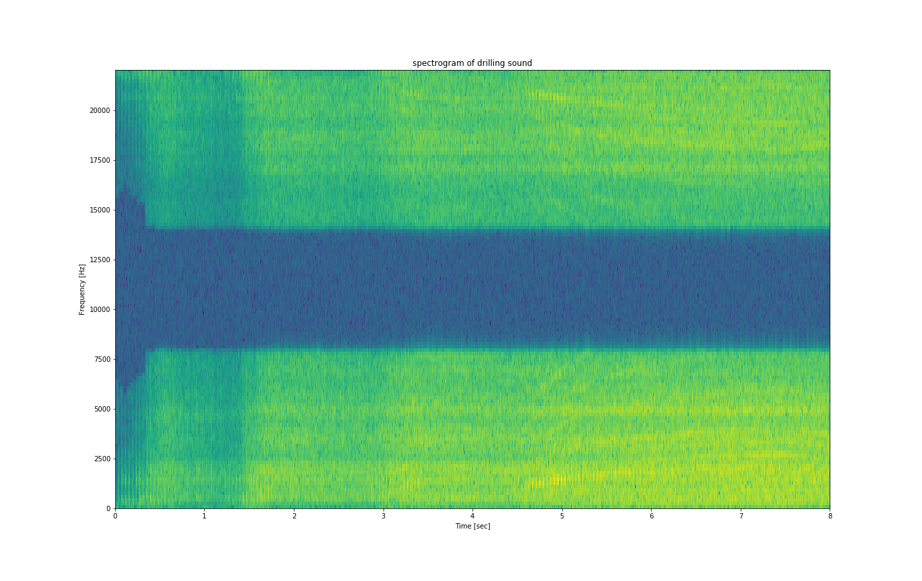
2D Feature Extraction
spectrogram of street music
spectrogram of drilling sound file

Slide 11
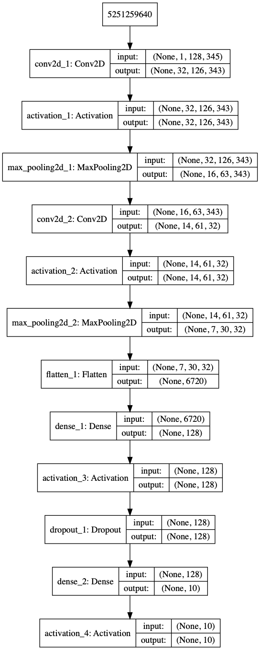
CNN (2D Features)
Sequential Model with
2 Conv 1D Layers
3 Activation Layers
2 Dense Layers
1 Dropout Layer
# Epochs = 50
Receives 2D spectrogram as image
Dataset 1:
Accuracy: 0.60
Dataset 2:
Accuracy: = 0.72
Notes:
Visualize Models

Slide 12
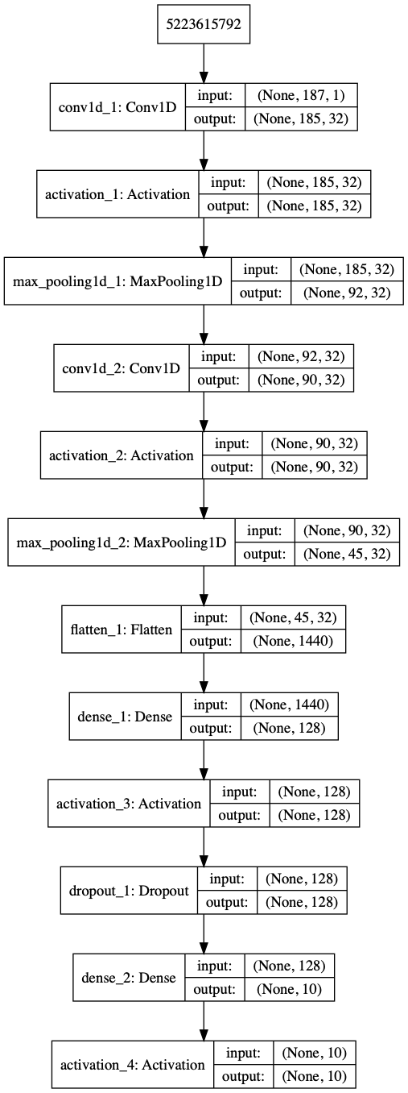
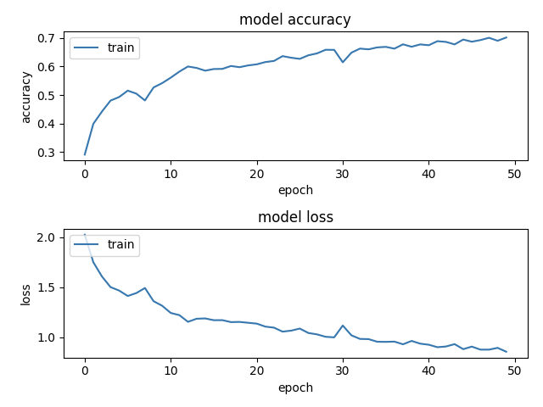
CNN (1D Features)
Similar layer structure with different input size (2D)
Dataset 1:
Accuracy: 0.746
Dataset 2:
Accuracy: 0.750
Notes:
Describe CNN

Slide 13
Insights/Observations
LR & SVM:
Similar accuracy with parameter tuning
Performance gets worse after augmentation
CNN (2D features):
Can use pre-trained models fine-tuned for audio spectrograms
Data Augmentation provides better metrics
Very slow model convergence due to number of features for each sample
Gave promising results with real-world data
CNN (1D Features):
Very fast convergence time (due to 1D features)
Does not benefit from data augmentation as much
Notes:
Visualize Models

Slide 14
Future Work
CNN:
Add more training data
More data augmentation
Use pre-trained audio models
Increase model complexity e.g. number of layers, epochs etc.
Notes:
Visualize Models

Slide 15


