Slide 1
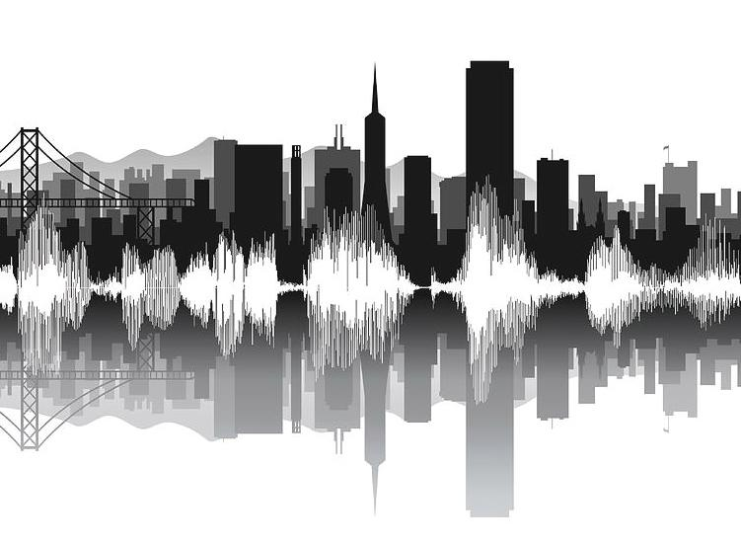
Urban Sound Classification
Reham Aburas, Habiba Farrukh, Pavani Guttula, Aly Shehata

Slide 2
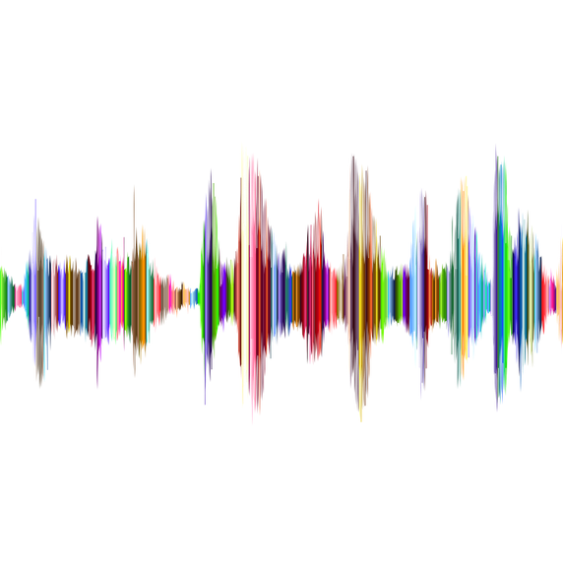
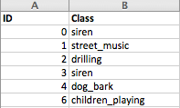
Introduction
Urban Sound Dataset
8732 labeled sound samples (<= 4s) from 10 classes
Classes include: Car Horn, Children Playing, Dog bark, etc…
Goal : Implement and evaluate different algorithms to classify a given urban sound.

Slide 3
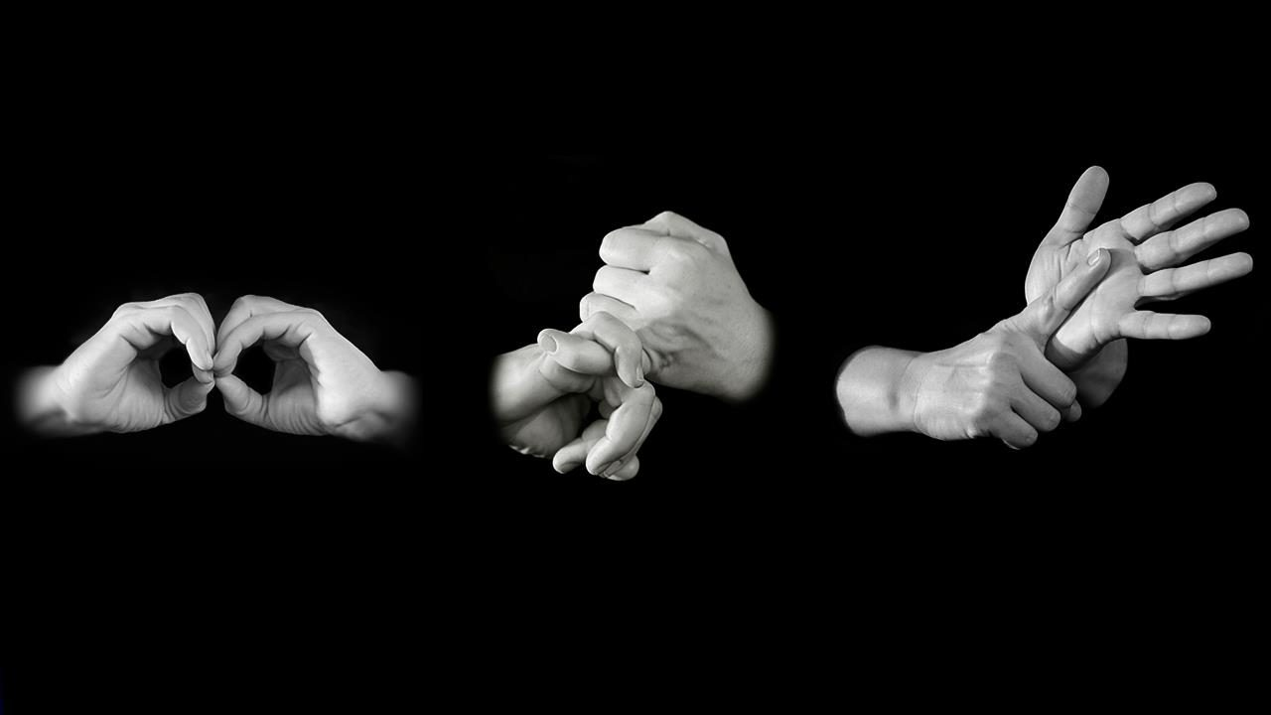
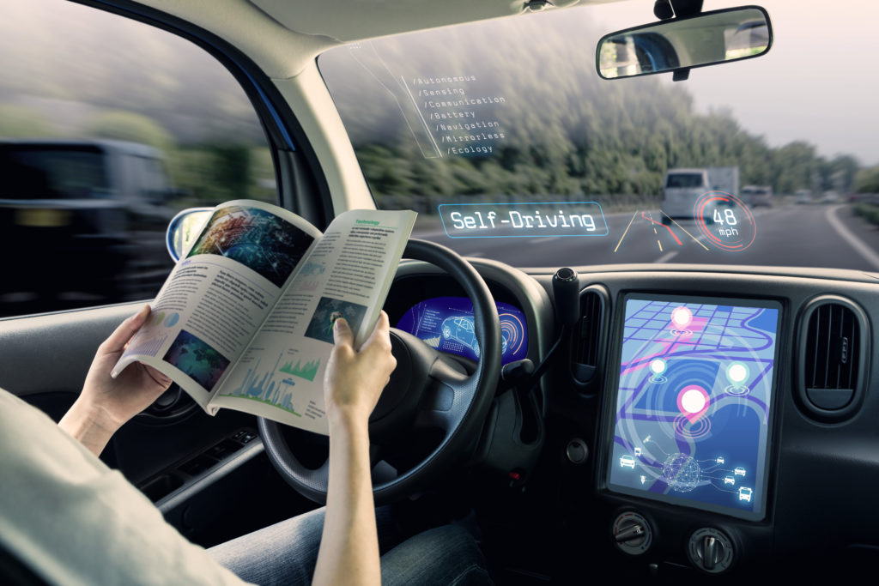

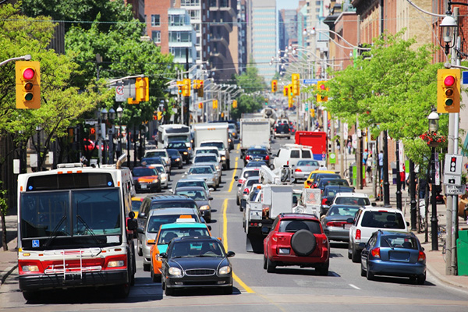
Motivation
Notes:
Differently Abled Assistance - Deaf, Low-Hearing, etc…
Self-driving vehicles
Security and Law Enforcement
Noise level monitoring in crowded areas

Slide 4
Expected Outcome
Preprocess audio files and extract features
Implement classification techniques
SVM
Logistic Regression
Deep Learning
Measure and compare performance for the algorithms
Data Augmentation
Parameter Tuning
Cross-Validation
Evaluate the classifiers on real world data

Slide 5
References
[1] J. Salamon, C. Jacoby and J. P. Bello, "A Dataset and Taxonomy for Urban Sound Research", 22nd ACM International Conference on Multimedia, Orlando USA, Nov. 2014.
[2] Salamon, Justin, and Juan Pablo Bello. "Deep convolutional neural networks and data augmentation for environmental sound classification." IEEE Signal Processing Letters 24.3 (2017): 279-283.
[3] Wu, Hongwei, and Jerry M. Mendel. "Classification of battlefield ground vehicles using acoustic features and fuzzy logic rule-based classifiers." IEEE transactions on fuzzy systems 15.1 (2007): 56-72.
[4] “Feature learning with deep scattering for urban sound analysis,” in 2015 European Signal Processing Conference, Nice, France, Aug. 2015.
[5] J. T. Geiger and K. Helwani, “Improving event detection for audio surveillance using gabor filterbank features,” in 23rd European Signal Processing Conference (EUSIPCO), Nice, France, Aug. 2015, pp. 714– 718.

Slide 6


