Slide 1
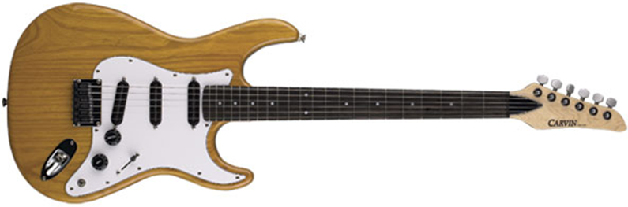
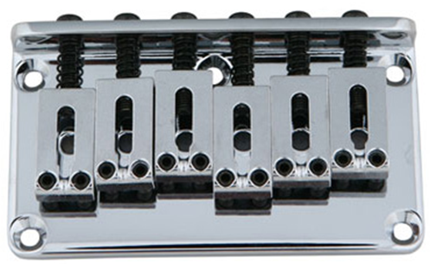
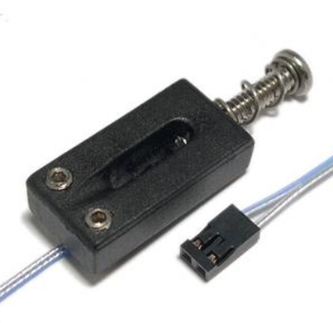
Piezo Pickup Processor the Pickgaurd
PCB with Kinetis MCU
Ghost Piezo Electric Saddles

Slide 2
Piezo Pickup Processor – Design Constraint
Each Pickup is individually sampled. One Sampling Channel for each string.
FPGA must Digitally sum the 6 channels, Apply filter + volume control, send results to DAC through standard JACK.
S/PDIF output.
FPGA Filter is remotely programmable by external microcontroller
External Microcontroller has ADCs to sample 2, control potentiometers and switches
External Microcontroller can store FPGA configuration
Microcontroller has USB interface to upload new configuration and parameters.
CAT 5 cable jack to receive power and to send digital audio and balanced line analog.
High-Speed USB to send all 6 pickup outputs to PC.

Slide 3
Control
Wheel
Control
Slider
Control Buttons
USB Mini-B
Piezo (E)
Signal Conditioning
USB Interface
Piezo (A)
Signal Conditioning
¼” Jack
Piezo (D)
Signal Conditioning
Freescale Kinetis K20
6x ADC Inputs
DAC Out
Signal Conditioning
Balanced Line Driver
Piezo (G)
Signal Conditioning
I2S Bus
Piezo (B)
Signal Conditioning
SPDIF Transmitter
Piezo (E)
Signal Conditioning
JTAG Interface (OSBDM)
System Power
CAT 6e Jack

