Slide 1
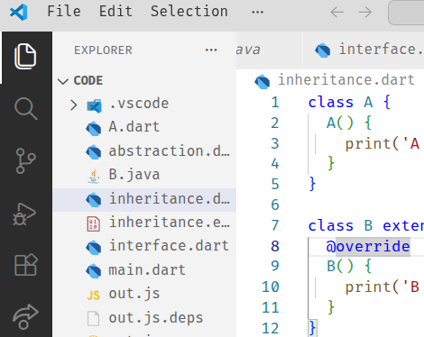
Flutter App Development Environment
Installing Flutter SDK & Setup
  Install using VS Code→
  Click on Extensions

Slide 2
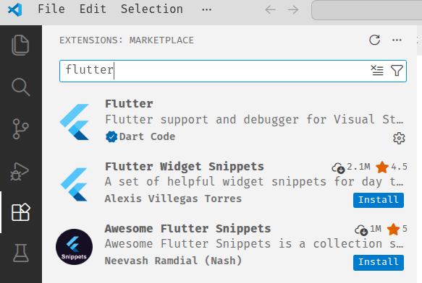
Search for Flutter
This one

Slide 3
After the install completion
Press ctrl+shift+P and write Flutter:New Project
Hit Enter and click on the Download SDK option in the Bottom Right Corner
Choose C: drive to install the SDK and wait for download complete(it’ll take approx. 5 mins.)
After download completion click on the ‘Add SDK to Path’ option on the bottom right corner.
Now open command prompt and check if Flutter is installed successfully write this command: <dart –-version> or <flutter –-version>
If you see versions for both, then dart is installed in your system.

Slide 4

The installation Steps are same for Android Studio→
Just open Android Studio and go to plugins tab and search for Flutter Plugin and install it.
After installation follow the on screen instructions to complete the flutter installation.

Slide 5
Running the App on Emulator and Physical Devices
Use Android Studio to Create a Virtual Device Manager.
Now open VS Code and open command pallette with ctrl+shift+P and type “Flutter:Launch Emulator”
Select the device you created on the Android Studio to run.

Slide 6
Running the App on Physical Devices:→
Connect your Mobile Device and Laptop Either via same WiFi or Physical wired medium.
Turn ON USB Debugging in the phone by tapping several times on the Build No.
Connect both the devices and choose your mobile device from the dropdown menu and run your app.

