Slide 1

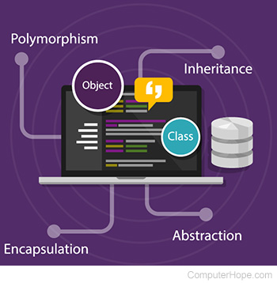
Object Oriented Programming
interface
Class Presentations on Object Oriented Programming
by Subhash Chand Agrawal
Notes:
The wiring and buttons circuits all are hidden from user known as abstraction.

Slide 2
Program
Write a java program to create an interface named Shape that contains empty method named Area() and Perimeter(). Provide two classes named Triangle and Circle such that each one of the classes implements Shape. Each one of the classes contains only the method Area () and Perimeter().that prints the area and perimeter() of the given shape.

Slide 3
interface
An interface in Java is a blueprint of a class.
It has static constants and abstract methods.
It is used to achieve abstraction and multiple inheritance in Java.
In other words, you can say that interfaces can have abstract methods and variables.

Slide 4
How to declare an interface?
interface <interface_name>{
// declare constant fields
// declare methods that abstract
// by default.
}
Notes:
/ public, static and final
// public and abstract

Slide 5
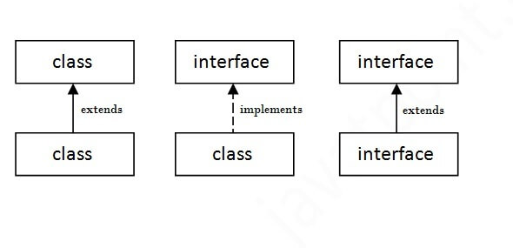
The relationship between classes and interfaces
Notes:
https://www.javatpoint.com/interface-in-java

Slide 6
Example
interface Example{
void print();
}
public class test implements Example{
public void print(){System.out.println("Interface example");}
public static void main(String args[]){
test obj = new test();
obj.print();
}
}
Interface example

Slide 7
Another use

Slide 8
interface Drawing{
void draw();
}
class Rectangle implements Drawing{
public void draw(){System.out.println("drawing rectangle");}
}
class Circle implements Drawing{
public void draw(){System.out.println("drawing circle");}
}
public class TestInterface1{
public static void main(String args[]){
Drawing d=new Circle();
Drawing d1=new Rectangle();
d.draw();
d1.draw();
}}
drawing circle
drawing rectangle

Slide 9
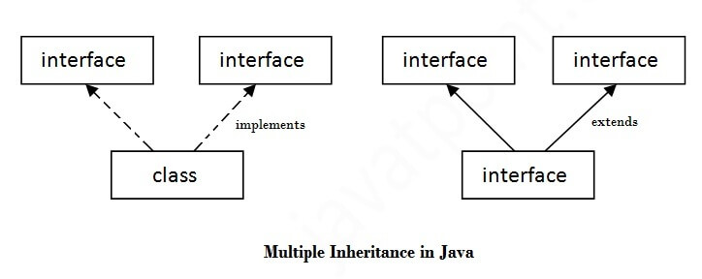
Multiple inheritance in Java by interface

Slide 10
interface Interface1{
void print();
}
interface Interface2{
void show();
}
public class test implements Interface1,Interface2{
public void print(){System.out.println("Hello");}
public void show(){System.out.println("Welcome");}
public static void main(String args[]){
test obj = new test();
obj.print();
obj.show();
}
}

Slide 11
Multiple inheritance is not supported through class in java, but it is possible by an interface, why?
Multiple inheritance is not supported in the case of class because of ambiguity.
However, it is supported in case of an interface because there is no ambiguity.
It is because its implementation is provided by the implementation class.

Slide 12
interface Interface1{
void print();
}
interface Interface2{
void print();
}
public class TestInterface3
Interface1,Interface2{
public void print(){System.out.println("Hello");}
public static void main(String args[]){
TestInterface3 obj = new TestInterface3();
obj.print();
}
}
implements

Slide 13
Interface inheritance
A class implements an interface, but one interface extends another interface.
interface Interface1{
void print();
}
interface Interface2 Interface1{
void show();
}
public class TestInterface4 implements Interface2{
public void print(){System.out.println("Hello");}
public void show(){System.out.println("Welcome");}
public static void main(String args[]){
TestInterface4 obj = new TestInterface4();
obj.print();
obj.show();
}
}
extends

Slide 14
Since Java 8, we can have method body in interface. But we need to make it default method.
interface Drawable{
void draw();
default void msg(){System.out.println("default method");}
}
class Rectangle implements Drawable{
public void draw(){System.out.println("drawing rectangle");}
}
public class TestInterfaceDefault{
public static void main(String args[]){
}}
Drawable d=new Rectangle();
d.draw();
d.msg();

Slide 15
Since Java 8, we can have static method in interface.
interface Drawable{
void draw();
static int square(int x){return x*x;}
}
class Rectangle implements Drawable{
public void draw(){System.out.println("drawing rectangle");}
}
public class TestInterfaceStatic{
public static void main(String args[]){
Drawable d=new Rectangle();
d.draw();
}}
System.out.println(Drawable.square(3));

Slide 16
import java.lang.*;
import java.text.*;
public class Gfg {
public static void main(String args[])
{
double a = 30;
DecimalFormat df=new DecimalFormat("#.###");
System.out.println(df.format(Math.sqrt(a)));
a = 45;
System.out.println(df.format(Math.sqrt(a)));
}
}

Slide 17
Ex-2
import java.text.DecimalFormat;
public class Main {
public static void main(String[] args)
{
// Create the DecimalFormat Instance
DecimalFormat deciFormat = new DecimalFormat();
deciFormat.setMaximumFractionDigits(1);
System.out.println(deciFormat.format(12.3456789));
}
}

Slide 18
Difference between Abstract class and Interface?

