Slide 1
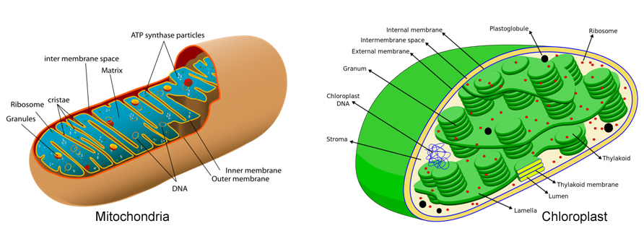
Light
Extra sugar
Sugar
Macro- & micro-
nutrient cycling
ATP yield
cell-free
Inorganic nutri
Metabolic prod
cell-free
Primitive detritivore

