Slide 1

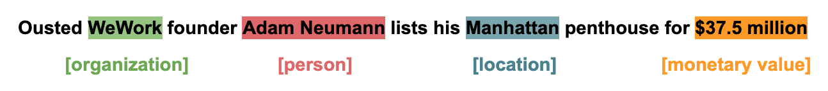
Name Entity Recognition (NER)
Sample Huggingface models with MultinerD-data in English.
Image source: https://monkeylearn.com/blog/named-entity-recognition/

Slide 2
Name Entity Recognition (NER)
Named entity recognition (NER) ‒ also called entity identification or entity extraction ‒ is a natural language processing (NLP) technique that automatically identifies named entities in a text and classifies them into predefined categories. Entities can be names of people, organizations, locations, times, quantities, monetary values, percentages, and more.

Slide 3
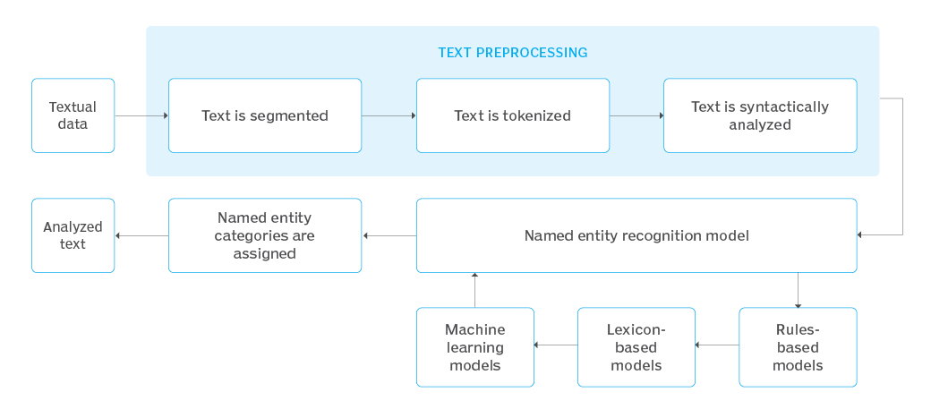
Name Entity Recognition (NER) -- Process --
Source: https://www.techtarget.com/whatis/definition/named-entity-recognition-NER

Slide 4
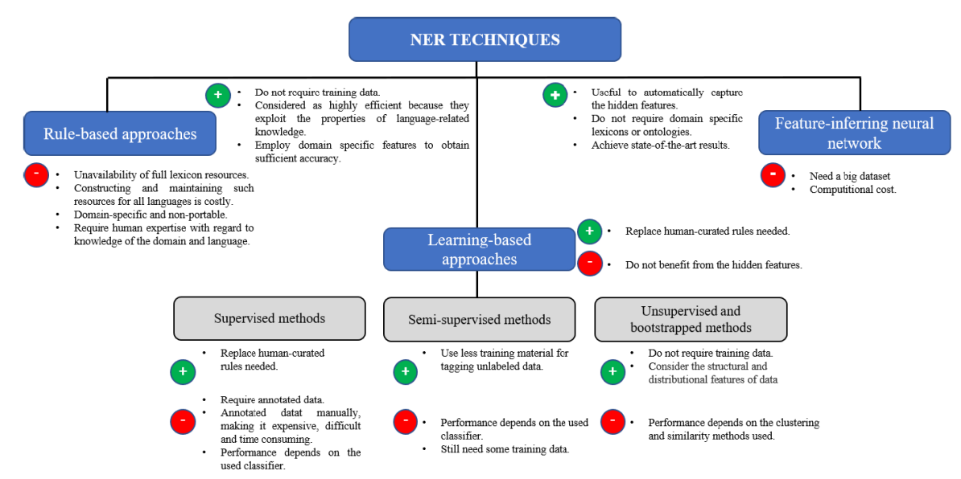
Current Methods
Machine Learning and Deep Learning
Source: https://ieeexplore.ieee.org/ielx7/6287639/8948470/08999622.pdf

Slide 5
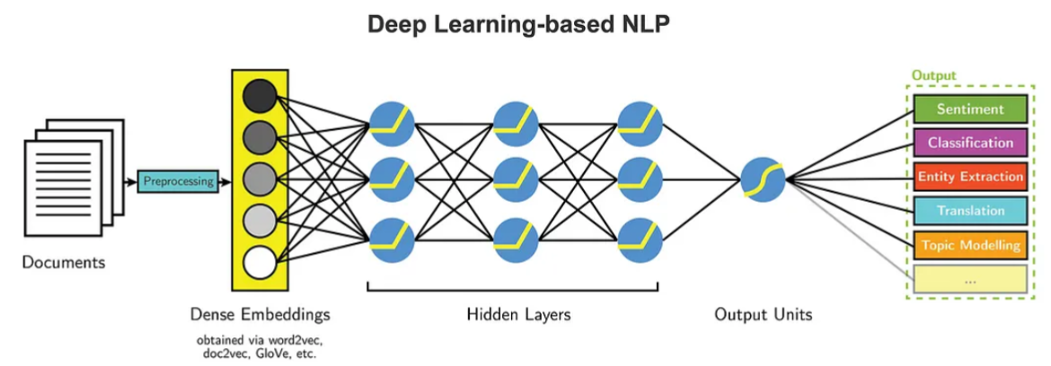
Current Methods -- Deep Learning --
Source: https://medium.com/intro-to-artificial-intelligence/entity-extraction-using-deep-learning-8014acac6bb8

Slide 6
Name Entity Recognition (NER) -- Deep Learning --
There are many pre-trained models for this task. For example, you can see the previous paper here (https://aclanthology.org/2020.coling-main.334.pdf, https://pahulpreet86.github.io/name-entity-recognition-pre-trained-models-review/ and https://pahulpreet86.github.io/name-entity-recognition-pre-trained-models-review/ ).
In this work, I used the Huggingface pre-trained model, namely Distillbert. This is because it is a small model with six deep learning layers and is suitable to run on my machine. You can try with other models such as Roberta and Bert-base. You can find it with the NER task here.

Slide 7
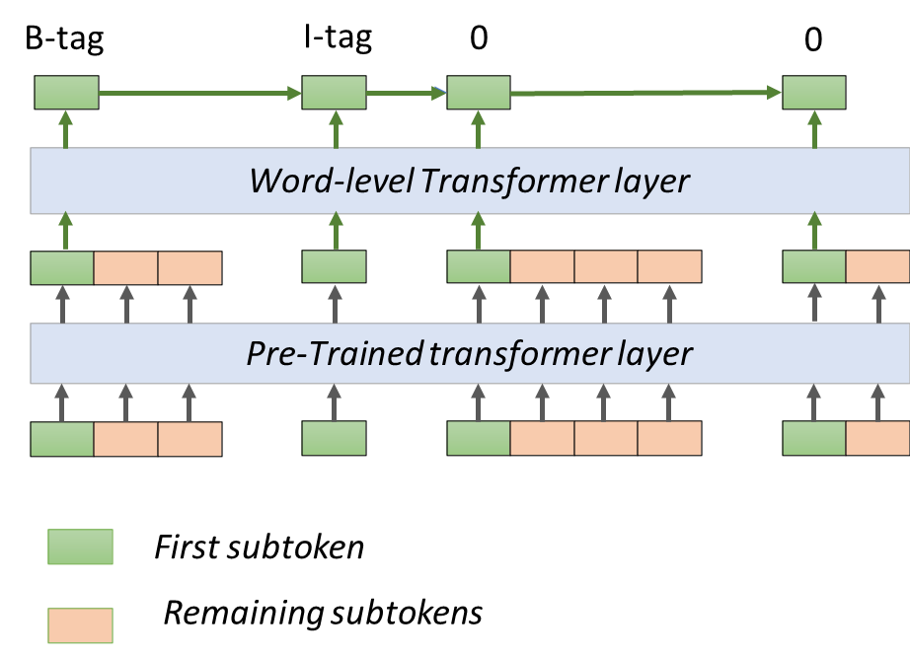
Name Entity Recognition (NER) -- HuggingFace--

Slide 8
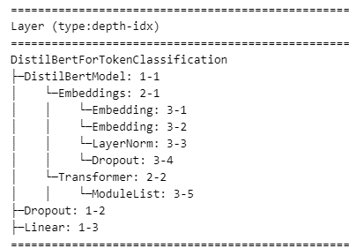
Name Entity Recognition (NER) -- Distillbert Pre-trained Model --

Slide 9
This Repository works
Scenario A: Select a model from huggingface and run the MultiNERD data for English. Fine-tune the parameters with suitable metrics to get the best results.
Scenario B: Similar to scenario A. However, the entity types belong to one of the following five entity types: PERSON(PER), ORGANIZATION(ORG), LOCATION(LOC), DISEASES(DIS), ANIMAL(ANIM).

Slide 10
This Repository works
You can find out the results of SystemA at SystemADistilbert.ipynb
Testing the SystemA with an example sentence (SystemADistilbert_Testing.ipynb).
You can find out the results of SystemB at SystemBDistilbert.ipynb
Testing the SystemB with an example sentence (SystemBDistilbert_Testing.ipynb).

Slide 11
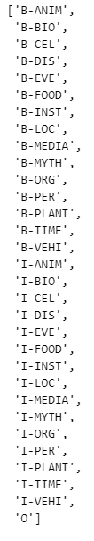
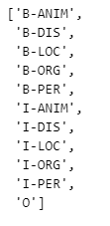
This Repository works -- Pre-processing data --
I only loaded the data and followed the instructions from Huggingface.
I selected small samples for all training, validation and test sets in two systems because of the limitation of my Machine. You can see it in the codes.
For SystemB, I only kept the entity types which belong to one of the following five entity types: PERSON(PER), ORGANIZATION(ORG), LOCATION(LOC), DISEASES(DIS), ANIMAL(ANIM).
A
B

Slide 12
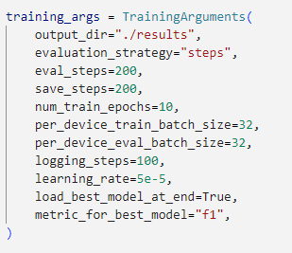
This Repository works -- Pre-processing data --
For two scenarios, I used the same configuration to compare the outcomes of the two systems.
Metrics: F1 score
Learning rate: 5e-5 = 0.00005
Epochs: 10

Slide 13
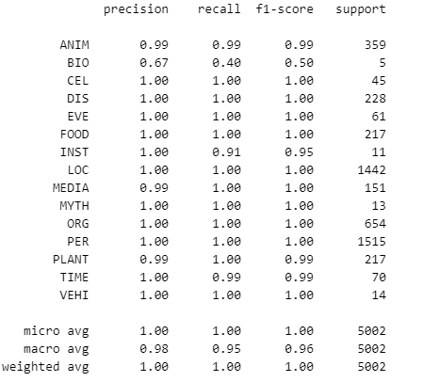
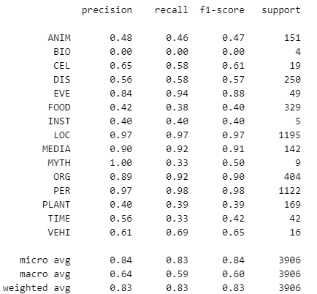
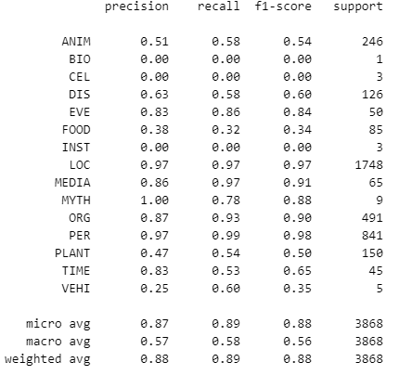
This Repository works -- Results -- SystemA
Training set
Validation set
Test set

Slide 14
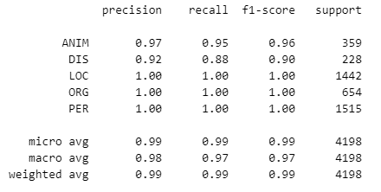
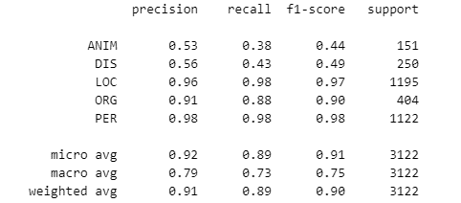
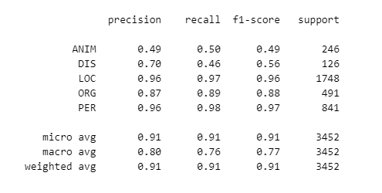
This Repository works -- Results -- SystemB
Training set
Validation set
Test set

Slide 15
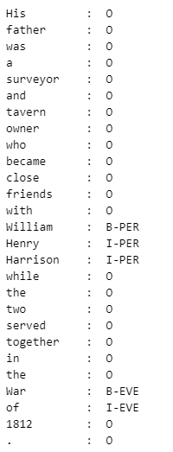
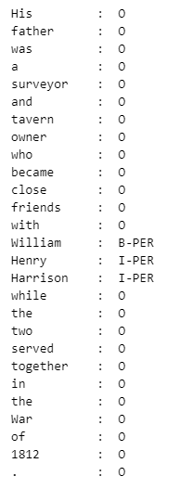
This Repository works -- Load saved models and run sample sentence --
Testing the SystemA with an example sentence (SystemADistilbert_Testing.ipynb).
Testing the SystemB with an example sentence (SystemBDistilbert_Testing.ipynb).
A
B

Slide 16
This Repository works -- Findings -
The testing set is missed a label ('I-BIO' - there is only 30 labels) compared to training set (31) and validation set (31).
Time for running:
SystemA: 5619.6813 s ~ 1.56 hour. (31 Labels)
SystemB: 5557,2894 ~ 1.5436915.
→ The times for training of 2 systems are not far different. This is because there are changes in the last layer for the output layer with Transformers. Other layers are trained in similar ways. However, it can be different with larger datasets because I only test these systems on small random data from the original data because of time limitations and my machine.

Slide 17
This Repository works -- Findings -
Accuaracy (Precision | recall | f1 score)
System A: 1.0 | 0.83 | 0.88
System B: 0.99 | 0.90 | 0.91
→ System B outperformed System A on average score. This is because of fewer labels compared to system A.
Limitations:
Randomly small parts of the data can lead to incorrect evaluation of the models. Therefore, It needs to run with a powerful computer for all datasets.
Because of time limitations, I only tested on the default learning rate (example) from HuggingFace. It can change the learning rate with different optimizers like Adam. (See more here)
Epoch = 10. It needs to be tested with more epochs. Note that I run 1 epoch with a full training set. It took more than 8 hours. According to the system, you can consider how many epochs you need for training. GPU is another solution to reduce the time for training.

Slide 18

Thanks

