Slide 1

Weekly meeting
Yeh Shun-Liang
International College of Semiconductor Technology
National Yang Ming Chiao Tung University

Slide 2
Recent Progress
Clarify the power model for energy calculation
Rerun the Simulation Under 22nm ITRS process node
Auto Refresh & WUPR Comparison

Slide 3
Power Model
Energy are divided into Command energy & Background energy
Command energy are calculated & extracted using CACTI-3DD
Background energy is being calculated using the HBM2E voltage and currents

Slide 4
Power Model(Per Bank Level Controller)
Category | Energy Component | Formula
Command Energy | Total Activation Energy | Activation Energy (nJ/Access) × Number of Activations (nJ)
 | Total Precharge Energy | Precharge Energy (nJ/Access) × Number of Precharges (nJ)
 | Total Read Energy | Read Energy (nJ/Access) × Number of Reads (nJ)
 | Total Write Energy | Write Energy (nJ/Access) × Number of Writes (nJ)
 | Total Refresh Energy | (((VDD × IDD5B) + VPP × IPP5B)× nRFC_{Cycles} × Number of Refreshes × t_{CKns} ) / 1000 (nJ)
Background Energy | Active Background Energy | ((VDD × IDD3N) + VPP × IPP3N)× Active_{Cycles} × t_{CKns} ) / 1000 (nJ)
 | Idle Background Energy | ((VDD × IDD2N) + VPP × IPP2N)× Idle_{Cycles} × t_{CKns} ) / 1000 (nJ)

Slide 5
Power Model(Per Bank Level Controller)
Category | Description | Value
VDD | Core Supply voltage | 1.0(V)
VPP | Wordline Boost Voltage | 1.5(V)
IDD2N | Precharge Standby Current | 40(mA)
IDD3N | Active Standby Current | 55(mA)
IDD5B | Refresh Current | 250(mA)

Slide 6
Finding Optimal Number of Subarrays
Simulation Configuration
DRAM Model | Proposed 3D-DRAM Model
Number of Banks | 64
Ideal Bandwidth | 2TB/s
Ideal Bandwidth per Core | 128GB/s
Name of Trace | Single Core Partial LLM Workload Trace
Number of Traces | 193881265
Number of Subarrays | 64,128,256,512,1024
Clock Frequency | 1Ghz
DRAM Technology Node | ITRS 22nm

Slide 7
Timing Constraints Trend

Slide 8
Energy per command Trend

Slide 9
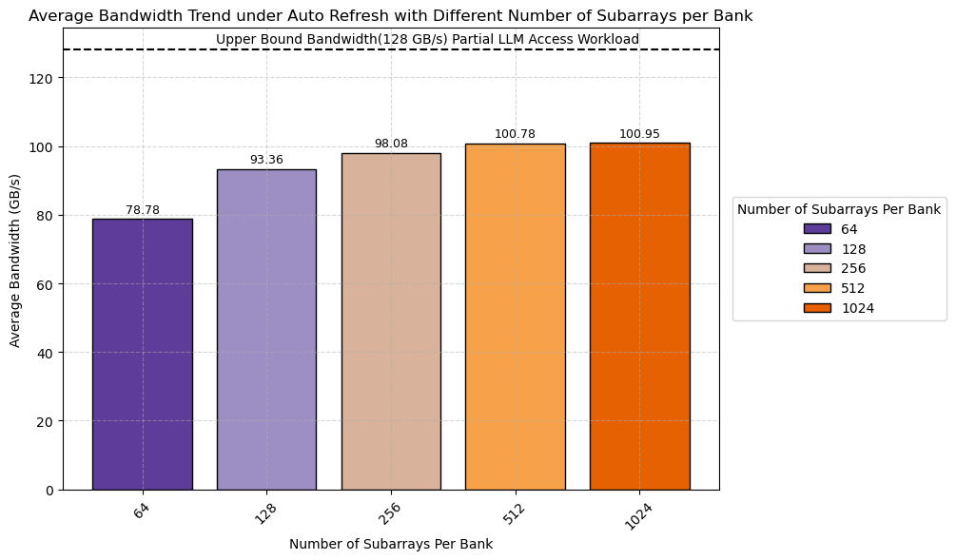
Bandwidth Trend

Slide 10
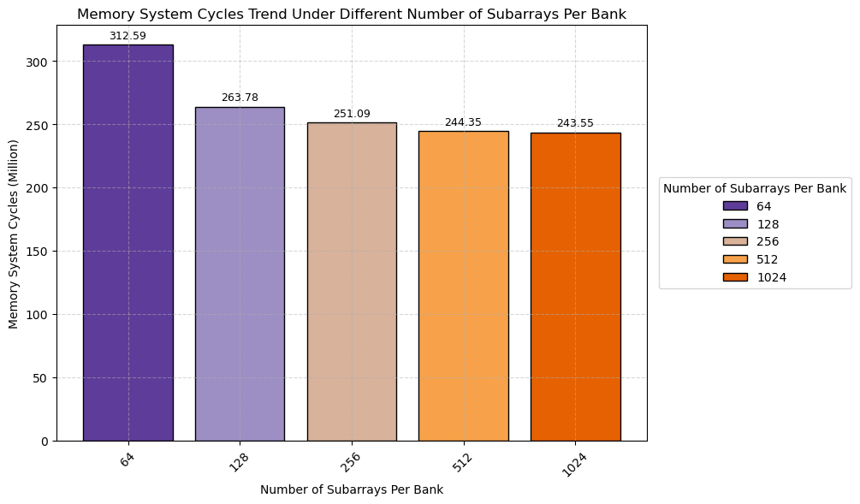
Simulation Cycles Trend

Slide 11
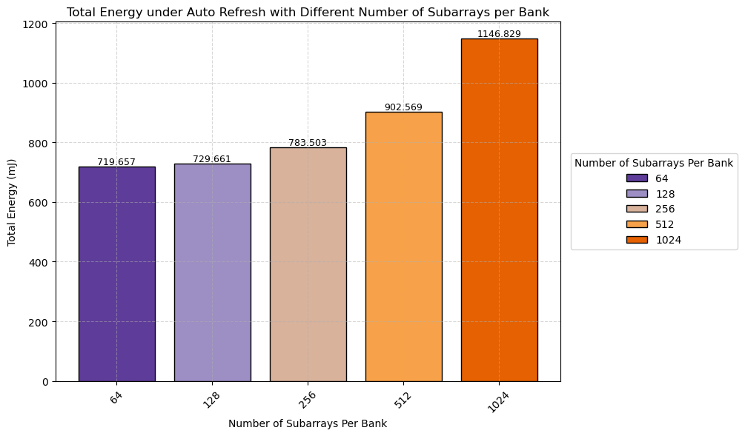
Latency Trend For Different Of Subarrays

Slide 12
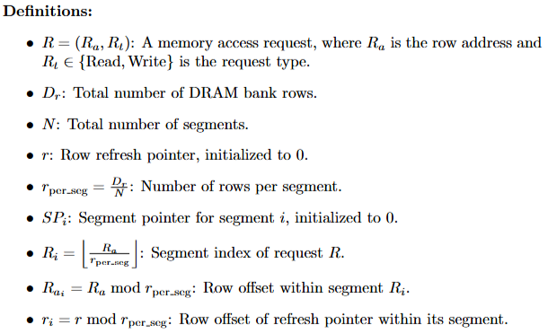
Write Updated Partial Refresh(WUPR)

Slide 13
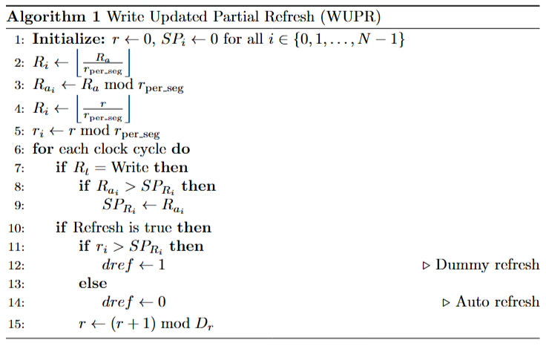
Write Updated Partial Refresh(WUPR)

Slide 14
WUPR with 4 Segments(N=4)
SP₀
WUPR
N₀
Pointer Update Logic
Segment Pointers
Used Space
Request
R
Ra
SP₁
r
Unused Space
Row Tracker
N₁
refresh
Refresh
SP₂
r
Select & Compare
SP₀
dref
dref
SP₁
N₂
SP₂
SP₃
SP₃
N₃
DRAM Row Space

Slide 15
WUPR Optimal Number of Segments
Selects 512 as Number of Subarray per Bank
Simulation Configuration
DRAM Model | Proposed 3D-DRAM Model
Number of Banks | 64
Ideal Bandwidth | 2TB/s
Ideal Bandwidth per Core | 128GB/s
Name of Trace | Single Core Partial LLM Workload Trace
Number of Traces | 193881265
Number of Subarrays | 512
Clock Frequency | 1Ghz
DRAM Technology Node | ITRS 22nm

Slide 16
WUPR Optimal number of Segments
Find the optimal number of segments that best describe the LLM trace pattern, 16 Segments is enough
N=16

Slide 17
Area Overhead
0.97% area of DRAM Controller

Slide 18
Auto Refresh vs WUPR Settings
Selects 512 as Number of Subarray per Bank
Simulation Configuration
DRAM Model | Proposed 3D-DRAM Model
Number of Banks | 64
Ideal Bandwidth | 2TB/s
Ideal Bandwidth per Core | 128GB/s
Name of Trace | Single Core Partial LLM Workload Trace
Number of Traces | 193881265
Number of Subarrays | 512
Clock Frequency | 1Ghz
Temperature Range | <85C, 85~95C, >95C
DRAM Technology Node | ITRS 22nm

Slide 19
WUPR PTPX Energy Extraction
Run a small portion of Partial LLM Simulation Workload on RTL
Spans through 512 Refreshes & Takes the Average Power calculated by PTPX
Simulation Configuration
DRAM Model | Proposed 3D-DRAM Model
Name of Trace | Single Core Partial LLM Workload Trace
Number of Patterns | 100000
WUPR Number of Segments | 16
Process Technology | TSMC 16nm
Clock Frequency | 1Ghz

Slide 20
Energy Settings
Category | Description | Value
VDD | Core Supply voltage | 1.0(V)
VPP | Wordline Boost Voltage | 1.5(V)
IDD2N | Precharge Standby Current | 40(mA)
IDD3N | Active Standby Current | 55(mA)
IDD5B | Refresh Current | 250(mA)
WUPR_{POWER} | Average Power of WUPR | 0.5476(mW)

Slide 21
Adding WUPR Term Into Simulator
Category | Energy Component | Formula
Command Energy | Total Activation Energy | Activation Energy (nJ/Access) × Number of Activations (nJ)
 | Total Precharge Energy | Precharge Energy (nJ/Access) × Number of Precharges (nJ)
 | Total Read Energy | Read Energy (nJ/Access) × Number of Reads (nJ)
 | Total Write Energy | Write Energy (nJ/Access) × Number of Writes (nJ)
 | Total Refresh Energy | ((VDD × IDD5B + VPP × IPP5B)× nRFC_{Cycles} × Number of Refreshes × t_{CKns} ) / 1000 (nJ)
 | Total WUPR Energy | (WUPR Average Power × Active_{Cycles} × t_{CKns} ) / 1000 (nJ)
Background Energy | Active Background Energy | ((VDD × IDD3N) + VPP × IPP3N)× Active_{Cycles} × t_{CKns} ) / 1000 (nJ)
 | Idle Background Energy | ((VDD × IDD2N) + VPP × IPP2N)× Idle_{Cycles} × t_{CKns} ) / 1000 (nJ)

Slide 22
Energy Overhead

Slide 23
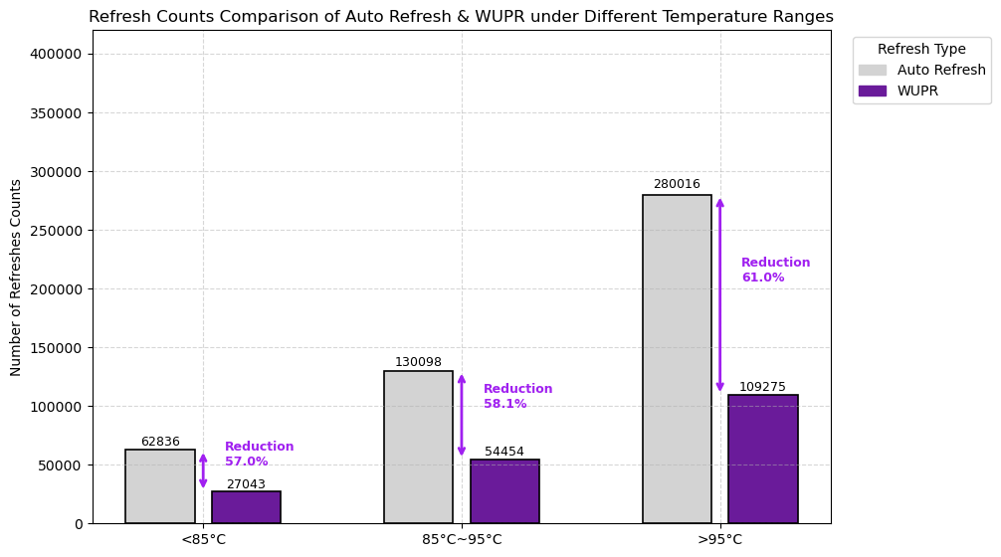
Refresh Counts Reduction

Slide 24
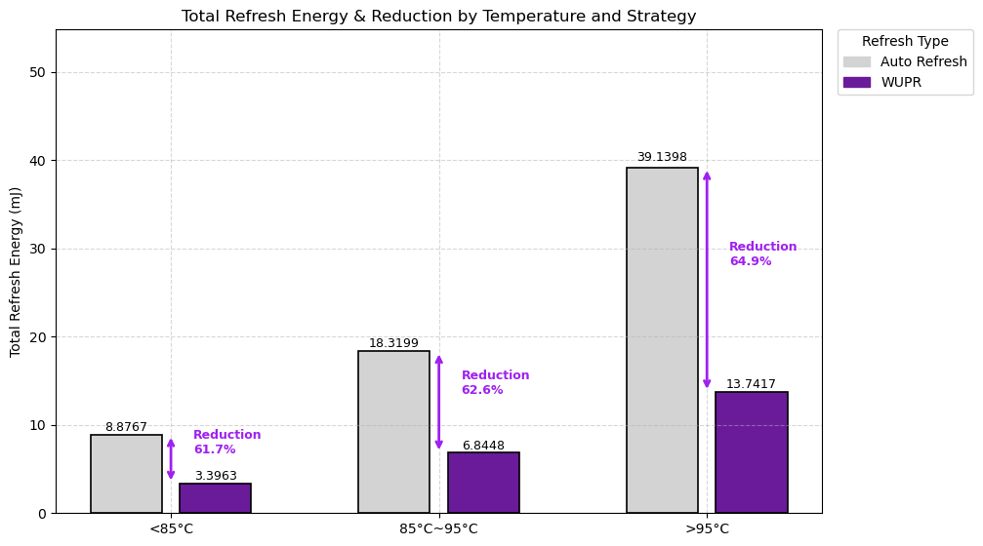
Refresh Energy Reduction

Slide 25
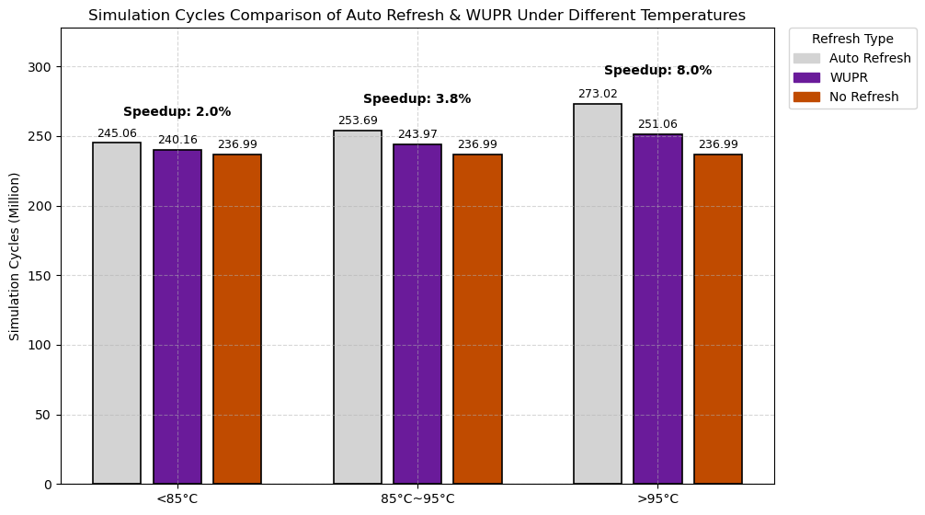
Total Latency Speedup

Slide 26
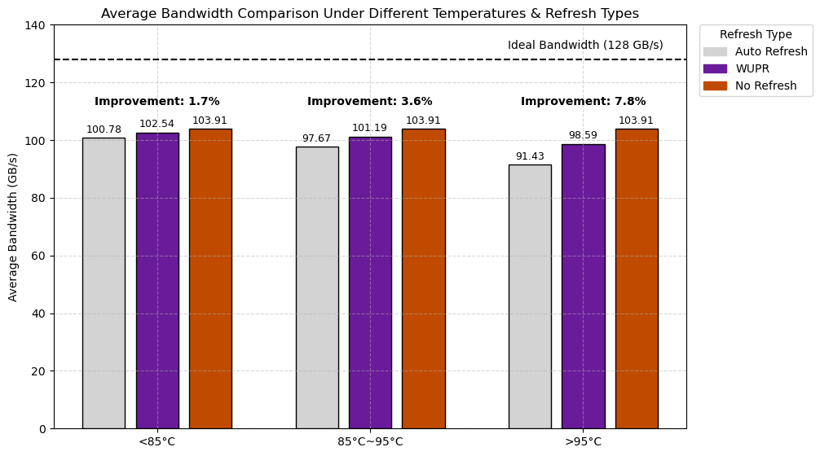
Average Bandwidth Improvements

Slide 27
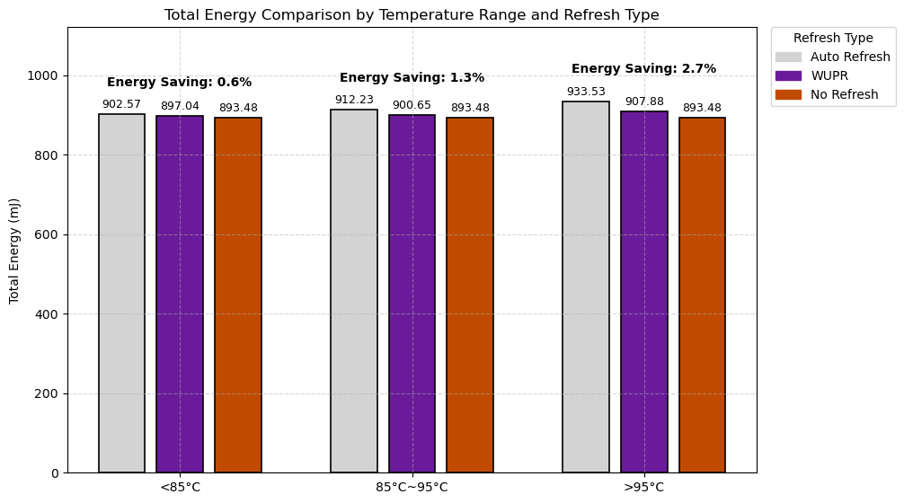
Total Energy Consumption

