Slide 1

Weekly meeting
Yeh Shun-Liang
International College of Semiconductor Technology
National Yang Ming Chiao Tung University

Slide 2
Recent Progress
Analyze Refresh Counts, Average Bandwidth & Energy under different Bank Size
Add the description of modification to DRAM logic Die for WUPR

Slide 3
Bank Analysis Configuration
Simulation Configuration
DRAM Model | Proposed 3D-DRAM Model
Number of Banks | 64
Ideal Bandwidth | 2TB/s
Ideal Bandwidth per Core | 128GB/s
Name of Trace | Single Core Partial LLM Workload Trace
Number of Traces | 193881265
Bank Sizes | 256Mb,512Mb,1024Mb & 2048Mb
Clock Frequency | 1Ghz
DRAM Technology Node | ITRS 32nm

Slide 4
Timing Constraints Trend

Slide 5
Energy per accesses trend

Slide 6
Refresh Counts with Different Bank Sizes
Worse Timing Constraints leads to longer execution time leads to more refreshes

Slide 7
Refresh Counts with Different Bank Sizes
WUPR helps skips unnecessary refreshes thus refresh counts does not change much as bank size increases

Slide 8
Average Bandwidth with Different Bank Sizes
Larger banks size bank leads to longer execution time, more long period refreshes, WUPR skipping refreshes performs well for larger banks

Slide 9
Average Bandwidth with Different Bank Sizes
Larger banks size leads to higher energy consumption due to longer latency and higher access energy

Slide 10
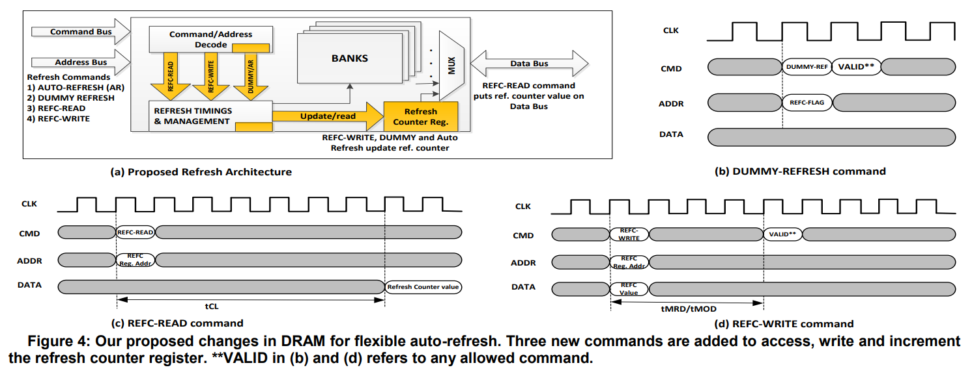
Dummy Refresh
[1] Bhati, I., Chishti, Z., Lu, S.-L., & Jacob, B. (2015). Flexible auto-refresh: Enabling scalable and energy-efficient DRAM refresh reductions. In Proceedings of the 42nd Annual International Symposium on Computer Architecture(ISCA)

Slide 11
WUPR Architecture
3D DRAM Bank
Memory Controller
Mode Register
DRAM rows
WUPR
Command Bus
Row Decoder
1
Row buffer
2
Refresh
Dummy Refresh/AR
Refresh
Management
Refresh
Counter
Update
2
Bhati, I., Chishti, Z., Lu, S.-L., & Jacob, B. (2015). Flexible auto-refresh: Enabling scalable and energy-efficient DRAM refresh reductions. In Proceedings of the 42nd Annual International Symposium on Computer Architecture

Slide 12
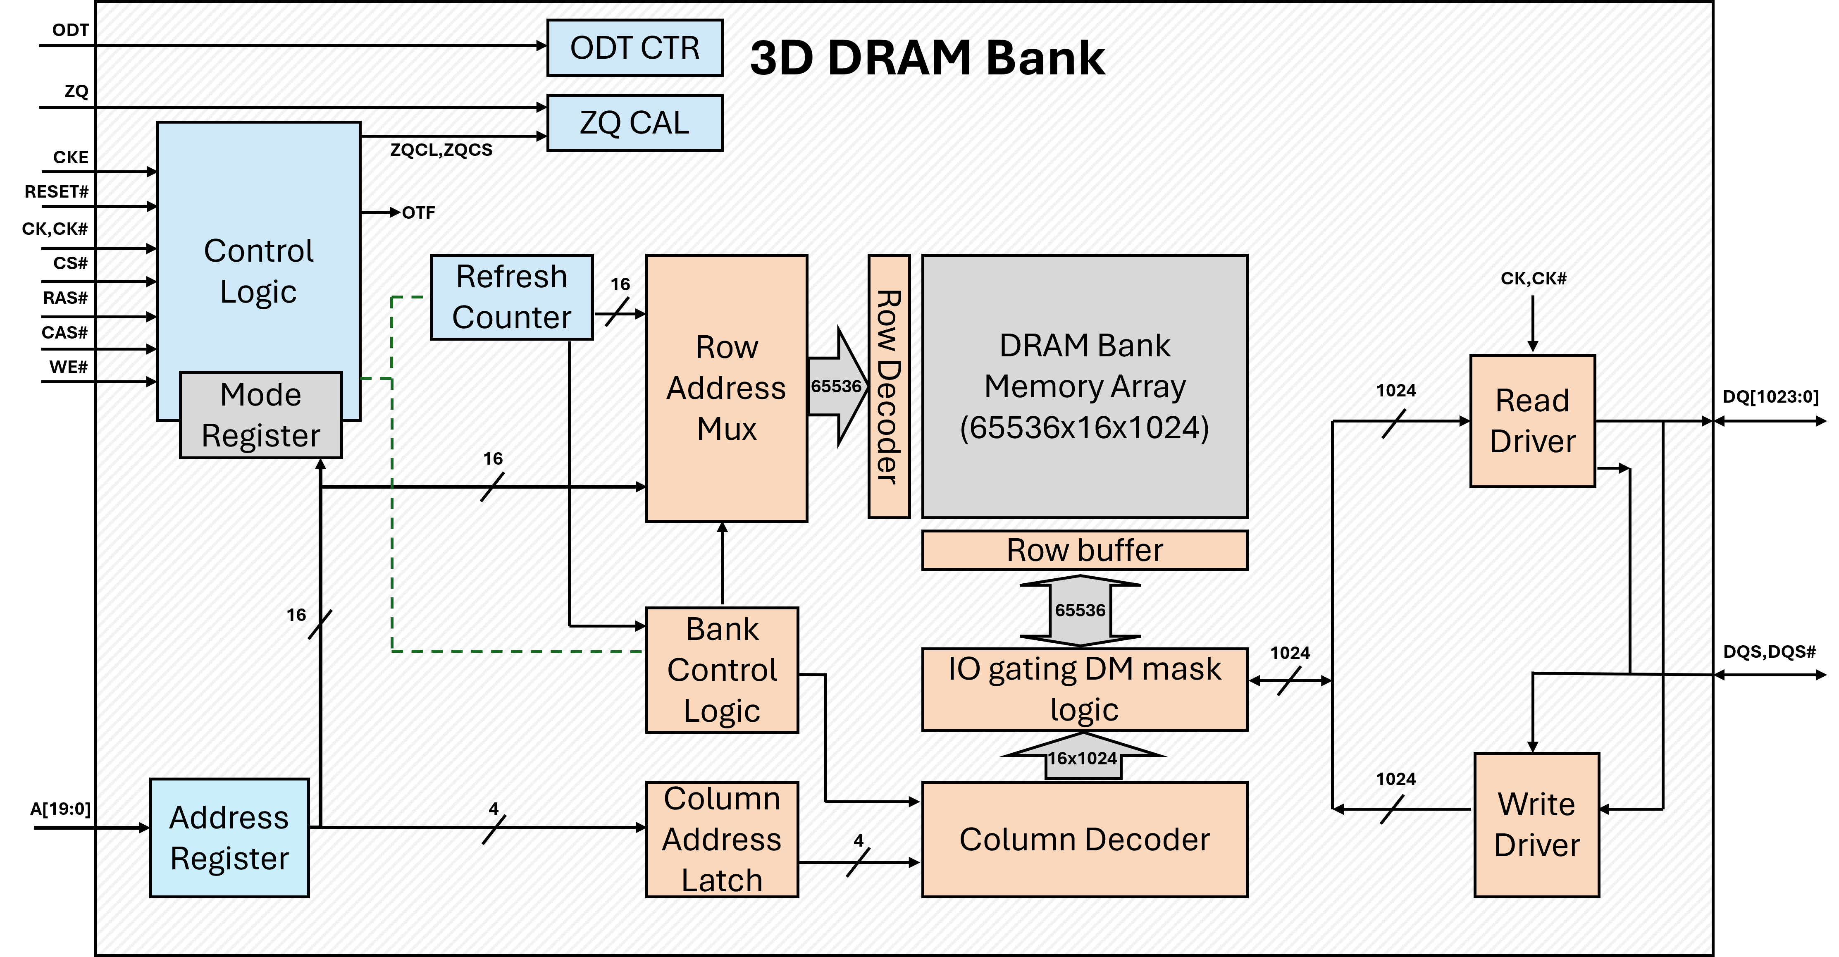
Original 3D-DRAM Die

Slide 13
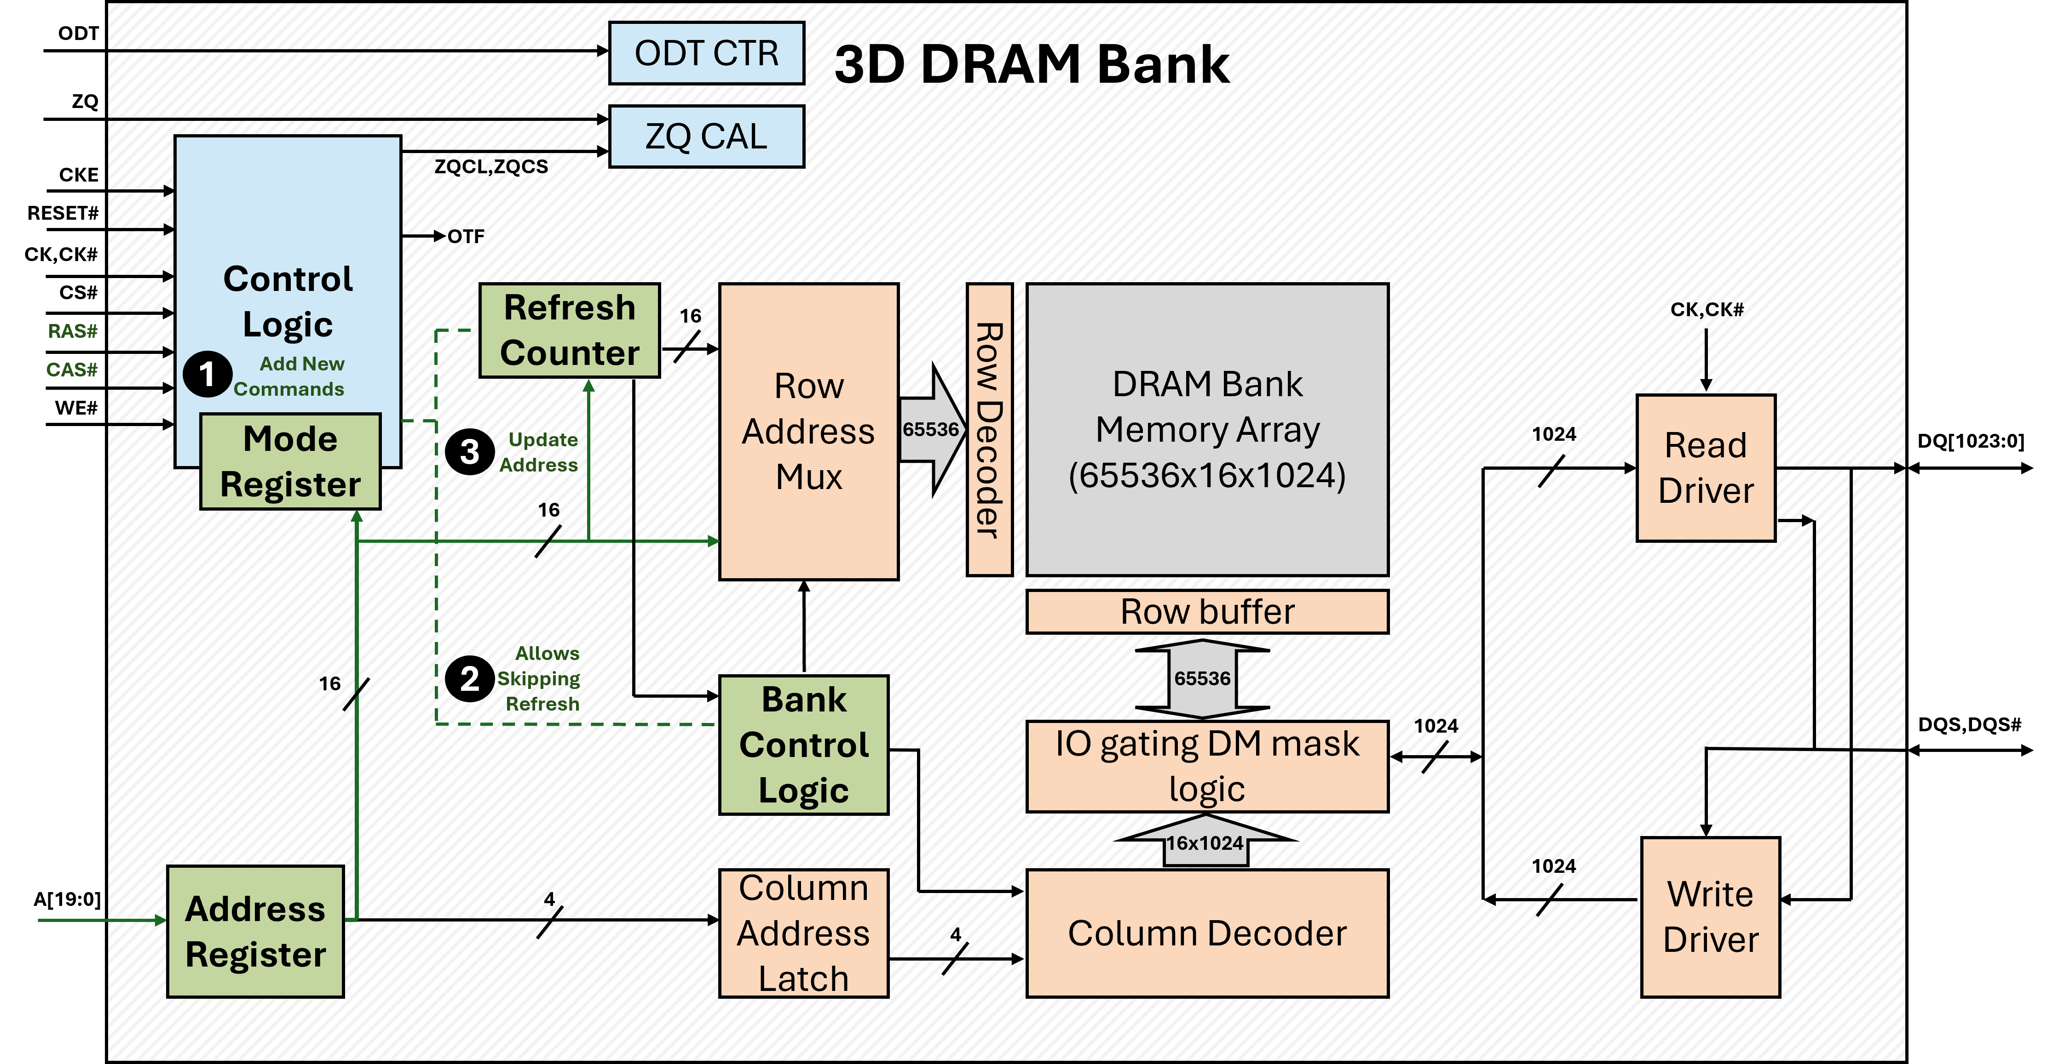
3D-DRAM Die Modification

Slide 14
Reference
[1] I. Bhati, Z. Chishti, S.-L. Lu, and B. L. Jacob, "Flexible Auto-Refresh: Enabling Scalable and Energy-Efficient DRAM Refresh Reductions," in Proceedings of the 42nd Annual International Symposium on Computer Architecture (ISCA), Portland, OR, USA, June 2015

