Slide 1

Weekly meeting
Yeh Shun-Liang
International College of Semiconductor Technology
National Yang Ming Chiao Tung University

Slide 2
Recent Progress
Analyze Refresh Counts, Average Bandwidth & Energy under different number of Subarrays per Bank
Add the description of modification to DRAM logic Die for WUPR

Slide 3
Bank Analysis Configuration
Simulation Configuration
DRAM Model | Proposed 3D-DRAM Model
Number of Banks | 64
Ideal Bandwidth | 2TB/s
Ideal Bandwidth per Core | 128GB/s
Name of Trace | Single Core Partial LLM Workload Trace
Number of Traces | 193881265
Number of Subarrays per Bank | 32,64,128,256,512
Clock Frequency | 1Ghz
DRAM Technology Node | ITRS 32nm

Slide 4
Timing Constraints Trend

Slide 5
Energy per command Trend

Slide 6
DRAM Core Area Trend

Slide 7
Refresh Counts with Different # of Subarrays

Slide 8
Bandwidth with Different # of Subarrays

Slide 9
Energy with Different # of Subarrays

Slide 10
WUPR Architecture
Memory Controller
3D DRAM Bank
WUPR
DRAM Control Logic
DRAM rows
1
Command Bus
Row Decoder
Row buffer
Refresh Address
3
Refresh
2
Mode Register
Bank Control Logic
Address
Bus
1
Memory Controller is now in charge of recording the DRAM Bank row to refresh, address of the row to refresh has to be sent together with the Auto Refresh Command

Slide 11
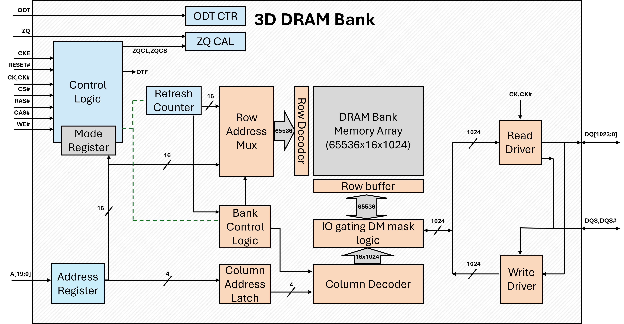
Original 3D-DRAM Die

Slide 12
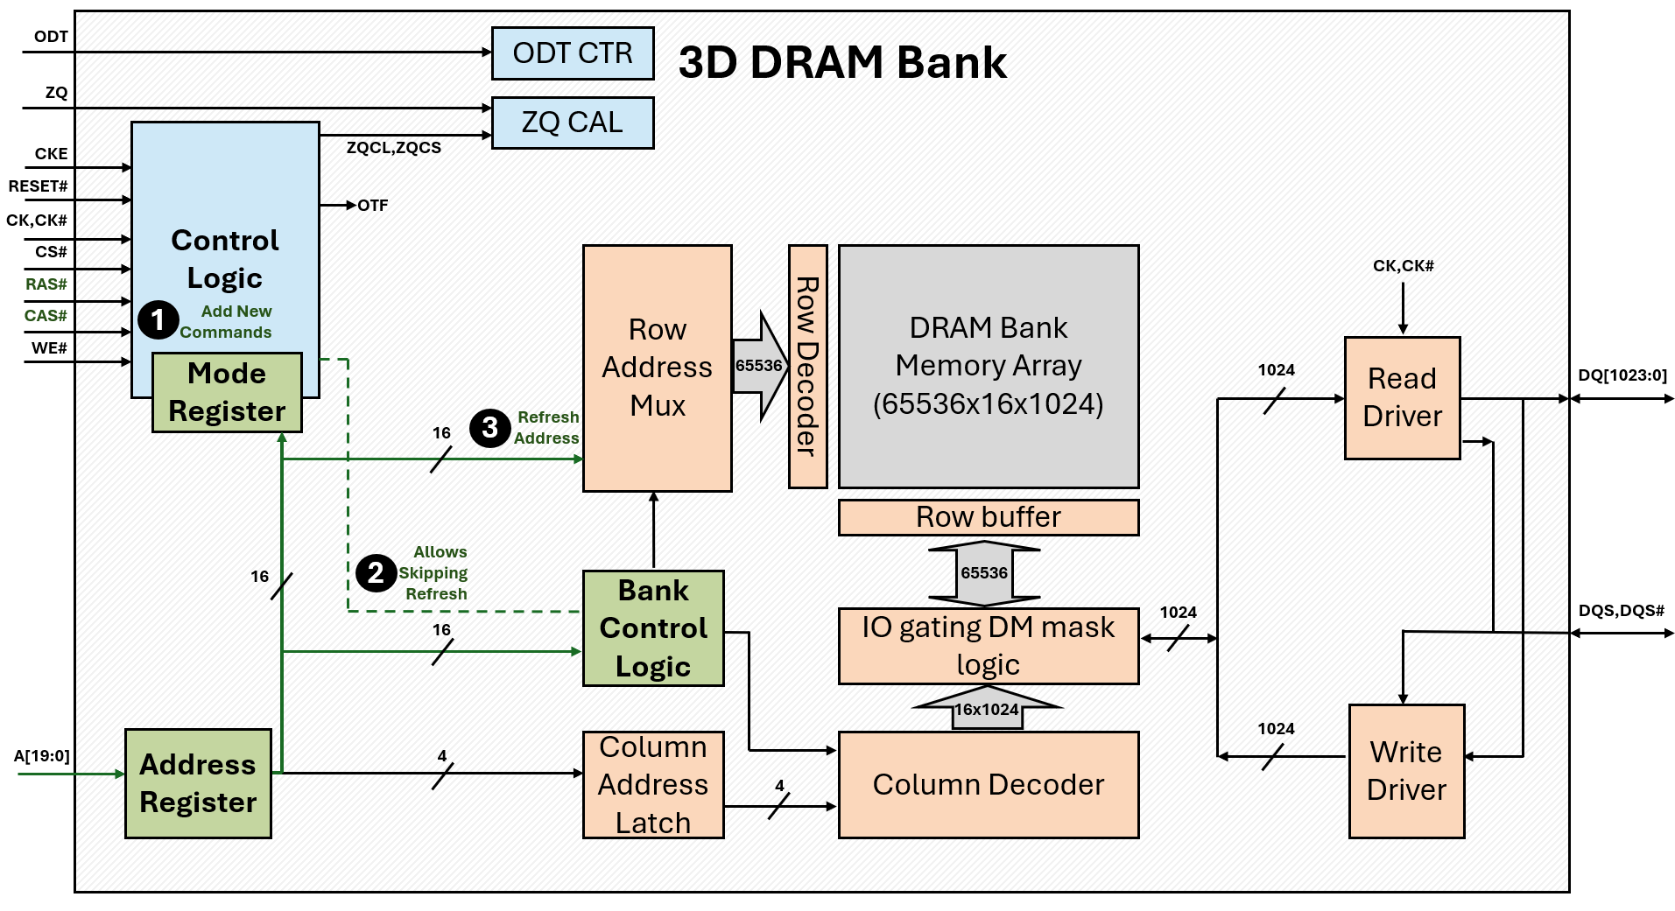
3D-DRAM Die Modification

Slide 13
Reference
[1] I. Bhati, Z. Chishti, S.-L. Lu, and B. L. Jacob, "Flexible Auto-Refresh: Enabling Scalable and Energy-Efficient DRAM Refresh Reductions," in Proceedings of the 42nd Annual International Symposium on Computer Architecture (ISCA), Portland, OR, USA, June 2015

