Slide 1

Weekly meeting
Yeh Shun-Liang
International College of Semiconductor Technology
National Yang Ming Chiao Tung University

Slide 2
Recent Progress
Analyze Refresh Counts, Average Bandwidth & Energy under different Bank Size
Add the description of modification to DRAM logic Die for WUPR

Slide 3
Bank Analysis Configuration
Simulation Configuration
DRAM Model | Proposed 3D-DRAM Model
Number of Banks | 64
Ideal Bandwidth | 2TB/s
Ideal Bandwidth per Core | 128GB/s
Name of Trace | Single Core Partial LLM Workload Trace
Number of Traces | 193881265
Bank Sizes | 256Mb,512Mb,1024Mb & 2048Mb
Clock Frequency | 1Ghz

Slide 4
Timing Constraints Changes

Slide 5
Refresh Counts with Different Bank Sizes
Worse Timing Constraints leads to longer execution time leads to more refreshes

Slide 6
Refresh Counts with Different Bank Sizes
WUPR helps skips unnecessary refreshes thus refresh counts does not change much as bank size increases

Slide 7
Average Bandwidth with Different Bank Sizes
Larger banks size bank leads to longer execution time, more long period refreshes, WUPR skipping refreshes performs well for larger banks

Slide 8
Average Bandwidth with Different Bank Sizes
Larger banks size leads to higher energy consumption due to longer latency and higher access energy

Slide 9
WUPR Architecture
3D DRAM Bank
Memory Controller
Mode Register
DRAM rows
WUPR
Command Bus
Row Decoder
1
Row buffer
2
Refresh
Dummy Refresh/AR
Refresh
Management
Refresh
Counter
Update
2
Bhati, I., Chishti, Z., Lu, S.-L., & Jacob, B. (2015). Flexible auto-refresh: Enabling scalable and energy-efficient DRAM refresh reductions. In Proceedings of the 42nd Annual International Symposium on Computer Architecture

Slide 10
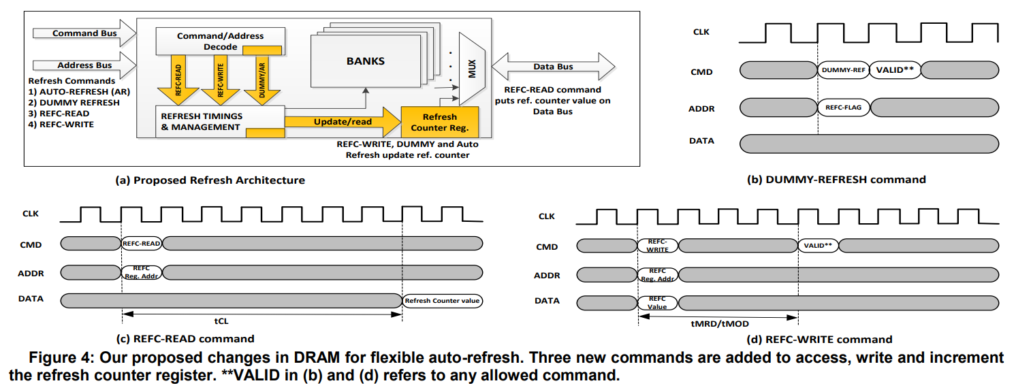
Dummy Refresh
[1] Bhati, I., Chishti, Z., Lu, S.-L., & Jacob, B. (2015). Flexible auto-refresh: Enabling scalable and energy-efficient DRAM refresh reductions. In Proceedings of the 42nd Annual International Symposium on Computer Architecture(ISCA)

Slide 11
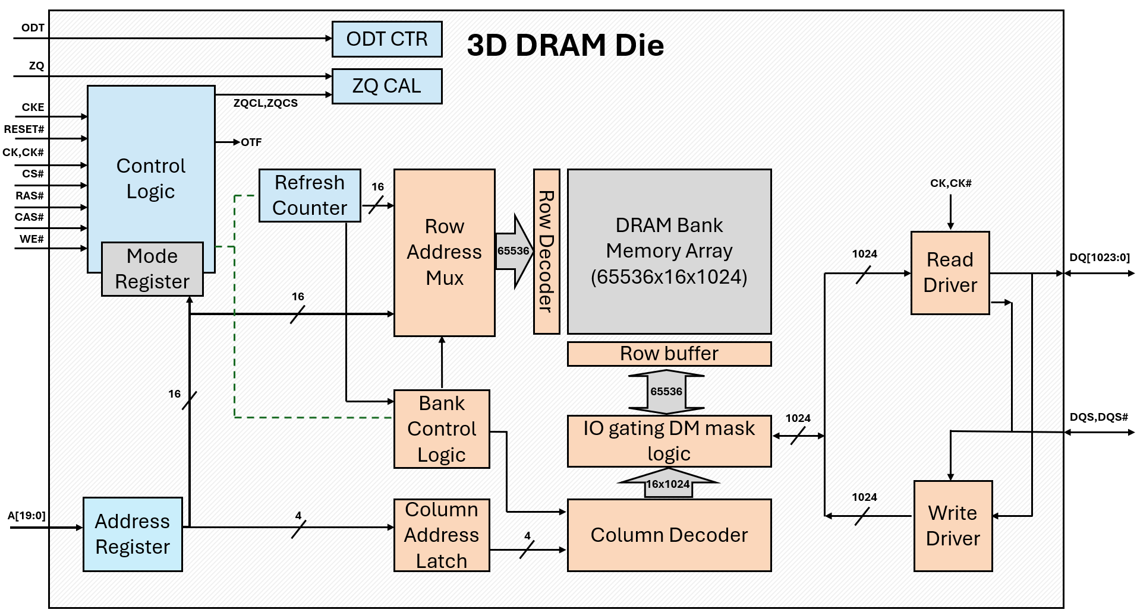
Original 3D-DRAM Die

Slide 12
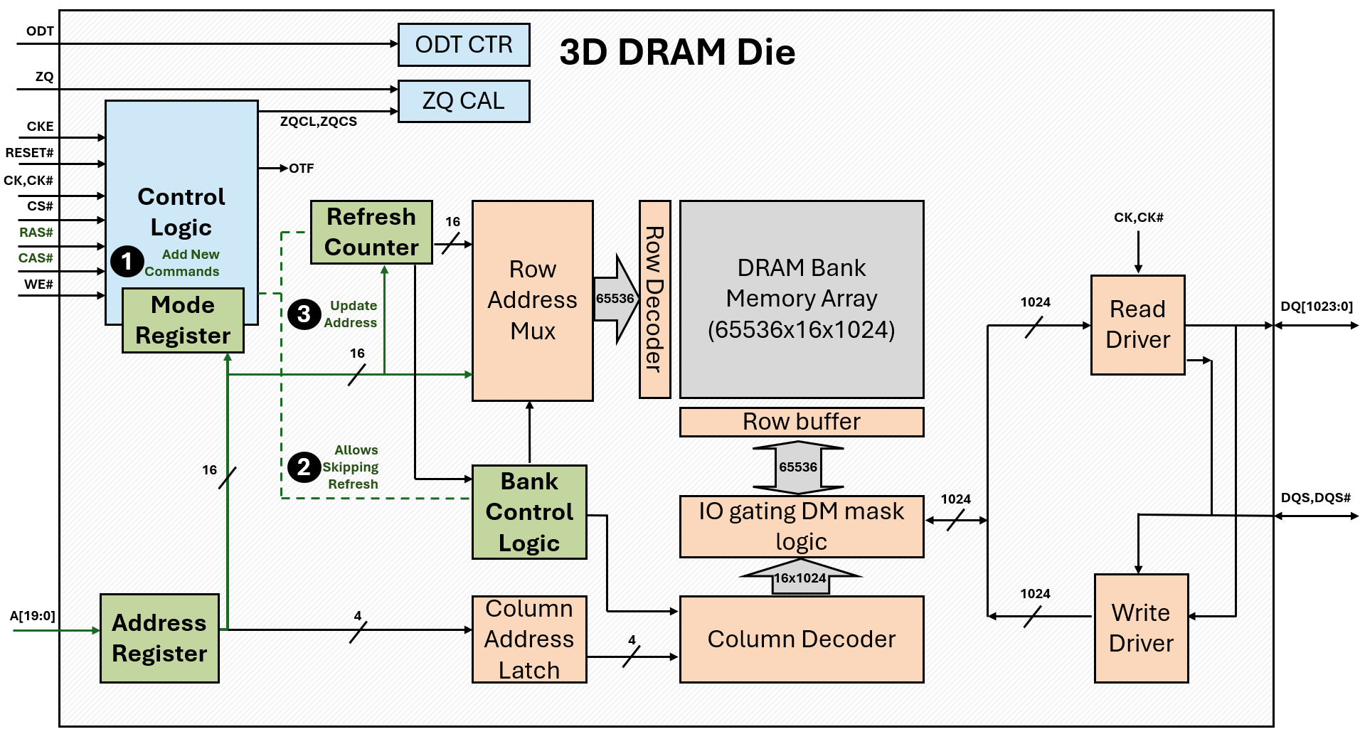
3D-DRAM Die Modification

Slide 13
Reference
[1] I. Bhati, Z. Chishti, S.-L. Lu, and B. L. Jacob, "Flexible Auto-Refresh: Enabling Scalable and Energy-Efficient DRAM Refresh Reductions," in Proceedings of the 42nd Annual International Symposium on Computer Architecture (ISCA), Portland, OR, USA, June 2015

