Slide 1

Weekly meeting
Yeh Shun-Liang
International College of Semiconductor Technology
National Yang Ming Chiao Tung University

Slide 2
Recent Progress
Clarify the power model for energy calculation
Rerun the Simulation Under 22nm ITRS process node
Auto Refresh & WUPR Comparison

Slide 3
Finding Optimal Number of Subarrays
Simulation Configuration
DRAM Model | Proposed 3D-DRAM Model
Number of Banks | 64
Ideal Bandwidth | 2TB/s
Ideal Bandwidth per Core | 128GB/s
Name of Trace | Single Core Partial LLM Workload Trace
Number of Traces | 193881265
Number of Subarrays per Bank | 64,128,256,512,1024
Clock Frequency | 1Ghz
DRAM Technology Node | ITRS 22nm

Slide 4
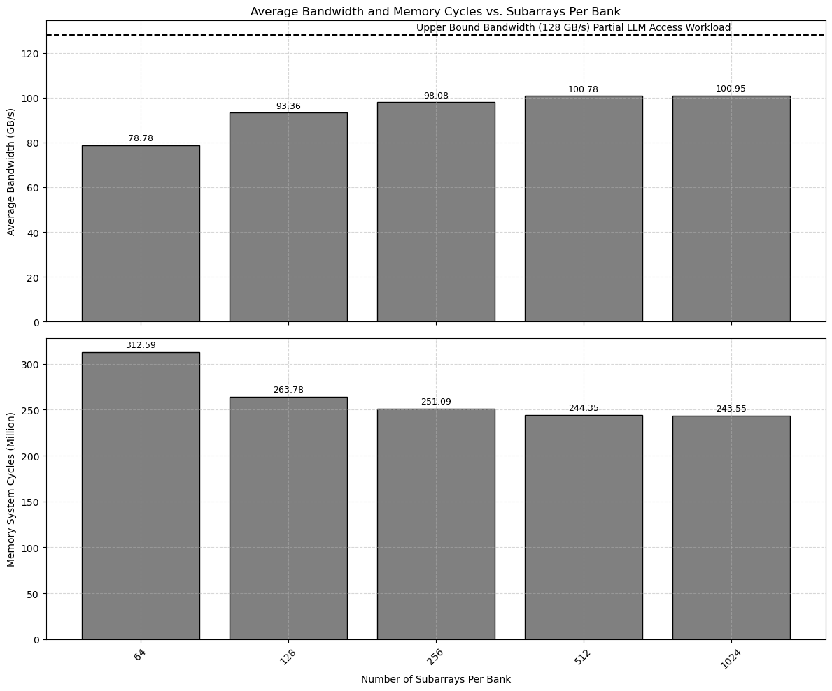
Bandwidth & Simulation Latency Trend

Slide 5
Power Model
Energy Types | Energy Component | Energy(pJ)
Command Energy | Total Activation Energy | Activation Energy (pJ/bit) × 1024(bits) × #Activations
 | Total Precharge Energy | Precharge Energy (pJ/bit) × 1024(bits) × #Precharges
 | Total Read Energy | Read Energy (pJ/bit) × 1024(bits) × #Reads
 | Total Write Energy | Write Energy (pJ/bit) × 1024(bits) × #Writes
 | Total Refresh Energy | Refresh_{Power}× RFC_{Cycles} × #Refreshes × t_{CKns} )
Background Energy | Active Background Energy | ((VDD(V) × IDD3N(mA)) + VPP(V) × IPP3N(mA))× Active_{Cycles} × t_{CKns} )
 | Idle Background Energy | ((VDD(V) × IDD2N(mA)) + VPP(V) × IPP2N(mA))× Idle_{Cycles} × t_{CKns} )
Voltage&Current[1] | Description | Value
VDD | Core Supply voltage | 0.9(V)
VPP | Wordline Boost Voltage | 2.3(V)
IDD2N | Precharge Standby Current | 60(mA)
IDD3N | Active Standby Current | 60(mA)
Refresh_{Power} | Refresh Power | 155.417(mW)
[1] K. Chen, S. Li, N. Muralimanohar, J. H. Ahn, J. B. Brockman and N. P. Jouppi, "CACTI-3DD: Architecture-level modeling for 3D die-stacked DRAM main memory," 2012 Design, Automation & Test in Europe Conference & Exhibition (DATE)

Slide 6
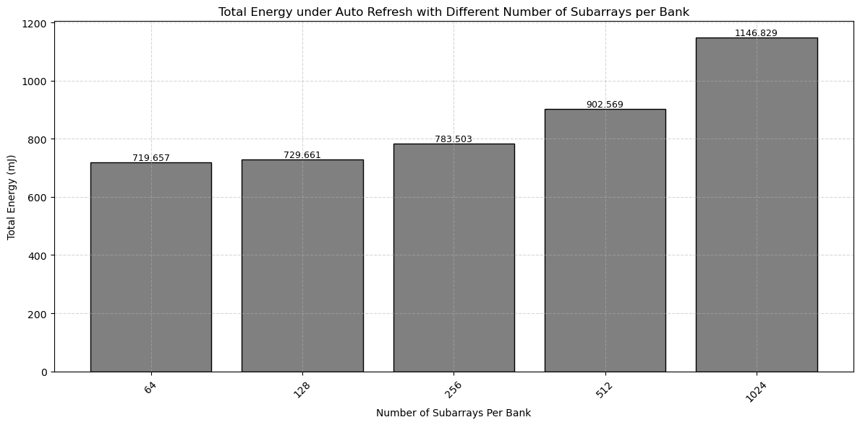
Energy Trend For Different Of Subarrays

Slide 7
WUPR Optimal Number of Segments
Selects 512 as Number of Subarray per Bank
Simulation Configuration
DRAM Model | Proposed 3D-DRAM Model
Number of Banks | 64
Ideal Bandwidth | 2TB/s
Ideal Bandwidth per Core | 128GB/s
Name of Trace | Single Core Partial LLM Workload Trace
Number of Traces | 193881265
Number of Subarrays per Banks | 512
Clock Frequency | 1Ghz
DRAM Technology Node | ITRS 22nm

Slide 8
WUPR with 4 Segments(N=4)
SP₀
WUPR
N₀
Pointer Update Logic
Segment Pointers
Used Space
Request
R
Ra
SP₁
r
Unused Space
Row Tracker
N₁
refresh
Refresh
SP₂
r
Select & Compare
SP₀
dref
dref
SP₁
N₂
SP₂
SP₃
SP₃
N₃
DRAM Row Space

Slide 9
WUPR Optimal number of Segments
Find the optimal number of segments that best describe the LLM trace pattern, 16 Segments is enough
0.97% Area of DRAM Controller
N=16

Slide 10
WUPR Analysis Settings
Selects 16 as the Number of Segment for WUPR
Simulation Configuration
DRAM Model | Proposed 3D-DRAM Model
Number of Banks | 64
Ideal Bandwidth | 2TB/s
Ideal Bandwidth per Core | 128GB/s
Name of Trace | Single Core Partial LLM Workload Trace
Number of Traces | 193881265
Number of Subarrays per Bank | 512
WUPR Number of Segments | 16
Clock Frequency | 1Ghz
Temperature Range | <85C, 85~95C, >95C
DRAM Technology Node | ITRS 22nm
Logic Technology | TSMC 16nm

Slide 11
WUPR PTPX Energy Extraction
To span through 512 Refreshes, takes a portion of Partial LLM Workload Trace & Calculate Average Power using PTPX for WUPR, add to Power Model
Simulation Configuration
DRAM Model | Proposed 3D-DRAM Model
Name of Trace | Single Core Partial LLM Workload Trace
Number of Patterns | 100000
WUPR Number of Segments | 16
Logic Process Technology | TSMC 16nm
Clock Frequency | 1Ghz

Slide 12
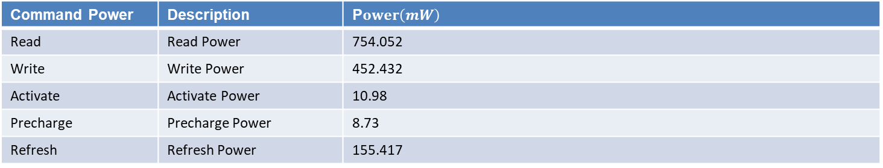
Energy Types | Energy Component | Energy(pJ)
Command Energy | Total Activation Energy | Activation_{Power} × RAS_{Cycles} × #Activations × t_{CKns}
 | Total Precharge Energy | × #Precharges
 | Total Read Energy | × #Reads
 | Total Write Energy | × #Writes
 | Total Refresh Energy | Refresh_{Power}(mW) * RFC_{Cycles} × #Refreshes × t_{CKns}
 | Total WUPR Energy | (WUPR Average Power(mW) × (Idle_{Cycles}+Active_{Cycles} )× tCKns )
Background Energy | Active Background Energy | ((VDD(V) × IDD3N(mA)) + VPP(V) × IPP3N(mA))× Active_{Cycles} × t_{CKns} )
 | Idle Background Energy | ((VDD(V) × IDD2N(mA)) + VPP(V) × IPP2N(mA))× Idle_{Cycles} × t_{CKns} )
Voltage&Current[2] | Description | Value
VDD | Core Supply voltage | 0.9(V)
VPP | Wordline Boost Voltage | 2.3(V)
IDD2N | Precharge Standby Current | 60(mA)
IDD3N | Active Standby Current | 60(mA)
WUPR_{POWER} | Average Power of WUPR | 0.5476(mW)
Command Power | Description | P$ower\left(mW\right)$
Read | Read Power | 754.052
Write | Write Power | 452.432
Activate | Activate Power | 10.98
Precharge | Precharge Power | 8.73
Refresh | Refresh Power | 155.417
[1] K. Chen, S. Li, N. Muralimanohar, J. H. Ahn, J. B. Brockman and N. P. Jouppi, "CACTI-3DD: Architecture-level modeling for 3D die-stacked DRAM main memory," 2012 Design, Automation & Test in Europe Conference & Exhibition (DATE)

Slide 13
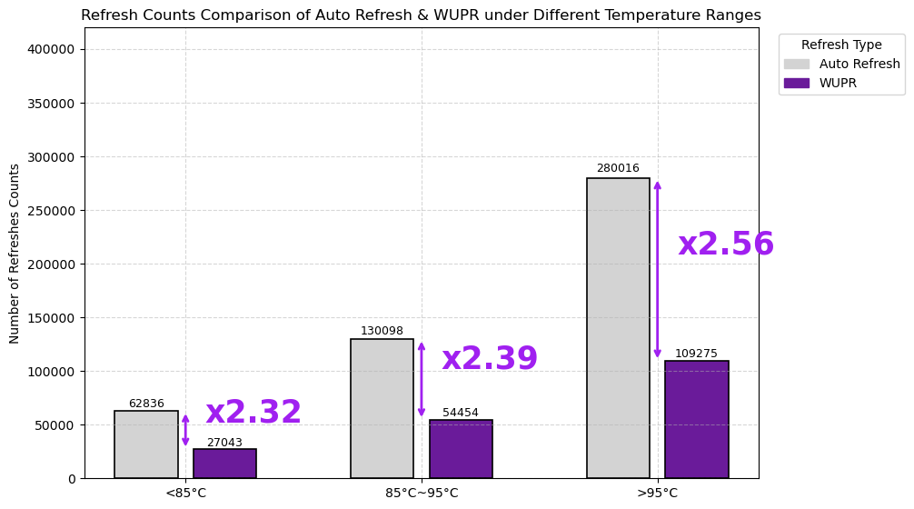
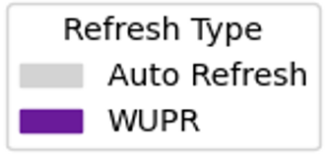
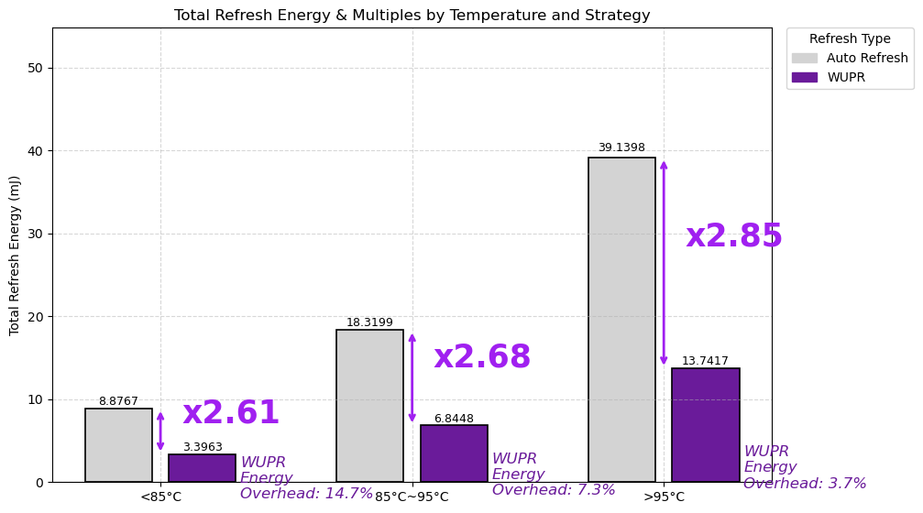
Refresh Counts & Energy Reduction

Slide 14
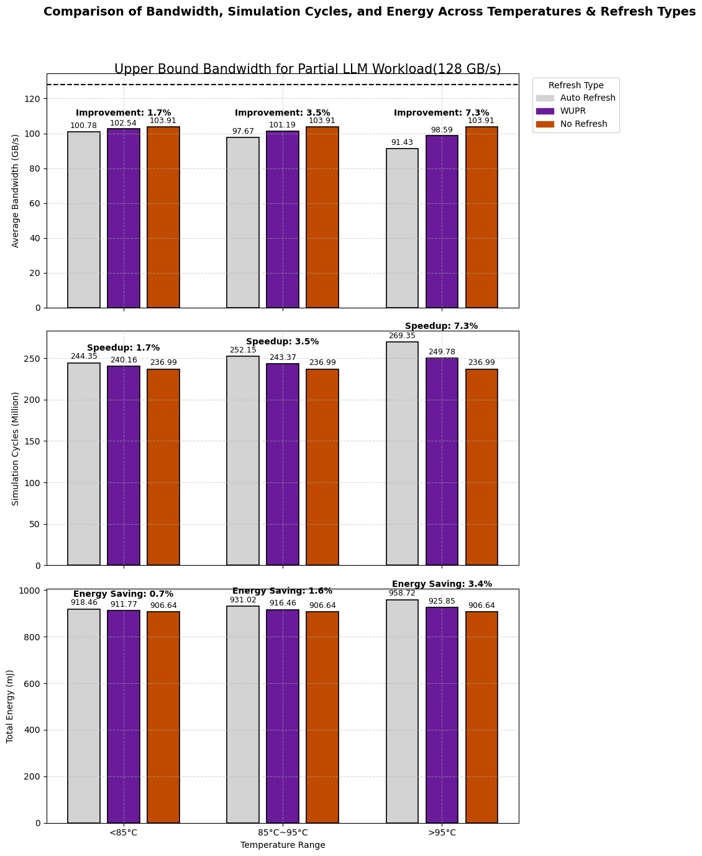
Total Energy Consumption

Slide 15
References
[1] JEDEC Solid State Technology Association, High Bandwidth Memory (HBM) DRAM, JESD235D, Oct. 2020
[2] K. Chen, S. Li, N. Muralimanohar, J. H. Ahn, J. B. Brockman and N. P. Jouppi, "CACTI-3DD: Architecture-level modeling for 3D die-stacked DRAM main memory," 2012 Design, Automation & Test in Europe Conference & Exhibition (DATE)

Slide 16
Appendices(Timing Constraints Trend)

Slide 17
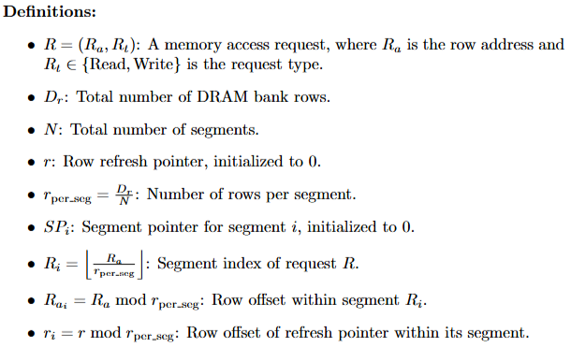
Write Updated Partial Refresh(WUPR)

Slide 18
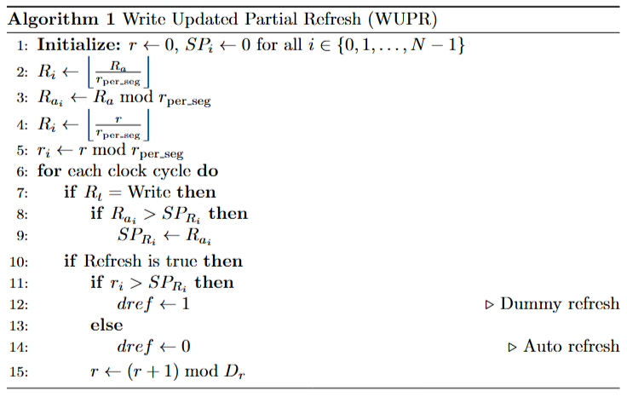
Write Updated Partial Refresh(WUPR)

Slide 19
Timing Constraints Trend

Slide 20
Energy per command Trend

Slide 21
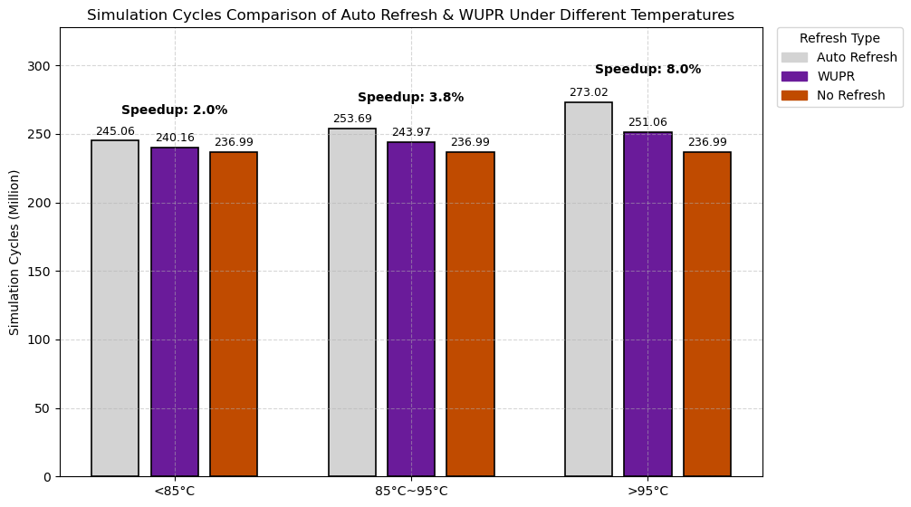
Total Latency Speedup

Slide 22
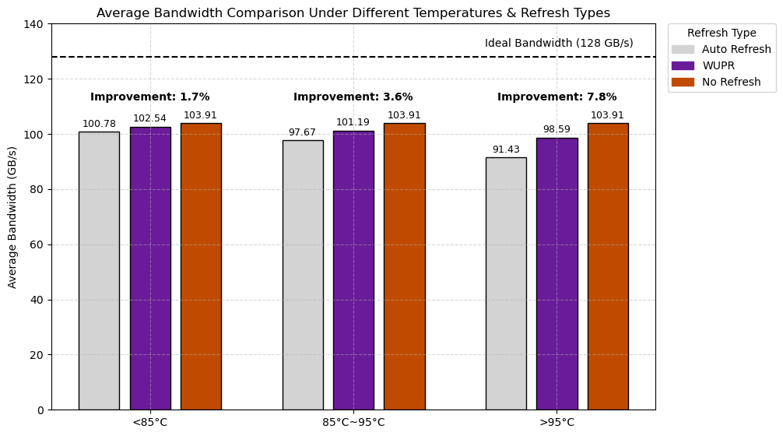
Average Bandwidth Improvements

Slide 23
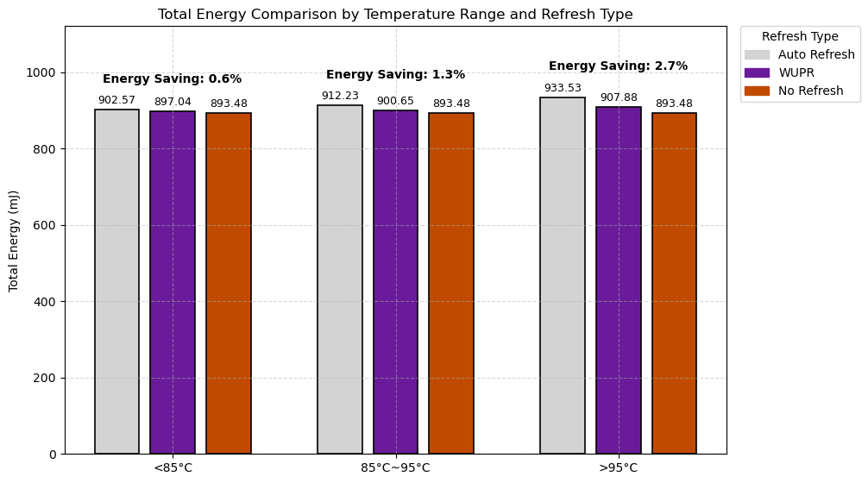
Total Energy Consumption

Slide 24
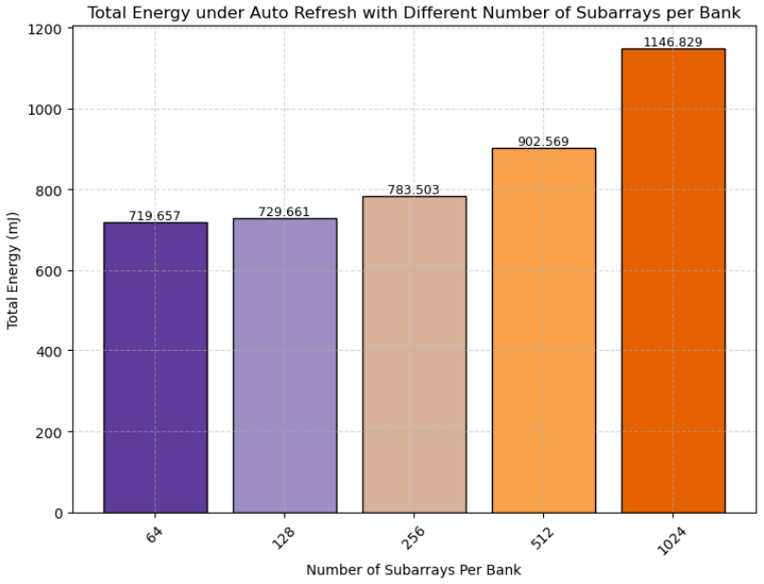
Energy Trend For Different Of Subarrays

Slide 25
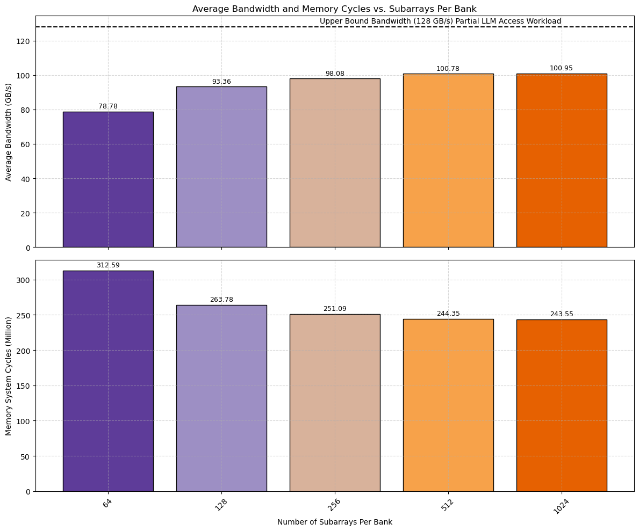
Bandwidth & Simulation Latency Trend

