Slide 1

Weekly meeting
Yeh Shun-Liang
International College of Semiconductor Technology
National Yang Ming Chiao Tung University

Slide 2
Recent Progress
Clarify the power model for energy calculation
Calculate power & power breakdown for DRAM Controller

Slide 3
Low-swing voltage for correct modeling
Previous setting does not use low-swing for power calculation, instead used full-swing; however modern 3D-DRAM[1],[2] uses low-swing technique to reduce power consumption
[1] J. C. Lee et al., "A 1.2 V 64 Gb 8-channel 256 GB/s HBM DRAM with peripheral-base-die architecture and small-swing technique on heavy-load interface," in Proc. IEEE Int. Solid-State Circuits Conf. (ISSCC), Feb. 2016, pp. 318–319.
[2] K. Chae et al., "A 4 nm 1.15 TB/s HBM3 interface with resistor-tuned offset calibration and in-situ margin detection," in Proc. IEEE Int. Solid-State Circuits Conf. (ISSCC), Feb. 2023, pp. 406–407, doi: 10.1109/ISSCC42615.2023.10067736.

Slide 4
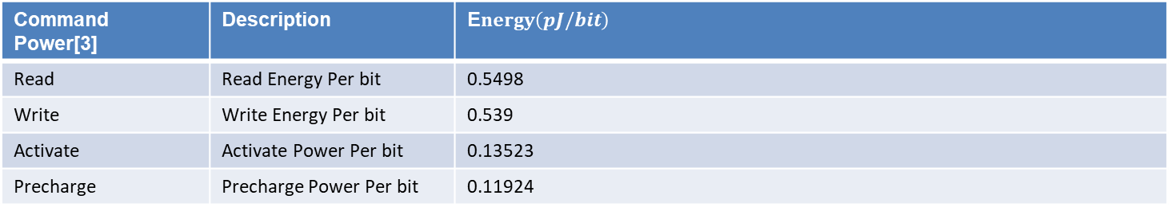
Energy Types | Energy Component | Energy(pJ)
Command Energy | Total Activation Energy | Activation Energy(pJ/bit)×1024(bits)× #Activations
 | Total Precharge Energy | Precharge Energy(pJ/bit)×1024(bits)× #Precharges
 | Total Read Energy | Read Energy(pJ/bit)×1024(bits)× #Reads
 | Total Write Energy | Write Energy(pJ/bit) ×1024(bits)× #Writes
 | Total Refresh Energy | Refresh_{Power}(mW) * RFC_{Cycles} × #Refreshes × t_{CKns}
 | Total WUPR Energy | (WUPR Average Power(mW) × (Idle_{Cycles}+Active_{Cycles} )× tCKns )
Background Energy | Active Background Energy | ((VDD(V) × IDD3N(mA)) + VPP(V) × IPP3N(mA))× Active_{Cycles} × t_{CKns} )
 | Idle Background Energy | ((VDD(V) × IDD2N(mA)) + VPP(V) × IPP2N(mA))× Idle_{Cycles} × t_{CKns} )
Voltage&Current[3] | Description | Value
VDD | Core Supply voltage | 0.9(V)
VPP | Wordline Boost Voltage | 2.3(V)
IDD2N | Precharge Standby Current | 60(mA)
IDD3N | Active Standby Current | 60(mA)
WUPR_{Power} | Average Power of WUPR | 0.3792(mW)
Refresh_{Power} | Average Power of Refresh | 24.4016(mW)
Command Power[3] | Description | E$nergy\left(pJ/bit\right)$
Read | Read Energy Per bit | 0.5498
Write | Write Energy Per bit | 0.539
Activate | Activate Power Per bit | 0.13523
Precharge | Precharge Power Per bit | 0.11924
[3] K. Chen, S. Li, N. Muralimanohar, J. H. Ahn, J. B. Brockman and N. P. Jouppi, "CACTI-3DD: Architecture-level modeling for 3D die-stacked DRAM main memory," 2012 Design, Automation & Test in Europe Conference & Exhibition (DATE)

Slide 5
Finding Optimal Number of Subarrays
Simulation Configuration
DRAM Model | Proposed 3D-DRAM Model
Number of Banks | 64
Ideal Bandwidth | 2TB/s
Ideal Bandwidth per Core | 128GB/s
Name of Trace | Single Core Partial LLM Workload Trace
Number of Traces | 193881265
Number of Subarrays per Bank | 32,64,128,256,512,1024
Clock Frequency | 1Ghz
DRAM Technology Node | ITRS 22nm

Slide 6
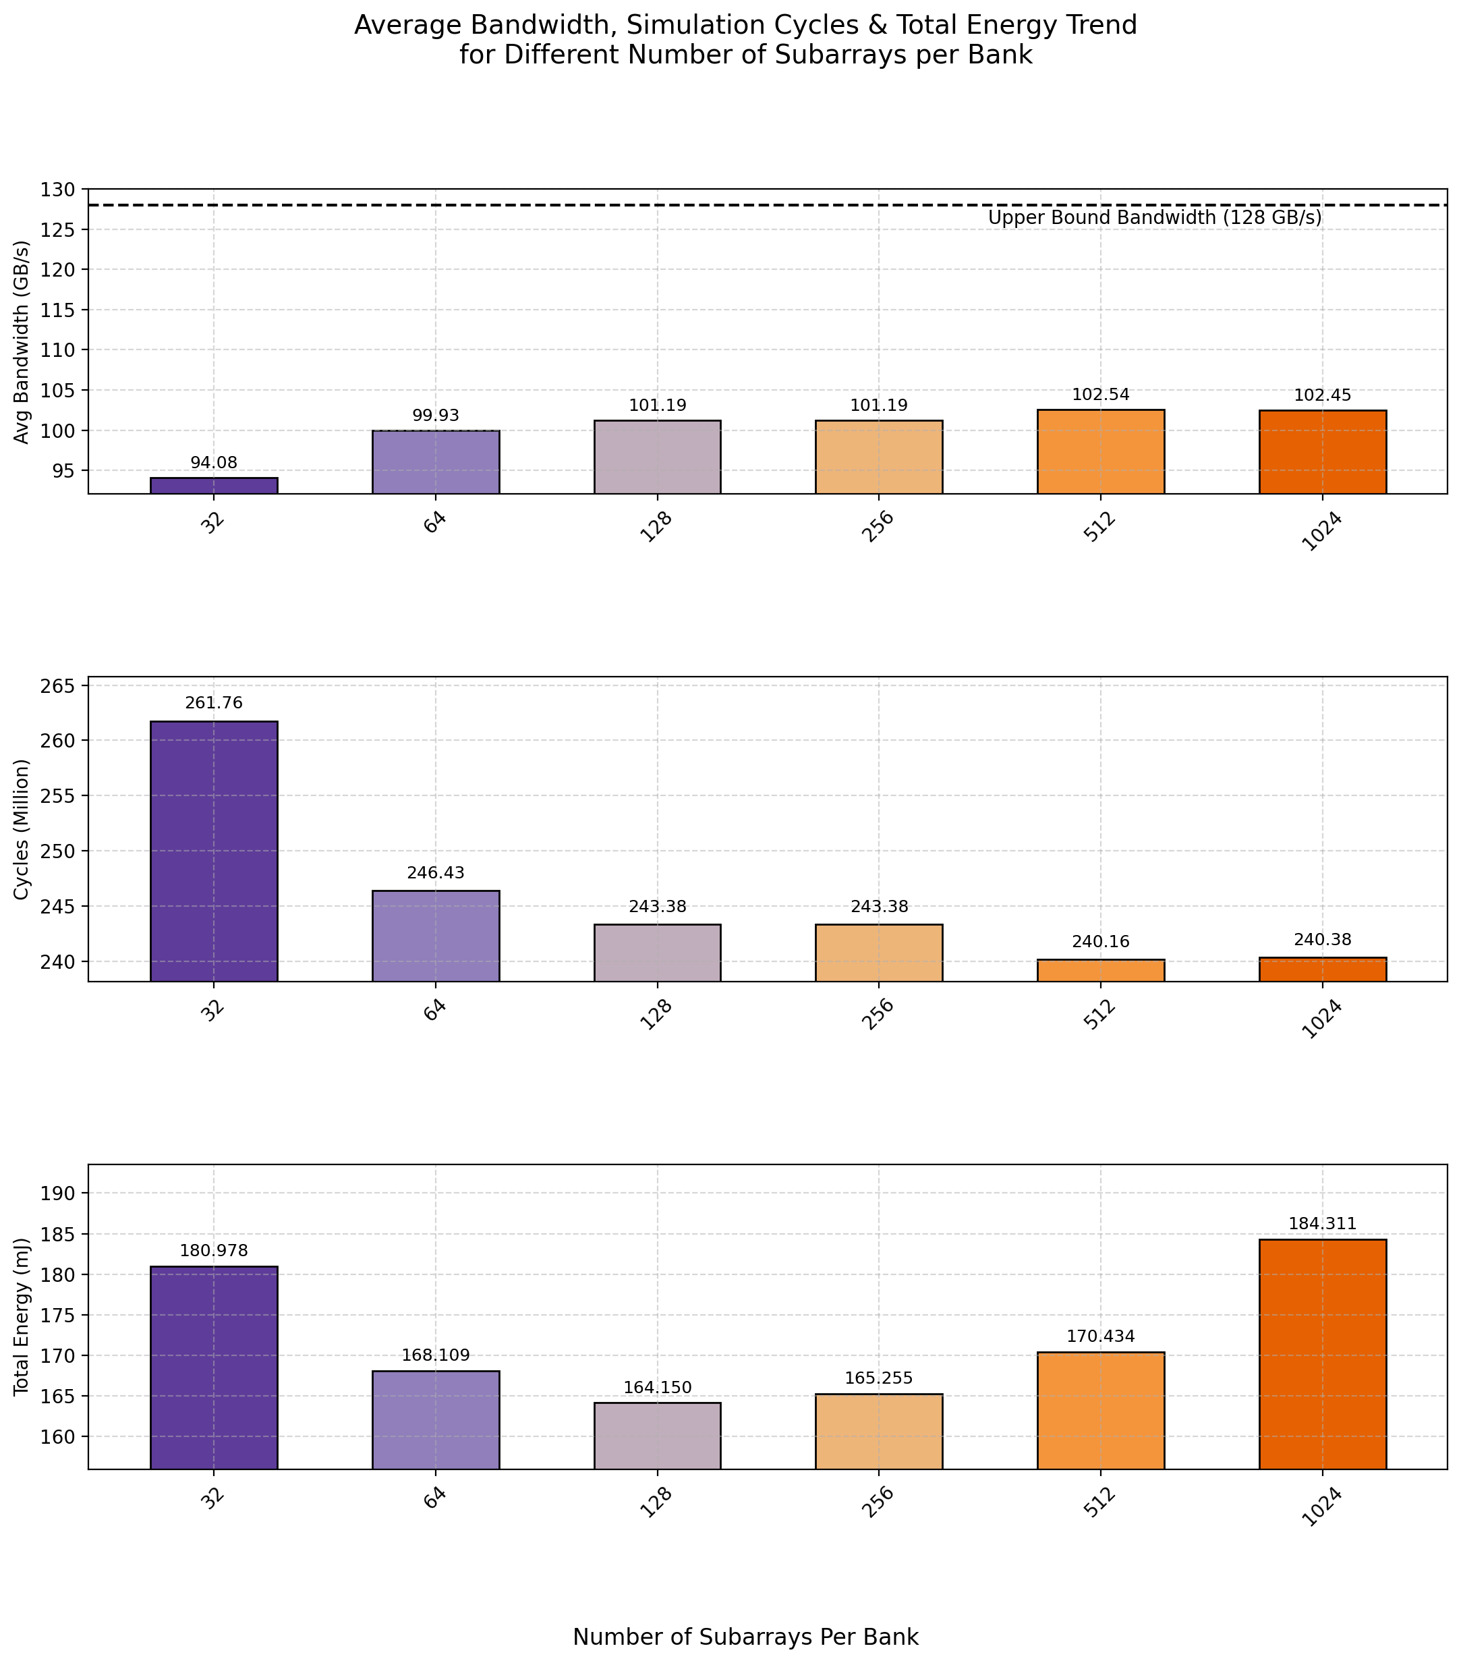

Slide 7
WUPR Analysis Settings
Simulation Configuration
DRAM Model | Proposed 3D-DRAM Model
Number of Banks | 64
Ideal Bandwidth | 2TB/s
Ideal Bandwidth per Core | 128GB/s
Name of Trace | Single Core Partial LLM Workload Trace
Number of Traces | 193881265
Number of Subarrays per Bank | 512
WUPR Number of Segments | 16
Clock Frequency | 1Ghz
Temperature Range | <85C, 85~95C, >95C
DRAM Technology Node | ITRS 22nm
Logic Technology | TSMC 16nm

Slide 8
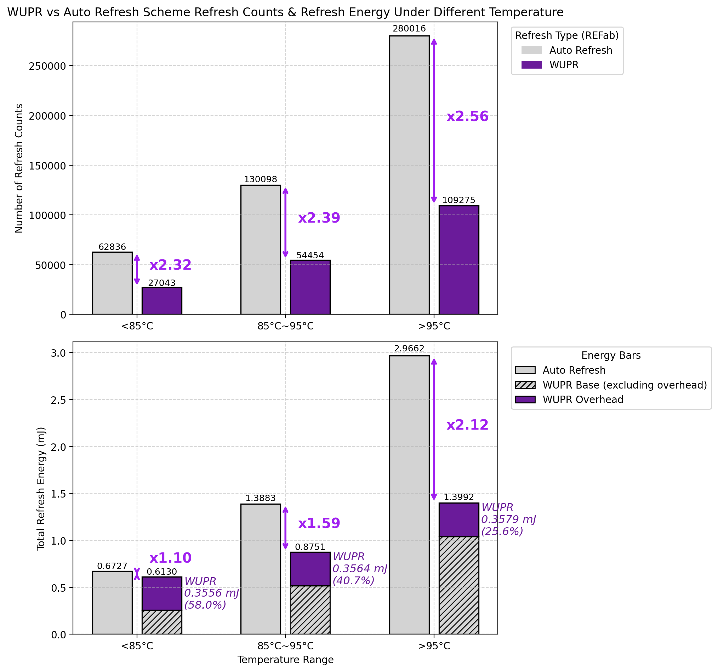
Refresh Counts & Energy Reduction

Slide 9
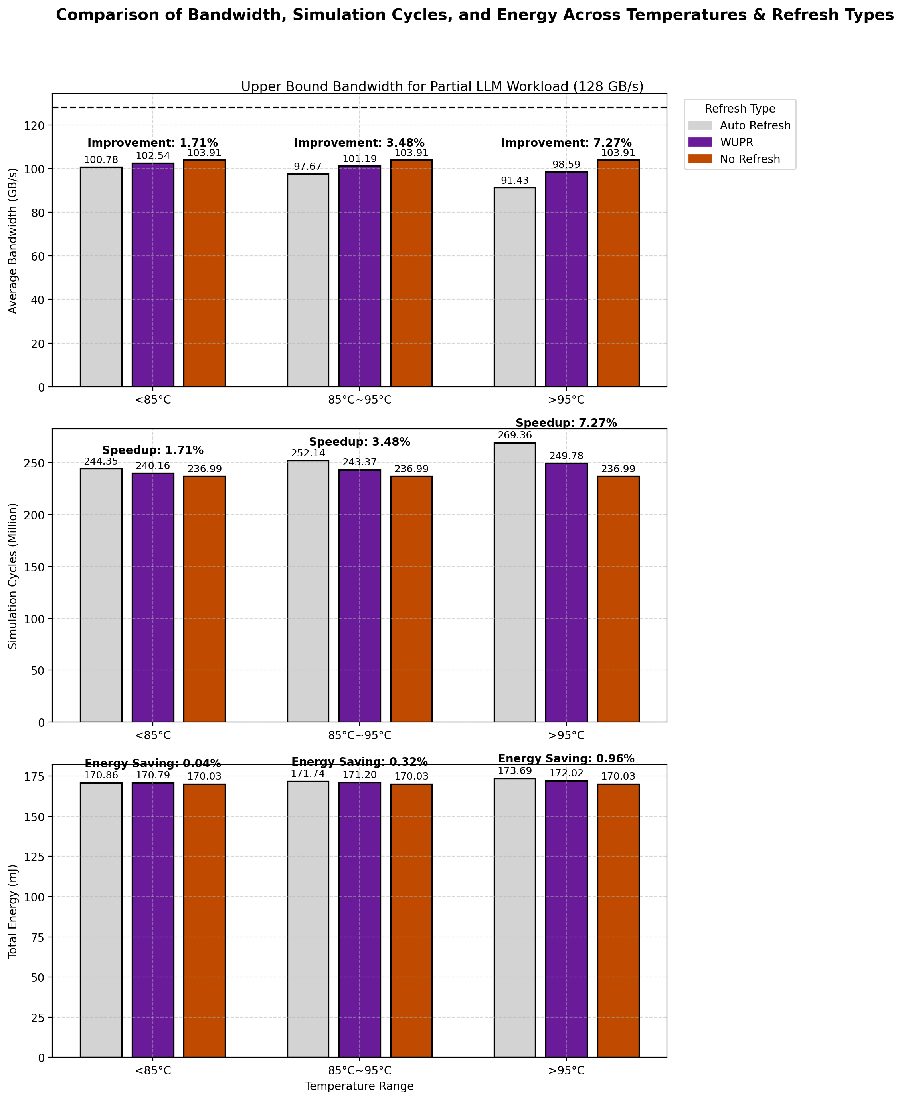
Total Energy Consumption

Slide 10
DRAM Controller Power Extraction
To span through 512 Refreshes, takes a portion of Partial LLM Workload Trace & Calculate Average Power using PTPX for DRAM Controller
Simulation Configuration
DRAM Model | Proposed 3D-DRAM Model
Name of Trace | Single Core Partial LLM Workload Trace
Number of Patterns | 100000
WUPR Number of Segments | 16
Logic Process Technology | TSMC 16nm
Clock Frequency | 1Ghz

Slide 11
DRAM Controller Power
Average Power of DRAM Controller is 77.2(mW) , the power is mostly consumed by the 1024-bit width read, write data queues

Slide 12
References
[1] J. C. Lee et al., "A 1.2 V 64 Gb 8-channel 256 GB/s HBM DRAM with peripheral-base-die architecture and small-swing technique on heavy-load interface," in Proc. IEEE Int. Solid-State Circuits Conf. (ISSCC), Feb. 2016, pp. 318–319.
[2] K. Chae et al., "A 4 nm 1.15 TB/s HBM3 interface with resistor-tuned offset calibration and in-situ margin detection," in Proc. IEEE Int. Solid-State Circuits Conf. (ISSCC), Feb. 2023, pp. 406–407, doi: 10.1109/ISSCC42615.2023.10067736.
[3] K. Chen, S. Li, N. Muralimanohar, J. H. Ahn, J. B. Brockman and N. P. Jouppi, "CACTI-3DD: Architecture-level modeling for 3D die-stacked DRAM main memory," 2012 Design, Automation & Test in Europe Conference & Exhibition (DATE)

